Slide 1
Evaluation metrics and strategies
Sonja Aits
“AI for Medicine and Life Science – AI for image and video data”, Lund University
20211019

Slide 2
Aim of evaluation
Training stage:
Gradual optimization (model type and hyperparameters): train -> evaluate -> adjust model -> train …
Troubleshooting
Test stage (final evaluation):
Determine ability to generalize
Comparison with current state-of-the-art and/or human performance
Explainability

Slide 3
Evaluation strategy
Which data to evaluate on?
Dataset splitting
Benchmark datasets
Which baseline?
Primary performance metric (e.g. F score)
Secondary metrics
Performance metrics (e.g. recall, precision, accuracy)
Operational metrics (e.g. runtime, memory requirements)
→ Success and exclusion criteria
Error exploration
Model explainability
→ Compile evaluation protocol/notebook/scripts

Slide 4
Task exploration
Scope and goal
Possible evaluation strategies/metrics
Data
Main dataset
Complementary data
Established benchmark datasets
Postprocessing
Downstream analysis
State-of-the-art performance
Human performance

Slide 5
Data exploration
Check size of entire dataset and of each category
General characteristics of input data (e.g. dimensions, image format, resolution, magnification, illumination, color) and labels (e.g. type, count)
Pixel intensity distribution (across dataset and for some individual images/videos of each group)
Characteristics related to downstream tasks, e.g.
Object counts/image
Object size/intensity distribution
Manually inspect random subset of images/videos and their labels!
Exclusion of bad data (“garbage in – garbage out”)

Slide 6
Evaluate on independent data
Main dataset
Data splitting
Training
set
Validation set
Test
set
Additional datasets
Train models
Optimize
Test ability to generalize
Training
set
Training
set
Training
set
Validation
set
Test
set
Training
set
Training
set
Validation
set
Training
set
Cross validation
(4-fold)
Validation set is also frequently called
dev set (development set)
Training
set
Validation
set
Training
set
Training
set
Validation
set
Training
set
Training
set
Training
set
6

Slide 7
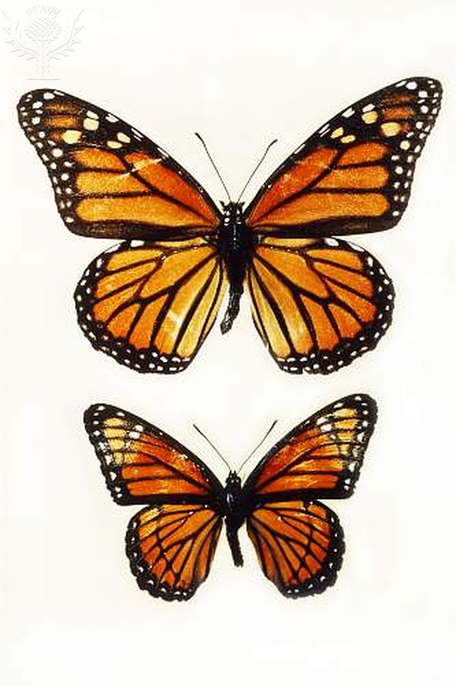
Test-time augmentation
original test image
Variant 1
Variant 2
Variant 3 ...Variant n
Prediction
Prediction
Prediction
Prediction
Prediction
Final prediction

Slide 8
Classification evaluation with confusion matrix
True
 | Yes | No
Yes | 70 True positive | 10 False positive
No | 30 False negative | 90 True negative
Predicted
True
 | A | B | C
A | 70 | 28 | 2
B | 29 | 65 | 0
C | 1 | 7 | 98
Predicted

Slide 9
Classification metrics
Correct “Yes” Predictions
All “Yes” Predictions
TP
TP + FP
Precision =
=
True
 | Yes | No
Yes | 70 True positive | 10 False positive
No | 30 False negative | 90 True negative
Correct “Yes” Predictions
All with “Yes” label
TP
TP + FN
Recall =
=
Predicted
Precision x Recall
Precision + Recall
F score = 2 x
Correct Predictions
All Predictions
TP + TN
TP + FP + TN + FN
Accuracy =
=

Slide 10
Object detection/segmentation evaluation: Jaccard index (Intersection over Union, IoU)
Truth
Intersection
Prediction
Jaccard index =
Truth
Union
Union
Prediction

Slide 11
Image similarity metrics
Mean squared error (MSE)
Mean absolute error (MAE)
Structural similarity index (SSIM)
…
Compare predicted vs true pixel intensities

Slide 12
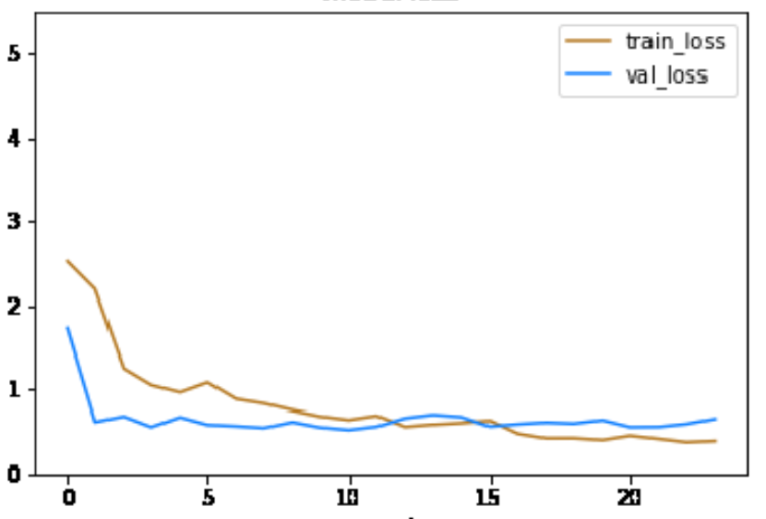
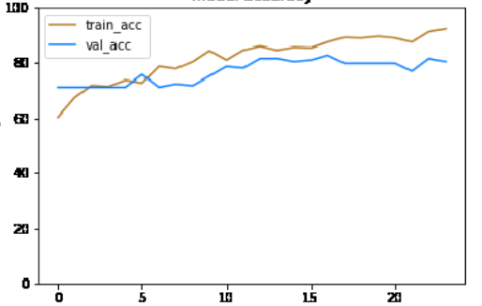
Inspect changes in key metrics over time!
Loss curve
Accuracy curve
Accuracy
Loss
epoch
epoch

Slide 13
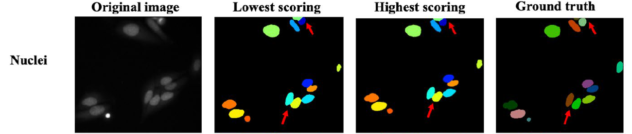
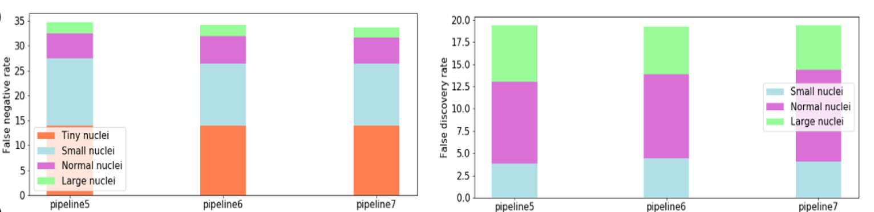
Explore the errors!
Work by Mariam Miari, Cell Death, Lysosomes and Artificial Intelligence Group

Slide 14
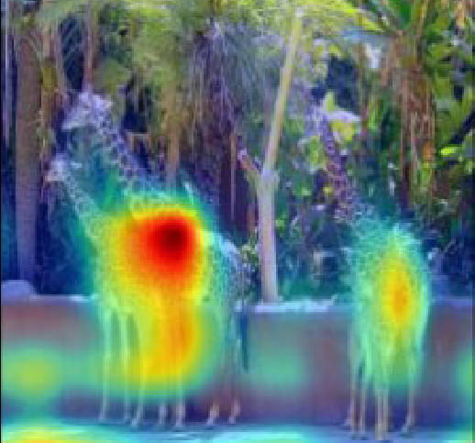
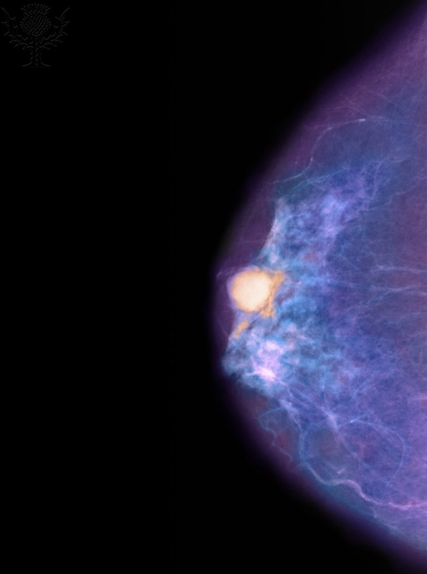
Explainability approaches
Grad-CAM
Ablation
Cancer
Cancer
Cancer
Compare prediction performance
Selvaraju et al. 2016. arxiv. https://arxiv.org/abs/1610.02391

Slide 15
Summary
Select metrics relevant for real-world application
Use independent test set to evaluate generalization
Create a simple baseline
Look at predictions not just at metrics
Examine errors
Consider approaches for model explainability
Document your training and evaluation meticulously!

