Slide 1
Computing the Degree of the Manipulability in the Case of Multiple Choice
Fuad Aleskerov (SU-HSE)
Daniel Karabekyan (SU-HSE)
Remzi M. Sanver (Istanbul Bilgi University, Turkey)
Vyacheslav Yakuba (ICS RAS)
Grants SU-HSE #08-04-0008
RFBR #01-212-07-525A
04.09.08

Slide 2
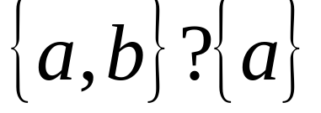
Literature survey
Strategy-proof analysis
  Gibbard (1973), Satterthwaite (1975)
Degree of manipulability
  Kelly (1993), Aleskerov, Kurbanov (1998)
Tie-breaking rule
  Alphabetical tie-breaking rule

Slide 3



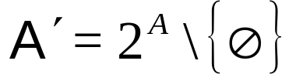
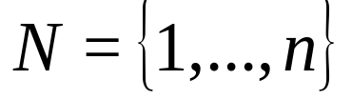

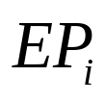

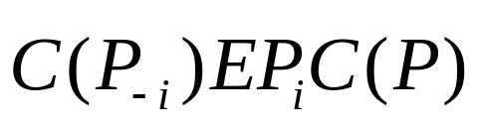
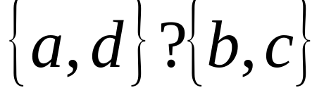
Model
.
Manipulation by a single agent
Set of alternatives
Set of all non-empty subsets of
voters with over and over
How to construct ?
Weak conditions
  Kelly’s principle, Gärdenfors’ principle and so on

Slide 4
Nonordinal methods
Lexicographic methods
  Leximax
  Leximin
Probabilistic methods
  Based on the probability of the best alternative
  Based on the probability of the worst alternative

Slide 5
Ordinal method
Assign rank to each alternative based on its place in voter’s preferences.
Each alternative have equal probability to be chosen as final outcome.
Utility of the set is an average rank of all alternatives within this set.
This method needs additional restrictions.

Slide 6
Ordinal method with restrictions:
Lexicographic restrictions
Probabilistic restrictions
Attitude to risk restrictions
  Risk-lover (prefer higher variance)
  Risk-averse (prefer lower variance)
Cardinality restrictions
  The lesser set is preferred to the greater one
  The greater set is preferred to the lesser one

Slide 7
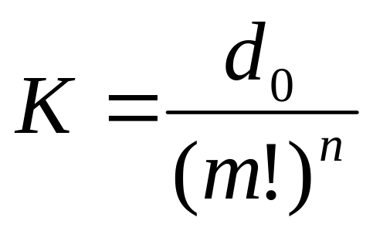
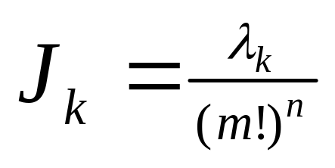
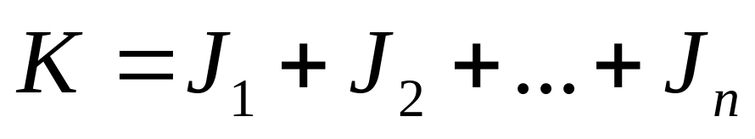
Indices
Kelly’s index

Slide 8

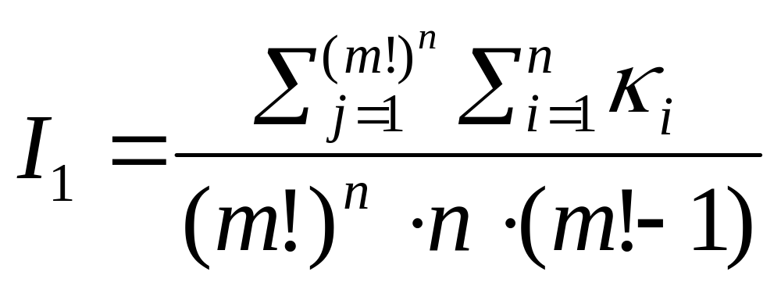
Indices

Slide 9
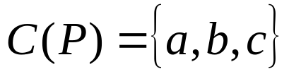
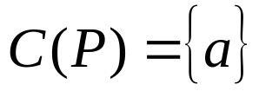
Rules
Agent 1 | Agent 2 | Agent 3
a | c | b
b | a | a
c | b | c
Plurality
Approval Voting q=2
Borda r(a)=4, r(b)=3, r(с)=2
Black
Threshold

Slide 10
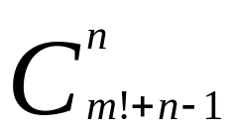
Computation
Two methods: look-through and statistical
Hard to compute – (5,5) – about 25 billions profiles. Using anonymity we can look only on 225 millions profiles.
Open question: How can we use neutrality and anonymity at the same time?
For example, (3,3) – 216 profiles, using anonimity – 56, using both – 26.

Slide 11
Results
1)
2)
3)
4)
(3;3) | Method1: | Method2: | Method3: | Method4:
p1 Plurality (0,1667) | 0,2222 | 0 | 0,2222 | 0
p2 Approval q=2 | 0,1111 | 0,6111 | 0,1111 | 0,6111
p6 Borda (0,2361) | 0,3056 | 0,4167 | 0,3056 | 0,4167
p7 Black (0,1111) | 0,0556 | 0,1667 | 0,0556 | 0,1667
p28 Threshold | 0,3056 | 0,4167 | 0,3056 | 0,4167

Slide 12
(3;4) | Method1: | Method2: | Method3: | Method4:
p1 Plurality (0,1852) | 0,3333 | 0,3333 | 0,3333 | 0,3333
p2 Approval q=2 | 0,2963 | 0,2963 | 0,2963 | 0,2963
p6 Borda (0,3102) | 0,3611 | 0,4028 | 0,3611 | 0,4028
p7 Black (0,1435) | 0,2361 | 0,2778 | 0,2778 | 0,2361
p28 Threshold | 0,4028 | 0,4028 | 0,4028 | 0,4028
(3;5) | Method1: | Method2: | Method3: | Method4:
p1 Plurality (0,2315) | 0,37037 | 0,37037 | 0,37037 | 0,37037
p2 Approval q=2 | 0,375 | 0,375 | 0,375 | 0,375
p6 Borda (0,2855) | 0,37037 | 0,4398 | 0,37037 | 0,4398
p7 Black (0,1698) | 0,1157 | 0,2314 | 0,1157 | 0,2314
p28 Threshold | 0,2585 | 0,2585 | 0,2585 | 0,2585

Slide 13
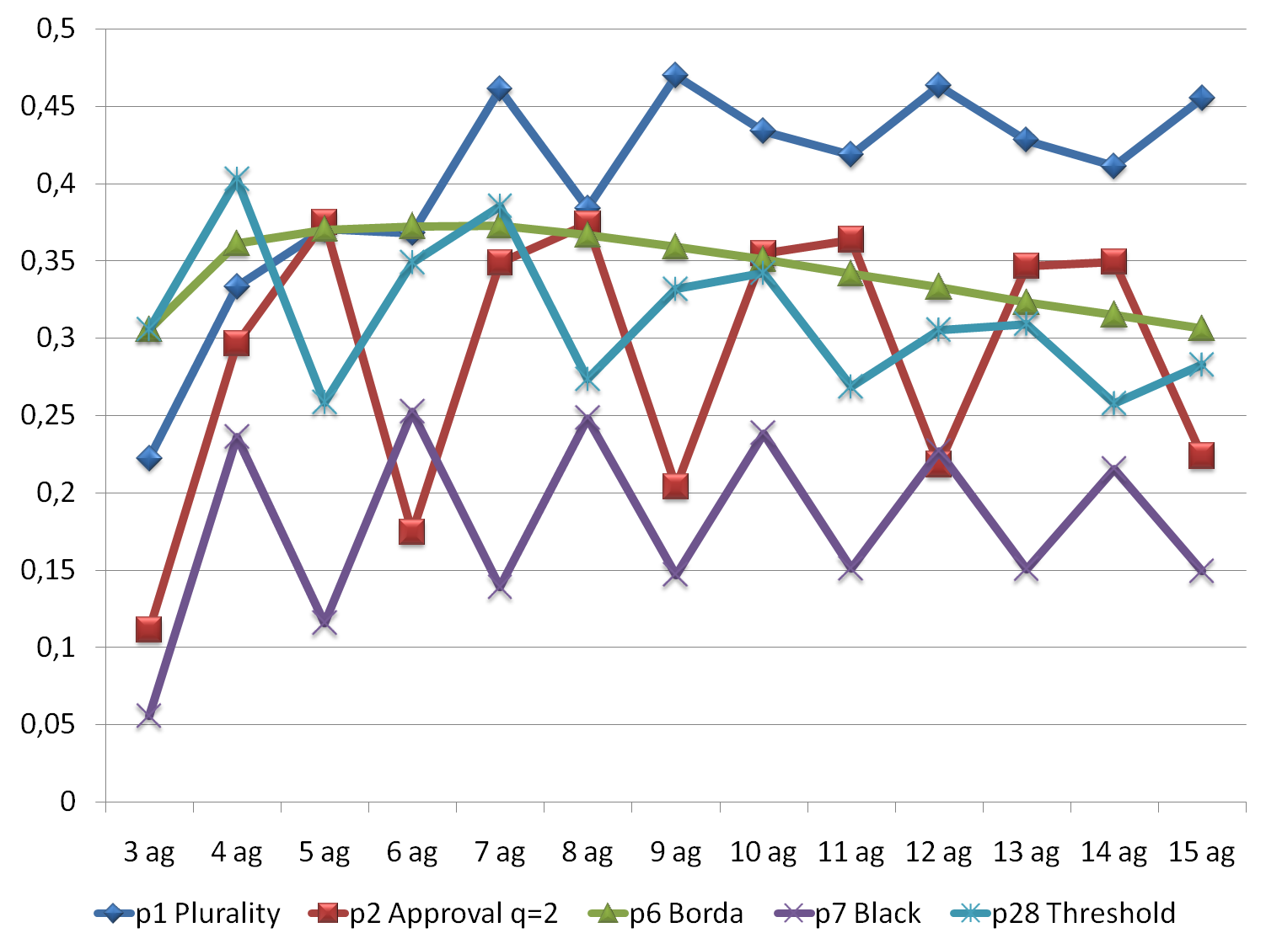

Slide 14
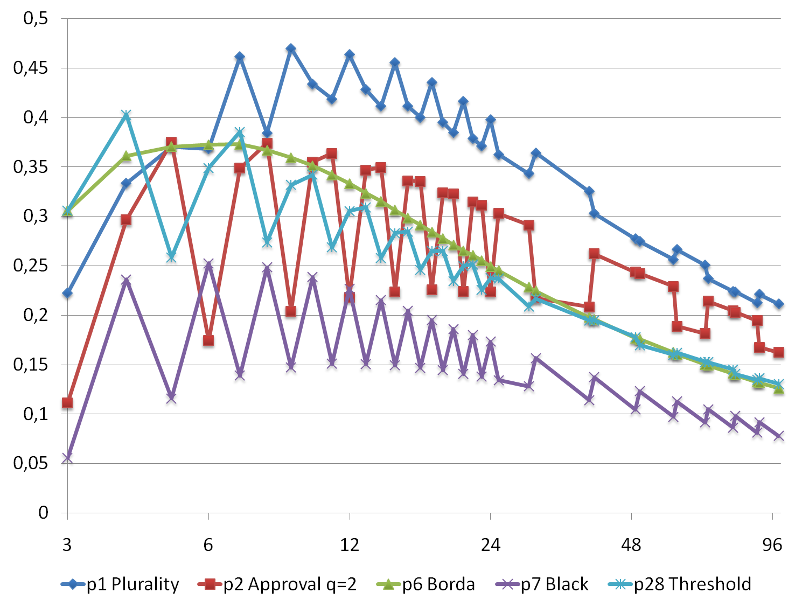

Slide 15
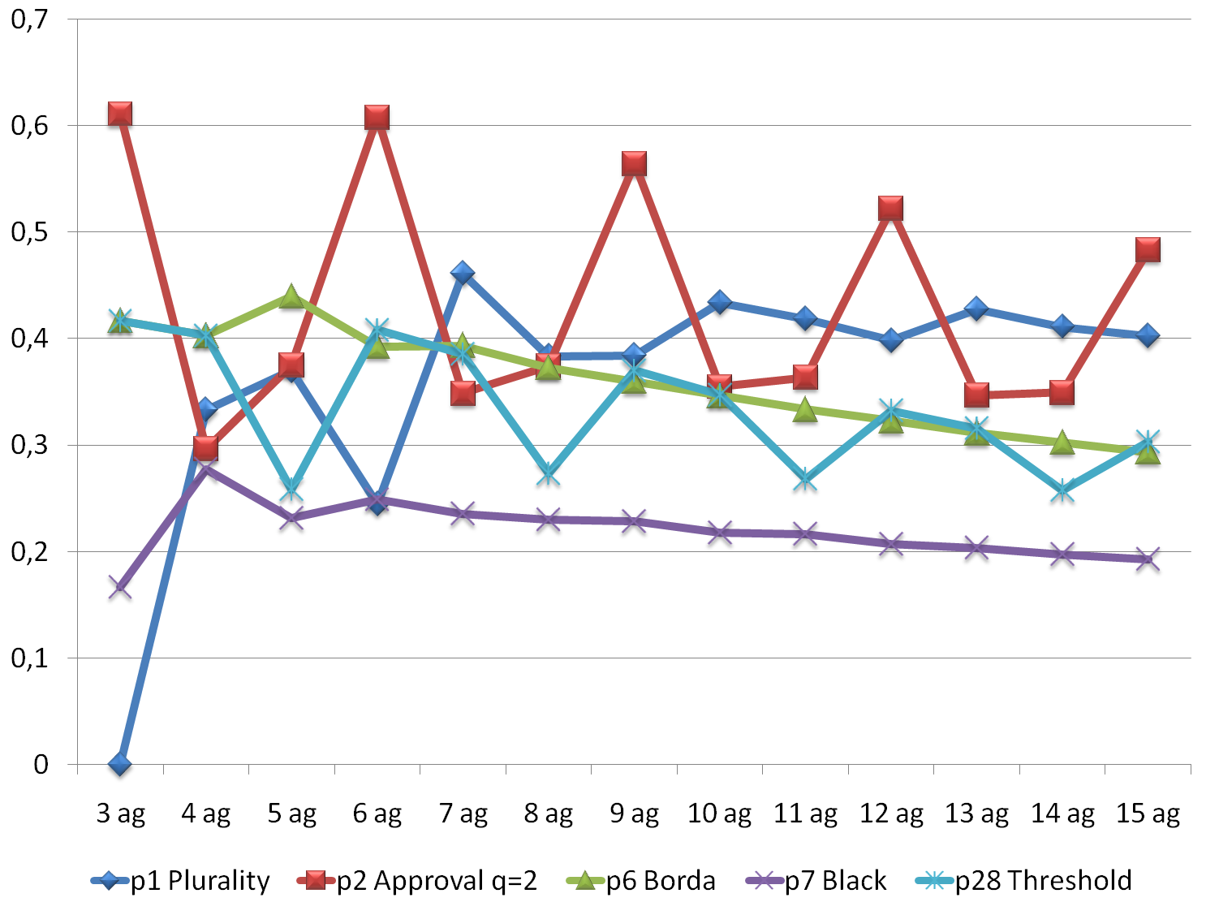

Slide 16
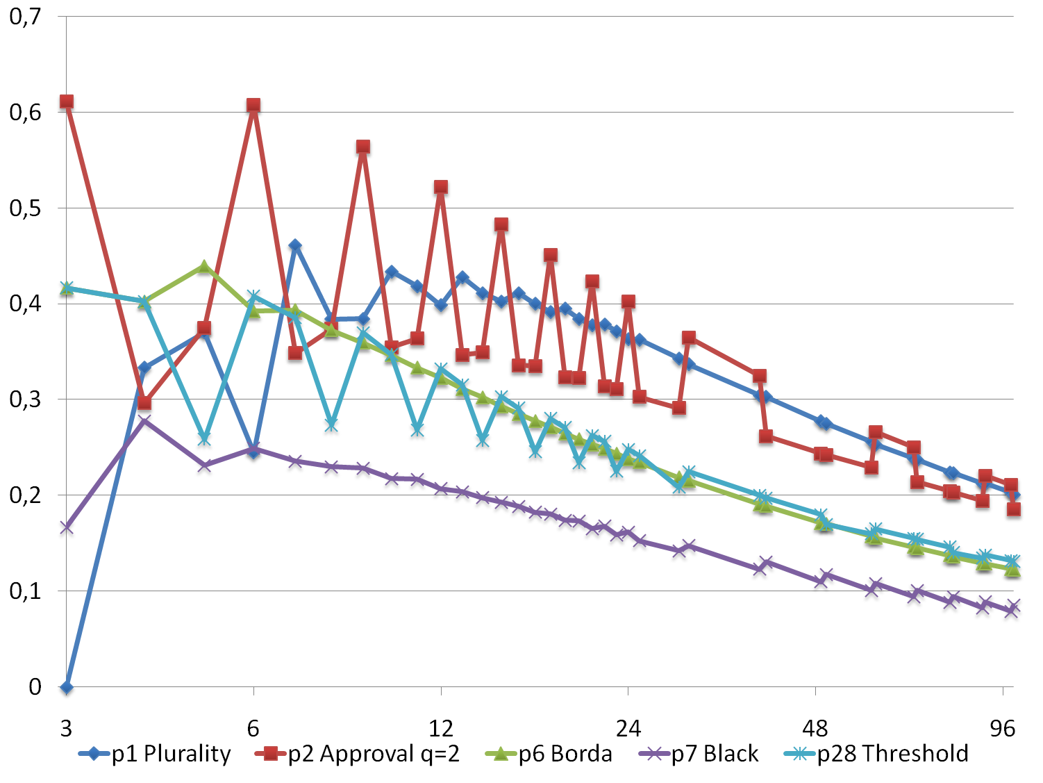

Slide 17
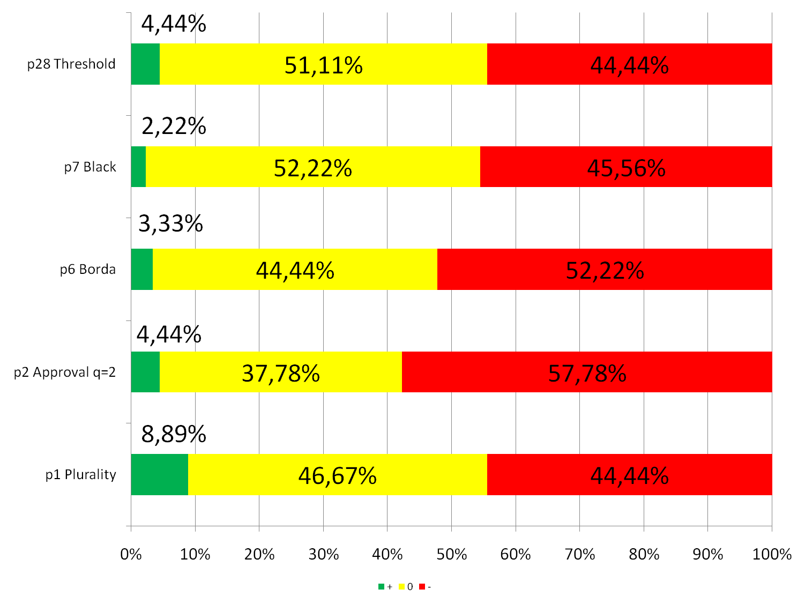

Slide 18
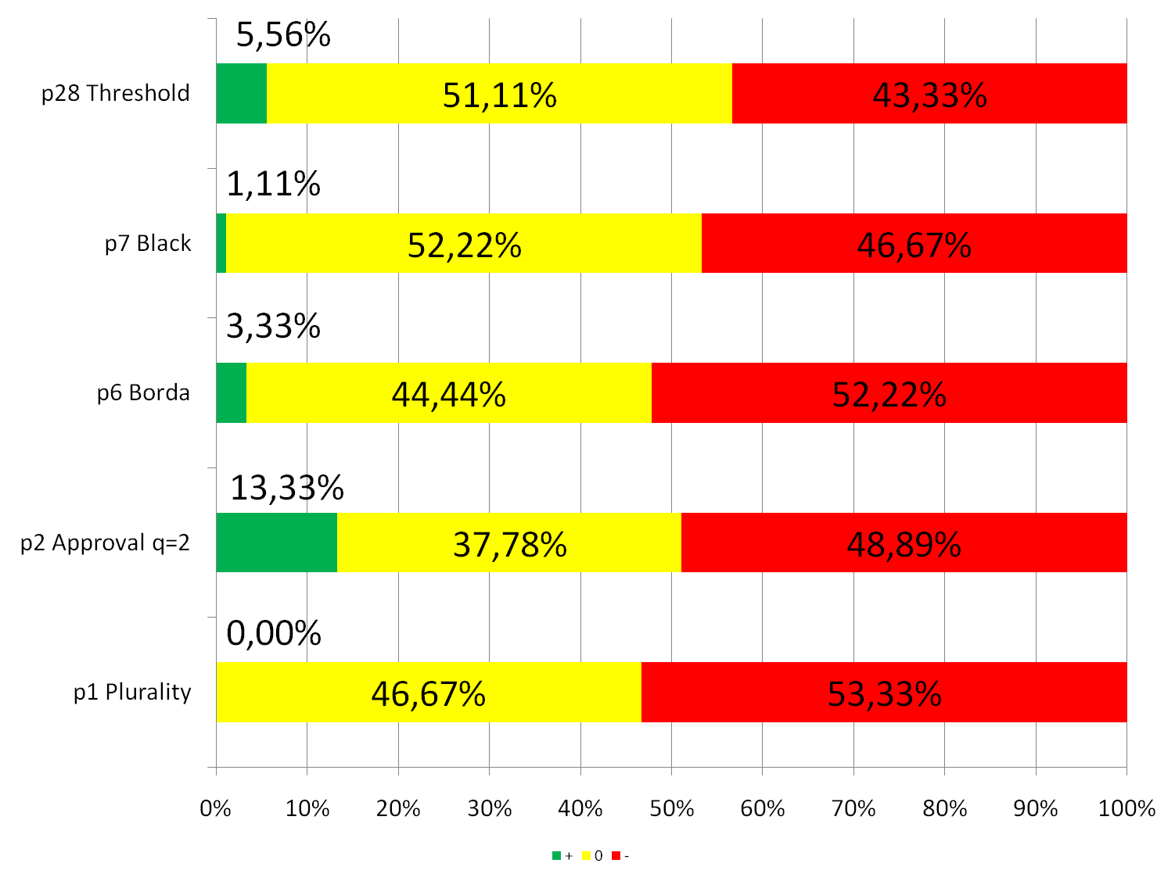

Slide 19
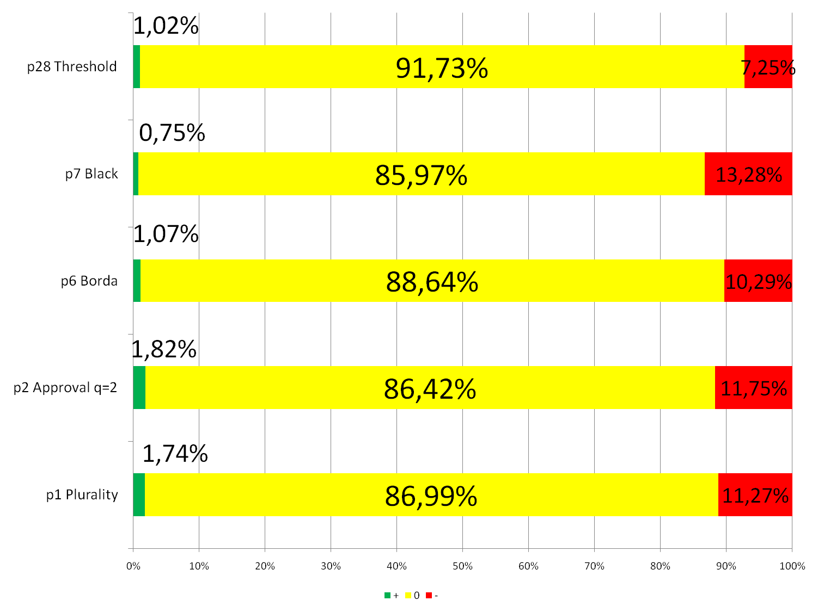

Slide 20
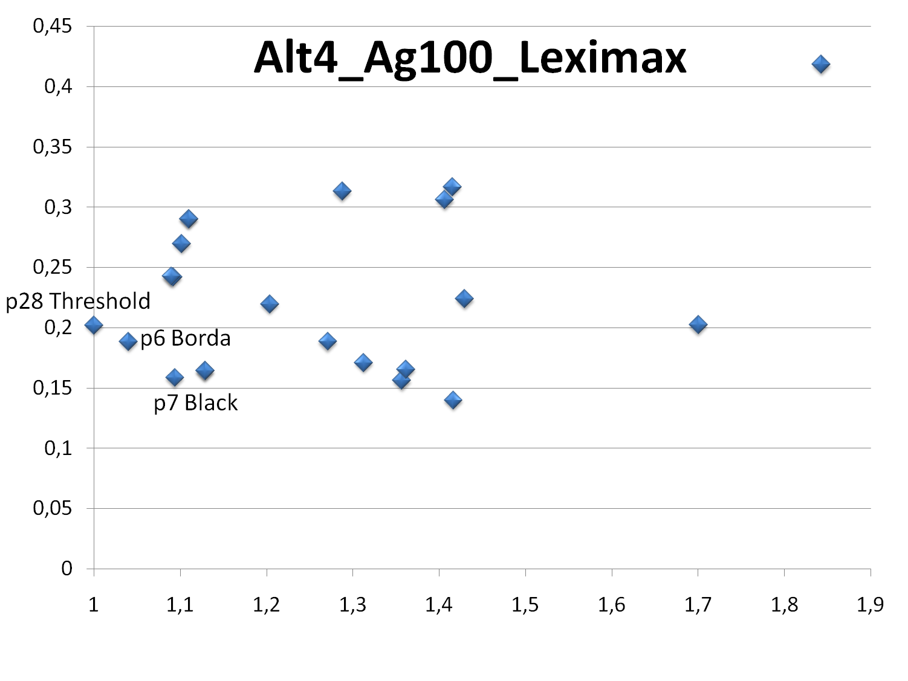

Slide 21
Thank you

