Slide 1
Approval-rating systems that never reward insincerity
COMSOC ’08
3 September 2008
Rob LeGrand
Washington University in St. Louis
(now at Bridgewater College)
legrand@cse.wustl.edu
Ron K. Cytron
Washington University in St. Louis
cytron@cse.wustl.edu

Slide 2
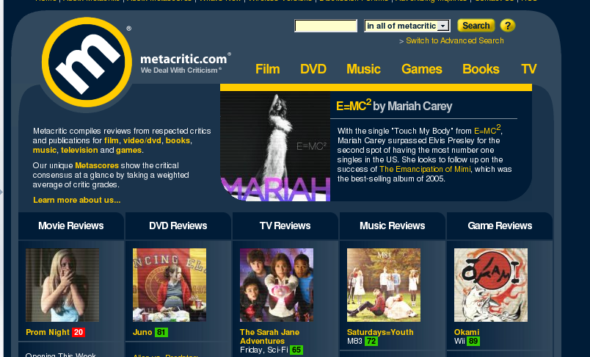
Approval ratings

Slide 3


Approval ratings
Aggregating film reviewers’ ratings
  Rotten Tomatoes: approve (100%) or disapprove (0%)
  Metacritic.com: ratings between 0 and 100
  Both report average for each film
  Reviewers rate independently

Slide 4



Approval ratings
Online communities
  Amazon: users rate products and product reviews
  eBay: buyers and sellers rate each other
  Hotornot.com: users rate other users’ photos
  Users can see other ratings when rating
Can these “voters” benefit from rating insincerely?

Slide 5
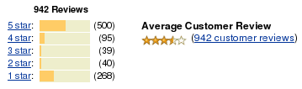

Approval ratings

Slide 6
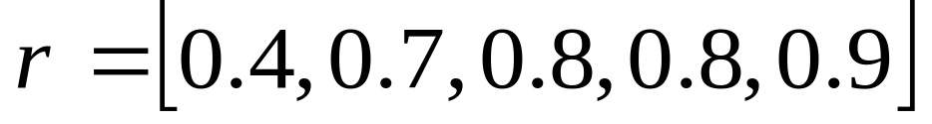
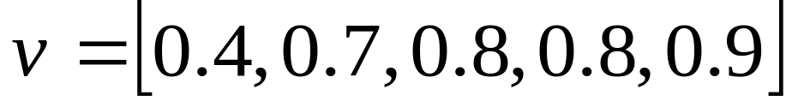
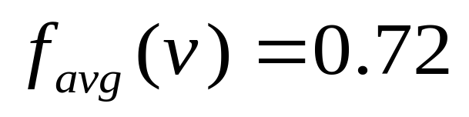



Average of ratings
outcome:
data from Metacritic.com: Videodrome (1983)

Slide 7
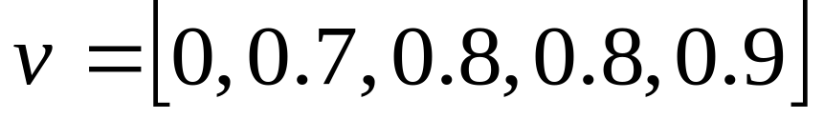
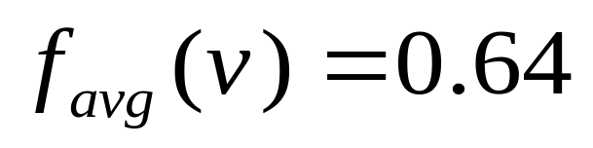

Average of ratings
outcome:
Videodrome (1983)

Slide 8
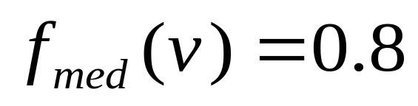

Another approach: Median
outcome:
Videodrome (1983)

Slide 9
Another approach: Median
outcome:
Videodrome (1983)

Slide 10
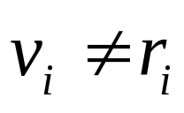
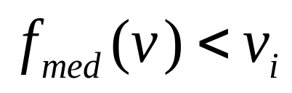

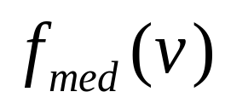
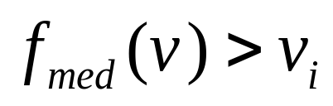
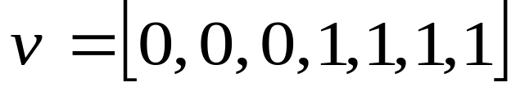
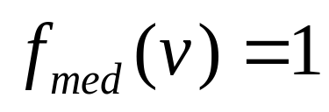
Another approach: Median
Immune to insincerity
  voter i cannot obtain a better result by voting
  if , increasing will not change
  if , decreasing will not change
Allows tyranny by a majority
  no concession to the 0-voters

Slide 11
Declared-Strategy Voting
[Cranor & Cytron ’96]
cardinal
preferences
rational
strategizer
ballot
election
state
outcome

Slide 12
Declared-Strategy Voting
[Cranor & Cytron ’96]
sincerity
strategy
cardinal
preferences
rational
strategizer
ballot
election
state
outcome
Separates how voters feel from how they vote
Levels playing field for voters of all sophistications
Aim: a voter needs only to give sincere preferences

Slide 13
Average with Declared-Strategy Voting?
Try using Average protocol in DSV context
But what’s the rational Average strategy?
And will an equilibrium always be found?
cardinal
preferences
rational
strategizer
ballot
election
state
outcome

Slide 14




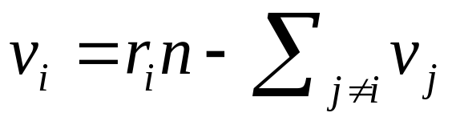
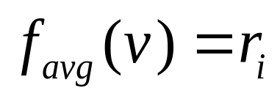
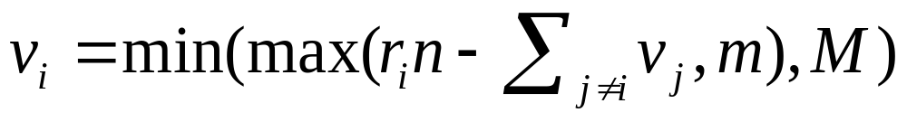
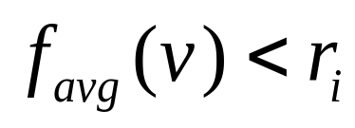
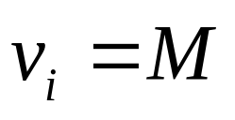
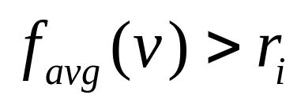
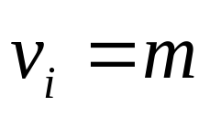
Rational [m,M]-Average strategy
Allow votes between and
For , voter i should choose to move outcome as close to as possible
Choosing would give
Optimal vote is
After voter i uses this strategy, one of these is true:
  and
  and

Slide 15
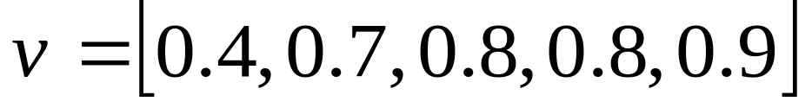
Equilibrium-finding algorithm
Videodrome (1983)

Slide 16
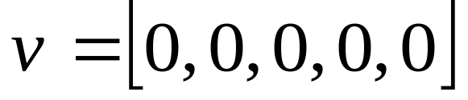
Equilibrium-finding algorithm

Slide 17
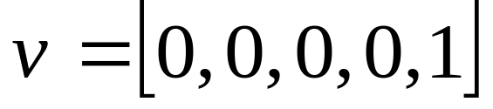

Equilibrium-finding algorithm

Slide 18
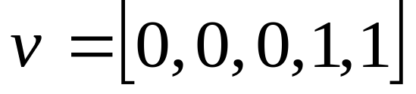

Equilibrium-finding algorithm

Slide 19
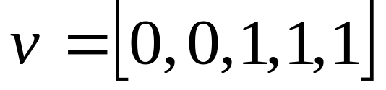

Equilibrium-finding algorithm

Slide 20
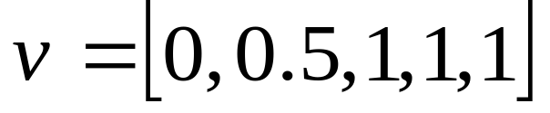

Equilibrium-finding algorithm
Is this algorithm guaranteed to find an equilibrium?
equilibrium!

Slide 21
Equilibrium-finding algorithm
Is this algorithm guaranteed to find an equilibrium?
Yes!
equilibrium!

Slide 22
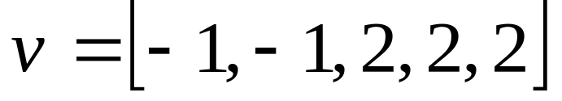


Expanding range of allowed votes
These results generalize to any range

Slide 23
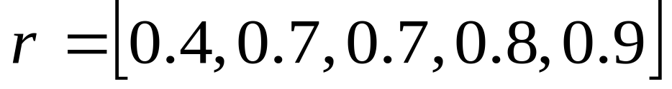

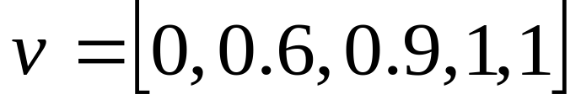
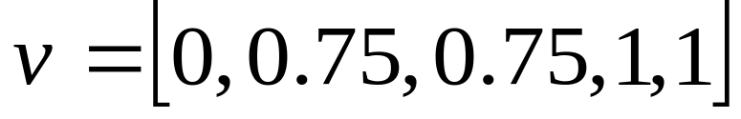
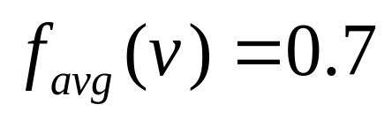
Multiple equilibria can exist
Will multiple equilibria always have the same average?
outcome in each case:

Slide 24
Multiple equilibria can exist
Will multiple equilibria always have the same average?
Yes!
outcome in each case:

Slide 25
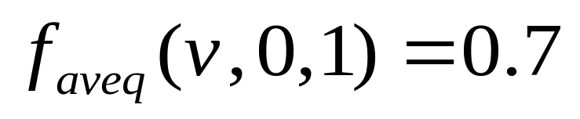
Average-Approval-Rating DSV
outcome:
Videodrome (1983)

Slide 26
Average-Approval-Rating DSV
AAR DSV is immune to insincerity in general
outcome:

Slide 27
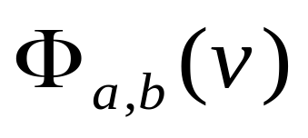


Evaluating AAR DSV systems
Expanded vote range gives wide range of AAR DSV systems:
If we could assume sincerity, we’d use Average
Find AAR DSV system that comes closest
Real film-rating data from Metacritic.com
  mined Thursday 3 April 2008
  4581 films with 3 to 44 reviewers per film
  measure root mean squared error
Perhaps we can come much closer to Average than Median or [0,1]-AAR DSV does

Slide 28

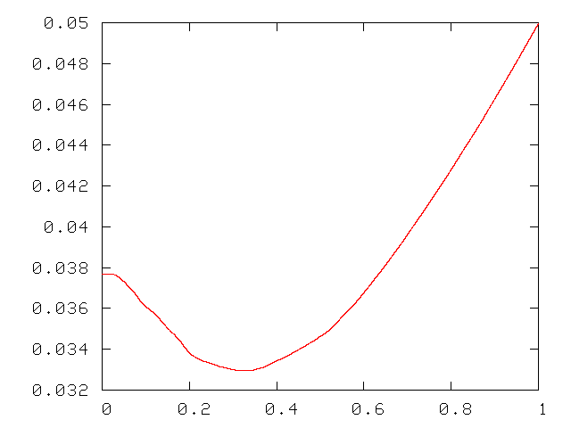
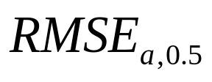


Evaluating AAR DSV systems
minimum at

Slide 29

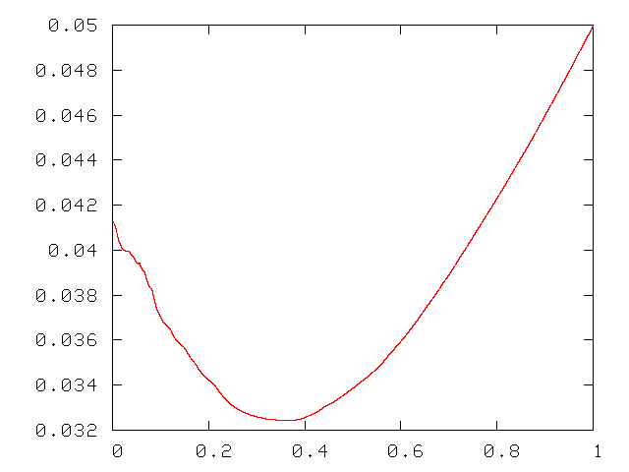
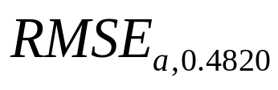

Evaluating AAR DSV systems: hill-climbing
minimum at

Slide 30

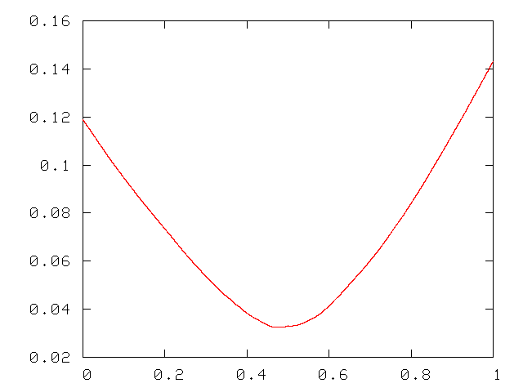
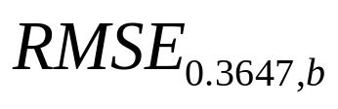


Evaluating AAR DSV systems: hill-climbing
minimum at

Slide 31
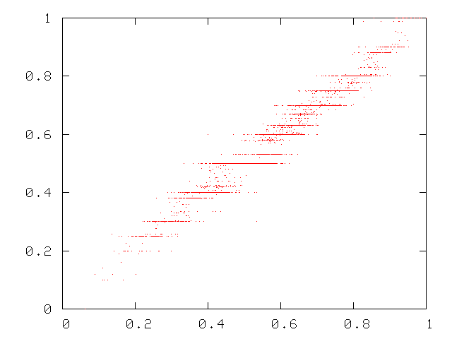
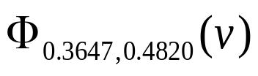
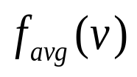
Evaluating AAR DSV systems

Slide 32
AAR DSV: Future work
New website: trueratings.com
  Users can rate movies, books, each other, etc.
  They can see current ratings without being tempted to rate insincerely
  They can see their current strategic proxy vote
Richer outcome spaces
  Hypercube: like rating several films at once
  Simplex: dividing a limited resource among several uses
  How assumptions about preferences are generalized is important
Thanks! Questions?

Slide 33
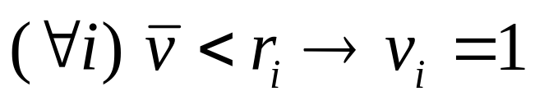
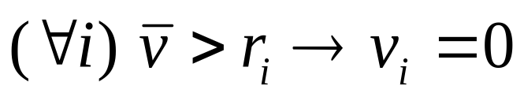
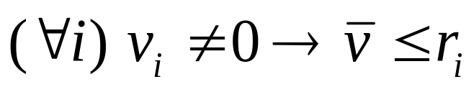
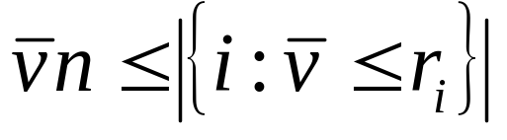
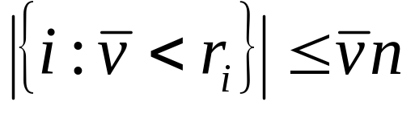
What happens at equilibrium?
The optimal strategy recommends that no voter change
So
And
  equivalently,
Therefore any average at equilibrium must satisfy two equations:
  (A)
  (B)

Slide 34
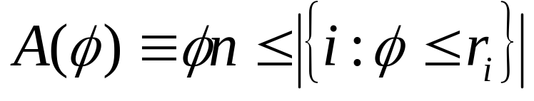
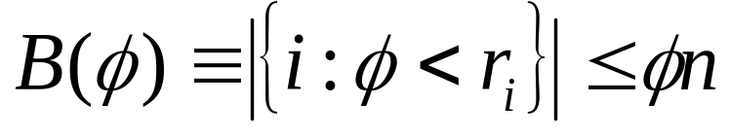


Proof: Only one equilibrium average
Theorem:
Proof considers two symmetric cases:
  assume
  assume
Each leads to a contradiction

Slide 35










Proof: Only one equilibrium average
case 1:
, contradicting

Slide 36




Proof: Only one equilibrium average
Case 1 shows that
Case 2 is symmetrical and shows that
Therefore
Therefore, given , the average at equilibrium is unique

Slide 37


An equilibrium always exists?
At equilibrium, must satisfy
Given a vector , at least one equilibrium indeed always exists.
A particular algorithm will always find an equilibrium for any . . .

Slide 38



An equilibrium always exists!
Equilibrium-finding algorithm:
sort so that
for i = 1 up to n do
Since an equilibrium always exists, average at equilibrium is a function, .
Applying to instead of gives a new system, Average-Approval-Rating DSV.
(full proof and more efficient algorithm in dissertation)

Slide 39


Average-Approval-Rating DSV
What if, under AAR DSV, voter i could gain an outcome closer to ideal by voting insincerely ( )?
It turns out that Average-Approval-Rating DSV is immune to strategy by insincere voters.
Intuitively, if , increasing will not change .

Slide 40



AAR DSV is immune to strategy
If ,
  increasing will not change .
  decreasing will not increase .
If ,
  increasing will not decrease .
  decreasing will not change .
So voting sincerely ( ) is guaranteed to optimize the outcome from voter i’s point of view
(complete proof in dissertation)

Slide 41





Parameterizing AAR DSV
[m,M]-AAR DSV can be parameterized nicely using a and b, where and :

Slide 42






Parameterizing AAR DSV
For example:

Slide 43


Evaluating AAR DSV systems
Real film-rating data from Metacritic.com
  mined Thursday 3 April 2008
  4581 films with 3 to 44 reviewers per film

Slide 44


Higher-dimensional outcome space
What if votes and outcomes exist in dimensions?
Example:
If dimensions are independent, Average, Median and Average-approval-rating DSV can operate independently on each dimension
  Results from one dimension transfer

Slide 45

Higher-dimensional outcome space
But what if the dimensions are not independent?
  say, outcome space is a disk in the plane:
A generalization of Median: the Fermat-Weber point [Weber ’29]
  minimizes sum of Euclidean distances between outcome point and voted points
  F-W point is computationally infeasible to calculate exactly [Bajaj ’88] (but approximation is easy [Vardi ’01])
  cannot be manipulated by moving a voted point directly away from the F-W point [Small ’90]

