Slide 1

Strong Implementation of Social Choice Functions in Dominant Strategies
Clemens Thielen Sven O. Krumke
3rd International Workshop on Computational Social Choice
15 September 2010
krumke@mathematik.uni-kl.de
TexPoint fonts used in EMF.
Read the TexPoint manual before you delete this box.: AAAAAAAAAAAA

Slide 2

Problem Definition
Social choice setting with private information:
Notes:
In this talk: The objective function will always be weighted sum of completion times.

Slide 3
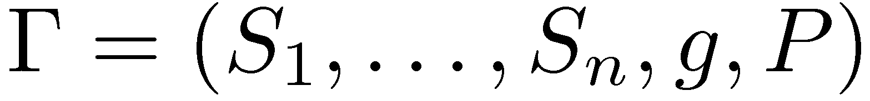


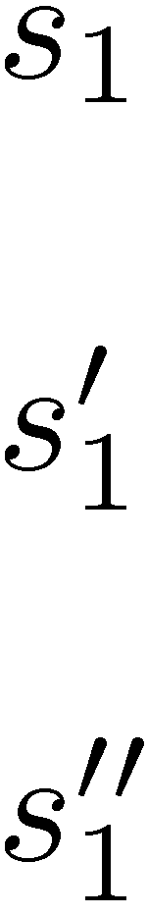
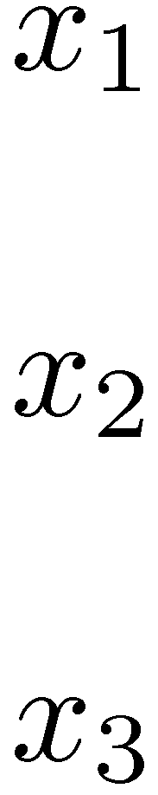
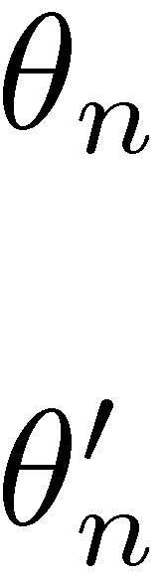
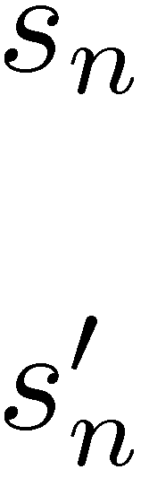
Mechanisms
Mechanism:
Types
Bids
Social Choices
Agent 1
strategy α₁
.
.
.
g
Agent n
strategy α_{n}
.
.
.
Notes:
Work_i = total size of the jobs assigned to I
Hence: work_i/s_i is the total time machine i will be busy

Slide 4

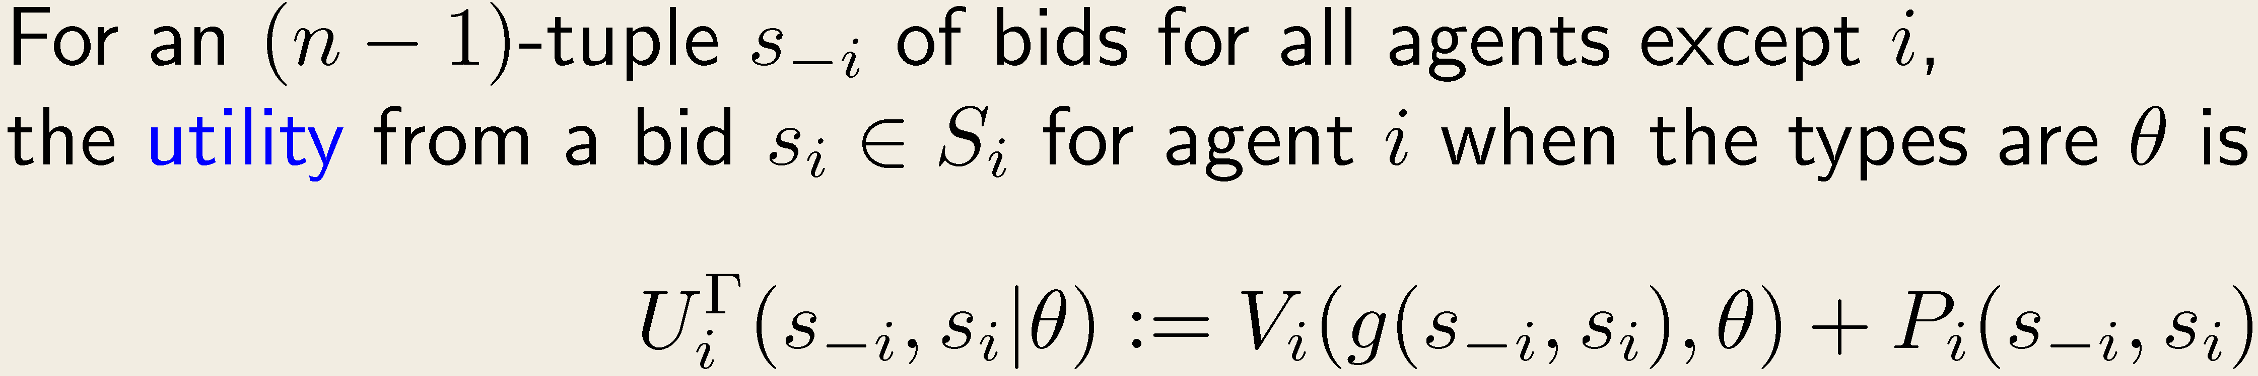
Utilities and Equilibria
Definition:
valuation of the output
payment obtained
Strong Implementability
Notes:
Intuitively: Small changes in the speeds induce only small changes in the objective value
Technique used in the proof: Geometric rounding
(all speeds are rounded to powers of 1+epsilon)

Slide 5
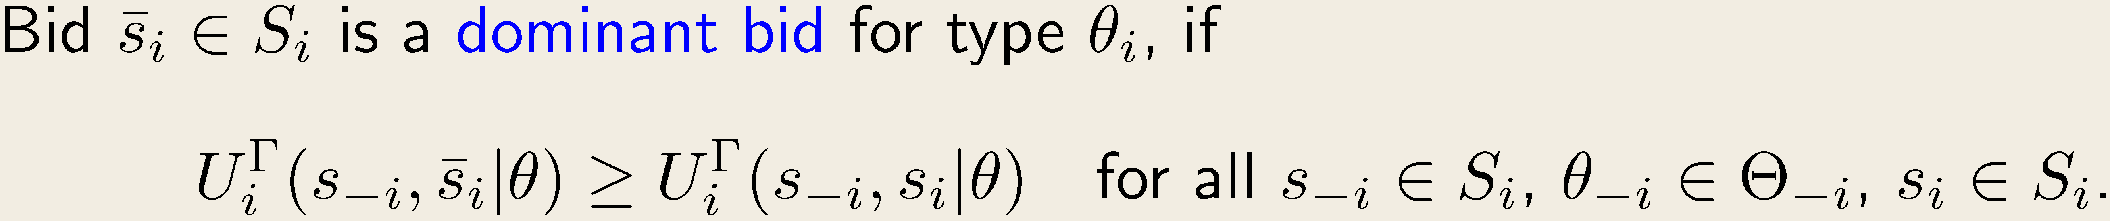
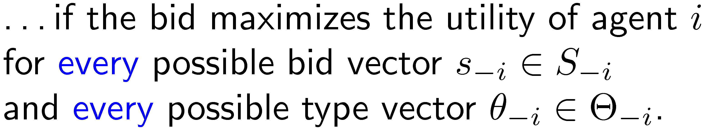
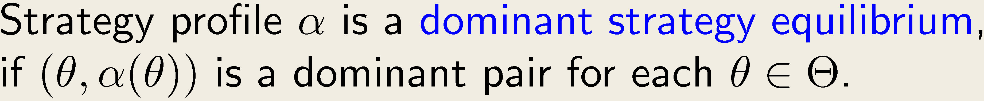
Utilities and Equilibria
Definition:
Definition:
Strong Implementability
Notes:
Intuitively: Small changes in the speeds induce only small changes in the objective value
Technique used in the proof: Geometric rounding
(all speeds are rounded to powers of 1+epsilon)

Slide 6
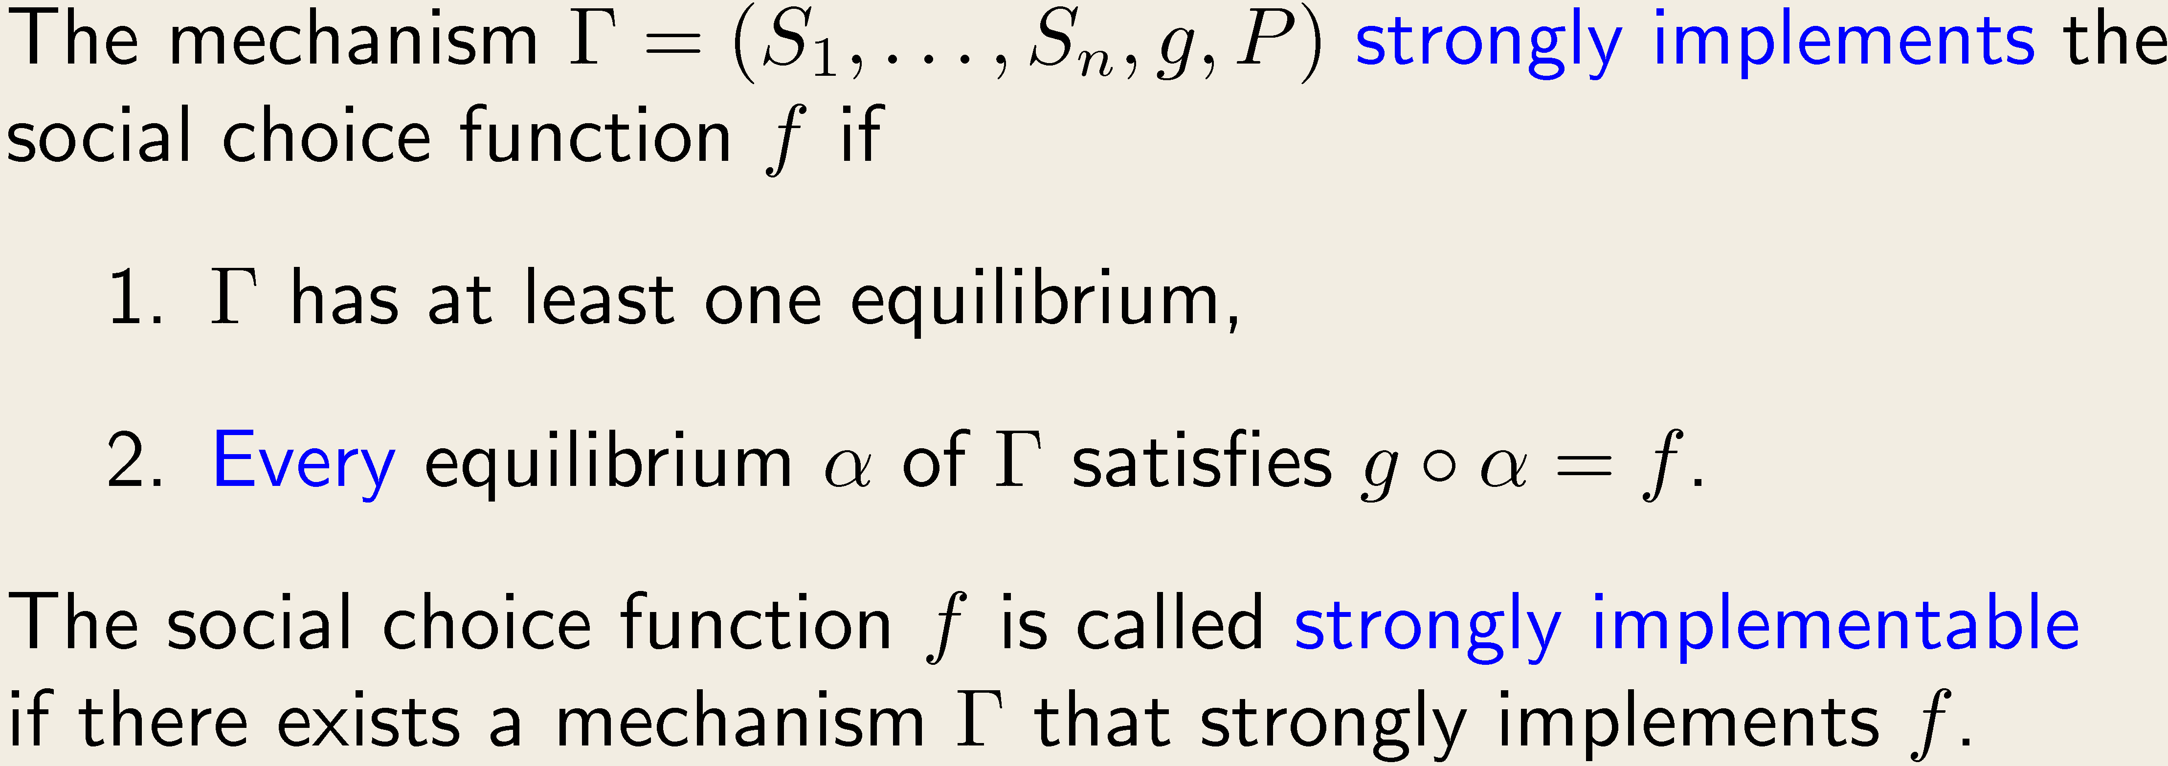
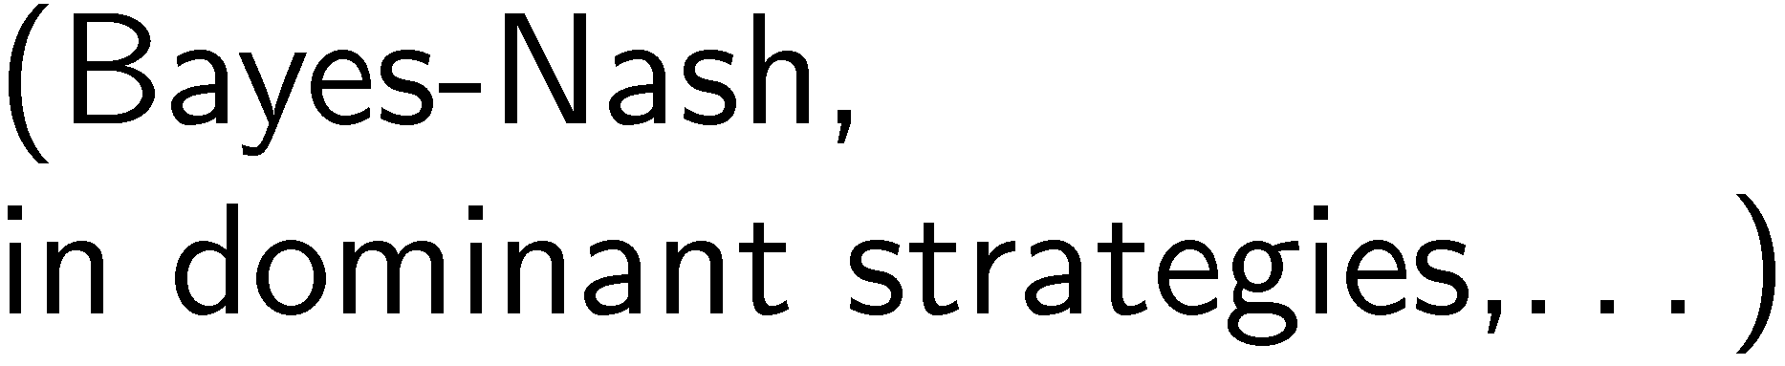
Strong Implementation
Definition:
Strong Implementability
Notes:
Intuitively: Small changes in the speeds induce only small changes in the objective value
Technique used in the proof: Geometric rounding
(all speeds are rounded to powers of 1+epsilon)

Slide 7
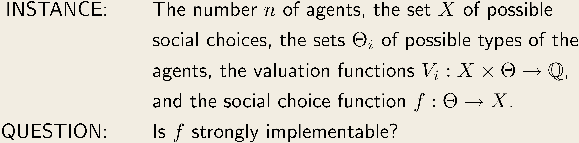
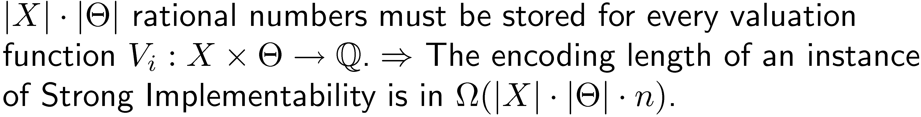
Strong Implementability Problem
The Strong Implementability Problem:
Encoding length:
Strong Implementability
Notes:
Intuitively: Small changes in the speeds induce only small changes in the objective value
Technique used in the proof: Geometric rounding
(all speeds are rounded to powers of 1+epsilon)

Slide 8
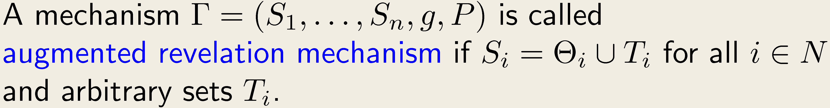
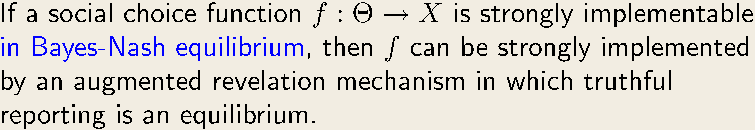
Augmented Revelation Mechanisms
Definition:
Augmented Revelation Principle:
[Mookherjee, Reichelstein 1990]
„incentive compatibility“
Strong Implementability

Slide 9
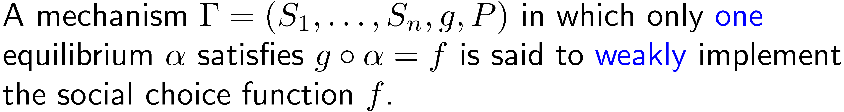
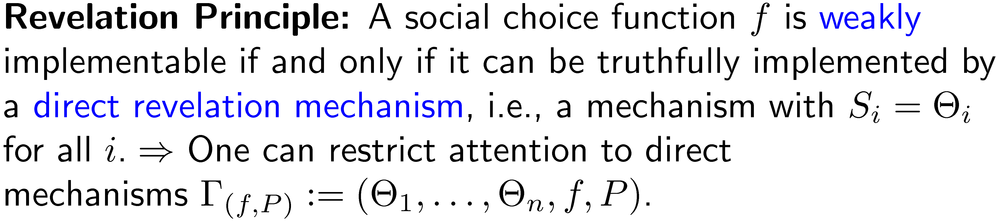
Previous Results
Strong Implementability

Slide 10
Previous Results (2)
Strong Implementability

Slide 11
Our Results
Strong Implementability

Slide 12
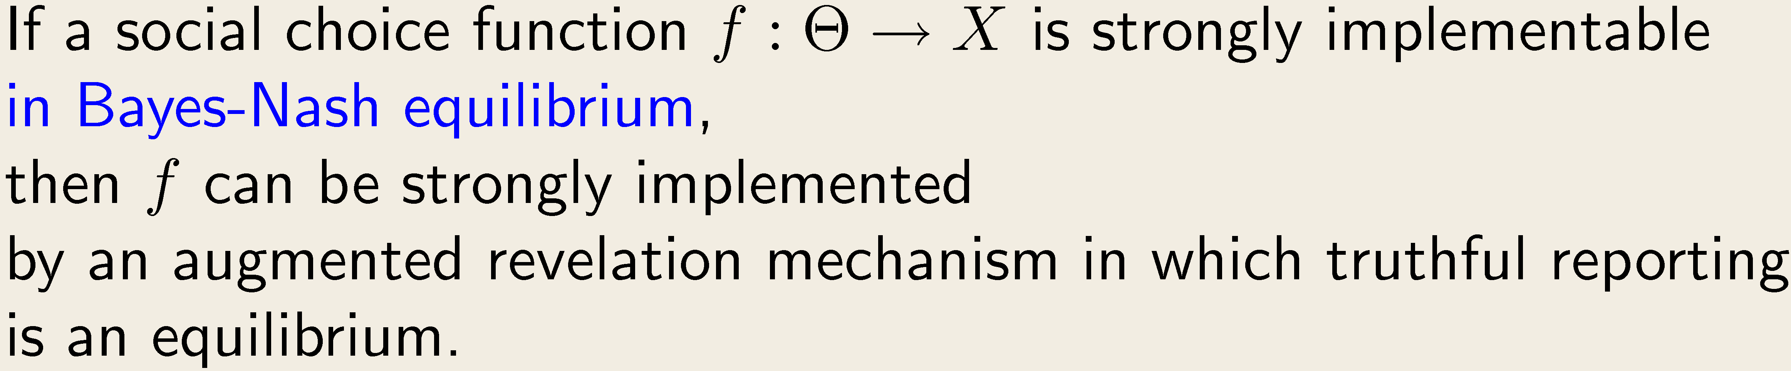
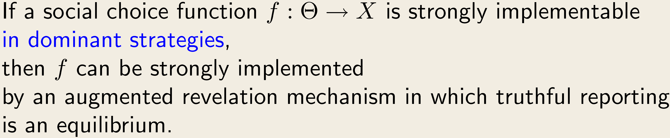
Augmented Revelation Principle
Augmented Revelation Principle:
[Mookherjee, Reichelstein 1990]
Augmented Revelation Principle for Dominant Strategies:
[this paper]
Strong Implementability

Slide 13

General Idea (I)
To obtain an augmented revelation mechanism:
see definition to follow soon
Definition:
Strong Implementability

Slide 14


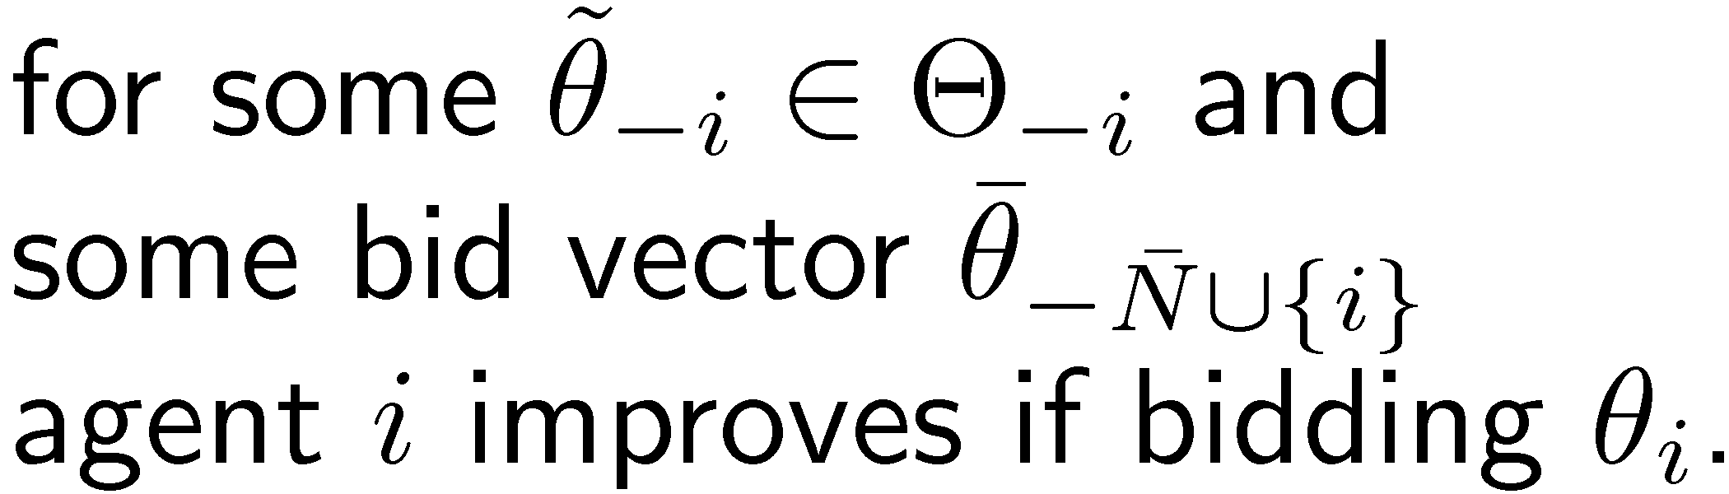

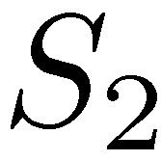
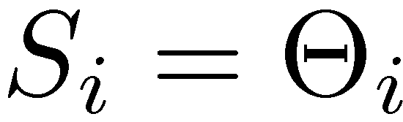
Selective Elimination
agent i
Strong Implementability

Slide 15

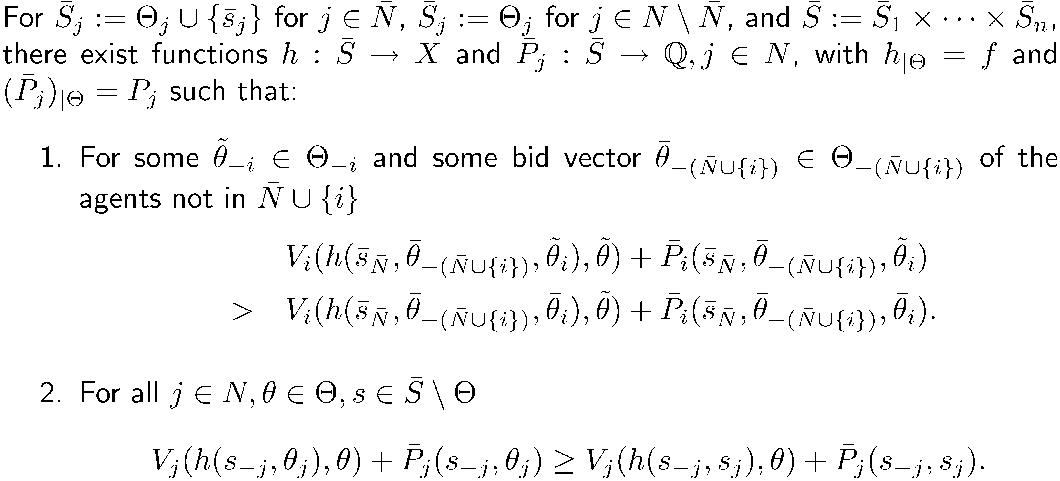
Selective Elimination
Strong Implementability

Slide 16
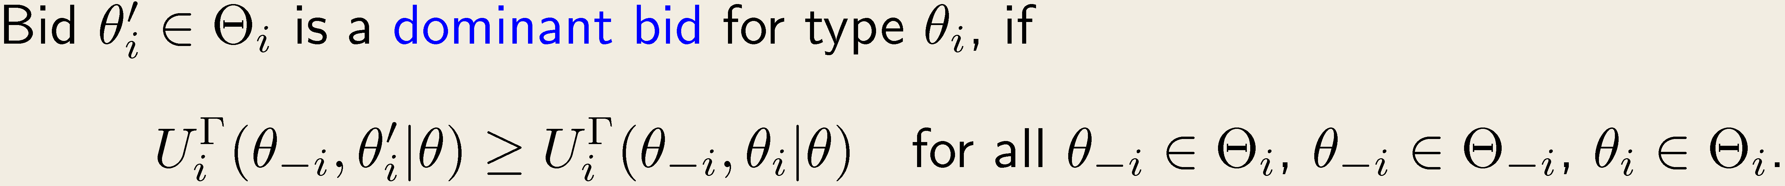
Bad Pairs and Elimination
Definition:
Definition:
Definition:
Strong Implementability

Slide 17
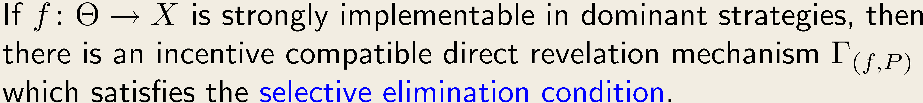
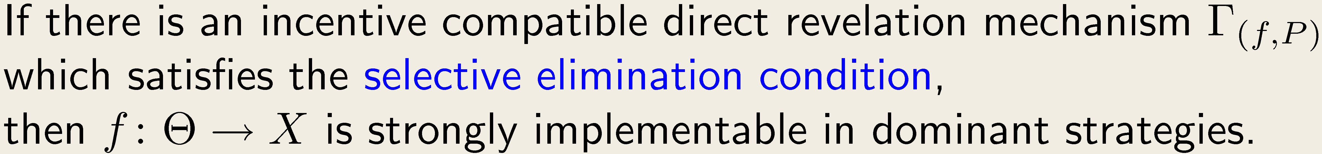
Two Important Steps
Theorem 2 (selective elimination is necessary):
Theorem 3 (selective elimination is sufficient):
Strong Implementability

Slide 18
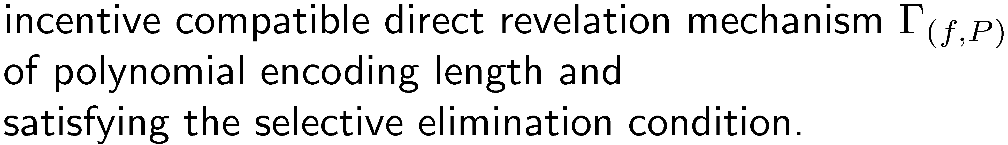
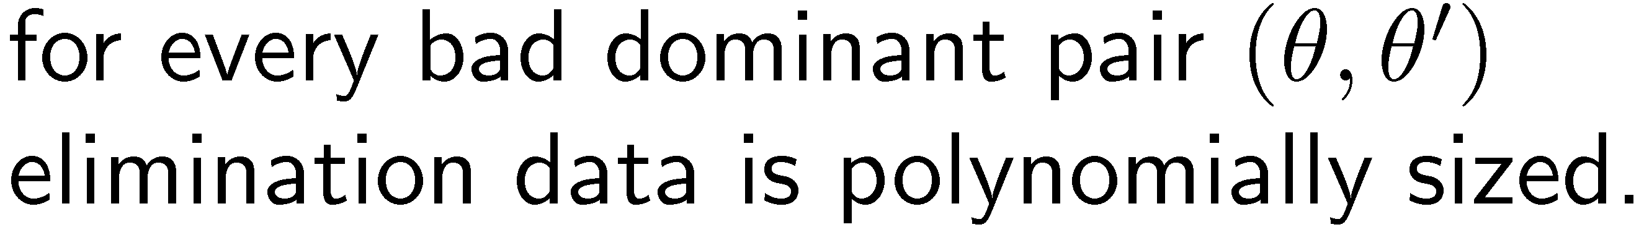
Structure of the Algorithm
Theorem 3 + close look at the proof
guess
Definition of selective elimination
guess
verify
Strong Implementability

Slide 19
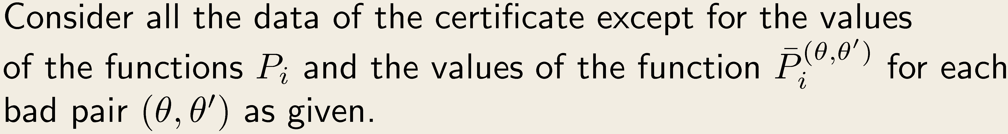
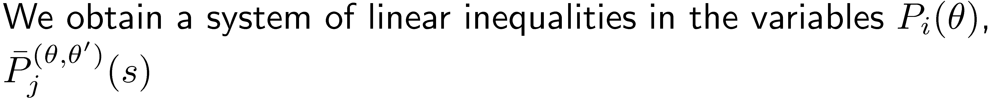
The Verification
General Approach:
Main Observation:
Strong Implementability

Slide 20
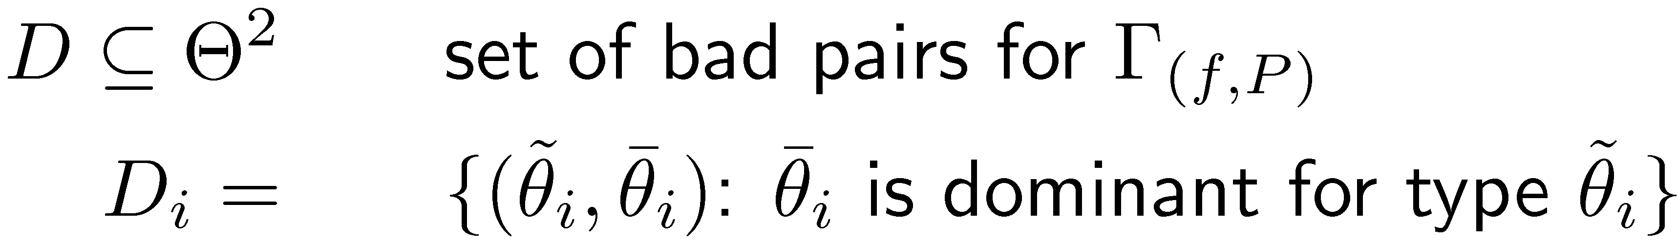
The Payment Polyhedron
Strong Implementability

Slide 21
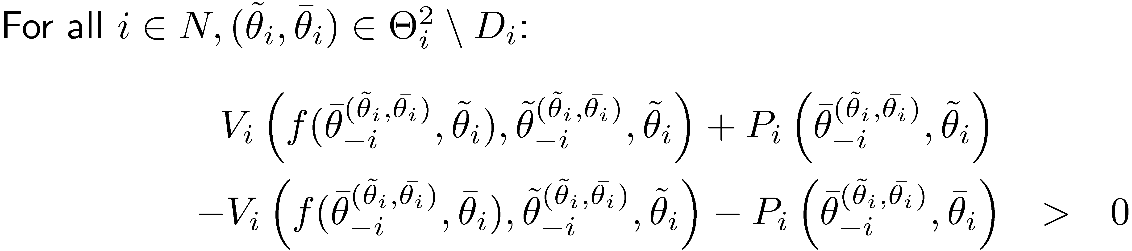
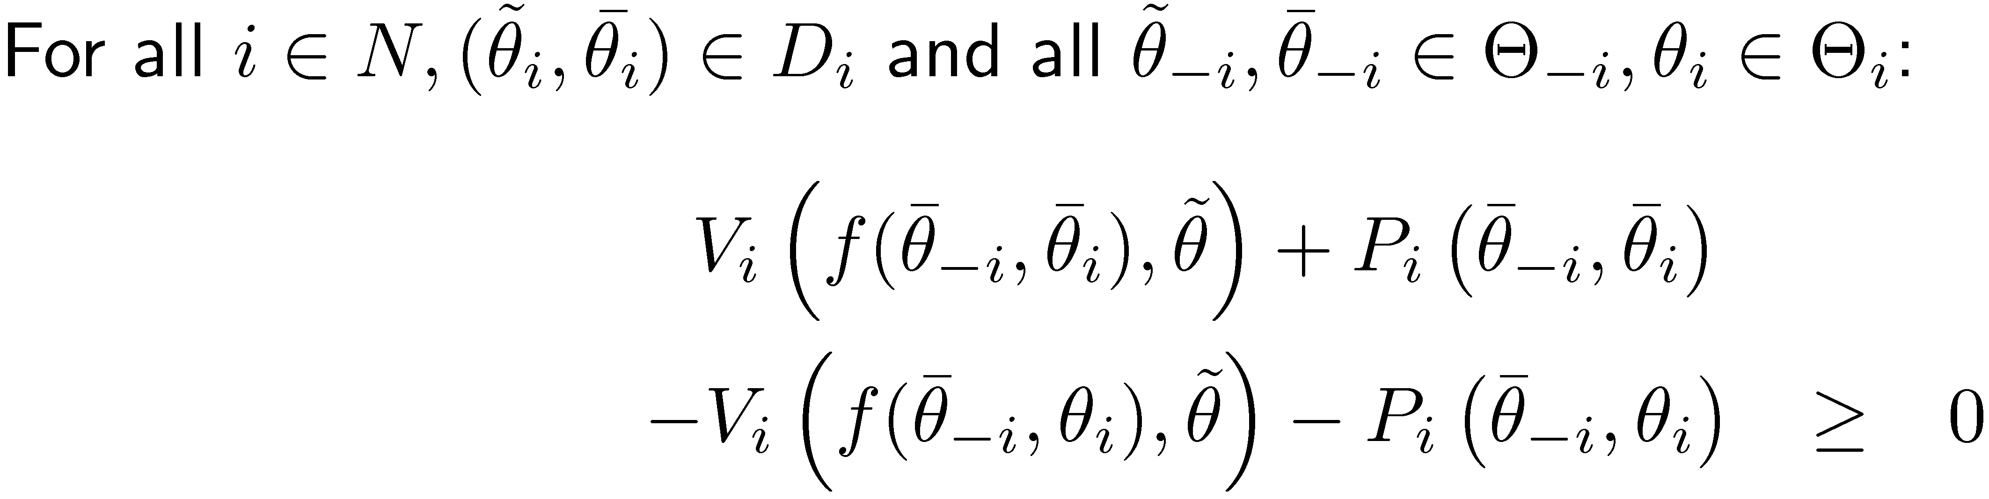
The Payment Polyhedron (I)
Incentive compatibility
&
dominant bids
Inequalities encode which bids are dominant bids.
Strong Implementability

Slide 22
The Payment Polyhedron (II)
Inequalities encode conditions of selective elimination
Strong Implementability

Slide 23
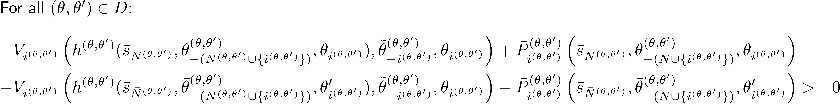
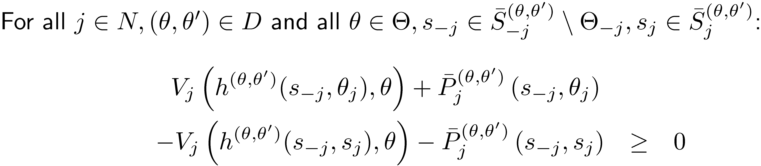
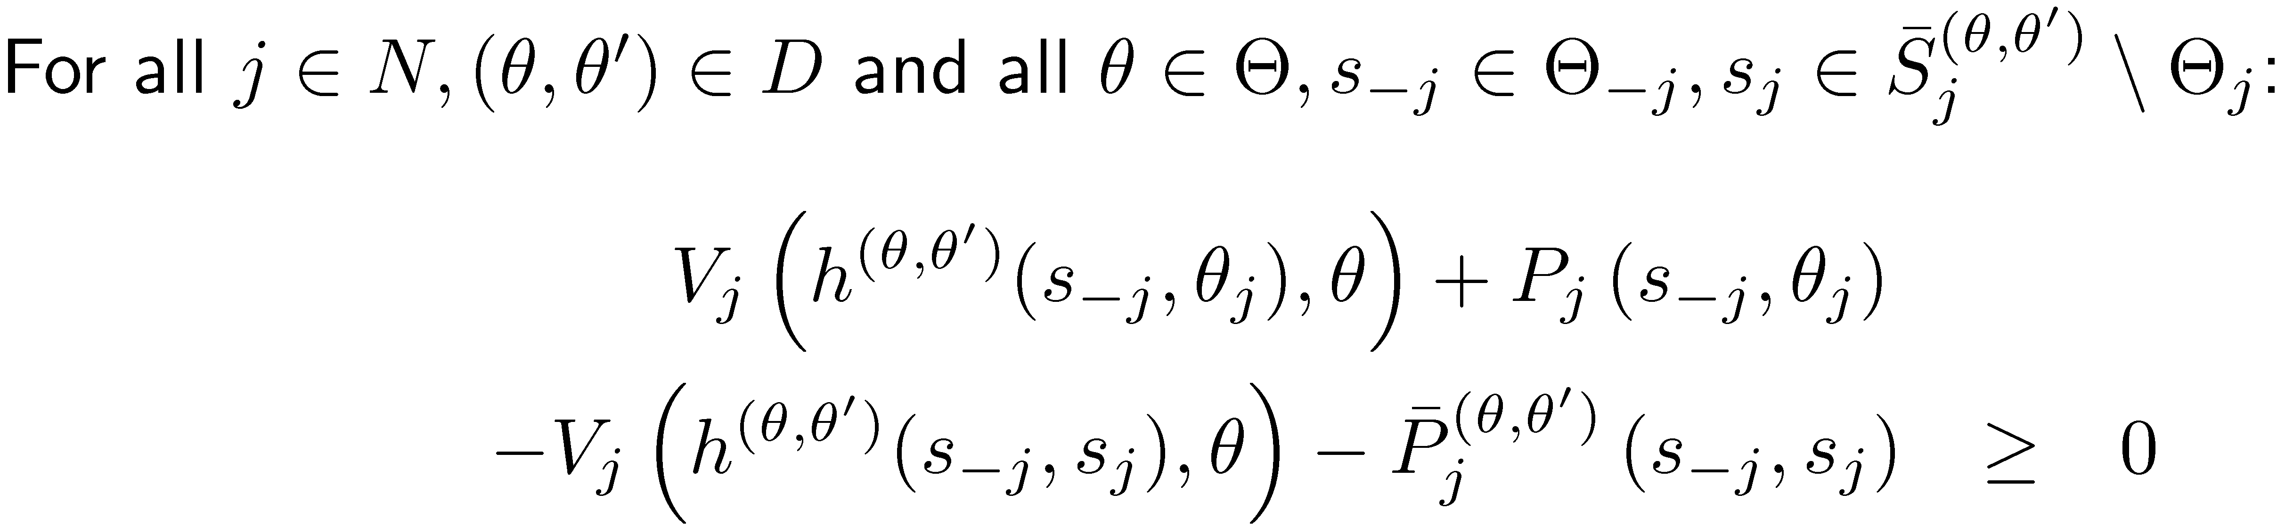
The Payment Polyhedron (II)
Inequalities encode conditions of selective elimination
Strong Implementability

Slide 24
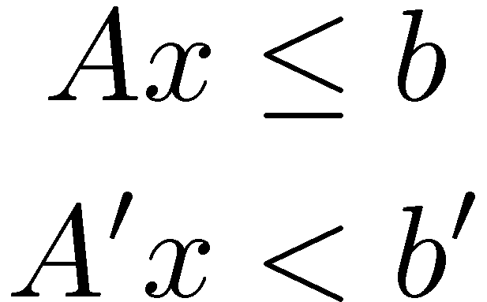
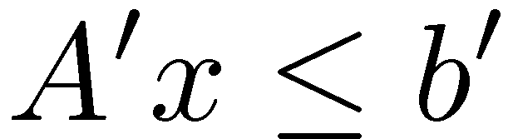

Verification Issues
Here I am!
Strong Implementability

Slide 25
Verification Issues
We have to handle strict inequalities.
To do so, we must find a point in the relative interior of the polyhedron.
This can be done by means of the Ellipsoid Method (directly) or by solving a sequence of LPs.
Byproduct: Payments are of polynomial encoding length.
Strong Implementability

Slide 26


Conclusion
Strong Implementability in dominant strategies∈NP
Characterization result generalizes to infinite type spaces
Open: Is the problem in P?
Useful(?) results:
Augmented Revelation Principle
Selective elimination procedure with polynomially many steps
Payments of polynomial encoding size
NP-complete!
Strong Implementability

Slide 27
Thank you!
Strong Implementability

