Slide 1
Convergence to Equilibria
in Plurality Voting
Reshef Meir
Jeff Rosenschein
Hebrew University of Jerusalem, Israel
Maria Polukarov
Nick Jennings
University of Southampton, United Kingdom
COMSOC 2010, Dusseldorf

Slide 2
What are we after?
Agents have to agree on a joint plan of action or allocation of resources
Their individual preferences over available alternatives may vary, so they vote
  Agents may have incentives to vote strategically
We study the convergence of strategic behavior to stable decisions from which no one will want to deviate – equilibria
  Agents may have no knowledge about the preferences of the others and no communication

Slide 3

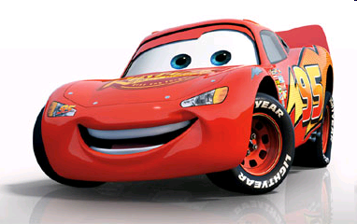
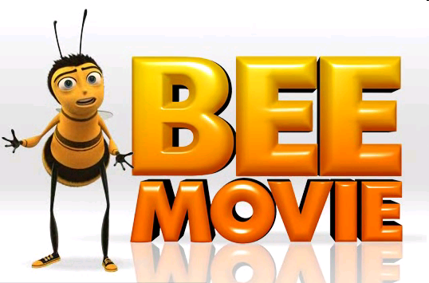












CARS
C>B>A
C>A>B

Slide 4
Voting: model
Set of voters V = {1,...,n}
  Voters may be humans or machines
Set of candidates A = {a,b,c...}, |A|=m
  Candidates may also be any set of alternatives, e.g. a set of movies to choose from
Every voter has a private rank over candidates
  The ranking is a complete, transitive order (e.g. d>a>b>c)
CARS
d
a
b
c

Slide 5
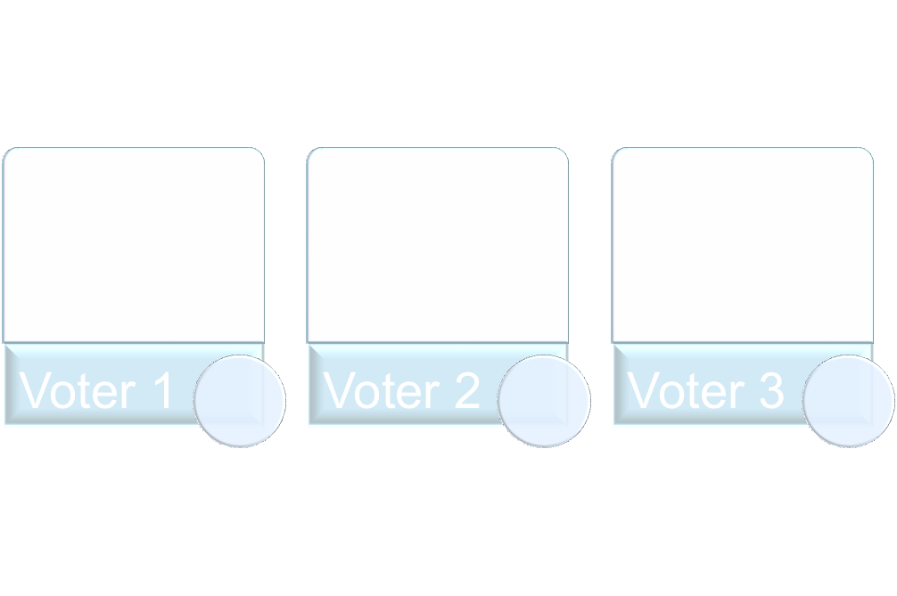



Voting profiles
The preference order of voter i is denoted by Ri
  Denote by R (A) the set of all possible orders on A
  Ri is a member of R (A)
The preferences of all voters are called a profile
  R = (R1,R2,…,Rn)
a
a
b
b
c
a
c
b
c

Slide 6
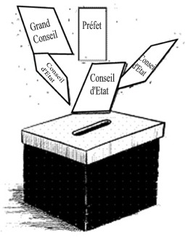
Voting rules
A voting rule decides who is the winner of the elections
  The decision has to be defined for every profile
  Formally, this is a function
  f : R (A)^{n} → A

Slide 7

The Plurality rule
  Each voter selects a candidate
  Voters may have weights
  The candidate with most votes wins
Tie-breaking scheme
  Deterministic: the candidate with lower index wins
  Randomized: the winner is selected at random from candidates with highest score

Slide 8
Voting as a normal-form game
W₂=4
a
b
c
W₁=3
a
b
c
7
9
3
Initial score:
CARS

Slide 9
Voting as a normal-form game
 | (14,9,3)
 | (11,12,3)
W₂=4
a
b
c
W₁=3
a
b
c
7
9
3
Initial score:
CARS

Slide 10
Voting as a normal-form game
 | (14,9,3) | (10,13,3) | (10,9,7)
 | (11,12,3) | (7,16,3) | (7,12,7)
 | (11,9,6) | (7,13,6) | (7,9,10)
W₂=4
a
b
c
W₁=3
a
b
c
7
9
3
Initial score:
CARS

Slide 11
Voting as a normal-form game
 | (14,9,3) | (10,13,3) | (10,9,7)
 | (11,12,3) | (7,16,3) | (7,12,7)
 | (11,9,6) | (7,13,6) | (7,9,10)
W₂=4
a
b
c
W₁=3
a
b
c
a > b > c
Voters preferences:
Nash Equilibria
c > a > b

Slide 12
Voting in turns
We allow each voter to change his vote
Only one voter may act at each step
The game ends when there are no objections
This mechanism is implemented in some on-line voting systems, e.g. in Google Wave

Slide 13
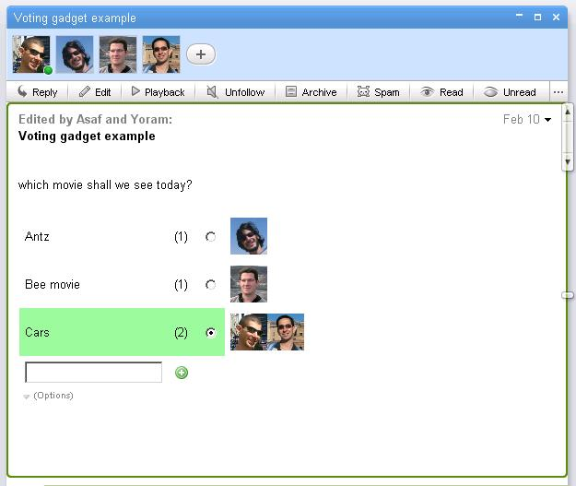

Slide 14
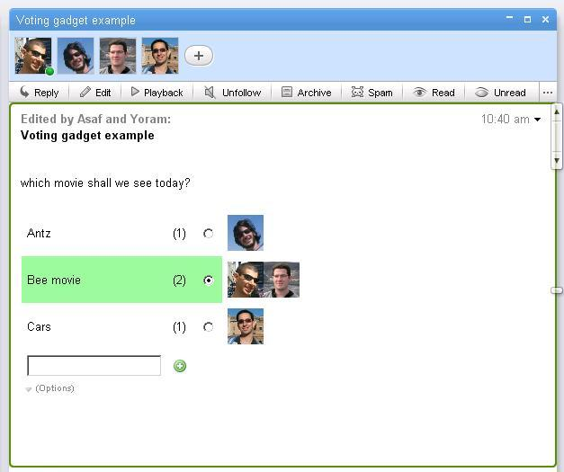

Slide 15
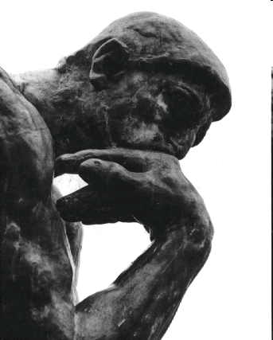
Rational moves
We assume, that voters only
make rational steps, but what
is “rational”?
Voters do not know the preferences of others
Voters cannot collaborate with others
Thus, improvement steps are myopic, or local.

Slide 16








Dynamics
There are two types of improvement steps that a voter can make
CARS
C>D>A>B
“Better replies”

Slide 17
Dynamics
There are two types of improvement steps that a voter can make
CARS
C>D>A>B
“Best reply” (always unique)

Slide 18
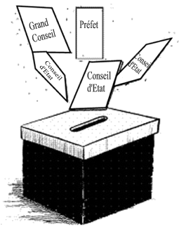
Variations of the voting game
Properties of the game
Tie-breaking scheme:
  Deterministic / randomized
Agents are weighted / non-weighted
Number of voters and candidates
Voters start by telling the truth / from arbitrary state
Voters use best replies / better replies
Properties of the players

Slide 19
Our results
We have shown how the convergence depends on all of these game attributes

Slide 20
Some games never converge
Initial score = (0,1,3)
Randomized tie breaking
 | (8,1,3) | (5,4,3) | (5,1,6)
 | (3,6,3) | (0,9,3) | (0,6,6)
 | (3,1,8) | (0,4,8) | (0,1,11)
W₂=3
a
b
c
W₁=5
a
b
c

Slide 21
Some games never converge
a > b
> c
Voters preferences:
b >
c > a
 | (8,1,3) | (5,4,3) | (5,1,6)
 | (3,6,3) | (0,9,3) | (0,6,6)
 | (3,1,8) | (0,4,8) | (0,1,11)
W₂=3
a
b
c
W₁=5
a
a
a
c
b
b
b
bc
c
c
c
c

Slide 22
Some games never converge
a > b
> c
> bc
Voters preferences:
b >
c > a
bc >
W₂=3
a
b
c
W₁=5
a
No equilibrium!
a
a
c
b
b
b
bc
c
c
c
c

Slide 23
Under which conditions the game is guaranteed to converge?
And, if it does, then
  How fast?
  To what outcome?

Slide 24

Is convergence guaranteed?
Tie breaking | Dynamics Agents | Best Reply from |  | Any better reply from
 |  | truth | anywhere | truth | anywhere
Deterministic | Weighted
 | Non-weighted
randomized | weighted
 | Non-weighted
?
X

Slide 25
Some games always converge
Theorem:
Let G be a Plurality game with deterministic tie-breaking. If voters have equal weights and always use best-reply, then the game will converge from any initial state.
Furthermore, convergence occurs after a polynomial number of steps.

Slide 26

Results - summary
Tie breaking | Dynamics Agents | Best Reply from |  | Any better reply from
 |  | truth | anywhere | truth | anywhere
Deterministic | Weighted (k>2)
 | Weighted (k=2)
 | Non-weighted
randomized | weighted
 | Non-weighted
X
X
X
X
V
V
V
X
V
V
X
X
X
X
X
X
V
?
X
X
X

Slide 27
Conclusions
The “best-reply” seems like the most important condition for convergence
The winner may depend on the order of players (even when convergence is guaranteed)
Iterative voting is a mechanism that allows all voters to agree on a candidate that is not too bad

Slide 28
Future work
Extend to voting rules other than Plurality
Investigate the theoretic properties of the newly induced voting rule (Iterative Plurality)
Study more far sighted behavior
In cases where convergence in not guaranteed, how common are cycles?

Slide 29
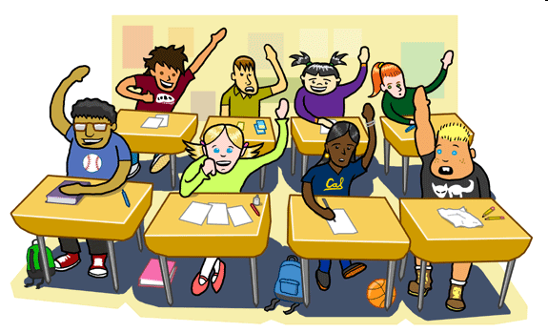
Questions?

