Slide 1
A Maximin Approach to Finding Fair Spanning Trees
A. Darmann, C. Klamler, U. Pferschy
University of Graz
COMSOC 2010, Düsseldorf
14 September 2010

Slide 2
Introduction
Graphs and spanning trees commonly used to analyse network structures
  e.g. use in connection with fair division problems such as cost-sharing
what if costs are considered of little relevance
and individual preferences are of greater importance
strengthens the link to Social Choice Theory

Slide 3
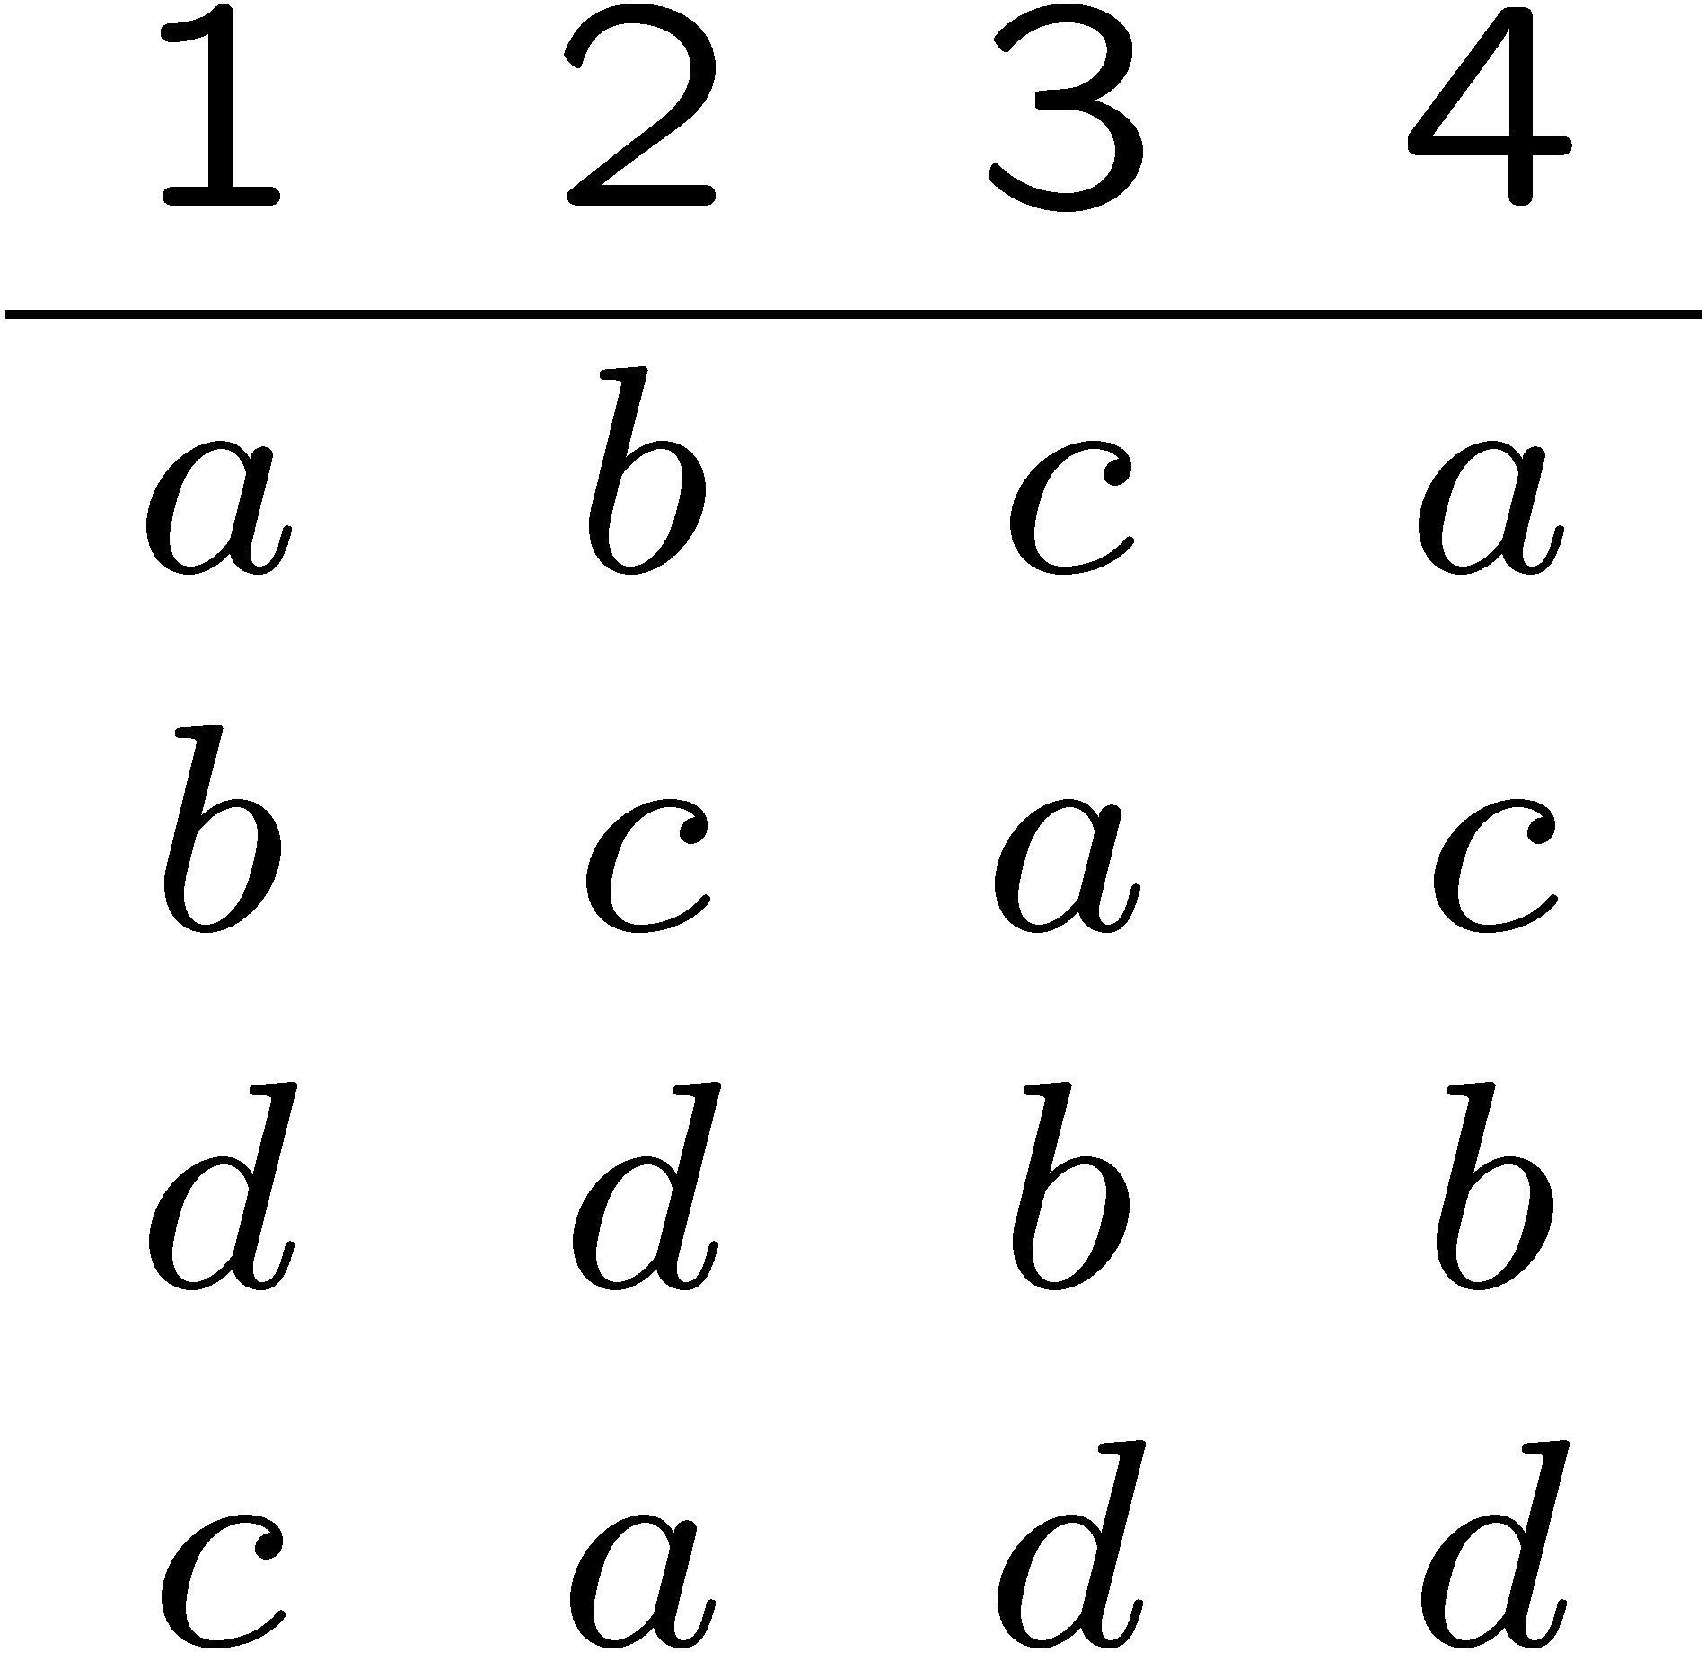
Introduction
Example
  group of homeowners has to decide on how to install a network (e.g. sewage system)
    have preferences over the links
    costs of network irrelevant
    looking for a spanning tree based on maximal voter satisfaction
c
d
a
b

Slide 4
Introduction
focus not on quality of solution (e.g. axiomatic analysis) but on computational aspects
  what is the computational complexity involved in finding optimal spanning trees based on different social choice rules
  focus on:
    Borda rule
    Approval voting
    choose-t rules, vote-against-t rules
Important distinction:
  whether number of voters are considered fixed or not

Slide 5
Literature
spanning trees and cost allocation
  Bird (1976); Bogomolnaia & Moulin (2010); Dutta & Kar (2004); Kar (2002)
maximin idea (w.r.t. robust optimization exercises)
  Aissi, Bazgan & Vanderpooten (2006); Kouvelis & Yu (1997)
fairness and social choice
  Brams & Fishburn (1983, 2002); Saari (1995); Thomson (2007); Barbera et al. (2004); Darmann et al. (2010)

Slide 6
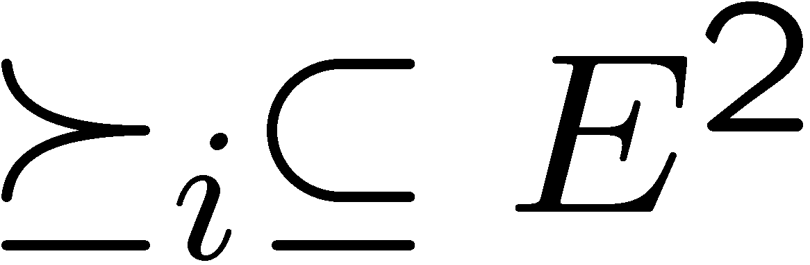
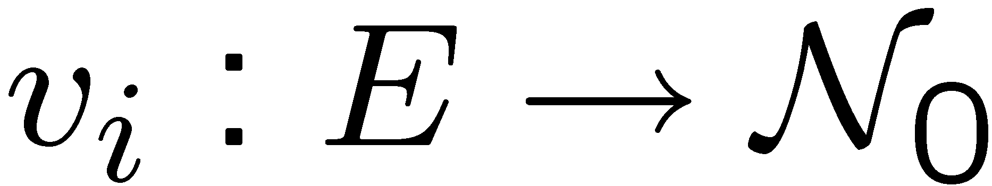
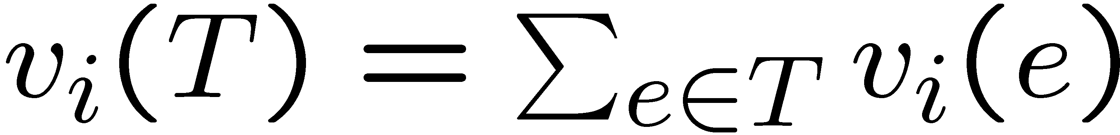
Formal Framework
graph G = (V,E)
individual preferences on E:
set of all spanning trees of G: τ
individual scoring function:
individual score of tree T is:
individual preferences on trees are additively separable
  no complementarities or synergies between edges

Slide 7
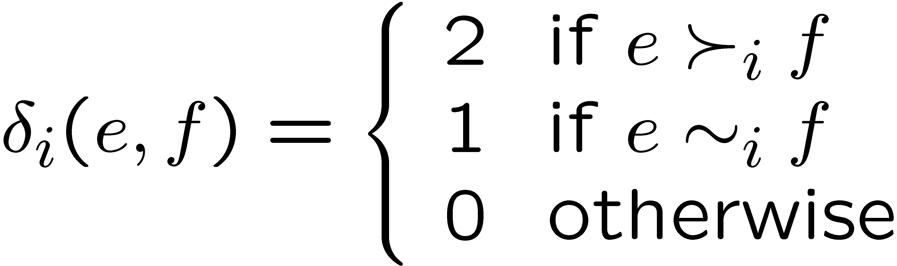
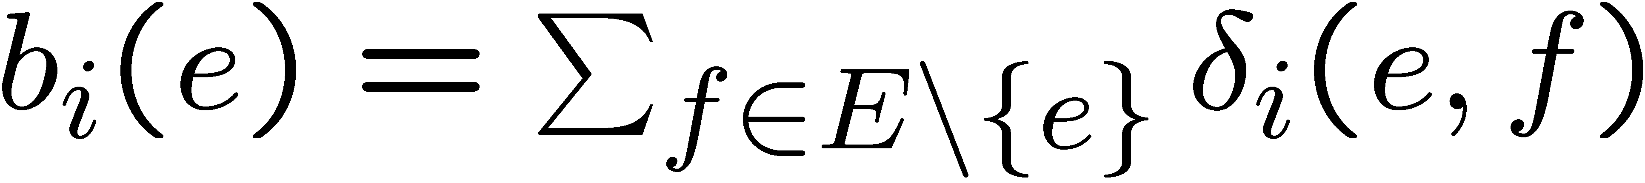
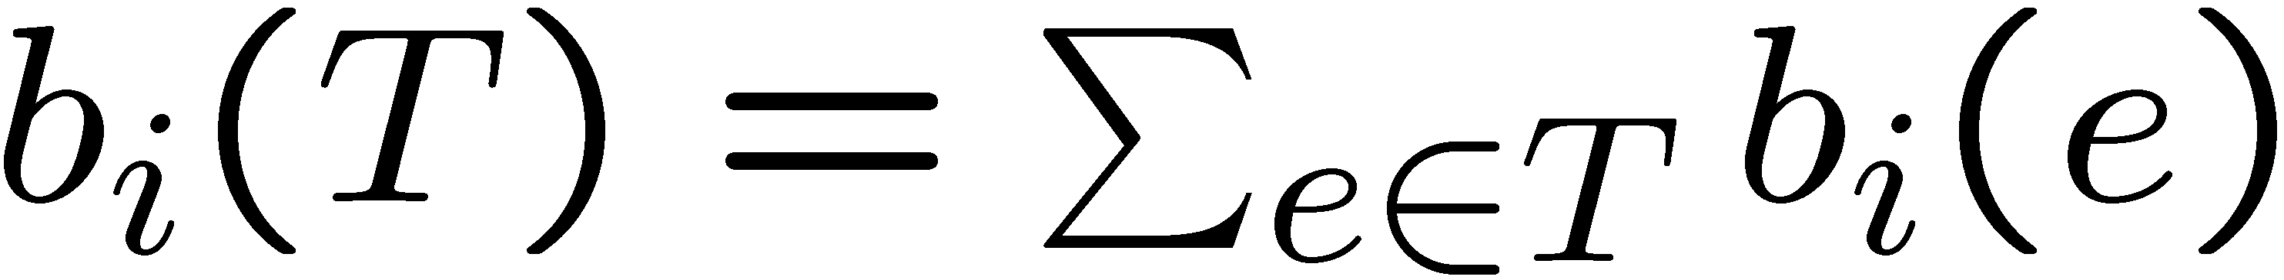
Voting Rules
Borda Rule
to get a Borda score:
Borda score for tree T:

Slide 8
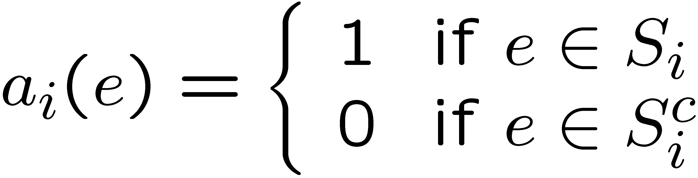
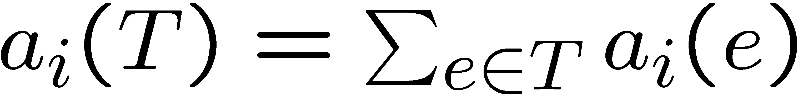
Voting Rules
Approval Voting
  approval score
  where S_{i} is i’s set of approved edges
approval score for tree T:
Choose-t elections; vote-against-t elections
  size of S_{i} is given
  e.g. plurality rule

Slide 9
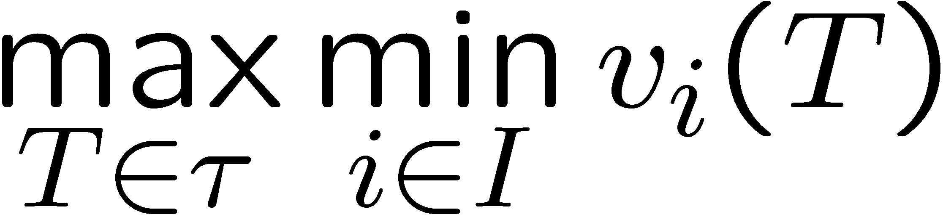
Problem Formulation
want to find the spanning tree that is as good as possible for the worst-off individual
  common way to formalize ideas of fairness
Maximin voter satisfaction problem (MMVS)
goal is to calculate the computational complexity of solving the MMVS under different types of procedures used to individually rank trees
  difference whether number of voters (k) is fixed or not

Slide 10
MMVS with k fixed
Theorem (Aissi et al. (2006)): MMVS can be solved in O(n⁴W^{k}logW) time, where W is an upper bound for the objective function value.
for n=|V| and m=|E| we get for approval voting W ≤ n and for Borda voting W ≤ 2nm. Hence:
Corollary: MMVS und AV can be solved in O(n^{4+k}log n) time and under Borda in O(n^{4+k}m^{k}log n) time.
Proposition: MMVS under plurality rule can be solved in O(mk) = O(m) time.

Slide 11
MMVS with variable k
now the number of voters is part of the input
  makes MMVS significantly harder
Kouvelis & Yu (1997): MMVS strongly NP-hard for arbitrary scoring functions
  but what happens with simpler procedures such as AV, choose-t rules, etc.

Slide 12
MMVS with variable k - RESULTS
Under Borda voting MMVS is NP-hard
Under approval voting MMVS is NP-hard
MMVS is NP-hard for any multichotomous preference profile.
Under vote-against-t or choose-t elections for t ≥ 2, MMVS is NP-hard
ONLY exception:
Under plurality or antiplurality rule, MMVS can be solved in O(mk) time.

Slide 13
Conclusion and Outlook
provided insight into the computational complexity w.r.t. the MMVS problem under various different ways to individually rank spanning trees
connection between Social Choice Theory and Discrete Optimization
look for a fair division of costs of a spanning tree based on individual preferences
use other structures such as shortest path, knapsack problems, etc.

