Slide 1
Approximation algorithms and mechanism design for minimax approval voting
Ioannis Caragiannis
Dimitris Kalaitzis
University of Patras
Vangelis Markakis
Athens University of Economics and Business

Slide 2
Outline
Approval Voting
  The minisum and the minimax solution
Approximation algorithms for the minimax solution
  Pareto-efficiency and approximability
  An LP-based algorithm
Immunity to manipulation
  Strategy-proof and group-strategyproof algorithms and lower bounds

Slide 3
Approval voting
Multi-winner elections
Every voter selects a subset of candidates that he approves of
Used by numerous organizations (IEEE, Game Theory Society, INFORMS,…) for selecting committees
Notation:
n voters
m candidates
k: size of the committee to be elected
Votes ⇒ elements of {0,1}^{m}

Slide 4
Electing a committee from approval ballots
What is the best committee of size k = 2?
m = 5 candidates
n = 4 ballots
11001
11110
11000
00111

Slide 5
The minisum solution
Pick the committee that minimizes the sum of the Hamming distances to the voters
⇒ Pick the k candidates with the highest approval rate
11001
11110
1
2
sum = 8
max = 5
11000
0
5
11000
00111

Slide 6
Maximum Hamming distance
The preferences of some voters may be completely ignored!
11001
11110
1
2
sum = 8
max = 5
11000
0
5
11000
00111

Slide 7
The minimax solution
[Brams, Kilgour, Sanver ’07]: Pick the k candidates that minimize the maximum Hamming distance to a voter
11001
11110
3
2
sum = 10
max = 3
10100
2
3
11000
00111

Slide 8
Some difficulties…
[LeGrand, Markakis, Mehta ’07]:
Computing a minimax solution is NP-hard
Any algorithm that computes a minimax solution is manipulable
⇒ Resort to approximation algorithms

Slide 9
Some difficulties…
[LeGrand, Markakis, Mehta ’07]: dictatorial 3-approximation strategyproof algorithm
Non-dictatorial algorithms?
∃ better than 3-approximation algorithms?
∃ better than 3-approximation strategyproof algorithms?
Group-strategyproof algorithms?

Slide 10
Approximation algorithms
P_{i}: approval set of voter i
d(K, P_{i}): Hamming distance of voter i from an outcome K
Definition: An outcome K is Pareto-efficient if there is no other outcome K’ with
  d(K’, P_{i}) ≤ d(K, P_{i}) ∀ voter i
  d(K’, P_{i}) < d(K, P_{i}) for some voter i
Theorem: Any Pareto efficient algorithm has an approximation ratio of at most 3 - 2/(k+1)
Corollary: The minisum solution is a non-dictatorial (3 - 2/(k+1))-approximation.

Slide 11
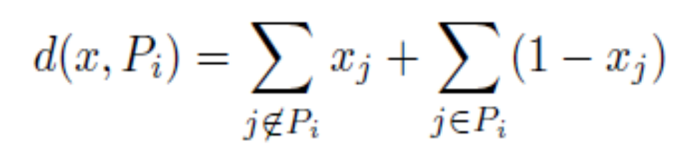
A Linear Programming approach
Integer Program:
min q
s.t. d(x, P_{i}) ≤ q ∀ voter i
∑ x_{j} = k
x_{j} ∈ {0,1}
where

Slide 12
A Linear Programming approach
Algorithm:
Relax to x_{j} ∈ [0,1]
Solve the LP
Pick the committee that corresponds to the k highest values x_{j}
Theorem:
The approximation ratio of the LP-based algorithm is 2
The integrality gap of the integer program is 2

Slide 13
Outline
Approval Voting
  The minisum and the minimax solution
Approximation algorithms for the minimax solution
  Pareto-efficiency and approximability
  An LP-based algorithm
Immunity to manipulation
  Strategy-proof and group-strategyproof algorithms and lower bounds

Slide 14
Mechanism Design (without money)
3 notions of immunity to manipulation
Strategyproof (SP): no voter can benefit by unilaterally changing his vote
Group-strategyproof (GSP): no set of voters can all benefit by changing their votes
Strongly group-strategyproof (strongly GSP): no set of voters can change their votes so that at least one of them benefits and no-one is worse off

Slide 15
SP algorithms
Upper bound: 3 – 2/(k+1)
  The minisum algorithm with proper tie breaking is strategyproof
Theorem: No strategyproof algorithm can have a ratio better than 2 for k=1, and better than 2 – 2/(k+1), for k≥2.

Slide 16


SP algorithms
Proof of lower bound for k=1
Suppose outcome is a₁ on 1st profile (same for other cases)
On 2nd profile outcome must also be a₁ by SP property
Then d(a₁, P₂) = 4
OPT = 2 (choose a₄)

Slide 17
GSP algorithms
Minisum is not GSP
The dictatorial algorithm of [LeGrand, Markakis, Mehta ’07] with appropriate tie breaking is GSP
Can also be made Pareto-efficient ⇒ (3 – 2/(k+1))-approximation
Known lower bound: same as for SP

Slide 18
Strongly GSP algorithms
Theorem: If a mechanism is strongly GSP, its ratio is either 3 – 2/(k+1) or ∞
Follows by:
Lemma 1: A strongly GSP algorithm with finite ratio is Pareto-efficient
  If not, ∃ better outcome K’
  Suppose everyone changes vote to K’
  Finite ratio ⇒ new output is K’
Lemma 2: Any strongly GSP algorithm has ratio at least 3 – 2/(k+1)

Slide 19
Conclusions
 | Lower Bound | Upper Bound
Approx. ratio | NP-hard | 2
SP | 2 – 2/(k+1) | 3 – 2/(k+1)
GSP | 2 – 2/(k+1) | 3 – 2/(k+1)
Strongly GSP | 3 – 2/(k+1) | ∞

Slide 20
Future work
What is the best approximation ratio achievable in polynomial time? ∃ PTAS?
  ∃ PTAS for unrestricted version (no constraints on size of committee)
Characterization of (group) strategyproof algorithms
Investigate weighted version of minimax [Brams, Kilgour & Sanver, ’07]
Other concepts in Approval Voting
  [Brams, Kilgour ’10]: Satisfaction Approval Voting (SAV): Pick committee that maximizes the sum of satisfaction scores of the voters
Thank you!

