Slide 1
Socially desirable approximations for Dodgson’s voting rule
Ioannis Caragiannis (University of Patras)
Christos Kaklamanis (University of Patras)
Nikos Karanikolas (University of Patras)
Ariel D. Procaccia (Harvard University)

Slide 2
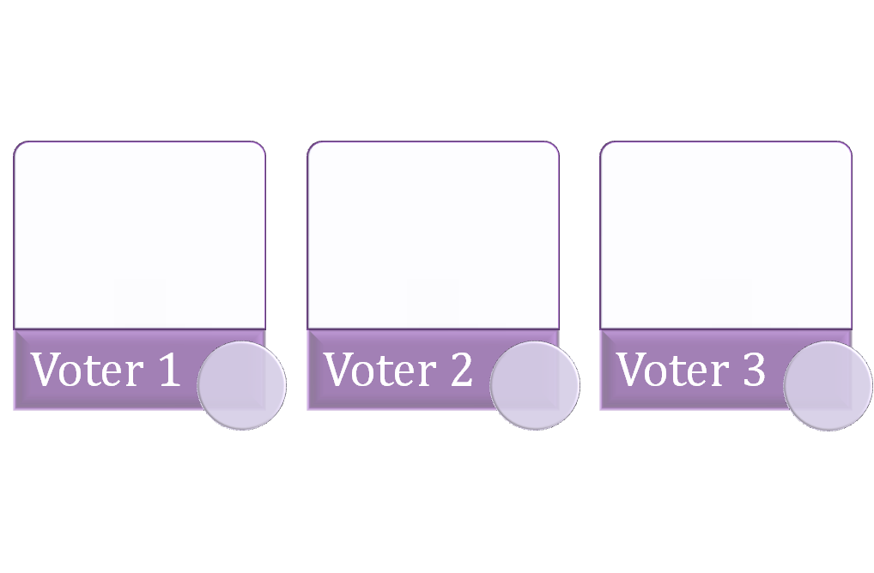






Voting
n voters
m candidates or alternatives
n >>> m
Voters rank the alternatives
Preference profile: a vector of rankings
Voting rule: a mapping of each preference profile to a winner, or a set of winners, or a ranking
a
a
b
b
c
a
c
b
c

Slide 3
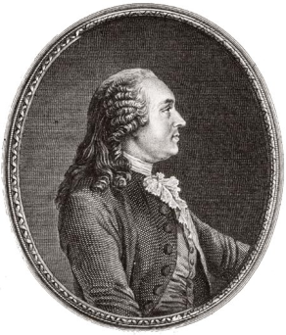
Condorcet criterion
Alternative x beats y in a pairwise election if the majority of voters prefers x to y
Alternative x is a Condorcet winner if x beats any other alternative in a pairwise election
Condorcet paradox: A Condorcet winner may not exist
a
c
b
b
a
c
c
b
a

Slide 4
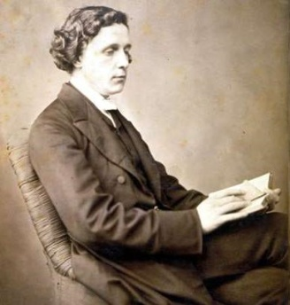
Dodgson’s voting rule
Choose an alternative as close as possible to being a Condorcet winner according to some proximity measure
Dodgson score of x: sc_{D}(x,R)
  the minimum number of exchanges between adjacent alternatives needed to make x a Condorcet winner
  alternatively: the total number of positions the voters push x

Slide 5
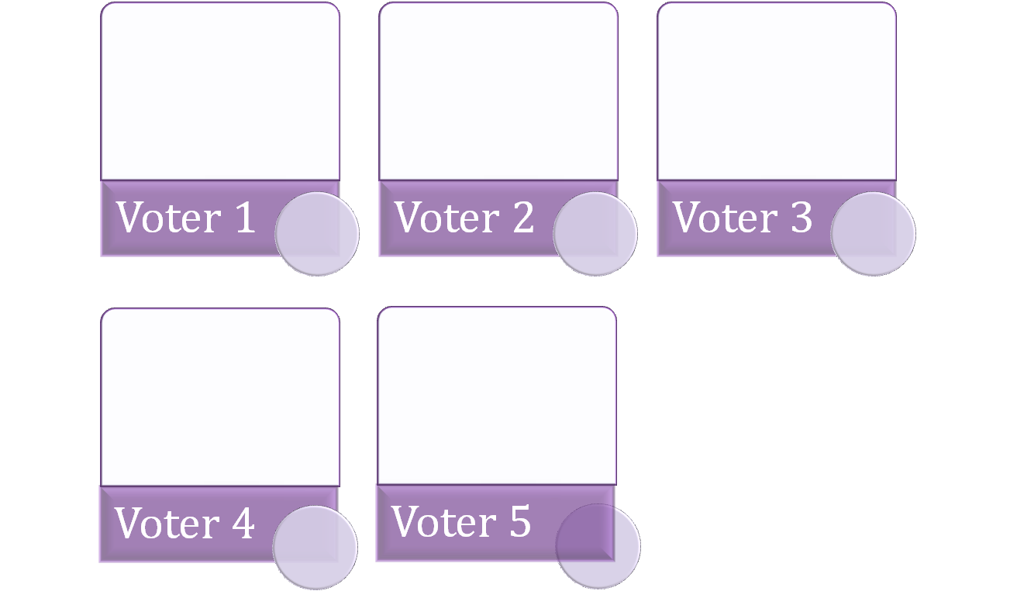







Dodgson’s voting rule
b
b
d
d
c
e
e
x
c
x
e
x
c
d
b
e
e
d
x
def (x,b,R) = 1
def (x,c,R) = 0
def (x,d,R) = 1
def (x,e,R) = 2
sc_{D}(x,R) = 4
b
c
x
b
c
d

Slide 6
Dodgson’s voting rule
Choose an alternative as close as possible to being a Condorcet winner according to some proximity measure
Dodgson score of x: sc_{D}(x,R)
  the minimum number of exchanges between adjacent alternatives needed to make x a Condorcet winner
  alternatively: the total number of positions the voters push x
Dodgson ranking:
  ranking of the alternatives in non-decreasing order of their Dodgson score
Dodgson winner:
  an alternative with the minimum Dodgson score

Slide 7
Related combinatorial problems
Dodgson score (decision version):
  Given a preference profile R, a particular alternative x, and an integer K, is the Dodgson score of x at most K? I.e., sc_{D}(x,R) ≤ K?
Dodgson score (optimization version):
  Given a preference profile and a particular alternative x, what is the Dodgson score of x?
Dodgson winner:
  Given a preference profile and a particular alternative x, is x a Dodgson winner?
Hard problems:
  Bartholdi, Tovey, and Trick (Social Choice & Welfare, 1989)
  Hemaspaandra, Hemaspaandra, and Rothe (J. ACM, 1997)

Slide 8
Approximation algorithms
Approximation algorithms compute approximate Dodgson scores
An algorithm V is a Dodgson approximation with approximation ratio ρ if given a preference profile R and a particular alternative x, computes a score sc_{V}(x,R) for x such that
  sc_{D}(x,R) ≤ sc_{V}(x,R) ≤ ρ sc_{D}(x,R)
There exist polynomial-time Dodgson approximations with approx. ratio at most H_{m-1} ≤ 1+lnm
  A greedy combinatorial algorithm
  An algorithm based on linear programming
Hard to approximate the Dodgson score within a factor better than (1/2-ε)lnm
  C., Covey, Feldman, Homan, Kaklamanis, Karanikolas, Procaccia, Rosenschein (SODA 09)

Slide 9
Approximation algorithms as voting rules
Dodgson approximations are new voting rules
  Simply rank the alternatives according to their score
How good are they as voting rules?
  Any Dodgson approximation with finite approx. ratio is Condorcet consistent
  What about other social choice properties?

Slide 10
Compare to Dodgson
The Dodgson rule satisfies
  Condorcet consistency (by definition)
but not
  Monotonicity
  Homogeneity
  Combinativity
  Smith consistency
  Mutual majority consistency
  Invariant loss consistency
  Independence of clones
Fishburn (SIDMA 77), Tideman (2006), Brandt (Math. Logic Q. 09)

Slide 11
The main question
What is the best possible approx. ratio of Dodgson approximations that satisfy
  Monotonicity?
  Homogeneity?
  Combinativity?
  Smith consistency?
  Mutual majority consistency?
  Invariant loss consistency?
  Independence of clones?
In other words, how far is Dodgson’s voting rule from these properties?

Slide 12
Overview of results
Social Choice property | Approx. ratio lower bound | Approx. ratio upper bound | Time
Monotonicity | 2 (1/2-ε)lnm | 2 2H_{m-1} | exp. poly
Homogeneity | Ω(mlnm) | O(mlnm) | poly
Combinativity Smith consistency | Ω(nm) | Trivial upper bound of O(nm)
Mutual majority consistency Invariant loss consistency Independence of clones | Ω(n)

Slide 13
Monotonicity
A voting rule is monotonic when for any profile R’ and a profile R that is obtained from R’ by pushing a single alternative x upwards in the preferences of some voters, the following holds:
  If x is a winner in R’, it is also a winner in R
x
x
R’
R

Slide 14
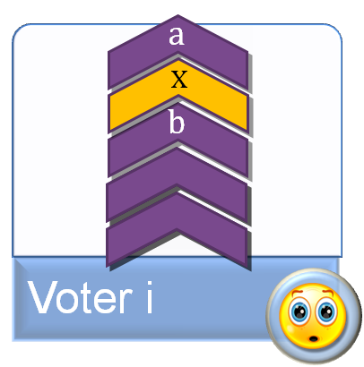
Dodgson is not monotonic (intuition)
x is the Dodgson winner and has no deficit against a
b has slightly higher Dodgson score and a deficit against a but not against x
a has a huge Dodgson score
Pushing x upwards does not affect its Dodgson score but it may decrease the Dodgson score of b

Slide 15
Monotonization
What modifications a voting rule requires in order to become monotonic?
E.g., for Dodgson:
  Construct a new voting rule by considering all profiles
  First decide which the winning set W(R) of alternatives for each profile R should be so that monotonicity is preserved
  Then adjust the scores accordingly so that the resulting rule is a Dodgson approximation (with good approx. ratio, if possible)
x
x
R’
R

Slide 16
Monotonization
A non-monotonic voting rule
x y
x
y z
x y
x z
x y
x
x y
x y
x y
x
z
y z
z
y
x

Slide 17
Monotonization
Propagate x through the blue arcs, and similarly for y and z
x y
x
x y z
x y
x z
x y
x
x y
x y
x y
x
x z
y z
x z
x y
x

Slide 18
Monotonization
A monotonic voting rule M
x y
x
x y z
x y
x z
x y z
x y
x y
x y
x y z
x
x z
y z
x y z
x y z
x

Slide 19
Monotonization
Adjust the scores in order to obtain M:
  Let Δ be the maximum Dodgson score of the alternatives in W(R)
  Set sc_{M}(x,R) = Δ for each alternative in W(R)
  Set sc_{M}(y,R) = max{Δ+1,sc_{D}(y,R)} for any other alternative

Slide 20
Upper bounds for monotonic Dodgson approximations
Monotonizing Dodgson yields a Dodgson approximation with approx. ratio 2
  Intuition: pushing an alternative upwards can decrease the Dodgson score of another alternative up to half
  Optimal approx. ratio
  Polynomial-time if m is constant
  Exponential-time in general
Monotonizing the LP-based Dodgson approximation can be done in polynomial-time
  Yields an approximation ratio of 2H_{m-1}
  Using a tool we call pessimistic estimator

Slide 21
Pessimistic estimators
Given a profile R with winning alternatives W(R) according to the LP-based Dodgson approximation, and an alternative x not in W(R)
  is there any profile R’ so that R is obtained from R’ by pushing x upwards in some voters
  so that x wins some alternative in W(R) in R’?
Our pessimistic estimators work in polynomial time by solving linear programs and are correct when answering NO
Loss of an extra factor of 2 in the approx. ratio
x
W(R)
R’
R
?

Slide 22
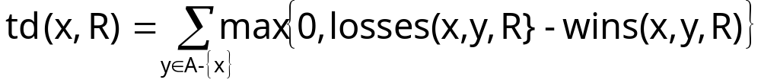
Homogeneity
A voting rule is homogeneous when for each profile R with a winning alternative x, x is also a winning alternative in any profile which is produced by replicating R
Tideman (2006)
  If there exists a Condorcet winner, then this is the winner
  Otherwise, set
  and rank the alternatives according to this score
This rule is homogeneous and monotonic
Is it a Dodgson approximation?
  At first glance: No

Slide 23
Tideman’s simplified Dodgson rule
An alternative definition
  If x is a Condorcet winner, then sc_{td}(x,R) = 0
  Otherwise sc_{td}(x,R) = m td(x,R) + mlogm
The alternative definition of Tideman’s simplified voting rule yields a Dodgson approximation with approx. ratio O(mlogm)

Slide 24
Are there better homogeneous Dodgson approximations?
No! Any homogeneous Dodgson approximation has approx. ratio Ω(mlogm)
Proof idea: Construction of a profile so that
  An alternative x is tied against Ω(m) other alternatives and has Dodgson score Θ(mlogm)
  Another alternative y has deficit 2 against some alternative and Dodgson score 2
  By duplicating the profile, the Dodgson score of x stays Θ(mlogm) but the Dodgson score of y pumps up
  Still, due to homogeneity, the winner in the original profile should be a winner in the duplicated one

Slide 25
Social Choice and Computational Complexity
Besides statements about the efficiency of computation, what other feedback can CCT give to SCT?
  Are there approximation algorithms for a given voting rule that can be used as alternative voting rules with desirable social choice properties?
  How far from a desirable social choice property is a given voting rule?

Slide 26
Open problems
What about approximations of other voting rules?
Different notions of approximation (additive, differential, approximation of rankings, etc.)
Approximability of a voting rule by known rules that have good social choice properties (e.g., Copeland, Maximin)

