Slide 1

Where are the hard manipulation problems?
Toby Walsh
NICTA and UNSW
Sydney
Australia
LogICCC Day, COMSOC 2010

Slide 2
Meta-message (especially if your not interested in manipulation)
NP-hardness is only worst case
There is a successful methodology to study such issues
  E.g. Finding a manipulation of STV,
Computing winner of Dodgson rule,
Finding tournament equilibrium set,
Computing winner of a combinatorial auction,
Finding a mixed strategy Nash equilibrium,
Allocating indivisible goods efficiently and without envy, ...
Not limited to NP-completeness
  E.g. computing safety of agenda in judgement aggregation

Slide 3


Manipulation
Under modest assumptions, all voting rules are manipulable
  Agents may get a better result by declaring untrue preferences
  Gibbard-Sattertwhaite theorem
Hard to see how to avoid assumptions
  Election has 3 or more candidates

Slide 4
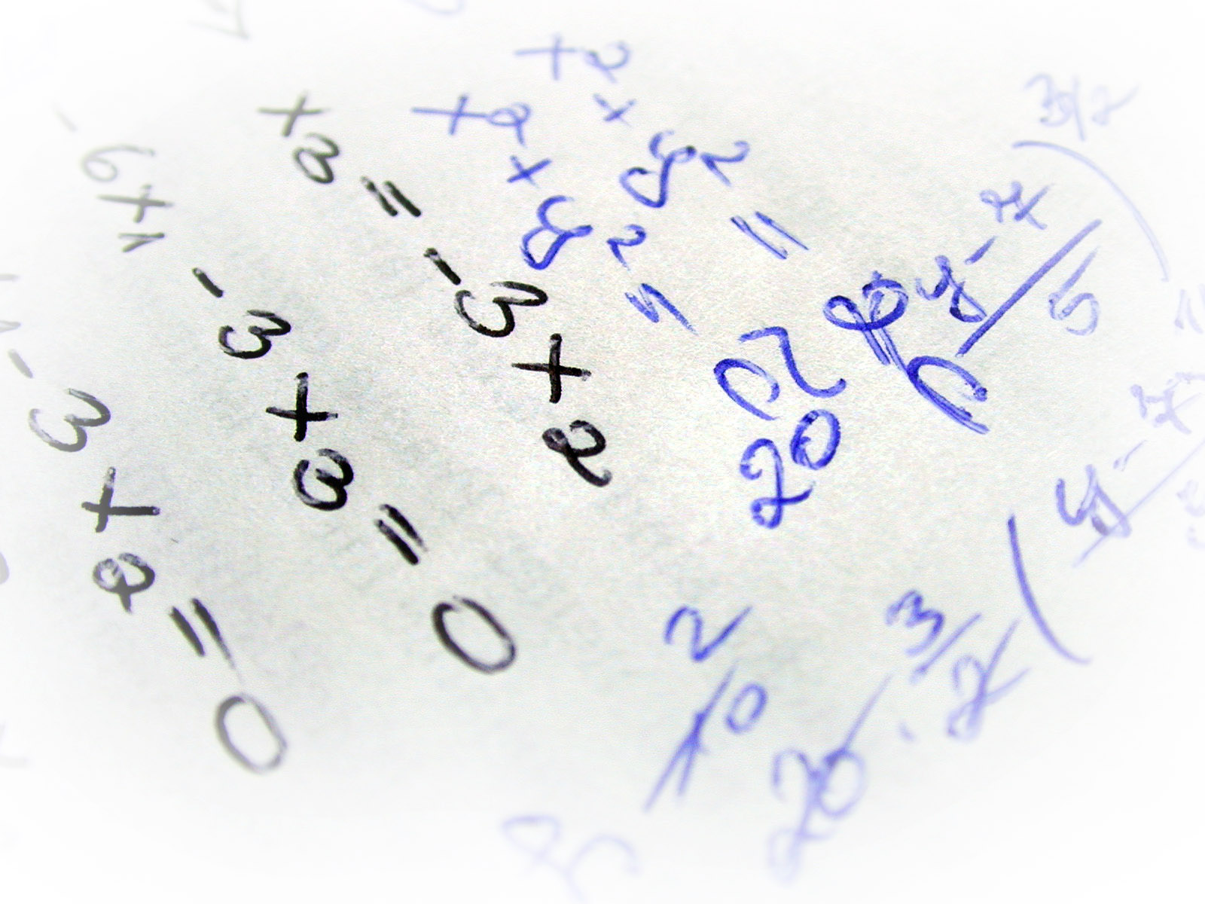
Escaping Gibbard-Sattertwhaite
Complexity may be a barrier to manipulation?
  Some voting rules (like STV) are NP-hard to manipulate
[Bartholdi, Tovey & Trick 89, Bartholdi & Orlin 91]

Slide 5
Escaping Gibbard-Sattertwhaite
Complexity may be a barrier to manipulation?
  Some voting rules (like STV) are NP-hard to manipulate
Two settings:
Unweighted votes, unbounded number of candidates
Weighted votes, small number of candidates (cf uncertainty)

Slide 6

Complexity as a friend?
  NP-hardness is only worst case
  Manipulation might be easy in practice

Slide 7
Is manipulation easy?
[Procaccia and Rosenschein 2007]
  For many scoring rules, wide variety of distribution of votes
    Coalition = o(√n), prob(manipulation)↦0
    Coalition = ω(√n), prob(manipulation)↦1
[Xia and Conitzer 2008]
  For many voting rules (incl. scoring rules, STV, ..) and votes drawn i.i.d
    Coalition = O(n^{p}) for p<1/2 then prob(manipulation)↦0
    Coalition = Ω(n^{p}) for p>1/2 then prob(manipulation)↦1 using simple greedy algorithm
    Only question is when coalition = Θ(√n)

Slide 8
How can we look closer?
Theoretical tools
  Average case
  Parameterized complexity
Empirical tools
  Heuristic methods (see Tu 12.15pm, Empirical Study of Borda Manipulation)
  Phase transition (cf other NP-hard problems like SAT and TSP)

Slide 9
How can we look closer?
Theoretical tools
  Average case
  Parameterized complexity
Empirical tools
  Heuristic methods (see Tu 12.15pm, Empirical Study of Borda Manipulation)
  Phase transition (cf other NP-hard problems like SAT and TSP)

Slide 10
Where are the really hard problems?
Influential IJCAI-91 paper by Cheeseman, Kanefsky & Taylor
  857 citations on Google Scholar
“… for many NP problems one or more "order parameters" can be defined, and hard instances occur around particular critical values of these order parameters … the critical value separates overconstrained from underconstrained …”

Slide 11
Where are the really hard problems?
Influential IJCAI-91 paper by Cheeseman, Kanefsky & Taylor
  857 citations on Google Scholar
“We expect that in future computer scientists will produce "phase diagrams" for particular problem domains to aid in hard problem identification”

Slide 12
Where are the really hard problems?
AAAI-92 (one year after Cheeseman et al)
  Hard & Easy Distributions of SAT Problems, Mitchell, Selman & Levesque
  804 citations on Google Scholar

Slide 13
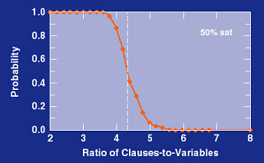
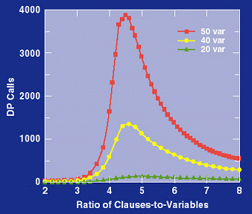
3-SAT phase transition

Slide 14
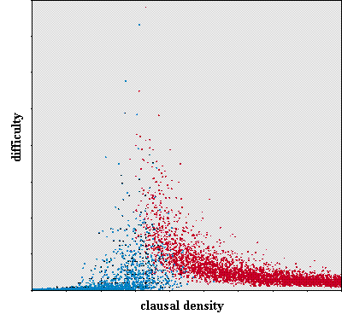
3-SAT phase transition

Slide 15
Phase transitions
Polynomial problems
  2-SAT, arc consistency, …
NP-complete problems
  SAT, COL, k-Clique, HC, TSP, number partitioning, …
Higher complexity classes
  QBF, planning, …

Slide 16
Phase transitions
Polynomial problems
  2-SAT, arc consistency, …
NP-complete problems
  SAT, COL, k-Clique, HC, TSP, number partitioning, …, voting
Higher complexity classes
  QBF, planning, …

Slide 17
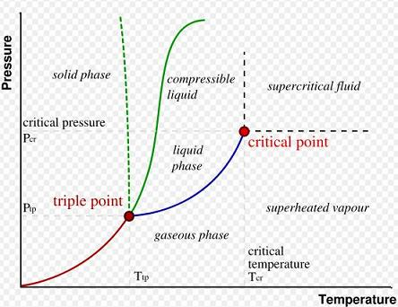
Phase transitions
Look like phase transitions in statistical physics
  Ising magnets
Similar mathematics
  Finite-size scaling
  Prob = f((X-c)*n^{k})

Slide 18
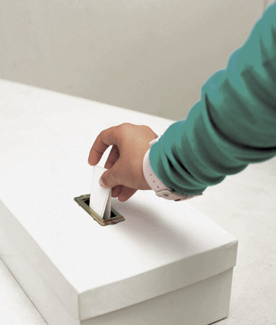
Phase transitions in voting
Unweighted votes
  Unbounded number of candidates
Weighted votes
  Bounded number of candidates
  Aside: informs probabilistic case

Slide 19
Phase transitions in voting
Unweighted votes
  STV
Weighted votes
  Veto

Slide 20
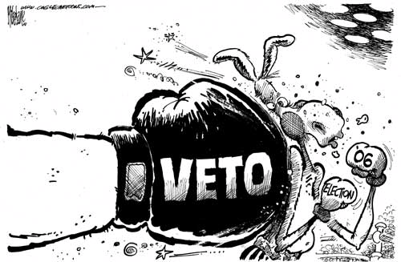
Veto rule
Simple rule to analyse
  Each agent has a veto
  Candidate receiving fewest vetoes wins
On boundary of complexity
  NP-hard to manipulate constructively with 3 or more candidates, weighted votes
  Polynomial to manipulate destructively
]

Slide 21

Manipulating veto rule
Manipulation not possible with 2 candidates
  If the coalition want A to win then veto B

Slide 22

Manipulating veto rule
Manipulation possible with 3 candidates
  Voting strategically can improve the result

Slide 23
Manipulating veto rule
Suppose
  A has 4 vetoes
  B has 2 vetoes
  C has 3 vetoes
Coalition of 5 voters
  Prefer A to B to C

Slide 24
Manipulating veto rule
Suppose
  A has 4 vetoes
  B has 2 vetoes
  C has 3 vetoes
Coalition of 5 voters
  Prefer A to B to C
  If they all veto C, then B wins

Slide 25
Manipulating veto rule
Suppose
  A has 4 vetoes
  B has 2 vetoes
  C has 3 vetoes
Coalition of 5 voters
  Prefer A to B to C
  Strategic vote is for 3 to veto B and 2 to veto C

Slide 26
Manipulating veto rule
With 3 or more candidates
Unweighted votes
  Manipulation is polynomial to compute
Weighted votes
  Destructive manipulation is polynomial
  Constructive manipulation is NP-hard (=number partitioning)

Slide 27
Uniform votes
n agents
3 candidates
manipulating coalition of size m
weights from [0,k]
Weighted form of impartial culture model

Slide 28
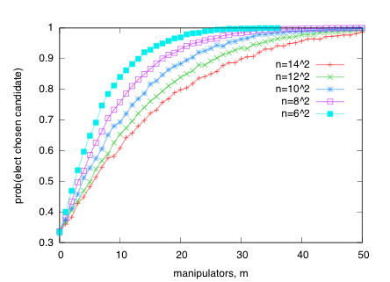
Phase transition

Slide 29
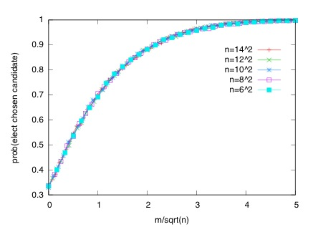
Phase transition

Slide 30
Phase transition
Prob = 1- ²/₃e^{-m/√n}

Slide 31
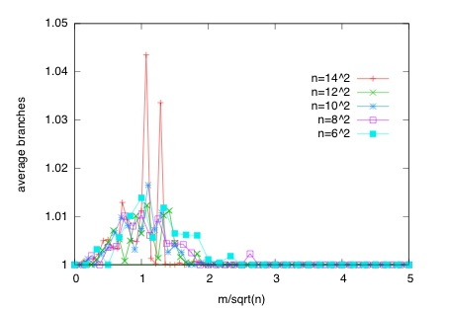
Phase transition

Slide 32
Phase transition
Similar results with other distributions of votes
  Different size weights
  Normally distributed weights
  ..

Slide 33
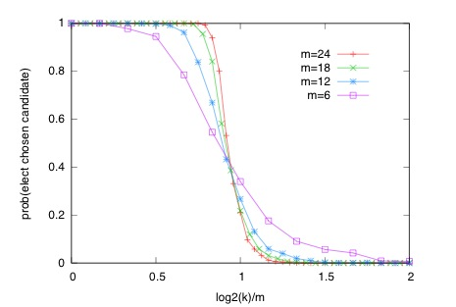
Hung elections
  n voters have vetoed one candidate
  coalition of size m has twice weight of these n voters

Slide 34
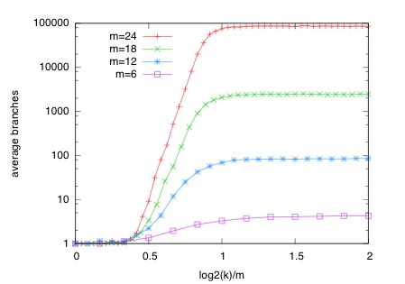
Hung elections
  n voters have vetoed one candidate
  coalition of size m has twice weight of these n voters

Slide 35
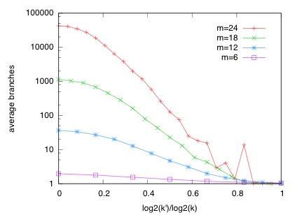
Hung elections
  n voters have vetoed one candidate
  coalition of size m has twice weight of these n voters
  But one random voter with enough weight makes it easy

Slide 36
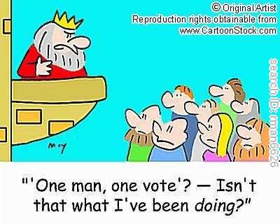
What if votes are unweighted?
STV is then one of the most difficult rules to manipulate
  One of few rules where it is NP-hard
  Even for one manipulating agent to compute a manipulation
  Multiple rounds, complex manipulations ...

Slide 37

Single Transferable Voting
Proceeds in rounds
If any candidate has a majority, they win
Otherwise eliminate candidate with fewest 1st place votes
  Transfer their votes to 2nd choices
Used by Academy Awards, American Political Science Association, IOC, UK Labour Party, ...

Slide 38
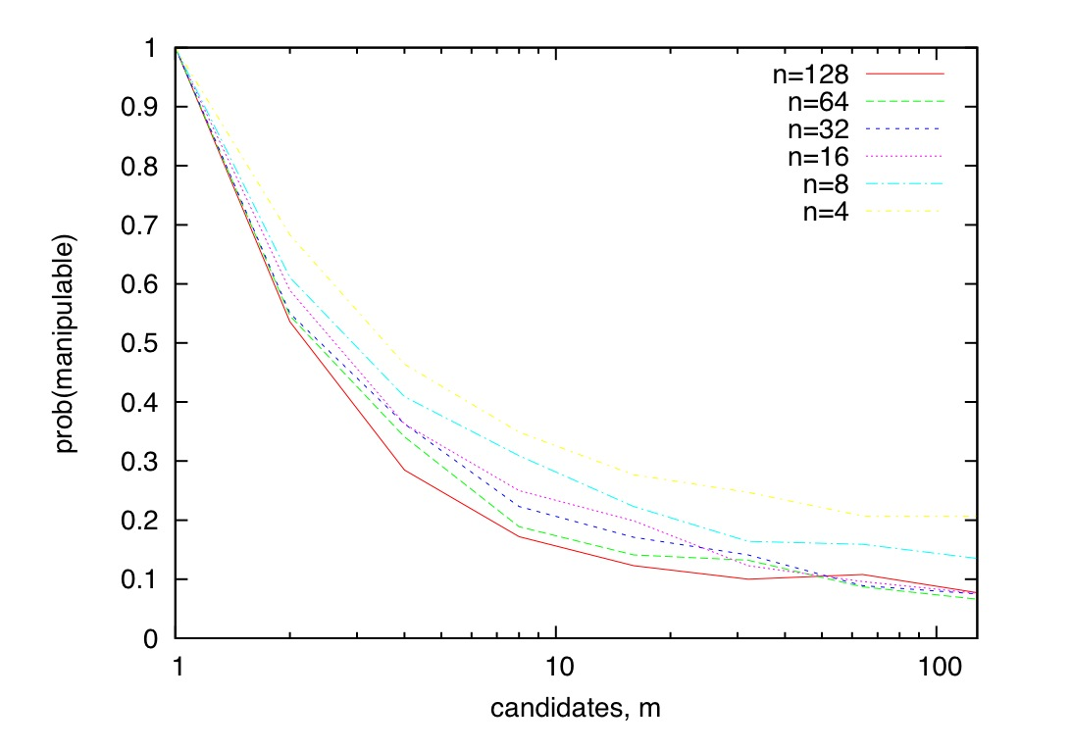
STV phase transition
Varying number of candidates

Slide 39
STV phase transition
Smooth not sharp?
  Other smooth transitions: 2-COL, 1in2-SAT, …

Slide 40
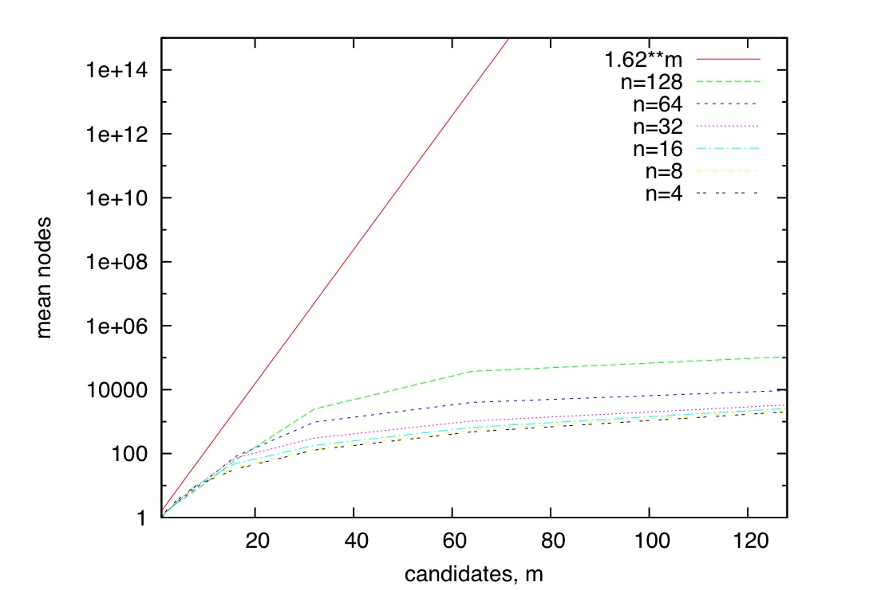
STV phase transition
Fits 1.008^{m} with coefficient of determination R²=0.95

Slide 41
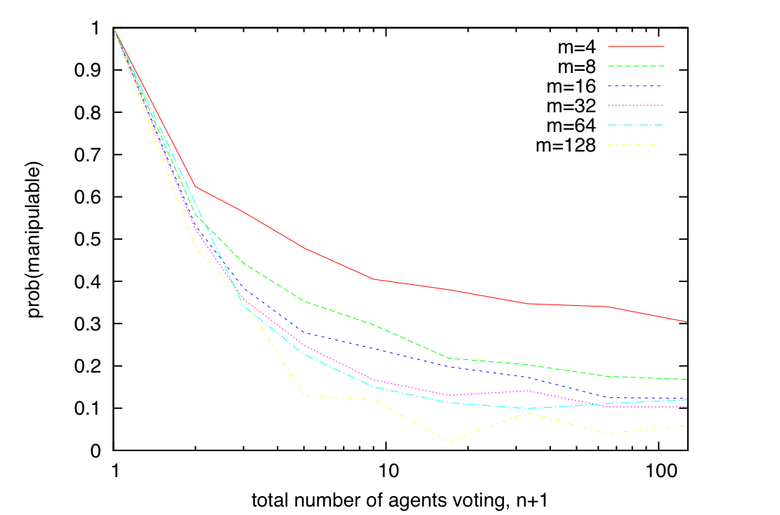
STV phase transition
Varying number of voters

Slide 42
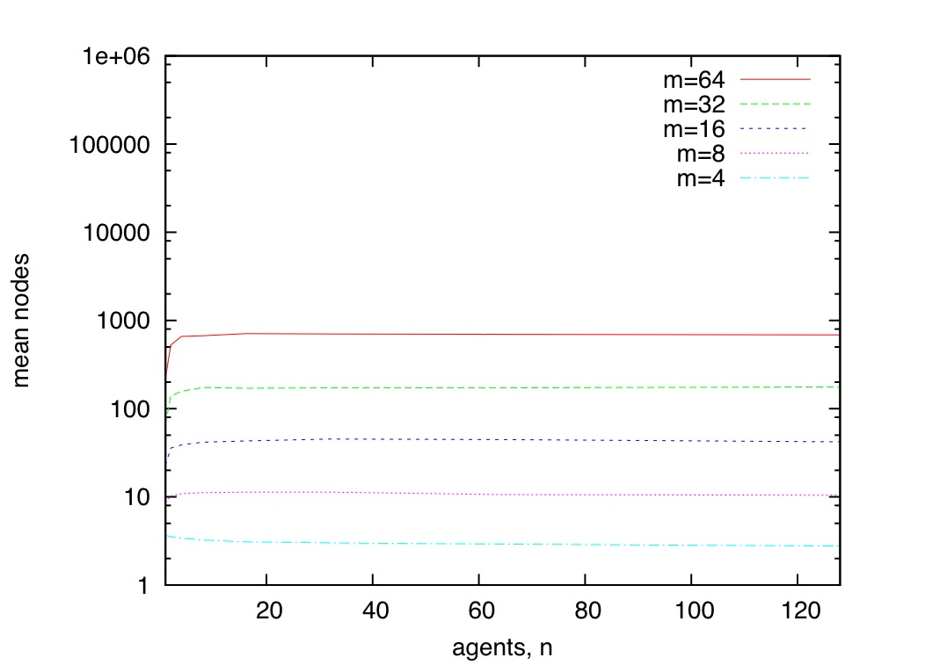

STV phase transition
Varying number of agents

Slide 43
STV phase transition
Similar results with many voting distributions
  Uniform votes (IC model)
  Single-peaked votes
  Polya-Eggenberger urn model (correlated votes)
  Real elections …

Slide 44
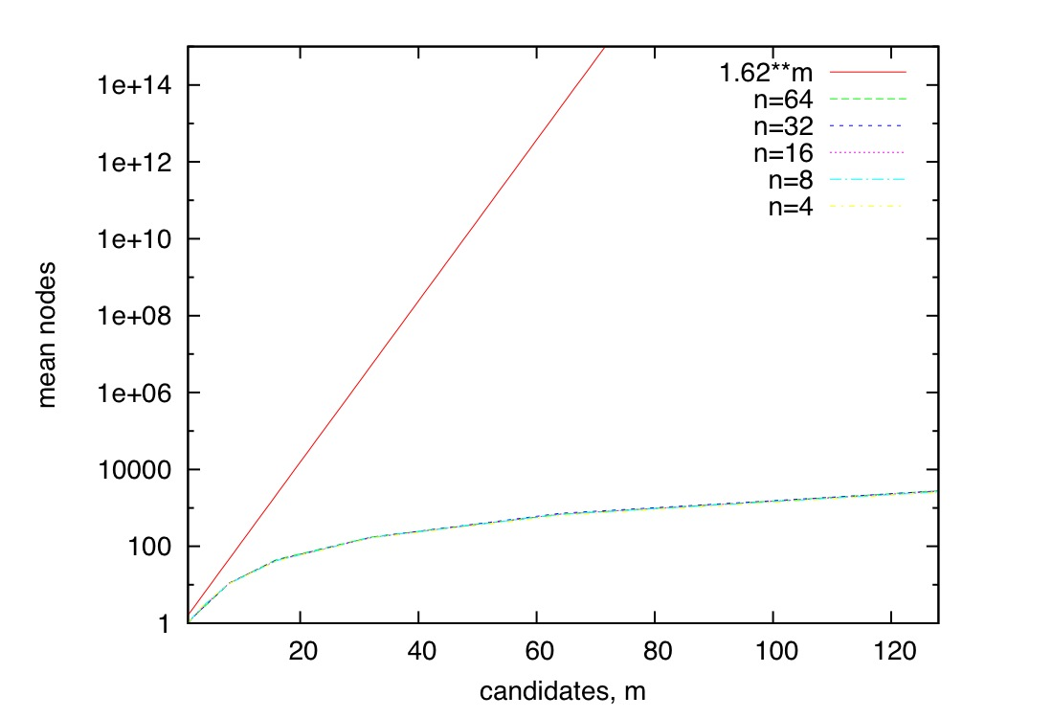
Correlated votes
Polya-Eggenberger model (50% chance 2nd vote=1st vote,..)

Slide 45

Coalition manipulation
One voter can rarely change the result
  Coalition needs to be O(√n) to manipulate result
But on a small committee
  It is possible to know other votes
  And for a small coalition to vote strategically

Slide 46
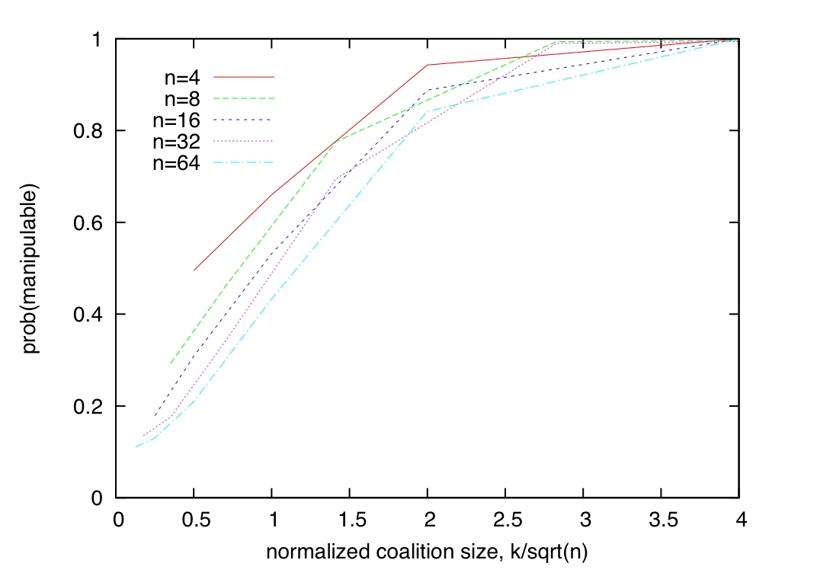
Coalitions

Slide 47
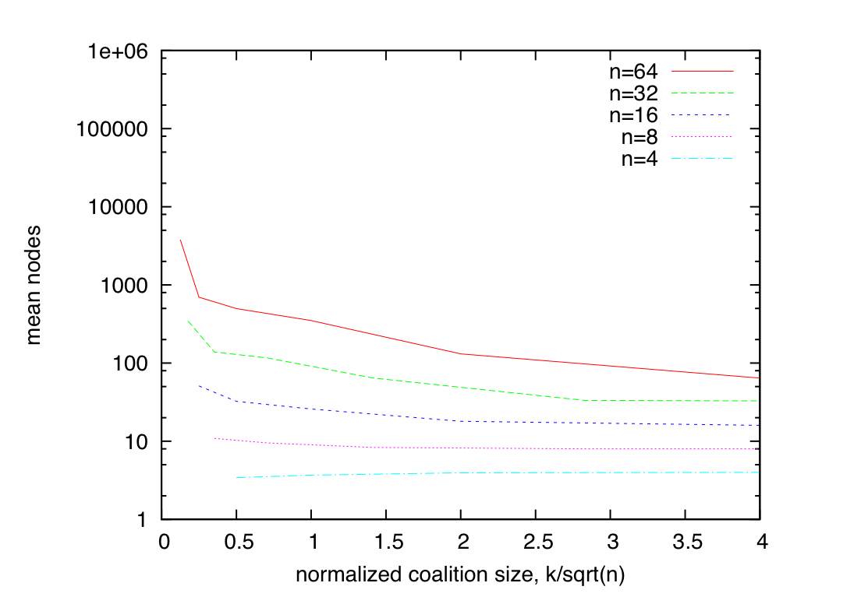
Coalitions

Slide 48
Sampling real elections
NASA Mariner space-craft experiments
  32 candidate trajectories, 10 scientific teams
UCI faculty hiring committee
  3 candidates, 10 votes

Slide 49
Sampling real elections
Fewer candidates
  Delete candidates randomly
Fewer voters
  Delete voters randomly
More candidates
  Replicate, break ties randomly
More voters
  Sample real votes with given frequency

Slide 50
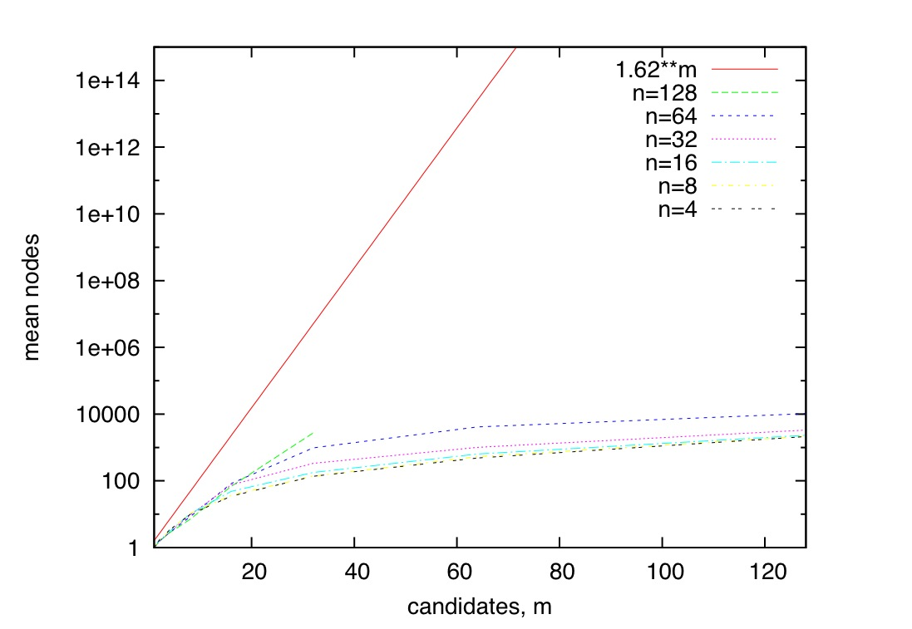
NASA phase transition

Slide 51

Plea: where is VoteLib?
Random problems can be misleading
  E.g. in random SAT, a few problems have exponential #sols
  SAT competition has non-random track
Most fields have a (real) benchmark library
  TSPLib, ORLib, CSPLib, ...

Slide 52
Conclusions
In many cases, NP hardness does not appear to be a significant barrier to manipulation!
  How else might we escape Gibbard Sattertwhaite?
    Higher complexity classes
    Undecidability
    Incentive mechanisms (money)
    Cryptography (one way functions)
    Uncertainty (random voting methods)
    Quantum
    …

Slide 53
Conclusions
In computational social choice
  Computational complexity often only tells us about worst case
  Empirical studies of phase transition behaviour may give useful additional insight
  Could be applied to other computational problems:
voting, combinatorial auctions, judgement aggregation, fair division, Nash equilibria, ...

Slide 54
Questions?
Some links into the literature
[J. Barthodli, C. Tovey and M. Trick, The Computational Difficulty of Manipulating an Election, Social Choice and Welfare, 6(3) 1989]
J. Bartholdi & J. Orlin, Single transferable vote resists strategic voting, Social Choice and Welfare 8(4), 1991]
[V. Conitzer, T. Sandholm and J. Lang, When are Election with Few Candidates Hard to Manipulate, JACM 54(3) 2007]
[T. Walsh, Where are the really hard manipulation problems? The phase transition in manipulating the veto rule, Proc. of IJCAI 2009]
[T. Walsh, An Empirical Study of the Manipulability of Single Transferable Voting, Proc. of ECAI 2010]

Slide 55
Come to Barcelona!
IJCAI 2011
W/shop proposal: Oct 4 2010
Tutorial proposal: Oct 15 2010
Paper submission: Jan 24 2011
Conference: Jul 19-22 2011

