Slide 1
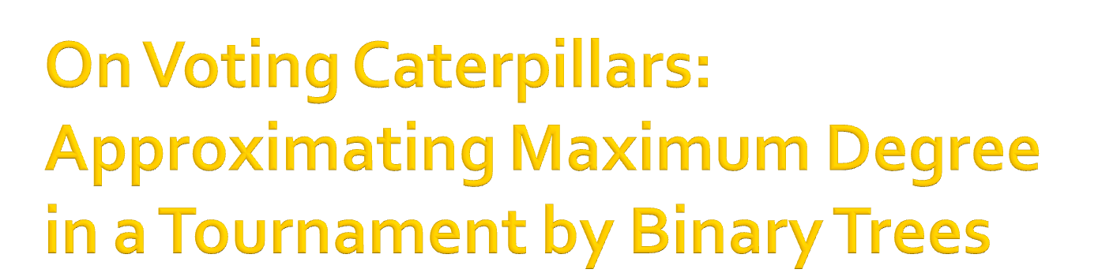
Felix Fischer, Ariel D. Procaccia and Alex Samorodnitsky

Slide 2

A = {1,...,m}: set of alternatives
A tournament is a complete and asymmetric relation T on A. T(A) set of tournaments
The Copeland score of i in T is its outdegree
Copeland Winner: max Copeland score in T
1
2
3
4
5
6

Slide 3
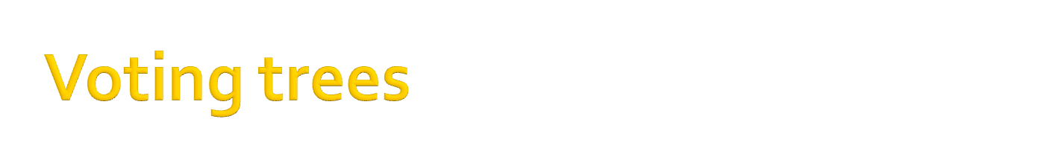




1
2
?
3
?
?
3
1
3
?
1
2

Slide 4

An alternative can appear multiple times in leaves of tree, or not appear (not surjective!)
Which functions f:T(A)→A can be implemented by voting trees? Many papers (since the 1960’s) but no characterization
[Moulin 86] Copeland cannot be implemented when m ≥ 8
[Srivastava and Trick 96] ... but can be implemented when m ≤ 7
Can Copeland be approximated by trees?

Slide 5

S_{i}(T) = Copeland score of i in T
Deterministic model: a voting tree Γ has an α-approx ratio if
∀T, (S_{Γ(T)}(T) / max_{i}S_{i}(T)) ≥ α
Randomized model:
  Randomizations over voting trees
  Dist. Δ over trees has an α-approx ratio if
  ∀T, (E_{Γ∼Δ}[S_{Γ(T)}(T)] / max_{i}S_{i}(T)) ≥ α
  Randomization is admissible if its support contains only surjective trees

Slide 6

Theorem. No deterministic tree can achieve approx ratio better than 3/4 + O(1/m)
Can we do very well in the randomized model?
Theorem. No randomization over trees can achieve approx ratio better than 5/6 + O(1/m)

Slide 7

Main theorem. ∃ admissible randomization over voting trees of polynomial size with an approximation ratio of ½-O(1/m)
Important to keep the trees small from CS point of view

Slide 8








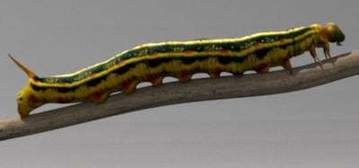
1-Caterpillar is a singleton tree
k-Caterpillar is a binary tree where left child of root is (k-1)-caterpillar, and right child is a leaf
Voting k-caterpillar is a k-caterpillar whose leaves are labeled by A
?
?
?
1
?
5
?
4
3
2
4

Slide 9

k-RSC: uniform distribution over surjective voting k-caterpillars
Main theorem reformulated. k-RSC with k=poly(m) has approx ratio of ½-O(1/m)
Sketchiest proof ever:
  k-RSC close to k-RC
  k-RC identical to k steps of Markov chain
  k = poly(m) steps of chain close to stationary dist. of chain (rapid mixing, via spectral gap + conductance)
  Stationary distribution of chain gives ½-approx of Copeland

Slide 10
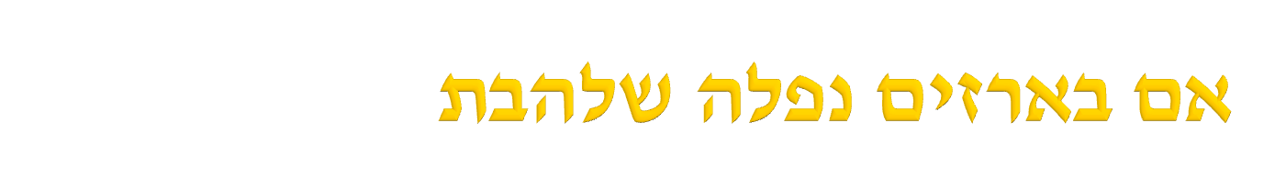




Permutation trees give Θ(log(m)/m)-approx
Huge randomized balanced trees intuitively do very well
“Theorem”. Arbitrarily large random balanced voting trees give an approx ratio of at most O(1/m)
5
7
2
1
3
4
8
6
9

Slide 11

Paper contains many additional results
Randomized model: gap between LB of ½ (admissible, small) and UB of 5/6 (even inadmissible and large)
Deterministic: enigmatic gap between LB of Θ(logm/m) and UB of ¾

