Slide 1
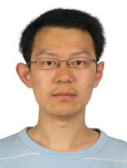





Complexity of unweighted coalitional manipulation under some common voting rules
Lirong Xia
Vincent Conitzer
Ariel D. Procaccia
Jeff S. Rosenschein
COMSOC08, Sep. 3-5, 2008
TexPoint fonts used in EMF.
Read the TexPoint manual before you delete this box.: AAA

Slide 2
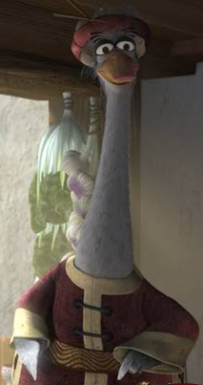
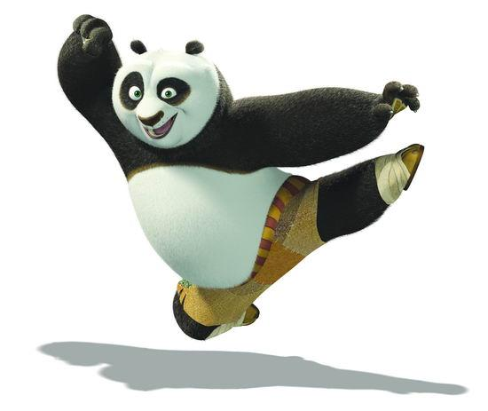
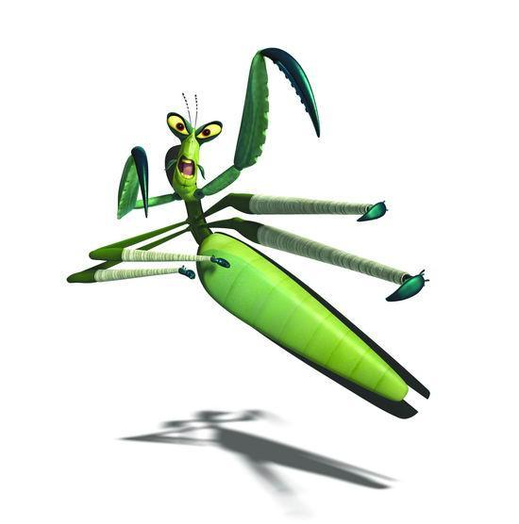

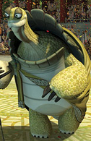
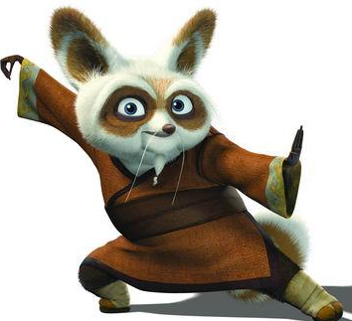
Voting
> >
A voting rule determines winner based on votes
> >
> >

Slide 3
Manipulation
Manipulation: a voter (manipulator) casts a vote that is not her true preference, to make herself better off.
A voting rule is strategy-proof if there is never a (beneficial) manipulation under this rule

Slide 4
Manipulation under plurality rule (ties are broken in favor of )
>
>
> >
Plurality rule
> >
> >

Slide 5
Gibbard-Satterthwaite Theorem [Gibbard 73, Satterthwaite 75]
When there are at least 3 alternatives, there is no strategy-proof voting rule that satisfies the following conditions:
  Non-imposition: every alternative wins under some profile
  Non-dictatorship: there is no voter such that we always choose that voter’s most preferred alternative

Slide 6
Computational complexity as a barrier against manipulation
Second order Copeland and STV are NP-hard to manipulate [Bartholdi et al. 89, Bartholdi & Orlin 91]
Many hybrids of voting rules are NP-hard to manipulate [Conitzer & Sandholm 03, Elkind and Lipmaa 05]
Many common voting rules are hard to manipulate for weighted coalitional manipulation [Conitzer et al. 07]
All of these are worst-case results: it could be that most instances are easy to manipulate
  Some evidence that this is indeed the case [Procaccia & Rosenschein 06, Conitzer & Sandholm 06, Zuckerman et al. 08, Friedgut et al 08, Xia & Conitzer 08a, Xia & Conitzer 08b]

Slide 7
Unweighted coalitional manipulation (UCM) problem
Given
  a voting rule r
  the non-manipulators’ profile P^{NM}
  alternative c preferred by the manipulators
  number of manipulators |M|
We are asked whether or not there exists a profile P^{M} (of the manipulators) such that c is the winner of P^{NM}∪P^{M} under r
Problem is defined for unique winner and co-winner

Slide 8
Complexity results about UCM
#manipulators | 1 | constant
Copeland | P [2] | NP-hard [4]
STV | NP-hard [1] | NP-hard [1]
Veto | P [5] | P [5]
Plurality with runoff | P [5] | P [5]
Cup | P [3] | P [3]
Maximin | P [2] | NP-hard
Ranked pairs | NP-hard | NP-hard
Bucklin | P | P
Borda | P [2] | ?
[1] Bartholdi et al 89
[2] Bartholdi & Orlin 91
[3] Conitzer et al 07
[4] Faliszewski et al 08
[5] Zuckerman et al 08
Bold: this paper

Slide 9
Maximin
For any alternatives c₁≠c₂, any profile P, let D_{P}(c₁, c₂)=|{R∈P: c₁>_{R}c₂}| - |{R∈P: c₂>_{R}c₁}|
Maximin(P)=argmax_{c}{min_{c'} D_{P}(c, c')}
Theorem [McGarvey 53] For any D:{(c₁, c₂): c₁≠c₂}→N (where the values in the range have the same parity, i.e., either all odd or all even), there exists a profile P s.t. D_{P}=D

Slide 10
UCM under Maximin
NP-hard
Reduction from the vertex independent disjoint paths in directed graph problem [LaPaugh & Rivest 78]
For any G=(V,E), (u,u'), (v,v'), where V={u,u',v,v',v₁,...,v_{m-5}}, let the UCM instance be
  For any c'≠c, D_{PNM}(c,c')=-4|M|
  D_{PNM}(u,v')=D_{PNM}(v,u')=-4|M|
  For any (s,t)∈E such that D_{PNM}(t,s) is not defined above, we let D_{PNM}(t,s) =-2|M|-2
  For all the other (t,s), we let D_{PNM}(t,s)=0

Slide 11
Ranked pairs [Tideman 87]
Creates a full ranking over alternatives
In each step, we consider a pair of alternatives (c_{i},c_{j}) that has not been considered before, such that D_{P}(c_{i},c_{j}) is maximized
  if c_{i}>c_{j} is consistent with the existing order, fix it in the final ranking
  otherwise discard it
The winner is the top-ranked alternative in the final ranking

Slide 12
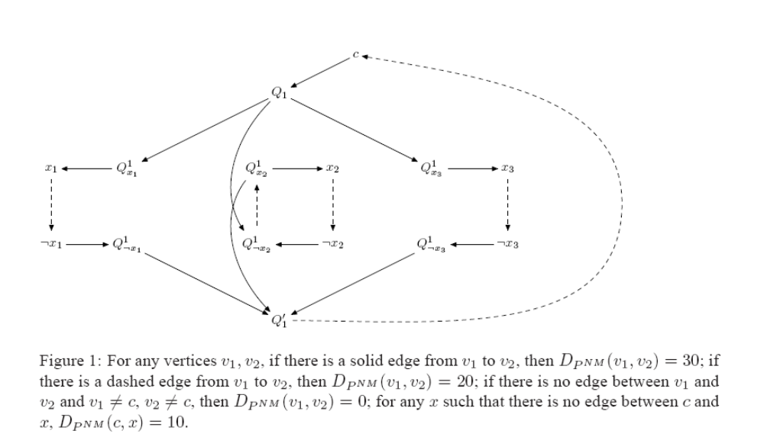
UCM under ranked pairs
Reduction from 3SAT

Slide 13
Bucklin
An alternative c is the unique Bucklin winner if and only if there exists d<m such that
  c is among top d positions in more than half of the votes
  no other alternative satisfies this condition

Slide 14
An algorithm for computing UCM under Bucklin
Find the smallest depth d such that c is among top d positions in more than half of the votes (including manipulators)
For each c'≠c, let k_{c'} denote the number of times that c' is ranked among top d in non-manipulators’ profile
  if there exists k_{c'}>(|M|+|NM|)/2, or
  ∑k_{c'}+(d-1)|M|>(m-1) floor((|M|+|NM|)/2),
  then c cannot be the unique winner
  otherwise c can be the unique winner

Slide 15
Summary
Unweighted coalitional manipulation problems
#manipulators | 1 | constant
Copeland | P [2] | NP-hard [4]
STV | NP-hard [1] | NP-hard [1]
Veto | P [5] | P [5]
Plurality with runoff | P [5] | P [5]
Cup | P [3] | P [3]
Maximin | P [2] | NP-hard
Ranked pairs | NP-hard | NP-hard
Bucklin | P | P
Borda | P [2] | ?
Thanks
[1] Bartholdi et al 89
[2] Bartholdi & Orlin 91
[3] Conitzer et al 07
[4] Faliszewski et al 08
[5] Zuckerman et al 08
Bold: this paper

