Slide 1
Welfare Properties of Argumentation-based Semantics
Kate Larson
University of Waterloo
Iyad Rahwan
British University in Dubai
University of Edinburgh

Slide 2
Introduction
Argumentation studies how arguments should progress, how to decide on outcomes, how to manage conflict between arguments
Interest in strategic behaviour in argumentation
  Requires an understanding of preferences of agents
Goals of this work
  Identify different kinds of agent preference criteria in argumentation
  Compare argumentation semantics based on their welfare properties

Slide 3
Outline
Abstract Argumentation and Acceptability Semantics
Preferences for Agents
Pareto Optimality in Acceptability Semantics
Further Refinement using Social Welfare

Slide 4


α₁: I haven’t done anything wrong!
α₂: Yes you did. You caused an accident and people got injured.
α₃: But it was the other guy’s fault for passing a red light!
α₃
α₂
α₁
Abstraction:

Slide 5
Abstract Argumentation
An abstract argumentation framework AF=<A,→>
  A is a set of arguments
  → is a defeat relation
S½A defends α if S
defeats all defeators
of α
  α is acceptable w.r.t S
α₃
α₂
α₁
α₅
α₄

Slide 6
Characteristic Function
α₃
α₂
F(S) = {α | S defends α}
α₁
α₅
α₄
S is a complete extension if S = F(S)
That is, all arguments defended by S are in S
α₃
α₂
α₁

Slide 7
Different Semantics
Grounded extension: minimal complete extension (always exists, and unique)
Preferred extension: maximal complete extension (may not be unique)
Stable extension: extension which defeats every argument outside of it (may not exist, may not be unique)
Semi-stable extension: complete extension which maximises the set of accepted arguments and those defeated by it (always exists, may not be unique)

Slide 8
Labellings
An alternative way to study argument status is via labellings.
Given an argument graph (A,→), a labelling is
L:A→ {in,out,undec} where
  L(a)=out if and only if 9 b2A such that b→a and L(b)=in
  L(a)=in if and only if 8 b2A if b→a then L(b)=out
  L(a)=undec otherwise

Slide 9
Labellings and Semantics
Semantics | Labelling, L
Complete Extension | Any legal labelling
Grounded Extension | L s.t. in(L) is minimal
Preferred Extension | L s.t. in(L) is maximal
Semi-Stable Extension | L s.t. undec(L) is minimal
Stable Extension | L s.t. undec(L)={}

Slide 10
What is the problem?
Formalisms focus on argument acceptability criteria, while ignoring the agents
Agents may have preferences
  They may care which arguments are accepted or rejected
α₁ α₃
α₃
α₂
α₁
α₂

Slide 11
Agents’ Preferences
Each agent, i, has
  a set of arguments, A_{i}
  preferences over outcomes (labellings), ≥_{i}
α₁ α₃
α₃
α₂
α₁
L2 ≥i L1,L3
L1
in={α₃, α₂}
out={α₁ }
undec={}
L2
in={α₃, α₁}
out={α₂ }
undec={}
L3
in={α₃ }
out={}
undec={α₁ α₂ }
α₂
L1 ≥i L2,L3

Slide 12
Agents’ Preferences
Acceptability maximising
  An agent prefers outcomes where more of its arguments are accepted
Rejection minimising
  An agent prefers outcomes where fewer of its arguments are rejected
Decisive
  An agent prefers outcomes where fewer of its arguments are undecided
All-or-nothing
  An agent prefers outcomes where all of its arguments are accepted (ambivalent otherwise)
Aggressive
  An agent prefers outcomes where the arguments of others are rejected

Slide 13
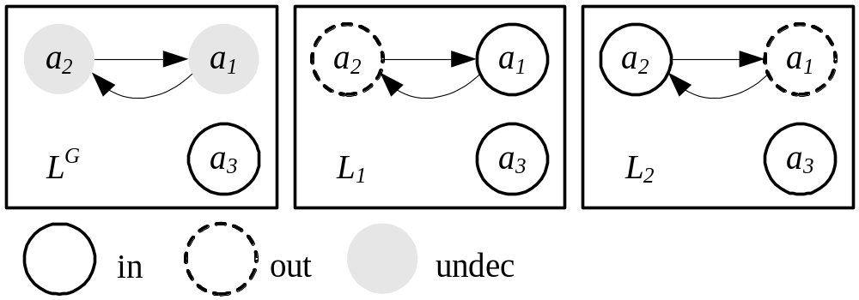
Acceptability Maximising Agents:
Grounded Extensions not always PO
A₁ = {α₁, α₃} A₂ = {α₂}
Grounded extension is L^{G}

Slide 14
Acceptability Maximising Agents
Pareto optimal outcomes are preferred extensions
  Intuition: Preferred extensions are maximal with respect to argument inclusion
Are all preferred extensions Pareto optimal (for acceptability max agents)?

Slide 15
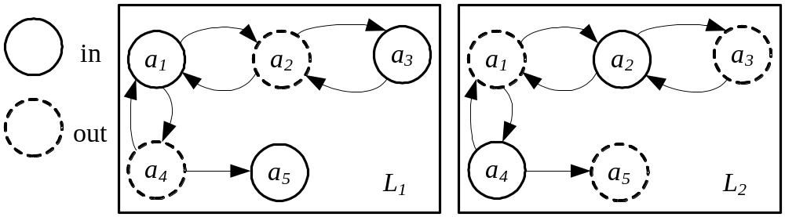
Acceptability Maximising Agents:
Preferred Extensions not always PO
Acc. Max.: A₁ = {α₃, α₄} A₂ = {α₁} A₃ = {α₂, α₅}
A₁ and A₃ are indifferent
A₂ strictly prefers L₁

Slide 16
Summary of Results
Population Type | Pareto Optimality
Acceptability maximizers | Pareto Optimal µ Preferred ext.
Rejection minimizers | Pareto Optimal = Grounded ext.
Decisive | Pareto Optimal µ Semi-stable ext.
All-or-nothing | Some preferred ext., and possibly other complete extensions
Aggressive | Pareto Optimal µ Preferred ext.

Slide 17
Restrictions on Argument Sets
If the argument sets of agents are restricted then can achieve refined characterizations
  Agents can not hold (indirect) defeating arguments
Decisive and acceptability maximising preferences
  Pareto optimal outcomes = stable extension

Slide 18
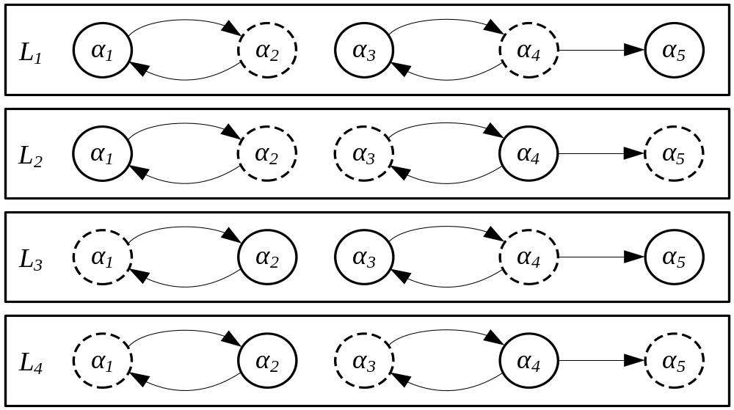
Further Refinement: Social Welfare
Acc. Max.: A₁ = {α₁, α₃, α₅} A₂ = {α₂, α₄}
Utility function: U_{i}(A_{i},L)=|A_{i}Åin(L)|
All L are PO. But L₁ and L₃ max. social welfare

Slide 19
Implications
We introduced a new criteria for comparing argumentation semantics
  More appropriate for multi-agent systems
What kind of mediator to use given certain classes of agents?
  Similar to choosing appropriate resource allocation mechanisms
Argumentation Mechanism Design: We know what kinds of social choice functions are worth implementing

