Slide 1
A Geometric Approach to Judgement Aggregation
Christian Klamler and Daniel Eckert
University of Graz
Liverpool, September 2008

Slide 2
Introduction <number>
Judgment Aggregation (JA) is concerned with the aggregation of individual judgments on logically interrelated propositions into a set of consistent group judgments (List and Puppe, 2007)
Example: Doctrinal Paradox/Discursive Dilemma (Kornhauser & Sager 1986)
p … valid contract; q … breach of contract
defendant liable iff p ∧ q
 | p | q | p ∧ q
Judge 1 | 1 | 1 | 1
Judge 2 | 1 | 0 | 0
Judge 3 | 0 | 1 | 0
Majority | 1 | 1 | 0
In general, impossibility results similar to Arrow and Sen in Social Choice Theory do arise.

Slide 3
Introduction <number>
Geometric approach introduced by Saari into social choice
Based on the mapping of a profile into a hypercube with dimension equal to the number of pairwise comparisons of alternatives.
cba
Vector of pairwise valuations:
{ab, bc, ca}
(0,1,1)
(1,1,1)
(0,0,1)
(1,0,1)
Vectors representing irrational voters are:
(1,1,1) and (0,0,0)
(0,1,0)
(1,1,0)
Representation polytope being the convex hull of all feasible vertices.
(1,0,0)
(0,0,0)
Why not use Saari’s approach for judgment aggregation?

Slide 4
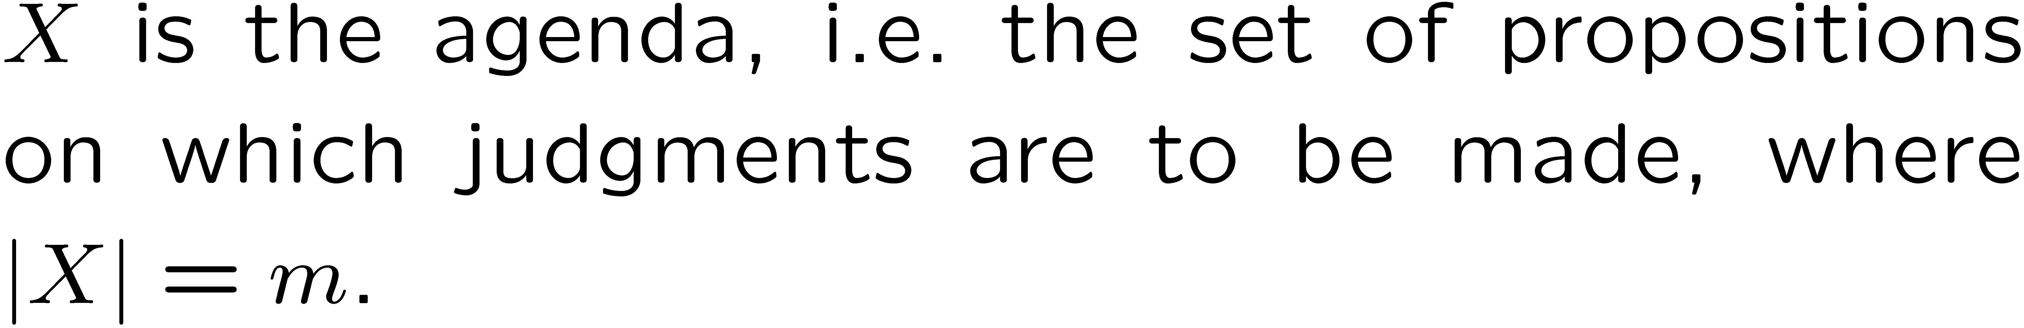
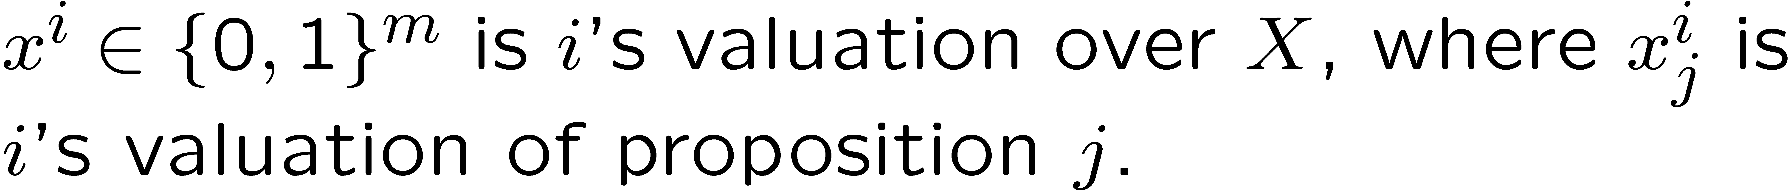
Formal Framework <number>

Slide 5
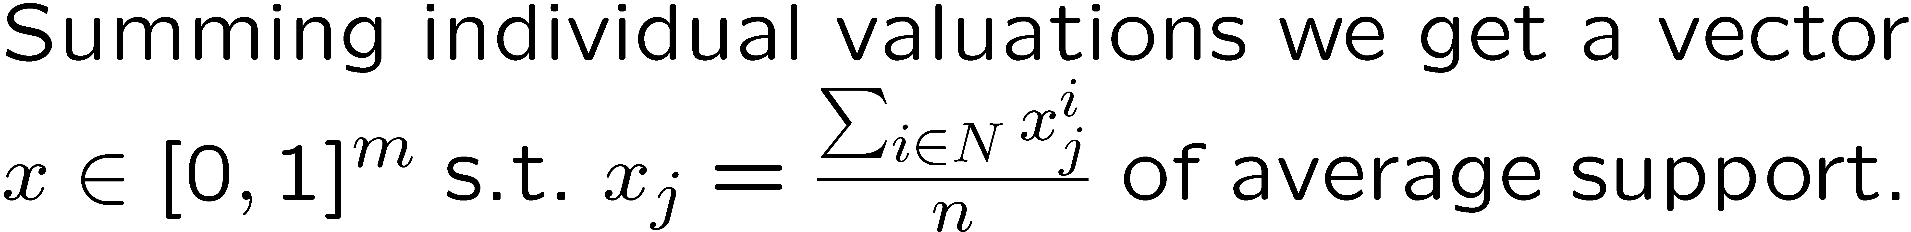
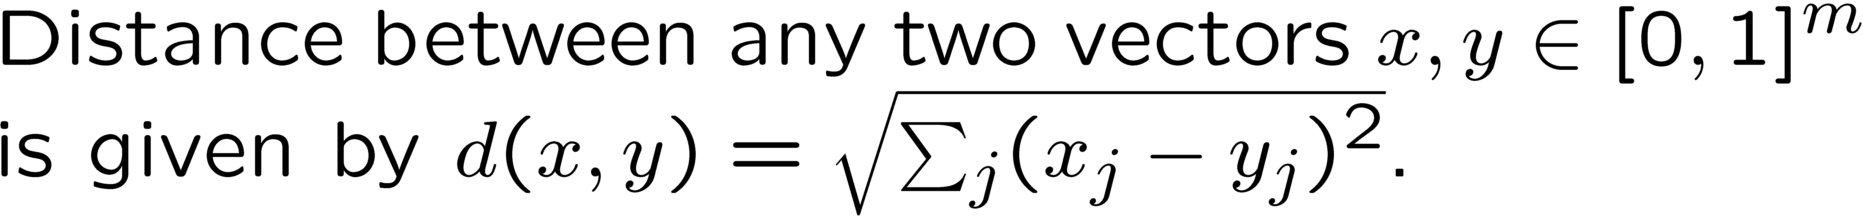
Formal Framework <number>

Slide 6
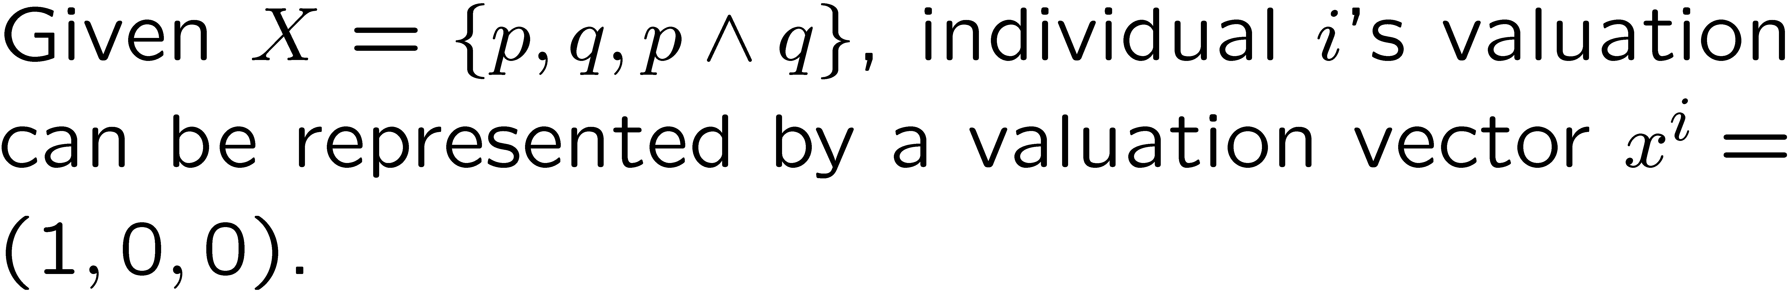
Representation Cube <number>
(0,1,1)
(1,1,1)
The 8 vertices correspond to the 8 possible valuations (of which not all may be rational).
(0,0,1)
(1,0,1)
(0,1,0)
(1,1,0)
(1,0,0)
(0,0,0)

Slide 7

Representation Cube <number>
(0,1,1)
(1,1,1)
(0,0,1)
(1,0,1)
(0,1,0)
(1,1,0)
(1,0,0)
(0,0,0)

Slide 8
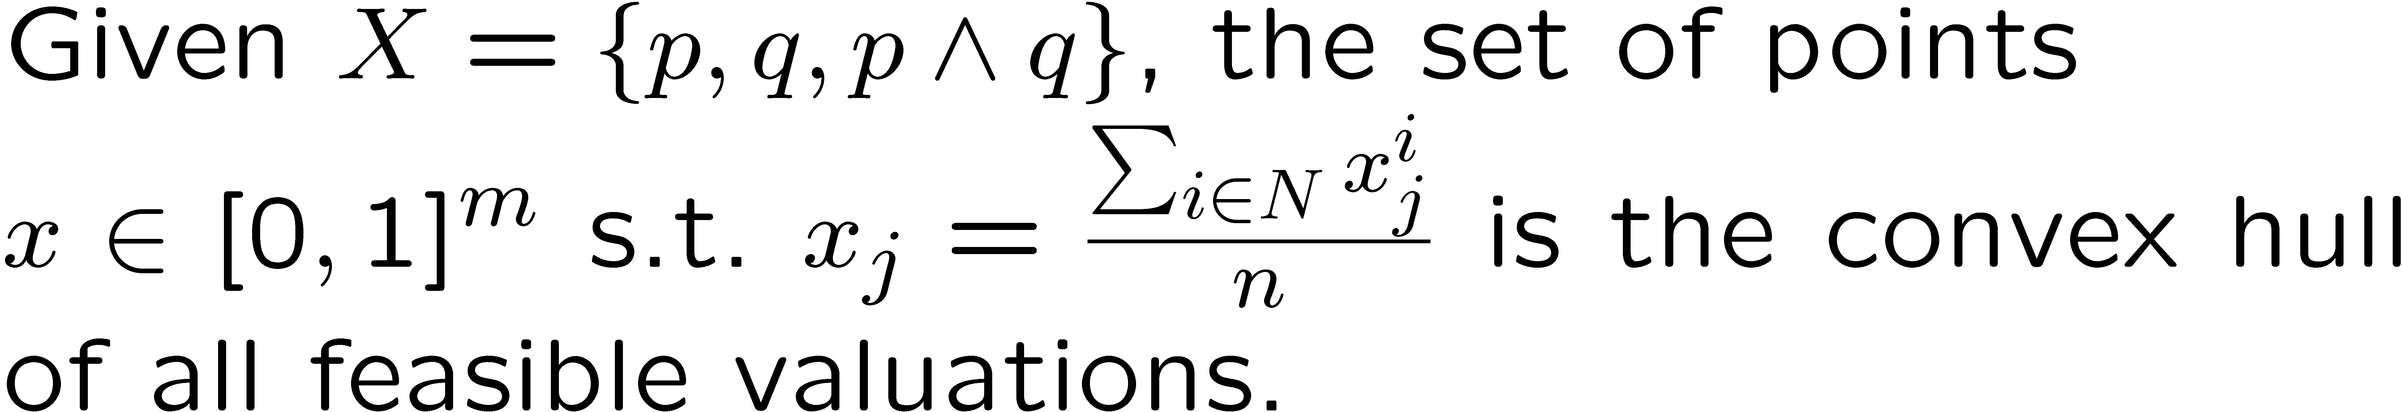
Polytope Representation of Profiles <number>
So every profile specifies a point x in the convex hull of the feasible vertices
(0,1,1)
(1,1,1)
(0,0,1)
(1,0,1)
(0,1,0)
(1,1,0)
(1,0,0)
(0,0,0)

Slide 9
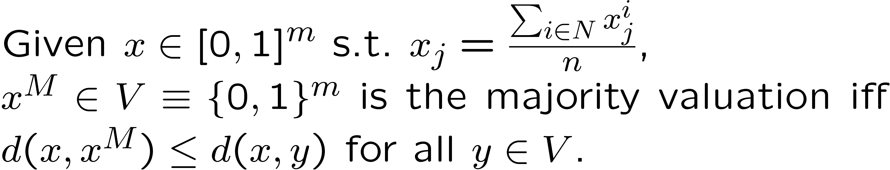
JA via simple majorities <number>
(0,1,1)
(1,1,1)
(1,0,1) – majority subcube
(0,0,1)
(1,0,1)
So its Euclidean distance from the vertex determines the majority outcome.
(0,1,0)
(1,1,0)
(1,0,0)
(0,0,0)

Slide 10
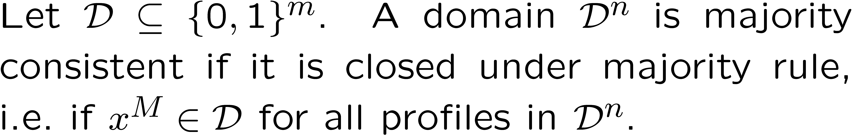
Majority (in)consistent JA

Slide 11
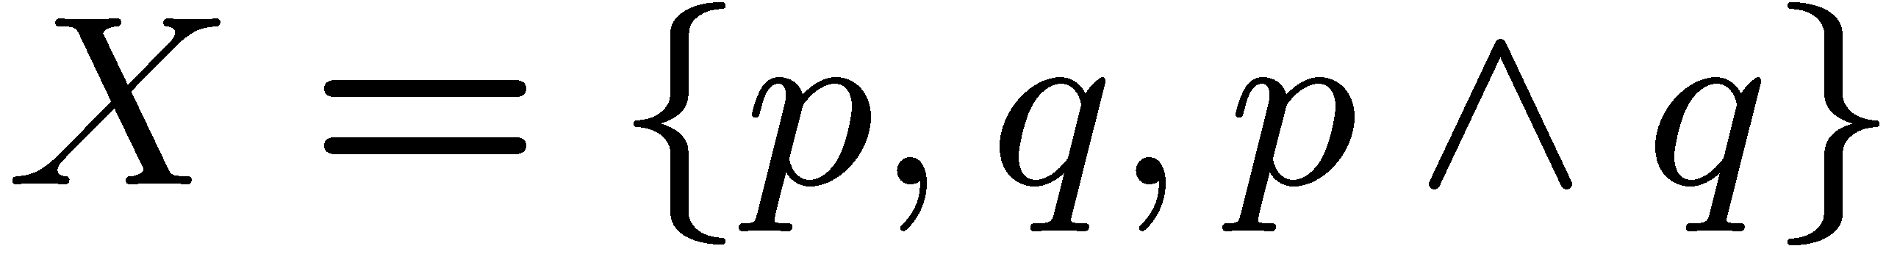
Discursive Dilemma <number>
(0,1,1)
(1,1,1)
Passes through one subcube giving an infeasible outcome, namely (1,1,0).
(0,0,1)
(1,0,1)
Happens because majority rule cannot distinguish between rational and irrational voters, e.g.:
{(0,1,0),(1,0,0),(1,1,1)} and
{(1,1,0),(1,1,0),(0,0,1)}
give the same majority outcome!
(0,1,0)
(1,1,0)
(1,0,0)
(0,0,0)

Slide 12
Identifying and evaluating majority (in)consistency in JA <number>
Consistency conditions
Inconsistency factors

Slide 13
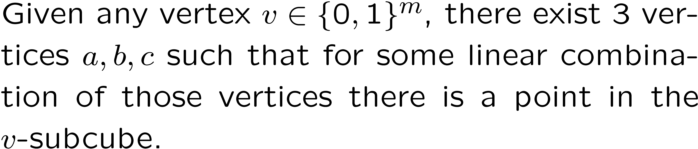
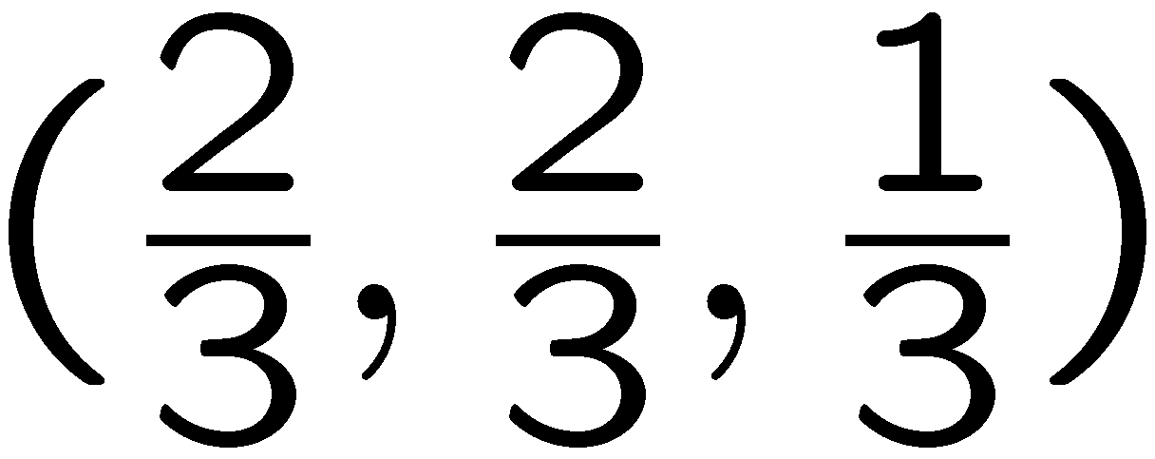
Lemma 1 <number>
(0,1,1)
(1,1,1)
passes through the (1,1,0) – subcube.
(0,0,1)
(1,0,1)
(0,1,0)
(1,1,0)
(1,0,0)
(0,0,0)

Slide 14
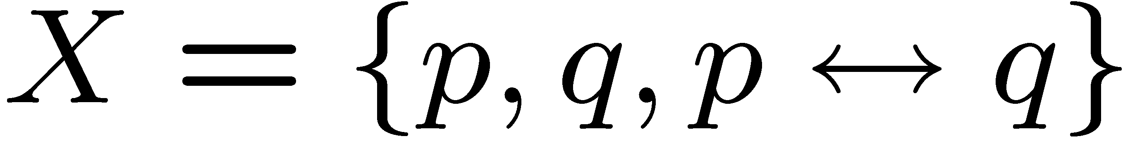
More Problems <number>
However other problematic domains exist, e.g. {(1,0,0),(0,1,0),(0,0,1),(1,1,1)}
(0,1,1)
(1,1,1)
Passes through each of the eight subcubes! So majority rule might lead to any of the vertices!
(0,0,1)
(1,0,1)
In general at least m+1 vertices needed to pass through all majority subcubes!
(0,1,0)
(1,1,0)
(1,0,0)
(0,0,0)

Slide 15
Profile Decomposition <number>
Consider two individuals with the respective judgments (1,0,0) and (0,1,1).
They are exact opposite, so from a majority rule point of view those two judgments cancel out!
Implies that for any two opposite feasible judgments in the domain we can cancel the judgment held by the smaller number of individuals.
(0,1,1)
(1,1,1)
(0,0,1)
Using majority rule, we can either eliminate (0,0,0) or (1,1,1).
This has certain useful implications!
(1,0,1)
(0,1,0)
(1,1,0)
(1,0,0)
(0,0,0)

Slide 16
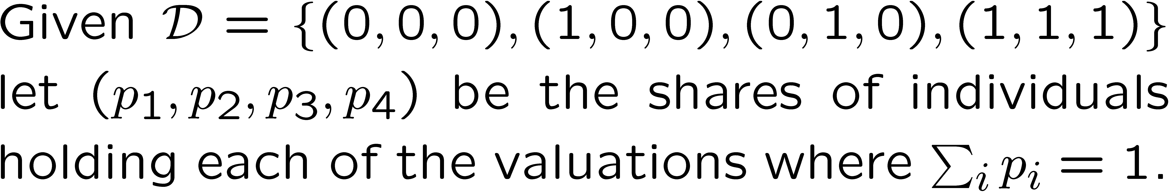
Profile Decomposition <number>
A reduced profile is one where either p₁ or p₄ is equal to zero!
This reduces the majority outcome to one of the following:

Slide 17
Profile Decomposition <number>
(0,1,1)
(1,1,1)
(0,1,1)
(1,1,1)
(0,0,1)
(0,0,1)
(1,0,1)
(1,0,1)
Plane T
(0,1,0)
(1,1,0)
(0,1,0)
(1,1,0)
(1,0,0)
(1,0,0)
(0,0,0)
(0,0,0)
No problems occur, as this subdomain is closed under majority rule.
Problems might occur for certain majority points on the plane T.

Slide 18
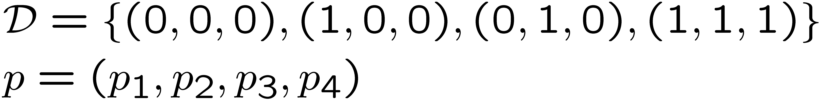
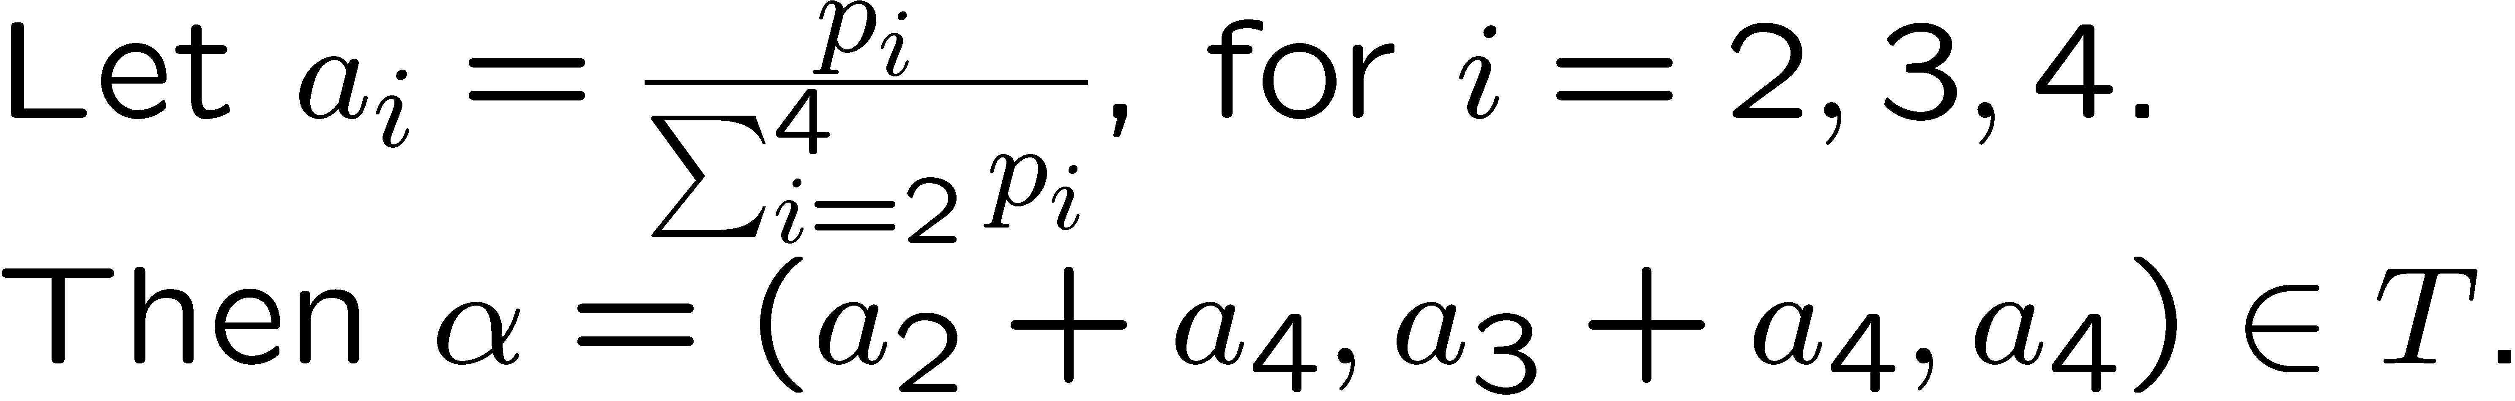
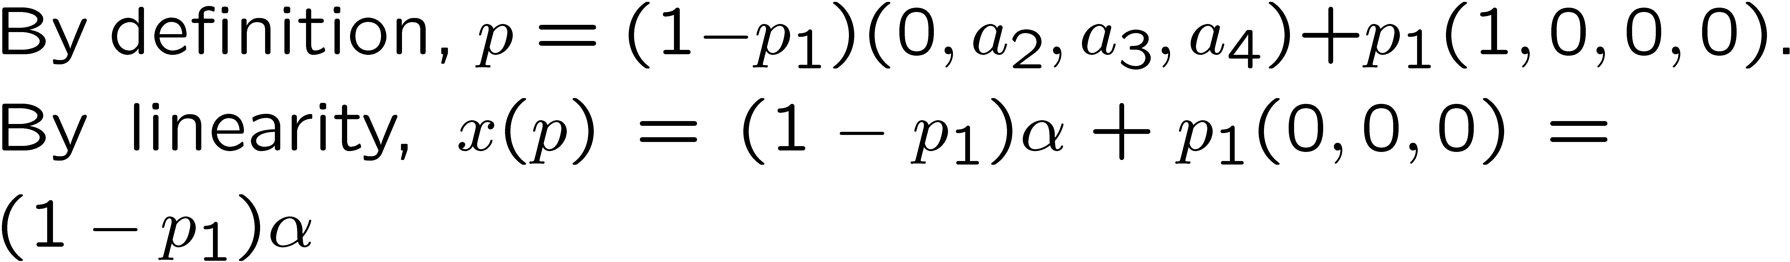
Profile Decomposition <number>

Slide 19
Profile Decomposition <number>
Geometrically any profile can be plotted via a point in T, its connection to the (0,0,0) vertex and a (weight) p₁.
(1,1,1)
Irrational Area
(1,0,0)
(0,1,0)

Slide 20
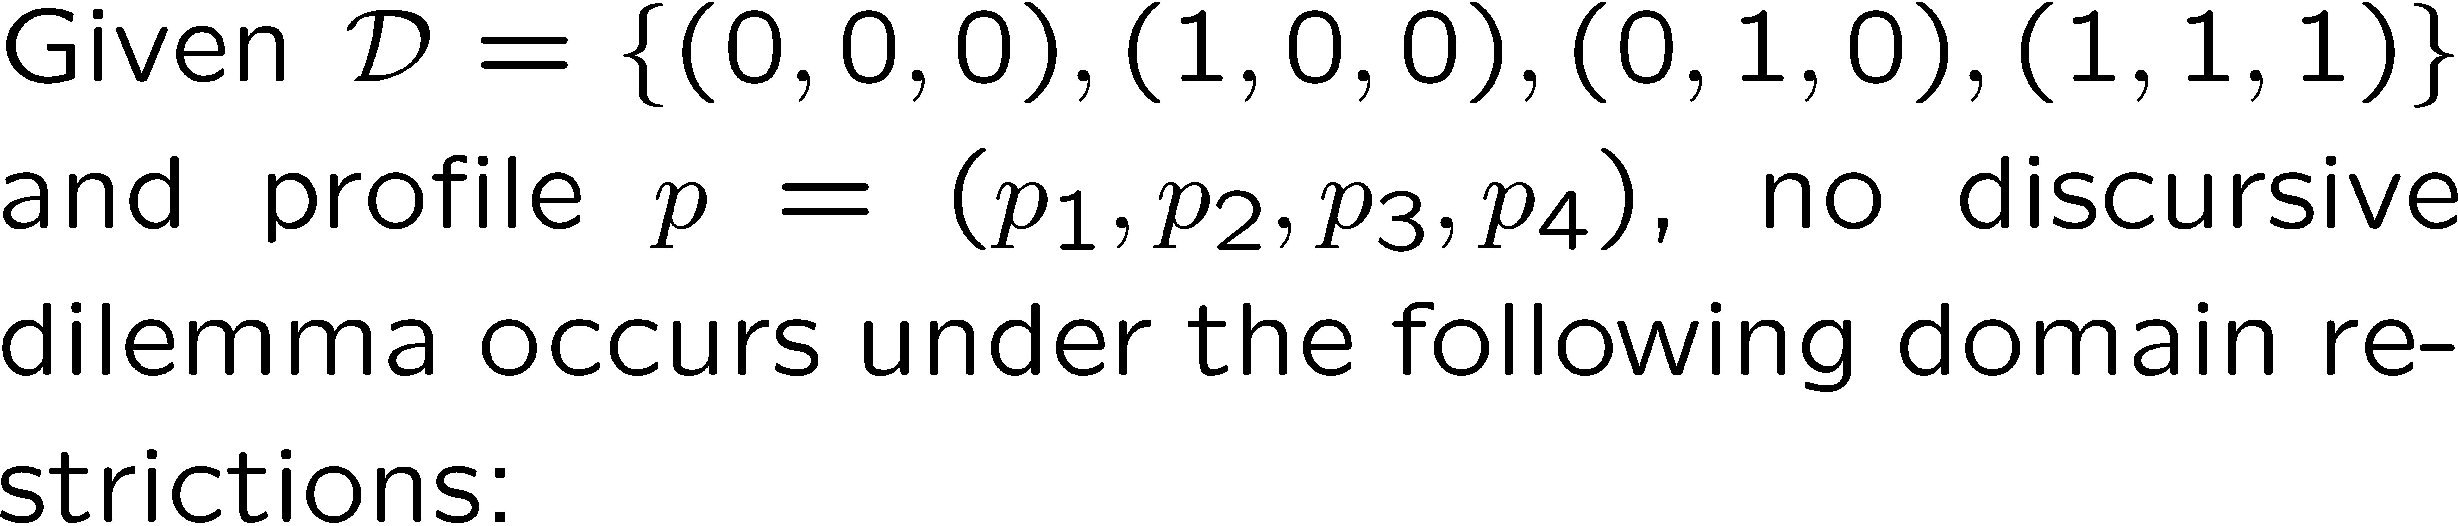
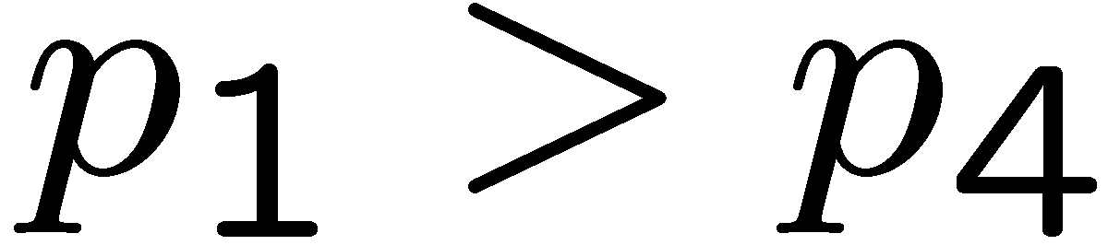
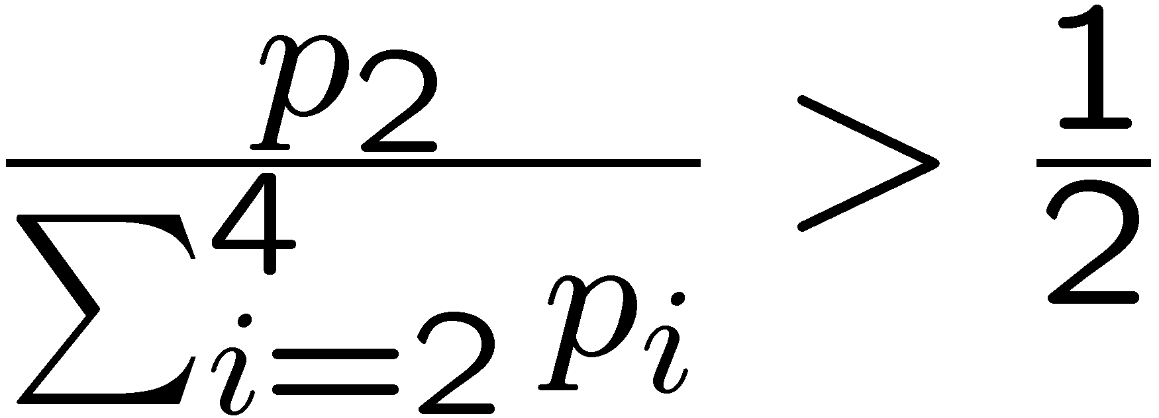
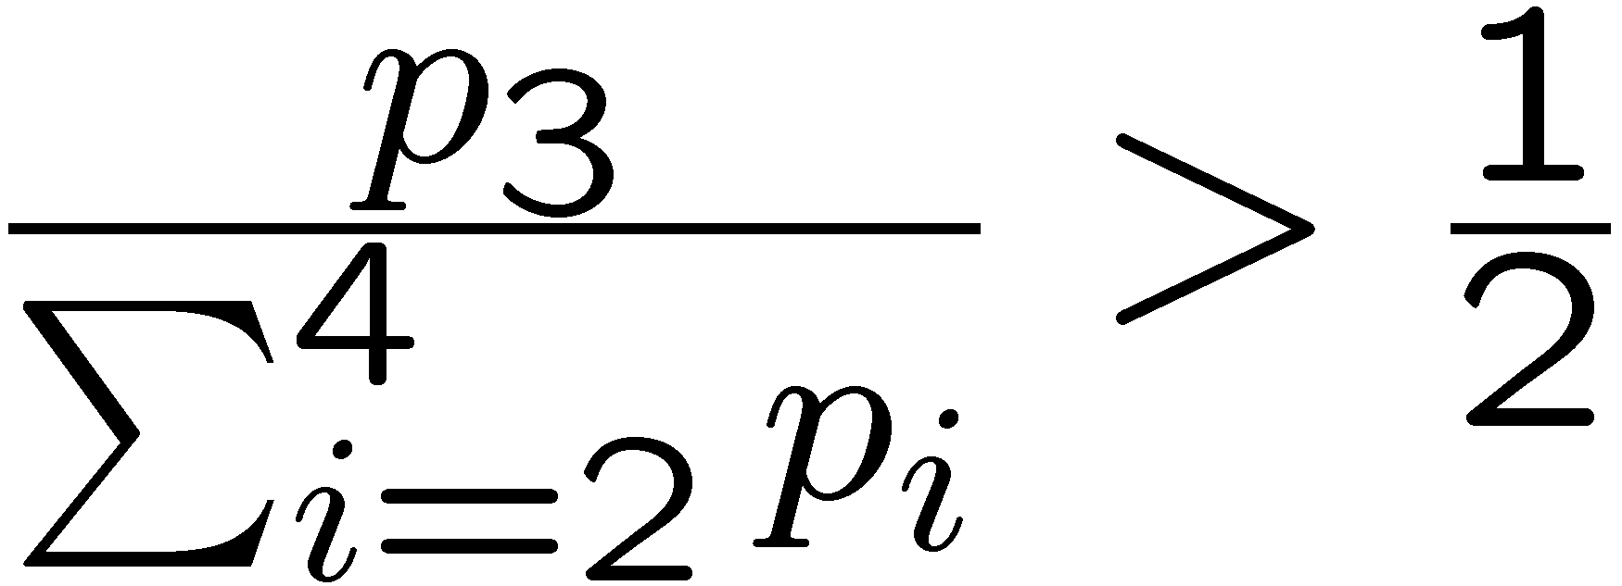
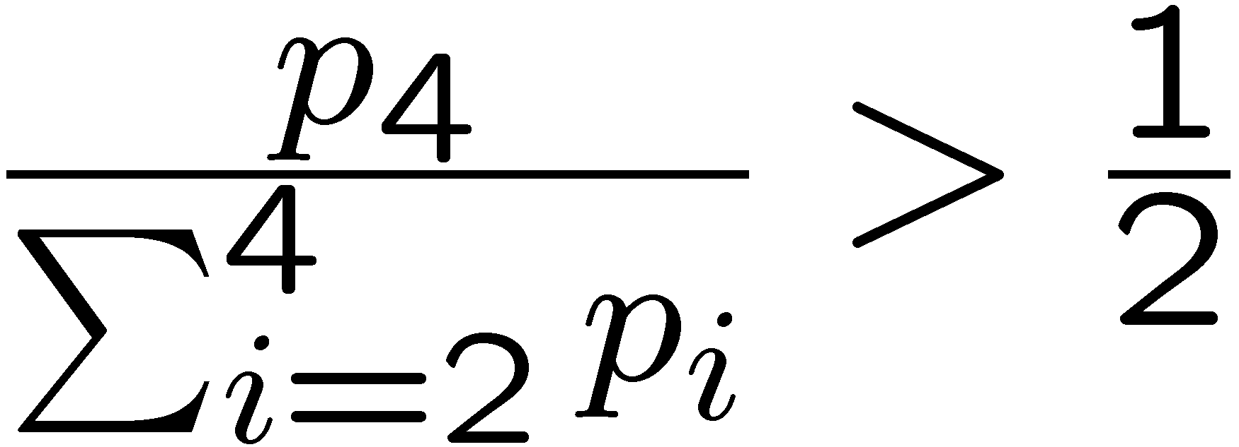
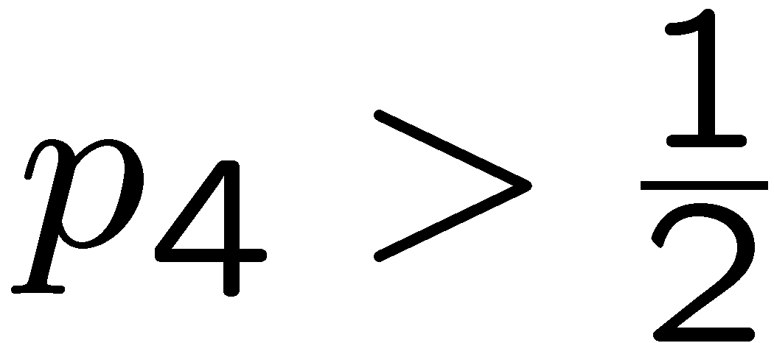
(Domain) Restrictions <number>
(1,1,1)
Restrictions based on the space of profiles are more general than restrictions on the space of valuations (classical domain restrictions).
(1,0,0)
(0,1,0)

Slide 21
Proposition <number>
There exist profiles such that there is almost unanimous agreement on one proposition and still an infeasible social judgment is reached.
For any point in the corners of the irrational area we get almost unanimous agreement on one proposition.
(1,1,1)
(1,0,0)
(0,1,0)

Slide 22
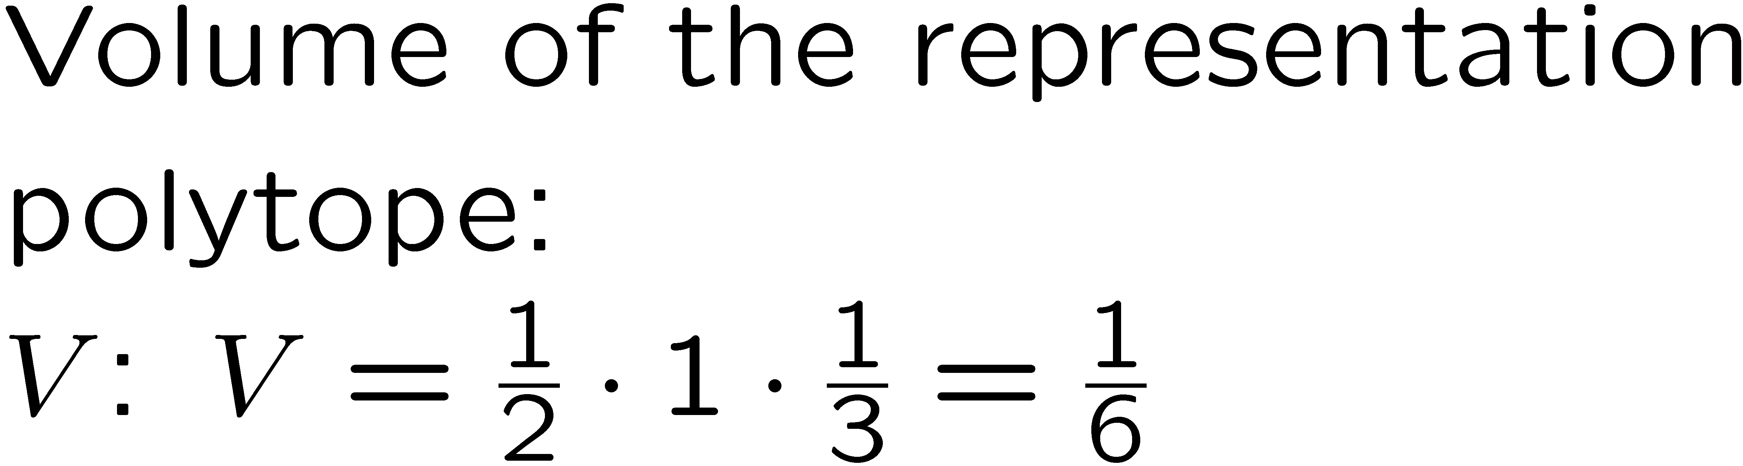
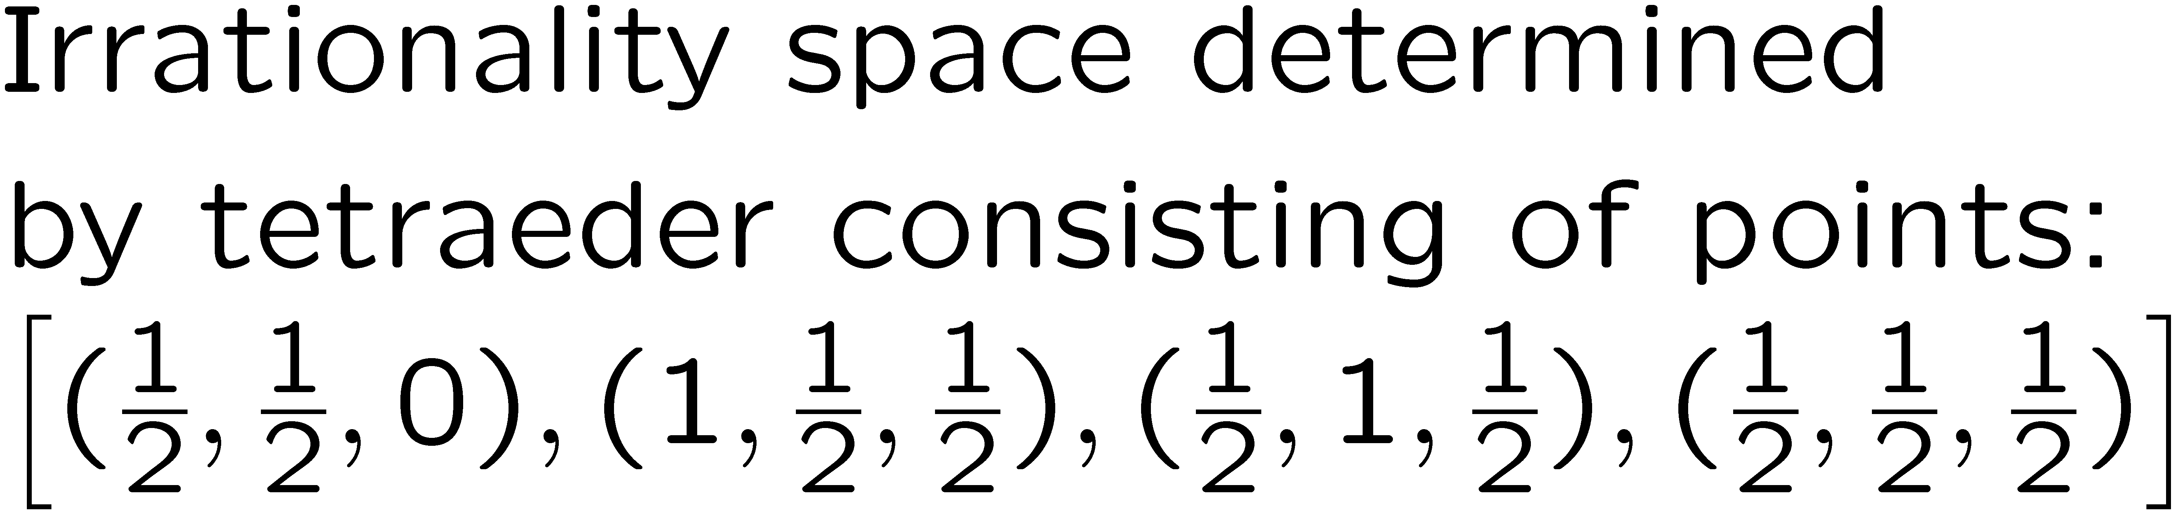
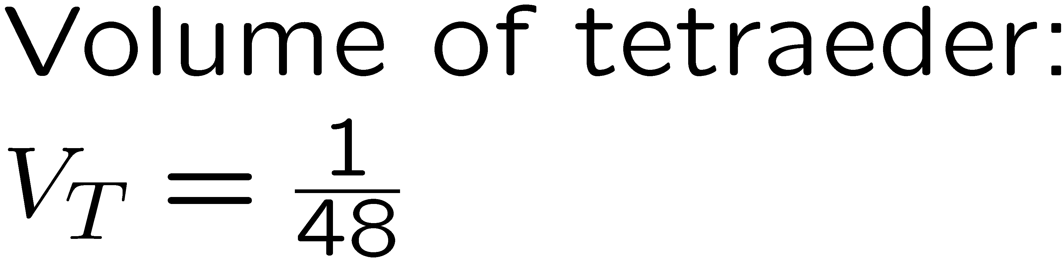
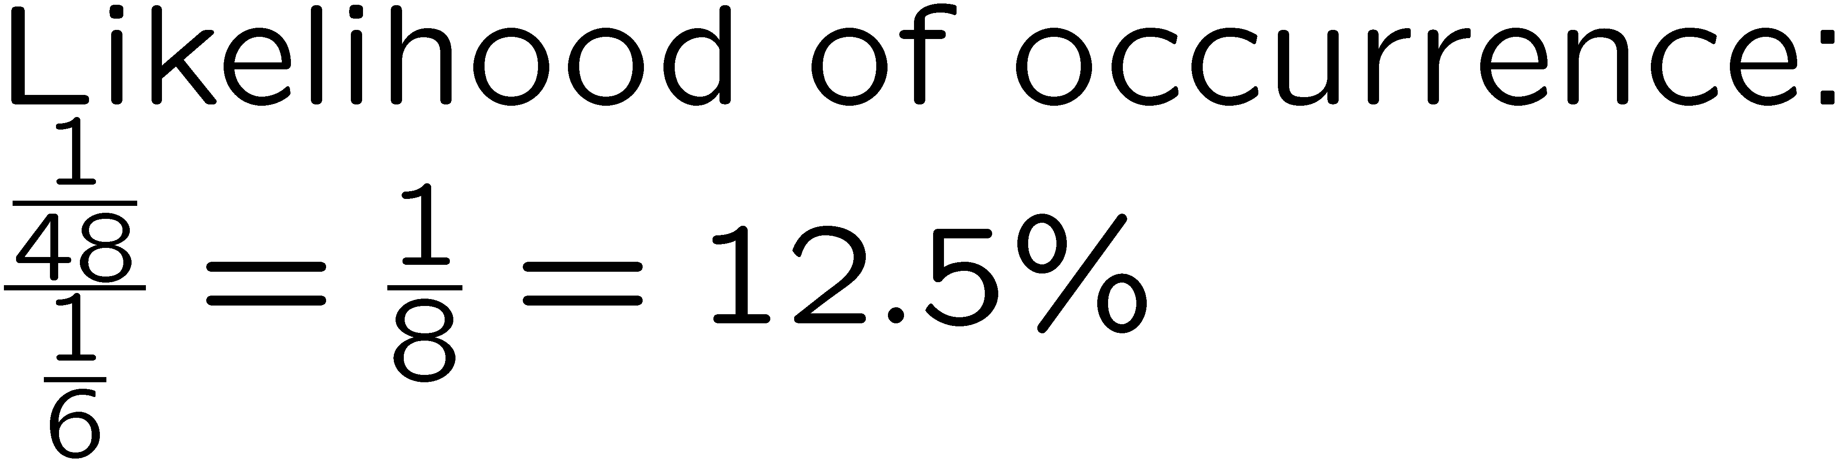
Likelihood of Inconsistency <number>
The volume of certain subspaces indicates the likelihood of the occurrence of certain outcomes.
(0,1,1)
(1,1,1)
(0,0,1)
(1,0,1)
(0,1,0)
(1,1,0)
(1,0,0)
(0,0,0)

Slide 23
Distance Based Rules <number>
Divide the yellow triangle into three areas based on their distance to the vertices.
(1,1,1)
(1,0,0)
(0,1,0)
This guarantees a consistent social outcome and is equivalent to switching the judgment which is closest to the 50-50 threshold (see Merlin and Saari, 2000; Pigozzi, 2006).

Slide 24
Conclusion <number>
Geometric framework highlights similarities between JA and Social Choice in general and distance-based voting in particular.
Saari’s approach can also be used for JA and provides a different way to illuminate various results in JA
Profile restrictions, which are more general than domain restrictions, can ensure collective rationality
Geometric framework used to determine likelihood of paradoxical situations
Geometric analysis of distance-based rules
What can be said about situations of more than 3 alternatives? Question of higher dimensions (4 dimensions in JA vs. 6 dimensions in voting).

