Slide 1
Ranking, Trust, and Recommendation Systems:
An Axiomatic Approach
Moshe Tennenholtz
Technion—Israel Institute of Technology
and
Microsoft Israel R&D Center

Slide 2
Acknowledgements
Research initiated in a UAI paper.
Work on Ranking Systems is joint work with Alon Altman.
Work on trust systems is with Alon Altman.
Work on recommendation systems is with MSR (see later).
Current work with Ola Rozenfeld.

Slide 3


Ranking Systems
Systems in which agents’ ranks for each other are aggregated into a social ranking.
Examples:
PageRank
Reputation System

Slide 4
Trust Systems:
Personalized Ranking Systems
The “client” of the ranking system is a participant.
Examples:
  Social Networks
  Trust (PGP).
A personalized ranking for each individual.

Slide 5

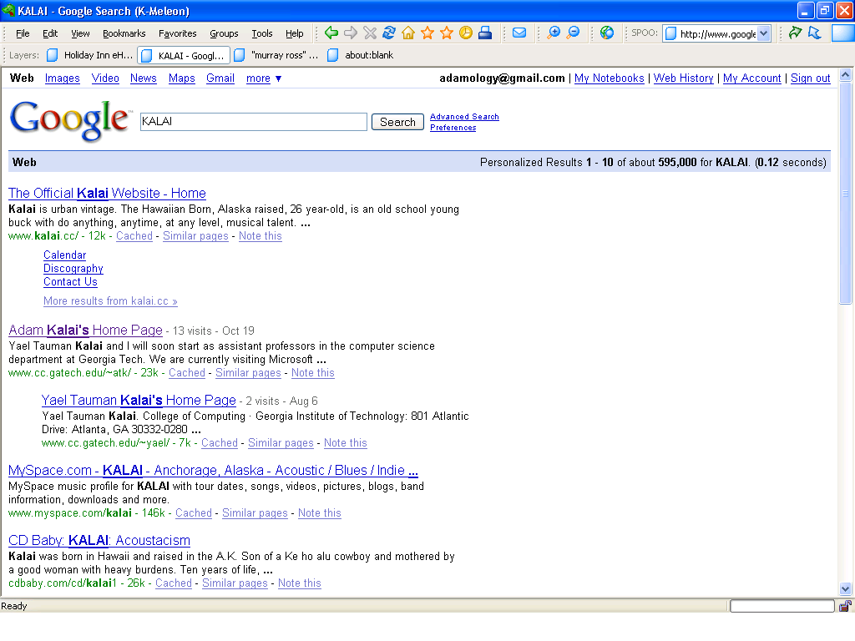


Ranking, Trust, and
Recommendation Systems
What is the right model / a good system?

Slide 6
Ranking Systems
Ranking systems can be defined in the terms of a ranking function combining the individual votes of the agents into a social ranking of the agents.
Can be seen as a variation of the social choice problem where the agents and alternatives coincide.

Slide 7
Social Choice
The classical social choice setting is comprised of:
  A set of agents
  A set of alternatives
  A preference relation for each agent over the set of alternatives.
A social welfare function is a mapping between the agents' individual preferences into a social ranking over the alternatives.
The goal: produce “good” social welfare functions.

Slide 8








Social Choice - Example

Slide 9
Graph Ranking Systems
Each agent may only make binary votes: only specify some subset of the agents as “good”.
Preferences of all the agents may be represented as a graph, where the agents are the vertices and the votes are the edges.
Applies for ranking WWW pages and eBay traders.

Slide 10
Ranking systems

Slide 11
The Axiomatic Approach
We try to find basic properties (axioms) satisfied by ranking systems.
Encompasses two distinct approaches:
  The normative approach, in which we study sets of axioms that should be satisfied by a ranking system; and
  The descriptive approach, in which we devise a set of axioms that are uniquely satisfied by a known ranking system

Slide 12
The Descriptive Approach
In social choice, May's Theorem(1952), provides an axiomatization of the majority rule.
This approach characterizes the essence of a particular method using representation theorems. .
We apply this approach towards the axiomatization of the PageRank ranking system.

Slide 13
The Normative Approach
Arrow's(1963) impossibility theorem is one of the most important results of the normative approach in Social Choice.
Does not apply to Ranking Systems.
In the ranking systems setting, different axioms arise from the fact that the voters and alternatives coincide.

Slide 14
Transitive Effects
The rank of your voters should affect your own.

Slide 15
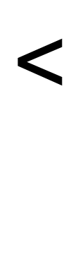
Transitivity
An agent voted by two strong agents should be ranked higher than one voted by strong+weak

Slide 16
Transitivity
An agent voted by two agents should be ranked lower than an agent who is voted by three agents two of which are ranked similarly to the voters of the former agent:

Slide 17
Strong Transitivity
Formally, a ranking system F satisfies strong transitivity if for every two vertices x,y where F ranks x's predecessor set P(x) (strictly) weaker than P(y), then F ranks x (strictly) weaker than y.
We define a predecessor set P(x) as being weaker than P(y) as the existence of a 1-1 mapping between P(x) and P(y) where every vertex in P(x) is mapped to a stronger or equal vertex in P(y) and at least one of the comparisons is strict, or the mapping is not onto.

Slide 18

Strong Transitivity
Doesn't always apply

Slide 19



Strong Transitivity too Strong?
=
Assume:
Many Pages
=
My Homepage
Seminar Homepage

Slide 20
More about Transitivity
Weak Transitivity
  The idea: Only match predecessors with equal out-degree.
  We assume nothing about predecessors of different out-degrees.
  Otherwise, same as Strong Transitivity.
PageRank satisfies Weak Transitivity but not Strong Transitivity.
Strong Transitivity can be satisfied by a nontrivial Ranking System [Tennenholtz 2004]

Slide 21
Ranked IIA
Consider the statement: “An agent with votes from two weak agents should be ranked the same as one with a vote from one strong agent”.
Such statement should hold / not hold in our ranking in a consistent way.

Slide 22
Ranked IIA
We would like such comparisons to be consistent.
That is, in every profile such as the one described in the previous slide we should decide >/</= consistently.
This captures the Independence of Irrelevant Alternatives (IIA) for ranking systems.
Satisfied by Approval Voting.
Compare to Arrow's IIA axiom, which considers the name but not rank of the agents.

Slide 23
Impossibility
Theorem: There exists no general Ranking System that satisfies Weak Transitivity and Ranked IIA.

Slide 24
Impossibility Proof – Part 1
Assume b ≤ a
a
a
c
b
d
b
c is weakest
a
a < b – Contradiction!
→ A vertex with two equal predecessors is stronger than one with one weaker and one stronger predecessor.

Slide 25
Impossibility Proof – Part 2
Assume a ≤ b
a
a
c
b
b
d
c is strongest
a
b < a – Contradiction!
→ A vertex with two equal predecessors is weaker than one with one weaker and one stronger predecessor.
→ Contradiction to part 1. QED

Slide 26
Stronger Impossibility Results
Our impossibility result exists even in very limited domains:
  Small graphs (4 agents are enough with Strong Transitivity).
  Strongly connected graphs
  Bipartite (buyer/seller) graphs.
  Single vote per agent

Slide 27
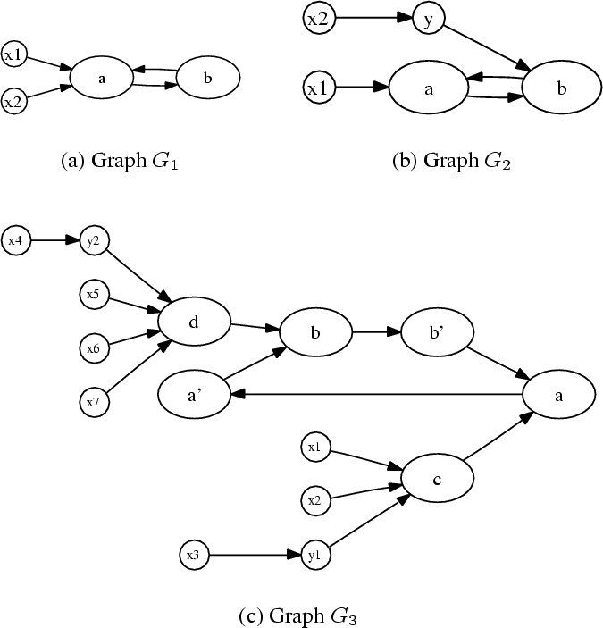
One Vote Bipartite Proof
In G₁: a(3) < b(1,1,2)
In G₂: a(1,4) < b(2,3)
In G₃: b(2,3) < a(1,4)
Contradiction!

Slide 28
Positive Results
Weak Transitivity is satisfied by Google's PageRank.
Strong Transitivity can be satisfied by a nontrivial ranking system [Tennenholtz 2004]
If we weaken our notion of transitivity, we find another nontrivial ranking system satisfying Ranked IIA and quasi-transitivity.

Slide 29
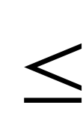
Quasi-Transitivity
We define the notion of quasi-transitivity as requiring only non-strict comparisons.
A ranking system F satisfies quasi- transitivity if for every two vertices x,y where F ranks x's predecessor set P(x) weaker or equal to P(y), F must rank x weaker or equal to y.

Slide 30
Positive Result
Theorem: There exists a nontrivial ranking system satisfying Ranked IIA and Quasi-Transitivity.
The system is the
recursive-indegree ranking system.

Slide 31
Incentives
Agents may choose to cheat and not report their real preferences, in order to improve their position.
Utility of the agents only depends on their own rank, not on the rank of other agents.
Utility is nonincreasing in rank.
Ties are considered a uniform distribution over pure rankings.

Slide 32
Utility Function
Formally, the utility function u maps for each agent the number of agents ranked lower than the agent to a utility for that ranking.
The expected utility of an agent with k agents ranked strictly below it and m agents ranked the same assumes uniform distribution of the ranking of agents who are ranked similarly.

Slide 33
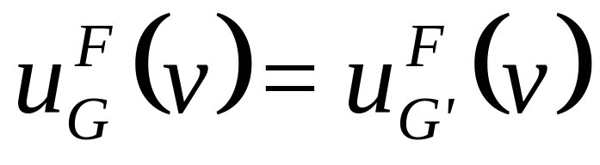
Incentive Compatibility
Let G=(V,E) and G'=(V,E') be graphs that differ only in the outgoing edges from vertex v.
A ranking system is strongly incentive compatible, if for every utility function u:

Slide 34
Results
We have classified several types of incentive compatible ranking systems, under a wide range of axioms.
  This classification has shown that full incentive compatibility is impossible for any practical purpose.
We have also quantified the incentive compatibility of known ranking systems, and suggested useful new ranking systems that are almost incentive compatible.

Slide 35
Ranking systems: conclusions
A normative approach
A basic impossibility result
Positive results by weakening requirements
New systems
Quantifying Incentive Compatibility
A descriptive approach
The PageRank axioms.

Slide 36
Trust Systems:
Personalized Ranking Systems
The “client” of the ranking system may also be a participant
Many impossibility results are reversed.

Slide 37
What is a personalized ranking system?
A personalized ranking system is like a general ranking system, except:
  Additional parameter: the source, i.e. the agent under whose perspective we're ranking.

Slide 38
Examples of PRSs
Distance rule - rank agents based on length of shortest path from s.
Personalized PageRank with damping factor d - The PageRank procedure with probability d of restarting at vertex s.
α-Rank - Rank based on distance, but break ties based on lexicographic order on predecessor rank.

Slide 39
Example of Ranking
a
c
e
s
b
d
f
Distance
s, a=b, c=d, e=f
Personalized PageRank
(d=0.2)
d, s, f, b, a, c, e
(d=0.5)
s, b, a, d, f, c, e
α-Rank
s, b, a, d, c, f, e

Slide 40
Properties of PRSs
A PRS satisfies self-confidence if the source s is ranked stronger than all other vertices.
The following properties from general ranking systems could be adapted to PRSs.
  Strong/Quasi/Weak transitivity
  Ranked IIA
  Strong Incentive Compatibility
In every case, we require the property to be satisfied by all vertices except s.

Slide 41
New type of Transitivity
Assume a ranking system F and two vertices x,y (excluding the source) with a mapping f from P(x) to P(y) that maps each vertex in P(x) to one at least as strong in P(y).
  Quasi-transitivity: y is less or equal to x.
  Strong Quasi transitivity: Furthermore, if all of the comparisons are strict: y < x.
  Strong transitivity: Furthermore, if at least one of the comparisons is strict or f is not onto: y < x.

Slide 42
From quasi-transitivity to strong quasi-transitivity
Right is preferable to left:

Slide 43
Classification of PRSs
Proposition: The distance PRS satisfies self confidence, ranked IIA, strong quasi transitivity, and strong incentive compatibility, but does not satisfy strong transitivity.
Proposition: The Personalized PageRank ranking systems satisfy self confidence iff d>1/2. Moreover, Personalized PageRank does not satisfy quasi transitivity, ranked IIA or incentive compatibility for any damping factor.
Proposition: The α-Rank PRS satisfies self confidence and strong transitivity, but does not satisfy ranked IIA or incentive compatibility.

Slide 44
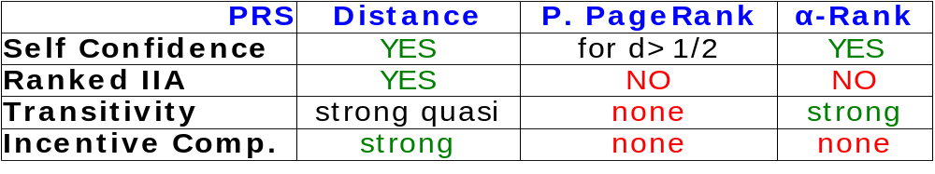
Intermediate Summary
Ranked
IIA
Incentive
Compatibility
?
?
?
distance
?
?
Personalized
PageRank
α-Rank
Strong
Quasi-
Transitivity
?
Strong
Transitivity

Slide 45
Strong Count Systems
Assume the source is the strongest
x will be ranked higher than y when the strongest predecessor of x is stronger than the strongest predecessor of y.
If the strongest predecessors of x and y are of equal power, then the ranking of x and y is determined by a fixed non-decreasing function from the number of strongest predecessors to the integers.

Slide 46
Classification Theorem
Theorem: F is a PRS that satisfies self confidence, strong quasi transitivity, RIIA and strong incentive compatibility, if and only if F is a strong count system.
Ranked
IIA
Incentive Compat.
?
?
?
Strong
?
?
Str.
Quasi-
Transitivity
?

Slide 47
Relaxing the Axioms
All axioms are required for the previous result.
In particular there is an artificial system that satisfies all axioms excluding self confidence, and an artificial system that satisfies all axioms excluding strong quasi-transitivity.

Slide 48
Relaxing Ranked IIA
The Path Count PRS ranks vertices based on distance, and break ties based on the number of shortest directed paths each vertex has from the source.
Proposition: The path count PRS satisfies all axioms excluding RIIA.

Slide 49
Relaxing Incentive Compatibility
The recursive in-degree ranking system can be adapted to the personalized setting by giving the source vertex a maximal value, as if it has in-degree n+1.
Proposition: The recursive in-degree PRS satisfies all axioms excluding incentive compatibility.

Slide 50
Full Classification
Ranked
IIA
Incentive
Compatibility
*
*
*
Weak Maximum Transitivity
?
strong
?
rec.
indegree
?
path
count
Personalized
PageRank
?
α-Rank
Strong
Quasi-
Transitivity
*
Strong
Transitivity
* Artificial Ranking Systems

Slide 51
Trust/personalized ranking systems: conclusions
Full characterization of the systems that are transitive, consistent, and incentive compatible.
New trust systems offered.
Impossibility results are reversed.

Slide 52
Trust-Based Recommendation Systems
:
Reid Anderson
Christian
Borgs
Adam Kalai
Vahab Mirrokni
Uri Feige
Moshe Tennenholtz
Abie Flaxman
Jennifer
Chayes

Slide 53
Ranking, Trust, and
Recommendation Systems
What is the right model / a good system?

Slide 54
Old-Fashioned Model
I want a recommendation about an item, e.g.,
  Professor
  Product
  Service
  Restaurant
  …
I ask my trusted friends
  Some have a priori opinions (first-hand experience)
  Others ask their friends, and so on
I form my own opinion based on feedback, which I may pass on to others as a recommendation

Slide 55


A Model
+
–
“Trust graph”
  Node set N, one node per agent
  Edge multiset E N²
    Edge from u to v means “u trusts v”
    Multiple parallel edges indicate more trust
Votes: disjoint V₊, V– N
  V₊ is set of agents that like the item
  V– is set of agents that dislike the item
Rec. system (software) assigns {–,0,+} rec. R_{s}(N,E,V₊,V–) to each nonvoter
+
+
0
+

Slide 56
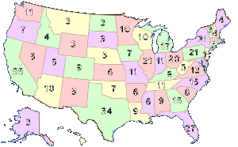
Famous Voting Networks
+
+
+
+
+
–
–
+
…
…
…
AL voters
ME voters
WY voters
…
…
…
…
…
electoral
college
AL (9)
ME (4)
WY (3)
congress
U.S. presidential election: majority-of-majorities system

Slide 57
Axiomatization #1
1. Symmetry
Neutrality: flipping vote signs flips rec signs:
R_{s}(N,E,V₊,V–)=– R_{s}(N,E,V–,V₊)
Anonymity: Isomorphic graphs have isomorphic rec’s
2. Positive response
If s’s rec is 0 or + and an edge is added to a brand new + voter, then s’s rec becomes +
+
–
–
+
r
s
-r
s
+
–
–
+
r
s
r
s
+
–
+
–
+
0
s
+
s

Slide 58
Axiomatization #1
1. Symmetry
2. Positive response
3. Scale invariance (edge repl.)
Replicating a node's outgoing edges k times doesn’t change any rec’s.
4. Independence of Irrelevant Stuff
A node's rec is independent of unreachable nodes and edges out of voters.
5. Consensus nodes
If u's neighbors unanimously vote +, and they have no other neighbors, then u’s may be taken to vote +, too.
+
–
+
–
+
0
1
–
?
+
s
r
+
r
+
+
u
u

Slide 59
Axiomatization #1
+
–
+
1. Symmetry
2. Positive response
3. Scale invariance (edge repl.)
4. Independence of Irrelevant Stuff
5. Consensus nodes
6. Trust Propogation
If u trusts (nonvoter) v, then an equal number of edges from u to v can be replaced directly by edges from u to the nodes that v trusts (without changing any rec’s).
–
+
0
1
–
?
+
s
v
u
≅

Slide 60
Axiomatization #1
+
–
+
1. Symmetry
2. Positive response
3. Scale invariance (edge repl.)
4. Independence of Irrelevant Stuff
5. Consensus nodes
6. Trust Propogation
If u trusts (nonvoter) v, then an equal number of edges from u to v can be replaced directly by edges from u to the nodes that v trusts (without changing any rec’s).
–
+
0
1
–
?
+
s
v
u
≅
THM: Axioms 1-6 are satisfied uniquely by random walk system.

Slide 61
Random Walk System
Input: voting network, source (nonvoter) s.
  Consider hypothetical random walk:
    Start at s
    Follow random edges
    Stop when you reach a voter
  Let p_{s} = Pr[walk stops at + voter]
  Let q_{s} = Pr[walk stops at – voter]
Output rec. for s =
+
–
+
+
0
+
+
+
0
+ if p_{s} > q_{s}
0 if p_{s} = q_{s}
– if p_{s} < q_{s}
–
–

Slide 62
Axiomatization #2
1. Symmetry
2. Positive response
3. Scale invariance (edge repl.)
4. Independence of Irrelevant Stuff
5. Consensus nodes
6. Trust Propogation
Def: s trusts A more than B in (N,E) if
(V₊=A and V– =B) and s’s rec is +
7. Transitivity (Disjoint A,B,C in N)
If s trusts A more than B and
s trusts B more than C then
s trusts A more than C
–
–

Slide 63
Axiomatization #2
1. Symmetry
2. Positive response
3. Scale invariance (edge repl.)
4. Independence of Irrelevant Stuff
5. Consensus nodes
6. Trust Propogation
Def: s trusts A more than B in (N,E) if
(V₊=A and V– =B) ) s’s rec is +
7. Transitivity (Disjoint A,B,C in N)
If s trusts A more than B and
s trusts B more than C then
s trusts A more than C
+
+
–
+
–
+
+
–
A
s
B
–
–
–
+
–
+
–
+
+
–
s
B
C
THM : Axioms 1-2, 4-5,
and 7 are a minimal
inconsistent set of axioms.

Slide 64
Towards Axiomatization #3
…
…
…
…
…
Majority Axiom
The rec. for a node is equal to the majority of the votes/recommendations of its trusted neighbors.

Slide 65
Axiomatization #3
No Groupthink Axiom
If a set S of nonvoters are all + rec’s, then a majority of the edges from S to N \ S are to
+ voters or + rec’s
If a set S of nonvoters are all – or 0 rec’s, then it cannot be that a majority of the edges from S to N \ S are to + voters or + rec’s
(and symmetric – conditions)
–
+
+
–
+
–

Slide 66
Axiomatization #3
No Groupthink Axiom
If a set S of nonvoters are all + rec’s, then a majority of the edges from S to N \ S are to
+ voters or + rec’s
If a set S of nonvoters are all – or 0 rec’s, then it cannot be that a majority of the edges from S to N \ S are to + voters or + rec’s
(and symmetric – conditions)
–
+
+
–
+
THM : The “No groupthink”
axiom uniquely implies
the min-cut system
–

Slide 67
Min-Cut-System
+
–
+
+
0
+
(Undirected graphs only)
Def: A +cut is a subset of edges that, when removed, leaves no path between –/+ voters
Def: A min+cut is a cut of minimal size
The rec for node s is:
+ if in every min+cut s is connected to a + voter, – if in every min+cut s is connected to a – voter,
0 otherwise

Slide 68
Recommendation Systems: Conclusion
Simple “voting network” model of trust-based rec systems
  Simplify matters by rating one item (at a time)
  Generalizes to real-valued weights, votes & rec’s
Two axiomatizations leading to unique sysetms
  Random walk system for directed graphs
  Min-cut system for undirected graphs
One impossibility theorem
Current work: nice systems/axioms in the continuous case.

Slide 69
Discussion
I believe that the axiomatic approach is the way to analyze ranking, trust, and recommendation systems.
Novel conceptual contributions: social choice when the set of agents and the set of alternatives may coincide (and more).
Novel technical contributions: a first rigorous approach to understanding the properties of existing systems, while offering also new novel systems.

