Slide 1
Alternatives to Truthfulness Are Hard to Recognize
Carmine Ventre (U. of Liverpool)
Joint work with:
Vincenzo Auletta & Paolo Penna & Giuseppe Persiano (U. of Salerno)

Slide 2


Principal-Agent Classical Model
Maximize utility
“Implement” f
Outcome function g
f:D->O social choice function
Declaration domain D
Observe his type t in D
Declare BR(t)
BR(t) is a t’ in D such that utility t(g(t’)) is maximized
Outcome g(BR(t)) is implemented
Notes:
Principal announces an outcome function g: D -> O
Agent observes his type t in D and declares a BR(t) defined as t’ in D such that utility t(g(t’)) is maximized
g(t’) is chosen and agent expierence an utility of t(g(t’))
Principal implements f iff g(BR(t))=f(t) truthfully iff t=t’

Slide 3
Implementation of Social choice functions
g implements f iff
g(BR(t))=f(t)
g truthfully implements f iff g implements f &
BR(t)=t
Revelation Principle: for all f
f implementable f truthfully implementable
D
f(t)=g(t)
f(t)=x
g(t’)=x
t’
t
There are no alternatives to truthfulness!?!

Slide 4



Toy Example: Tall-Short f
f
>180 cm
>
X2
X1

Slide 5
Implementation of Tally-Short f
t1=[170-180]
D = {t1, t2, t3}
t2=[181-190]
ti(x2) > ti(x1)
t3=[190+]
t1(x1)-t1(x2)<0
t1(x1)-t1(x2)<0
t2(x2)-t2(x2)=0
types
t1
t2
t3
t2(x2)-t2(x1)>0
t3(x2)-t3(x2)=0
g=f
X1
X2
X2
Tested in time poly in |D|
t3(x2)-t3(x1)>0
f is truthfully implementable iff there are no negative-weight edges
f is not truthfully implementable
nor implementable

Slide 6
Principal-Agent Model with Partial Verification [Green&Laffont 86]
<
<
=
t1
t2
t3
20+ cm
>
=
X1
X2
X2
>
t defines a set of allowed messages M(t)
BR(t) is a t’ in M(t) such that utility t(g(t’)) is maximized

Slide 7
M-Implementation of Tally-Short f
<
=
t1
t2
t3
>
=
f
X1
X2
X2
g
X1
X1
X2
[GL86] show that Revelation Principle holds only if NRC holds
Nested Range Condition
holds in uninteresting cases
[Singh&Wittman, 2001]
t
t’
t’’
Yes! There are alternatives to truthfulness!

Slide 8
But They are Hard to Find
Reduction from 3SAT for the following problem
Implementability
Input: D, O, f, M
Task: exists g M-implementing f?
We start from a formula with clauses C1,…, Cm and variables x1,…, xn

Slide 9
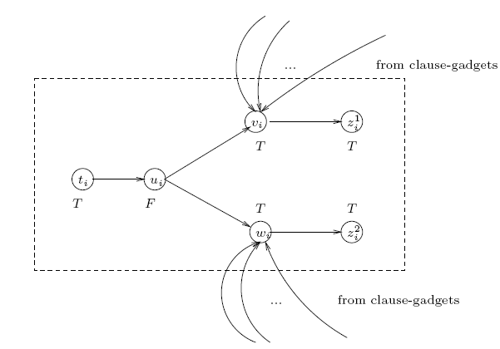
The gadget for the variable xi
ti(F)>ti(T)
ui(F)>ui(T)
vi(T)>vi(F)
wi(T)>wi(F)
?
T
F
?
T
T
T
g(vi)=F “means” xi=FALSE
g(wi)=F “means” xi=FALSE (ie, xi=TRUE)

Slide 10
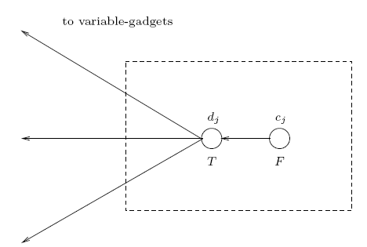
The gadget for the clause Cj
cj(F)<cj(T)
dj(T)>dj(F)
T
F
F

Slide 11
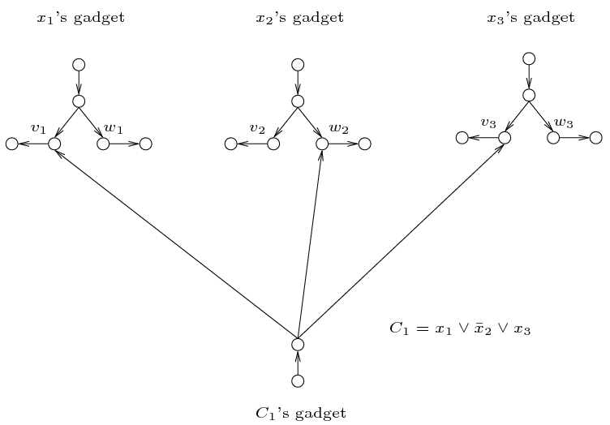
The Reduction
F
T
F
T
T
F
F
F
x1=TRUE
x2= FALSE
x3=FALSE
x1=TRUE
x2=*
x3=*
If formula is sat, then the assignment defines g implementing f
If f is implementable, g defines an assignment sat the formula

Slide 12
“Easy” M’s
Hardness holds even for outcome sets of size 2 and M’s of maximum outdegree 3
Implementability is polynomial-time solvable when the M is a collection of path and cycles (ie, maximum outdegree 1)
Simple reduction from 2SAT
Gap: Maximum outdegree 2?

Slide 13
Quasi-Linear Agents
Outcome function g
Maximize utility
“Implement” f
Payment function p
f:D->O social choice function
Declaration domain D
Observe his type t in D
Declare BR(t)
BR(t) is a t’ in M(t) such that utility t(g(t’))+p(t’) is maximized
Notes:
Principal announces an outcome function g: D -> O
Agent observes his type t in D and declares a BR(t) defined as t’ in D such that utility t(g(t’)) is maximized
g(t’) is chosen and agent expierence an utility of t(g(t’))
Principal implements f iff g(BR(t))=f(t) truthfully iff t=t’

Slide 14
Hardness for QLU Agent
Testing if f is M-truthfully implementable is “easy”
Check that there are no negative-weight cycle in weighted graph
(Even for outcome sets of size 2) testing M-implementability is hard
Reduction similar in spirit to the previous one

Slide 15
Conclusions
M's Graph |  | No Payments | Payments and QLU Agent
Path |  | Polynomial | Always implementable [SW01]
Directed acyclic |  | NP-hard | Always implementable [SW01]
Arbitrary |  | NP-hard | NP-hard
Testing M-truthful implementability is easy in both cases
Hardness depends on the freedom of agents in lying
3 ways: hard
1 way: easy
Use alternatives to truthfulness to implement social choice functions (more interesting than Tally-Short one) otherwise not implementable
t1
t2
t3
...
P2 >= P3+t2(f(t3))-t2(f(t2))
P3

