Slide 1

Llull and Copeland Voting Computationally Resist Bribery and Control
Piotr Faliszewski
University of Rochester
Edith Hemaspaandra
Rochester Institute of Technology
Lane A. Hemaspaandra
University of Rochester
Jörg Rothe
Heinrich-Heine-Universität Düsseldorf
My sincere apologies if you heard some of these results already at
AAAI-07
Dagstuhl 2007 or
AAIM-08.
COMSOC-08, Liverpool, UK, September 2008

Slide 2
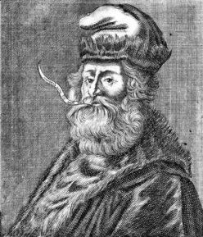
Outline
Introduction
  Computational Social Choice (COMSOC)
  Control, bribery, and manipulation
Llull and Copeland Elections
  Model of elections
  Representation of votes
  Llull/Copeland rule
Results
  Control of elections
  Bribery and microbribery
Hi, I am Ramon Llull. In 1299, I came up with the voting system that these guys now study!

Slide 3
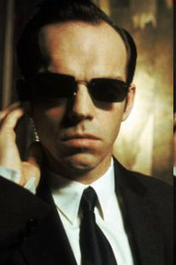



Introduction
Computational Social Choice
  Applications in AI
    Multiagent systems
    Multicriteria decision making
    Meta search-engines
    Planning
  Applications in social choice theory and political science
    Computational barrier to prevent cheating in elections
      Control
      Bribery
      Manipulation
Computational agents can systematically analyze an election to find the optimal behavior.

Slide 4
Introduction
Many ways to affect the result of an election
  The Bad Guy wants to make someone win (constructive case) or prevent someone from winning (destructive case).
  The Bad Guy knows everybody else’s votes.
  Control
    The Chair modifies the structure of
    the election to obtain the desired result.
  Bribery
    The Briber, an external agent, bribes a group
    of voters and tells them what votes to cast
    The briber is limited by some budget.
  Manipulation (not considered here)
    Coalition of Agents changes their vote
    to obtain their desired effect.
In my times it was enough that we all promised we would not cheat...

Slide 5
Outline
Introduction
  Computational Social Choice (COMSOC)
  Control, bribery, and manipulation
Llull and Copeland Elections
  Model of elections
  Representation of votes
  Llull/Copeland rule
Results
  Control of elections
  Bribery and microbribery
Let me tell you a bit about my system ...

Slide 6

Voting and Elections
Candidates and voters:
  C = {c₁, ..., c_{m}}
  V = {v₁, ..., v_{n}}
Each voter v_{i} is represented via his or her preferences over C.
  Assumption: We know all the preferences
    Strengthens negative results
    Can be justified as well
Voting rule aggregates these preferences and outputs the set of winners.
Hi, my name is v₇.
Hi v₇, I hope you are not one of those awful
people who support c₃!
How will they aggregate those votes?!

Slide 7
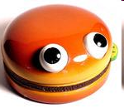


Representing Preferences
C = { , , }
Rational voters
  Preferences are strict linear orders
  No cycles in single voter’s preference list
Example
  > >

Slide 8
Representing Preferences
C = { , , }
Rational voters
  Preferences are strict linear orders
  No cycles in single voter’s preference list
Not all voters are rational though!
  People often have cyclical preferences!
  Irrational voters are represented via preference tables.
Example
  > >

Slide 9

Representing Preferences
Irrational preferences
C = { , , }
Rational voters
  Preferences are strict linear orders
  No cycles in single voter’s preference list
Example
  > >

Slide 10


Representing Preferences
Irrational preferences
C = { , , }
Rational voters
  Preferences are strict linear orders
  No cycles in single voter’s preference list
Example
  > >

Slide 11
Representing Preferences
Irrational preferences
C = { , , }
Rational voters
  Preferences are strict linear orders
  No cycles in single voter’s preference list
Example
  > >

Slide 12
Representing Preferences
Irrational preferences
C = { , , }
Rational voters
  Preferences are strict linear orders
  No cycles in single voter’s preference list
Example
  > >

Slide 13
Representing Preferences
Irrational preferences
C = { , , }
Rational voters
  Preferences are strict linear orders
  No cycles in single voter’s preference list
Example
  > >
> > >

Slide 14
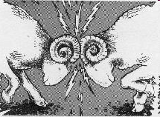


Llull/Copeland Rule
The general rule
  For every pair of candidates, c_{i} and c_{j},
  perform a head-to-head plurality contest.
  The winner of the contest gets one point.
  The loser gets zero points.
  There are also tie-related points.
  At the end of the day, the candidates with
  most points are the winners.
Difference between the Llull and the Copeland rule?
  What happens if the head-to-head contest ends with a tie?
  Llull: Both get 1 point
  Copeland₀: Both get 0 points
  Copeland_{0.5}: Both get half a point
  Copeland_{α}: Both get points, for a rational

Slide 15
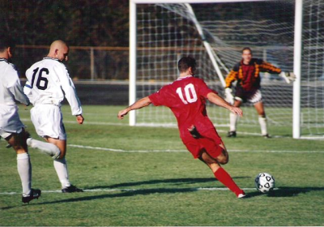
Llull/Copeland Rule
For FIFA World Championships
or UEFA European Championships:
Simply use α = 1/3 as the tie value.
Difference between the Llull and the Copeland rule?
  What happens if the head-to-head contest ends with a tie?
  Llull: Both get 1 point
  Copeland₀: Both get 0 points
  Copeland_{0.5}: Both get half a point
  Copeland_{α}: Both get α points, for a rational α, 0<α<1

Slide 16
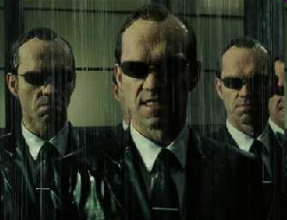
Outline
Introduction
  Computational Social Choice (COMSOC)
  Control, bribery, and manipulation
Llull and Copeland Elections
  Model of elections
  Representation of votes
  Llull/Copeland rule
Results
  Control of elections
  Bribery and microbribery
How will your system deal with my attempts to control, Mr. Llull ...?

Slide 17
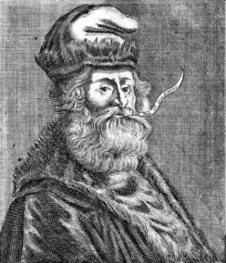
Control
Control of elections
  The chair of the election attempts to influence the result via modifying the structure of the election
  Constructive control (CC)
  Destructive control (DC)
Candidate control
  Adding candidates
    Limited number (AC)
    Unlimited number (AC_{u})
  Deleting candidates (DC)
  Partition of candidates
    with runoff (RPC)
    without runoff (PC)
Voter control
  Adding voters (AV)
  Deleting voters (DV)
  Partition of voters (PV)
My system is resistant to all types of constructive control!!
Okay, almost all.

Slide 18

Previous Results: Control
Constructive Control (Bartholdi, Tovey, Trick; 1992)
  Plurality and Condorcet Voting in seven scenarios of constructive control
  Introduced the notions of
    Immunity
    Susceptibility
    Resistance
    Vulnerability
Bottom line:
  Plurality resists constructive candidate control and is vulnerable to voter control
  Condorcet: vice versa

Slide 19
Previous Results: Control
Constructive Control (Bartholdi, Tovey, Trick; 1992)
  Plurality and Condorcet Voting in seven scenarios of constructive control
  Introduced the notions of
    Immunity
    Susceptibility
    Resistance
    Vulnerability
Bottom line:
  Plurality resists constructive candidate control and is vulnerable to voter control
  Condorcet: vice versa
Destructive Control (HHR: AAAI-05, Art.Int. 2007)
  Plurality, Condorcet, and Approval Voting
  20 constructive and destructive control scenarios
Bottom line:
  Mixed results:
  „The choice of one‘s voting system depends on the type of control one wants to avoid!“

Slide 20
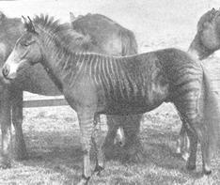
Hybrid Elections
Question: Can we find/design a voting system having full resistance to control?
Hybridization Scheme
(HHR: IJCAI-07)
  defines the Hybrid of k given candidate-anonymous election systems
  studies Hybrid‘s inheritance and strong inheritance of
    Immunity
    Susceptibility
    Resistance
    Vulnerability

Slide 21
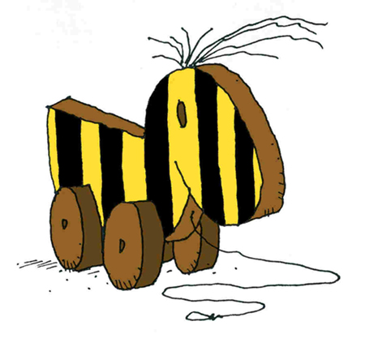
Hybrid Elections
Question: Can we find/design a voting system having full resistance to control?
Hybridization Scheme
(HHR: IJCAI-07)
  defines the Hybrid of k given candidate-anonymous election systems
  studies Hybrid‘s inheritance and strong inheritance of
    Immunity
    Susceptibility
    Resistance
    Vulnerability
Results (HHR: IJCAI-07)
  There exists a voting system, the Hybrid of Condorcet, Plurality, and E_{not-all-one}, that is resistant to all 20 standard types of control.
  Downside: This hybrid system is rather artificial.
  Upside: It proves that an impossibility result about full resistance to control is IMPOSSIBLE.

Slide 22
Results: Control
R – NP-complete
V – P membership
(FHHR: AAAI-07)
Control Scenarios
  AC & AC_{u} – adding candidates
  DC – deleting candidates
  (R)PC – (runoff) partition of candidates
  AV – adding voters
  DV – deleting voters
  PV – partition of voters
 | Llull / Copeland₀ |  | Plurality
Control | CC | DC | CC | DC
AC_{u} AC | V R | V V | R R | R R
DC | R | V | R | R
(R)PC-TP | R | V | R | R
(R)PC-TE | R | V | R | R
PV-TP | R | R | V | V
PV-TE | R | R | R | R
AV | R | R | V | V
DV | R | R | V | V
TP – ties promote
TE – ties eliminate
CC – constructive control DC – destructive control

Slide 23
Results: Control
R – NP-complete
V – P membership
The Complete Picture (FHHR: AAIM-08 & Monster-TR)
 | Copeland₀ Copeland₁ |  | Copeland_{α}0<α<1
Control | CC | DC | CC | DC
AC_{u} AC | V R | V V | R R | V V
DC | R | V | R | V
(R)PC-TP | R | V | R | V
(R)PC-TE | R | V | R | V
PV-TP | R | R | R | R
PV-TE | R | R | R | R
AV | R | R | R | R
DV | R | R | R | R
Main Result:
Copeland Voting
is fully resistant
to constructive
control.

Slide 24
Results: FPT & Extended Control
In addition, we have FPT results for:
All cases of voter control
  when the number of candidates is bounded, or
  when the number of voters is bounded.
All cases of candidate control
  When the number of candidates is bounded.
The above results hold:
  within Copeland_{α} for each rational α in [0,1],
  both in the constructive and the destructive case,
  whether voters are rational or irrational,
  whether or not the input is represented succinctly, and
  even in the more flexible model of „extended control.“
In contrast, Copeland_{α} remains resistant for the table‘s 19
irrational-voter, candidate-control, bounded-voter cases.

Slide 25

Outline
Introduction
  Computational Social Choice (COMSOC)
  Control, bribery, and manipulation
Llull and Copeland Elections
  Model of elections
  Representation of votes
  Llull/Copeland rule
Results
  Control of elections
  Bribery and microbribery
Mr. Llull. Let us see just how resistant your system is!

Slide 26

Bribery
E-bribery
(E – an election system)
  Given: A set C of candidates, a set V of voters specified via their preference lists, p in C, and budget k.
  Question: Can we make p win via bribing at most k voters?
E-$bribery
  As above, but voters have possibly distinct prices and k is the spending limit.
E-weighted-bribery,
E-weighted-$bribery
  As the two above, but now the voters have weights.
Hmm ... I seem to have trouble with finding the right guys to bribe ...

Slide 27

Bribery
E-bribery
(E – an election system)
  Given: A set C of candidates, a set V of voters specified via their preference lists, p in C, and budget k.
  Question: Can we make p win via bribing at most k voters?
E-$bribery
  As above, but voters have prices and k is the spending limit.
E-weighted-bribery,
E-weighted-$bribery
  As the two above, but the voters have weights.
Mr. Agent: My system is resistant to bribery!
Result (AAAI-07 & AAIM-08)
  For each rational
  Copeland_{α} is resistant to all
  forms of bribery, both for
  irrational and rational voters.

Slide 28

Microbribery
Microbribery
  We pay for each small change we make
  If we want to make two flips on the preference table of the same voter then we pay 2 instead of 1
  Comes in the same variants as bribery
Limitations
  Could be studied for the rational voters ...
  ... But we limit ourselves to the irrational case.
We do not really need to change each vote completely ...
Yeah ... It’s easier to work with the Preference Matrix™ ...
Preference Table,
I mean …

Slide 29
Microbribery
Microbribery
  We pay for each small change we make
  If we want to make two flips on the preference table of the same voter then we pay 2 instead of 1
  Comes in the same variants as bribery
Limitations
  Could be studied for the rational voters...
  ... But we limit ourselves to the irrational case.
Result (FHHR: AAAI-07 & AAIM-08)
  For each rational
  Copeland_{α} is vulnerable to destructive microbribery.
  Both Llull and Copeland₀ are vulnerable to constructive microbribery.
Uh oh ... How did they do that?!?!?

Slide 30
Microbribery in Copeland Elections
Setting
  C = {p=c₀, c₁,..., c_{n}}
  V = {v₁, ..., v_{m}}
  Voters v_{i} are irrational
For each two candidates c_{i}, c_{j}:
  p_{ij} – number of flips that switch the head-to-head contest between them
Approach
  If possible, find a bribery that gives p at least B points, ...
  ... and everyone else at most B points
  Try all reasonable B’s
  Validate B via min-cost flow problem

Slide 31
Proof Technique: Flow Networks
Notation:
s(c_{i}) – c_{i} score before bribery
B – the point bound
K – large number
p
capacity/cost
B/0
s(p)/0
1/p₂₀
c₁
1/p₁₀
s(c₁)/0
B/K
s
1/p₂₁
t
s(c₂)/0
c₂
B/K
source – models pre-
bribery scores
mesh – models bribery cost
sink – models bribery success
s(c_{n})/0
1/p_{2n}
B/K
c_{n}
source
mesh
sink
Cost = K(n(n-1)/2 - p-score) + cost-of-bribery

Slide 32

Summary
Arrgh! Llull, my agents are practically helpless against your system!
Copeland_{α} elections possess:
  Broad resistance to control:
    Full resistance to constructive control
    Full resistance to voter control
    Rational/Irrational
    Unique/Nonunique winner
  Full resistance to bribery:
    Constructive/Destructive
    Rational/Irrational
    Unique/Nonunique winner
  Vulnerability to microbribery:
    In some cases for irrational voters
    What about the other irrational cases?
    Rational voters: ???

Slide 33

... and a Call for Papers
„Logic and Complexity within Computational Social Choice“
To appear as a special issue of Mathematical Logic Quarterly
Edited by Paul Goldberg and Jörg Rothe
Deadline: September 15, 2008

Slide 34


Thank you!
I‘d be happy to answer your questions!

Slide 35
Proof Technique: Flow Networks
Notation:
s(c_{i}) – c_{i} score before bribery
B – the point bound
K – large number
p
capacity/cost
c₁
s
t
c₂
c_{n}

Slide 36
Proof Technique: Flow Networks
Notation:
s(c_{i}) – c_{i} score before bribery
B – the point bound
K – large number
p
capacity/cost
c₁
s
t
c₂
source – models pre-
bribery scores
mesh – models bribery cost
sink – models bribery success
c_{n}
source
mesh
sink

Slide 37
Proof Technique: Flow Networks
Notation:
s(c_{i}) – c_{i} score before bribery
B – the point bound
K – large number
p
capacity/cost
B/0
s(p)/0
c₁
s(c₁)/0
B/K
s
s(c₂)/0
B/K
t
c₂
source – models pre-
bribery scores
mesh – models bribery cost
sink – models bribery success
s(c_{n})/0
B/K
c_{n}
source
mesh
sink

Slide 38
Proof Technique: Flow Networks
Notation:
s(c_{i}) – c_{i} score before bribery
B – the point bound
K – large number
p
capacity/cost
B/0
s(p)/0
1/p₂₀
c₁
1/p₁₀
s(c₁)/0
B/K
s
1/p₂₁
t
s(c₂)/0
c₂
B/K
source – models pre-
bribery scores
mesh – models bribery cost
sink – models bribery success
s(c_{n})/0
1/p_{2n}
B/K
c_{n}
source
mesh
sink

Slide 39
Proof Technique: Flow Networks
Notation:
s(c_{i}) – c_{i} score before bribery
B – the point bound
K – large number
p
capacity/cost
B/0
s(p)/0
1/p₂₀
c₁
1/p₁₀
s(c₁)/0
B/K
s
1/p₂₁
t
s(c₂)/0
c₂
B/K
source – models pre-
bribery scores
mesh – models bribery cost
sink – models bribery success
s(c_{n})/0
1/p_{2n}
B/K
c_{n}
source
mesh
sink

Slide 40
Proof Technique: Flow Networks
Notation:
s(c_{i}) – c_{i} score before bribery
B – the point bound
K – large number
p
capacity/cost
B/0
s(p)/0
1/p₂₀
c₁
1/p₁₀
s(c₁)/0
B/K
s
1/p₂₁
t
s(c₂)/0
c₂
B/K
source – models pre-
bribery scores
mesh – models bribery cost
sink – models bribery success
s(c_{n})/0
1/p_{2n}
B/K
c_{n}
source
mesh
sink

Slide 41
Proof Technique: Flow Networks
Notation:
s(c_{i}) – c_{i} score before bribery
B – the point bound
K – large number
p
capacity/cost
B/0
s(p)/0
1/p₂₀
c₁
1/p₁₀
s(c₁)/0
B/K
s
1/p₂₁
t
s(c₂)/0
c₂
B/K
source – models pre-
bribery scores
mesh – models bribery cost
sink – models bribery success
s(c_{n})/0
1/p_{2n}
B/K
c_{n}
source
mesh
sink

Slide 42
Proof Technique: Flow Networks
Notation:
s(c_{i}) – c_{i} score before bribery
B – the point bound
K – large number
p
capacity/cost
B/0
s(p)/0
1/p₂₀
c₁
1/p₁₀
s(c₁)/0
B/K
s
1/p₂₁
t
s(c₂)/0
c₂
B/K
source – models pre-
bribery scores
mesh – models bribery cost
sink – models bribery success
s(c_{n})/0
1/p_{2n}
B/K
c_{n}
source
mesh
sink

Slide 43
Proof Technique: Flow Networks
Notation:
s(c_{i}) – c_{i} score before bribery
B – the point bound
K – large number
p
capacity/cost
B/0
s(p)/0
1/p₂₀
c₁
1/p₁₀
s(c₁)/0
B/K
s
1/p₂₁
t
s(c₂)/0
c₂
B/K
source – models pre-
bribery scores
mesh – models bribery cost
sink – models bribery success
s(c_{n})/0
1/p_{2n}
B/K
c_{n}
source
mesh
sink
Cost = K(n(n-1)/2 - p-score) + cost-of-bribery

Slide 44

Microbribery: Application
Round-robin tournament
  Everyone plays with everyone else
Bribery in round-robin tournaments
  For every game there we know
    Expected result
    The price for changing it
  We want a minimal price for our guy having most points
Round-robin tournament example
  FIFA World Cup, group stage
    3 points for winning
    1 point for tieing
    0 points for losing
Microbribery?

Slide 45
Microbribery: Application
Round-robin tournament
  Everyone plays with everyone else
Bribery in round-robin tournaments
  For every game there we know
    Expected result
    The price for changing it
  We want a minimal price for our guy having most points
Round-robin tournament example
  FIFA World Cup, group stage
    3 points for winning
    1 point for tieing
    0 points for losing
Microbribery?
  Applies directly!!
  Given the table of expected results and prices …
  … simply run the Microbribery algorithm
  For FIFA: Simply use
  α = 1/3 as the tie value.

