Slide 1

Skill Trade
Learn Skills From Others

Slide 2











Technologies Used
MERN Stack
Additional Technologies

Slide 3
Things That…
…went well
…not so well
Consistent team meetings and communication.
Active progress on all parts of the project.
Project includes a wide range of features.
The lack of experience at the start created problems later down the line.
Revisions were frequently needed to achieve desired functionality.

Slide 4
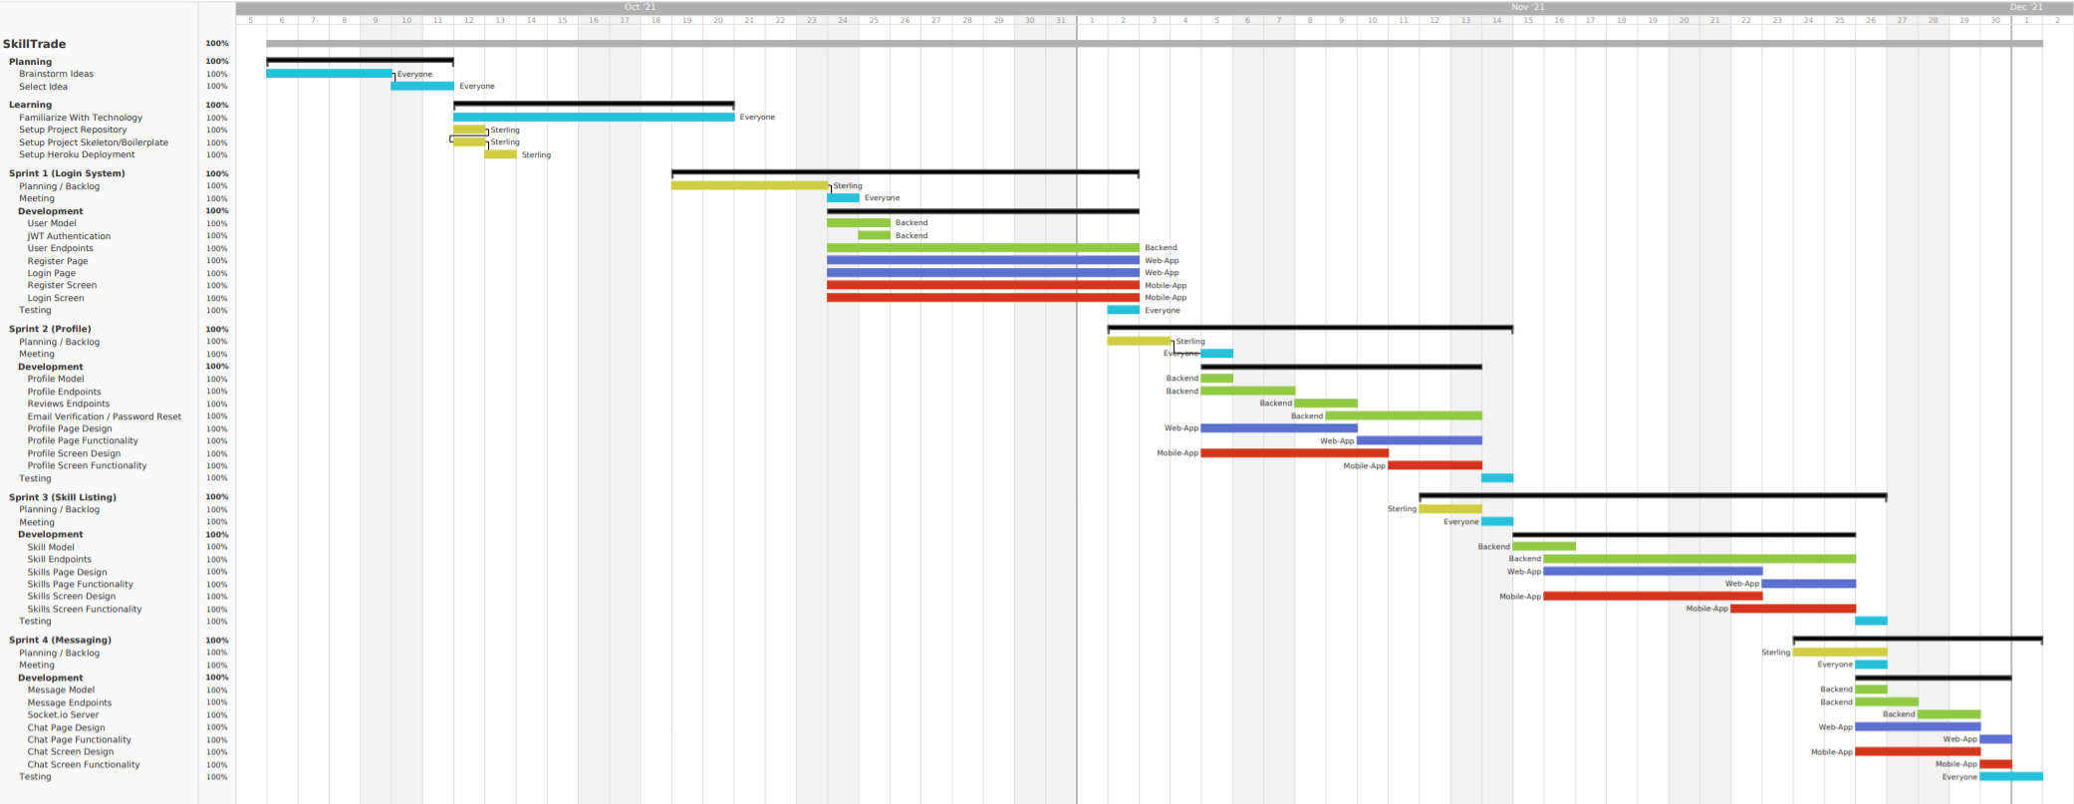
Gantt Chart

Slide 5
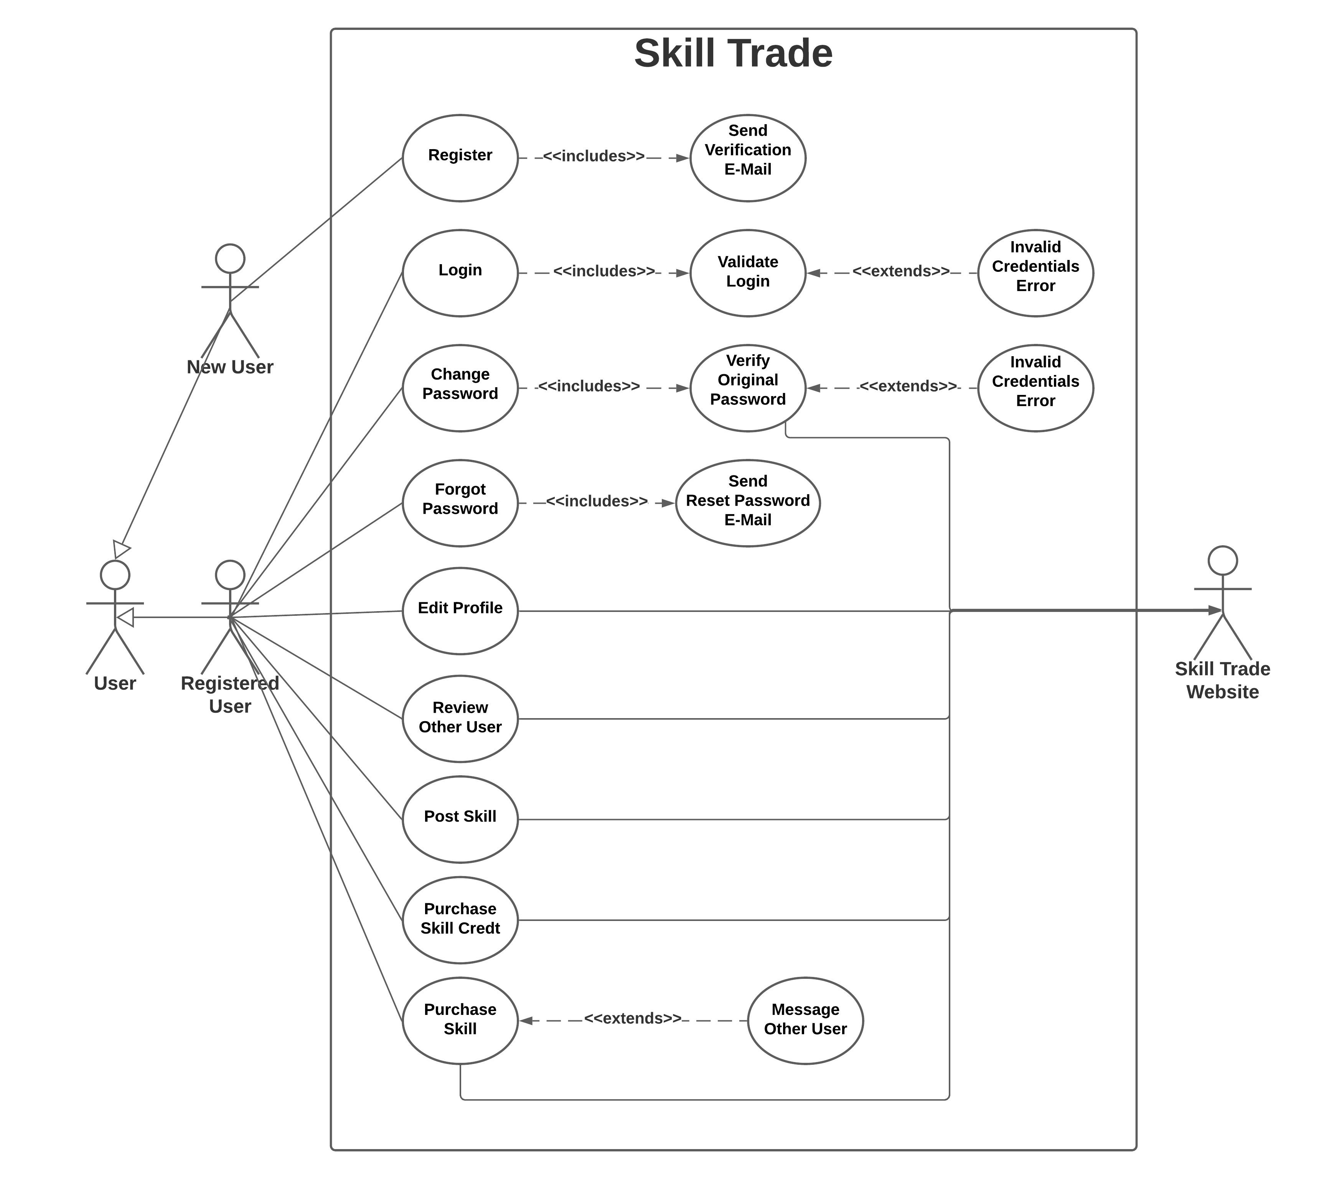
Use Case Diagram

Slide 6
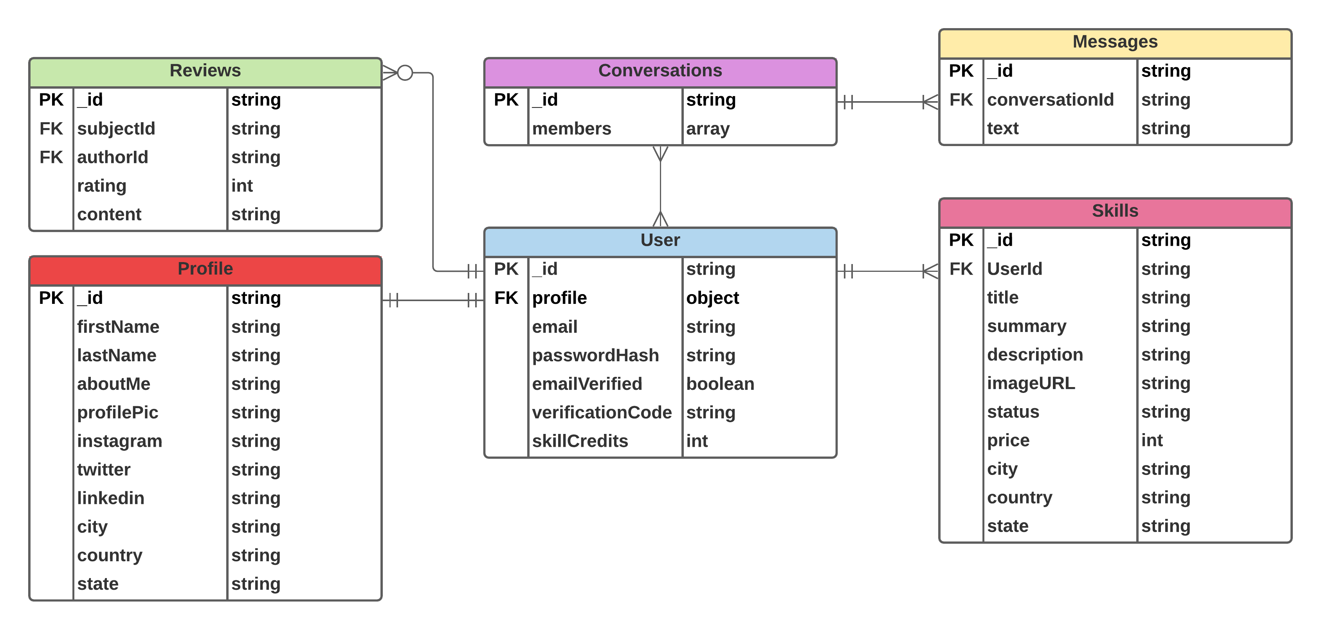
Entity Relationship Diagram (ERD)

Slide 7
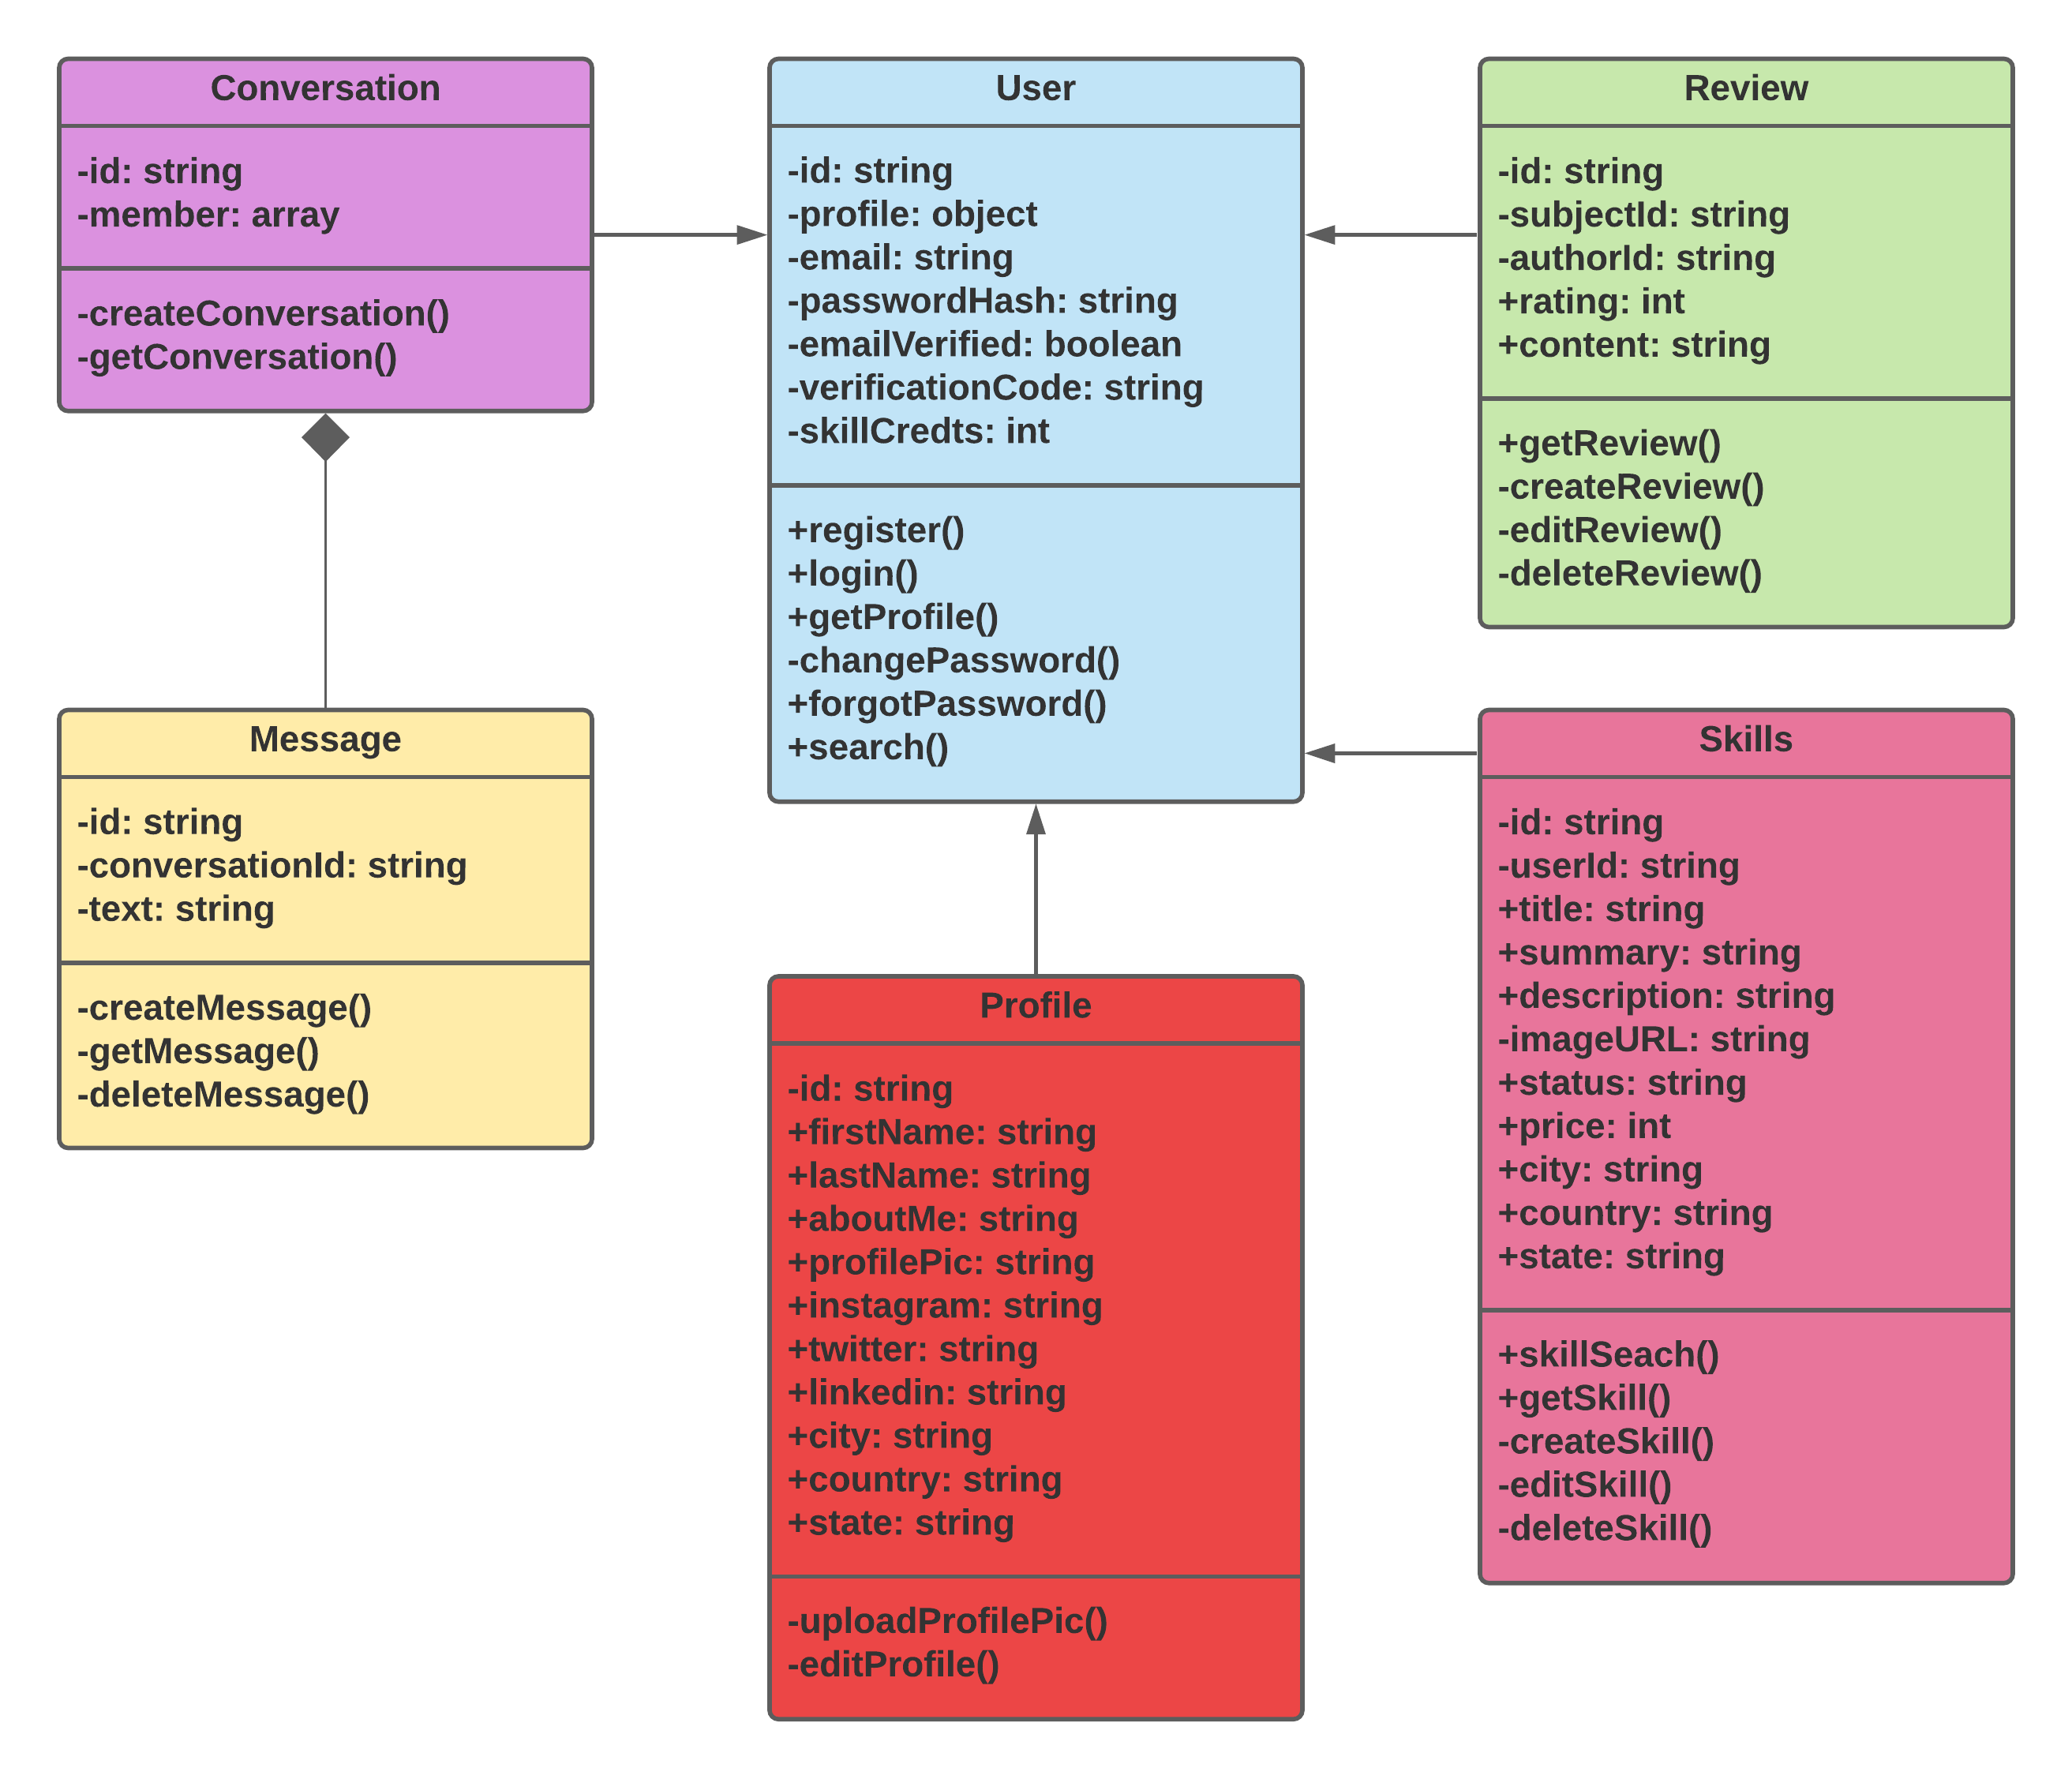
Class Diagram

Slide 8
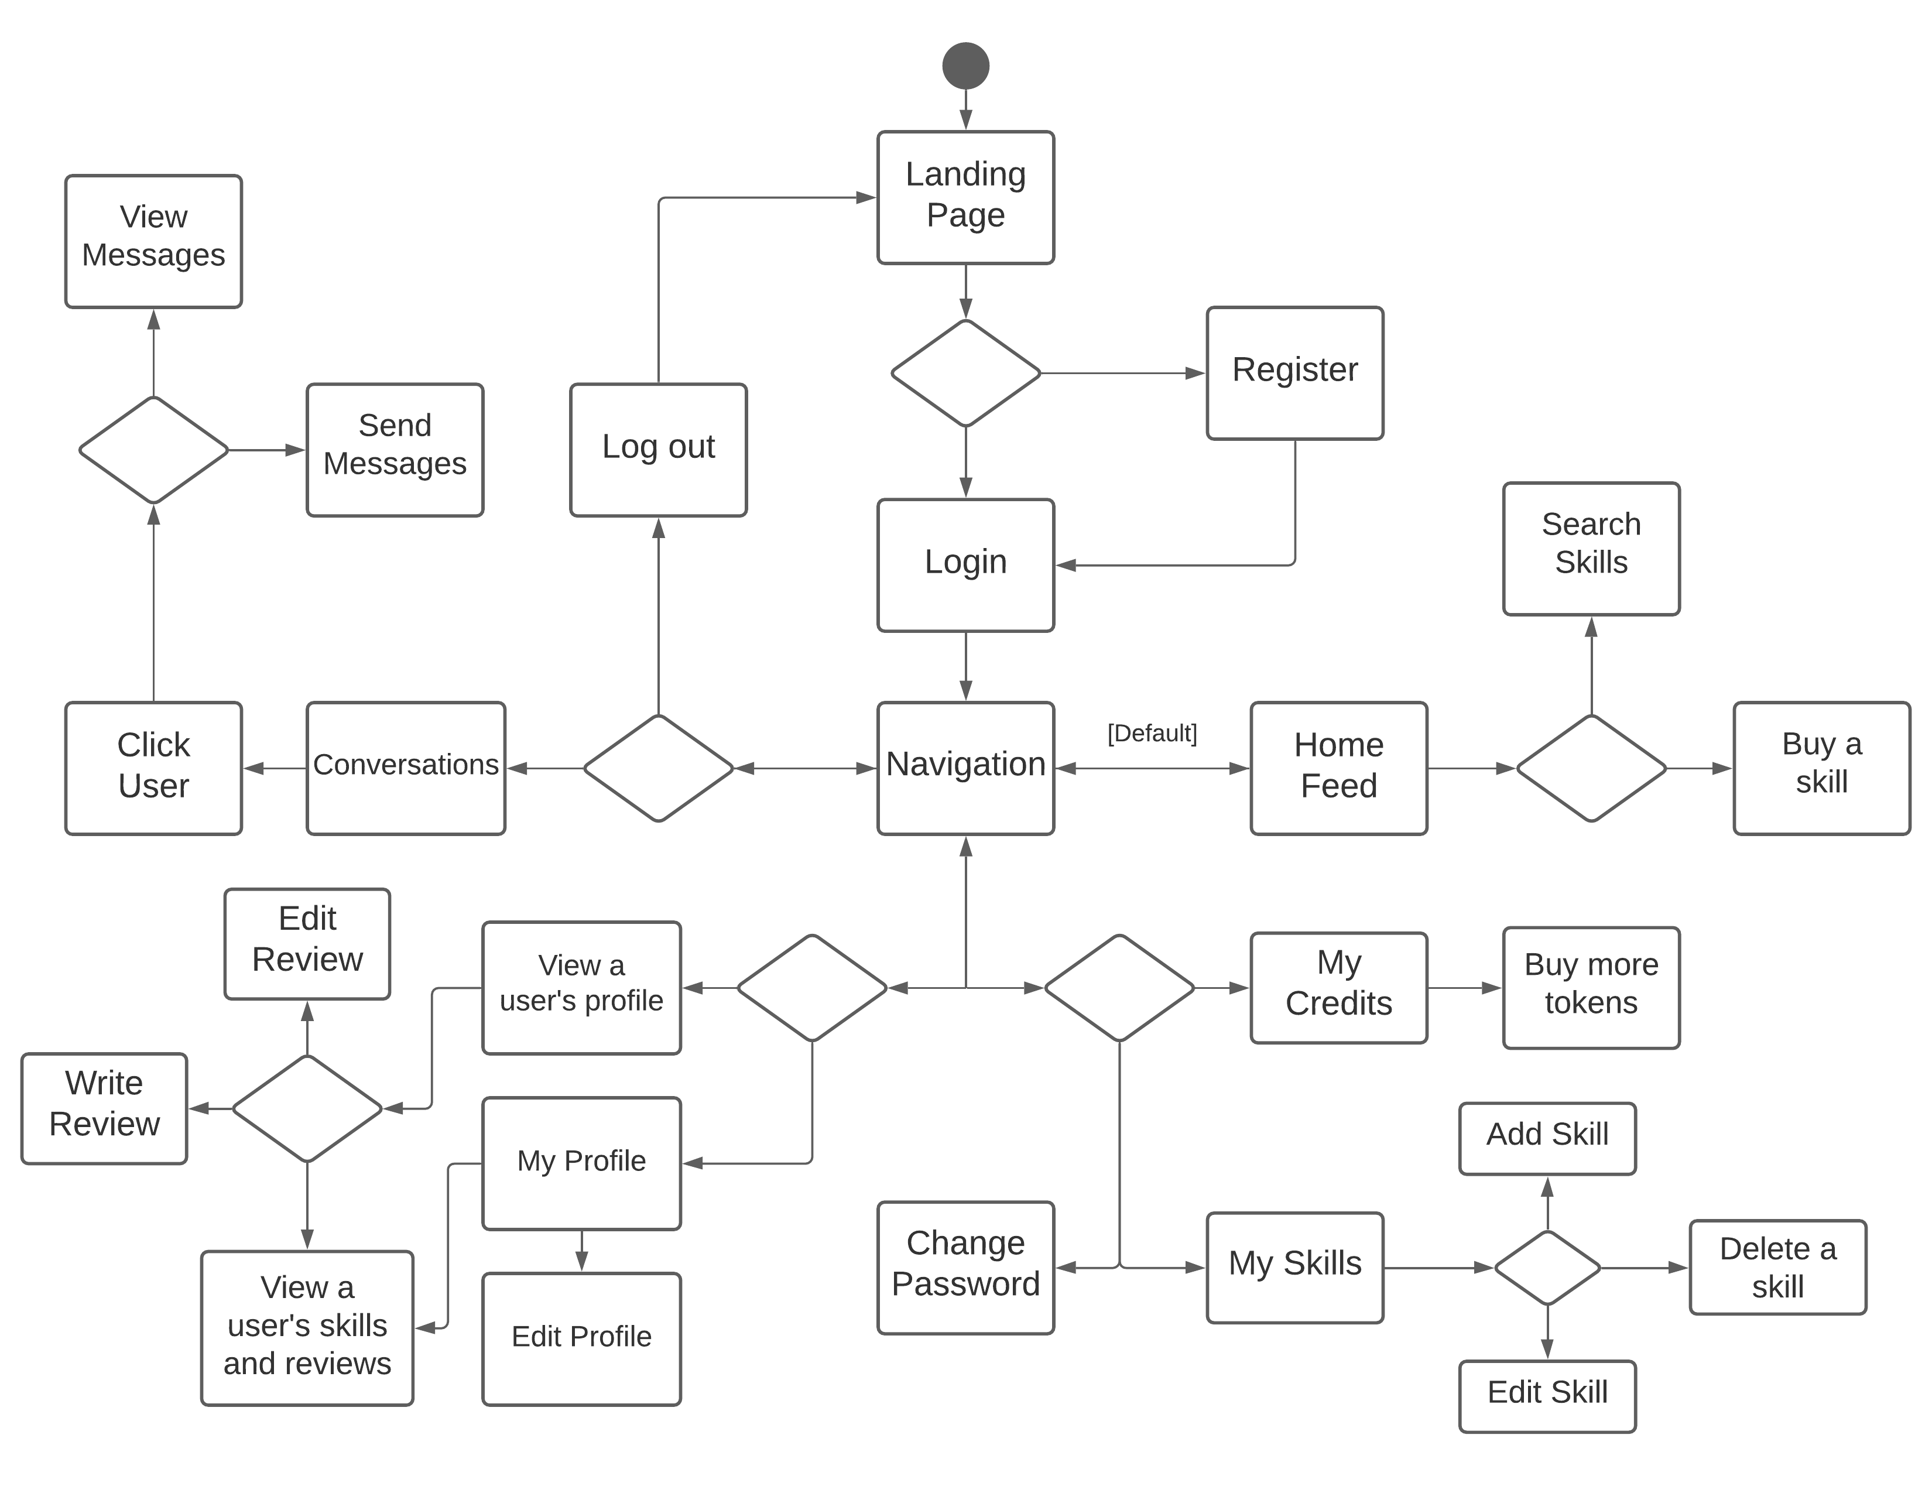
Activity Diagram

Slide 9
Application Programming Interface (API)
Swaggerhub
https://app.swaggerhub.com/apis/SkillTrade/api/1.0.0#/

Slide 10
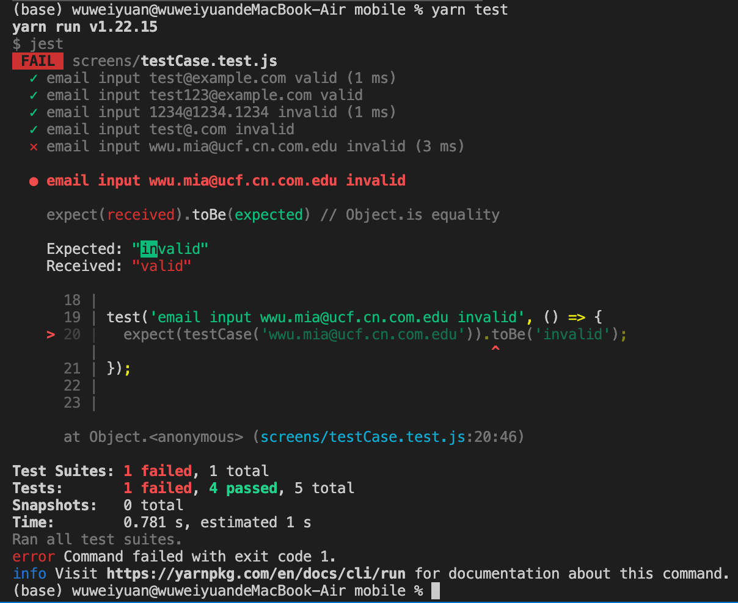
Unit Testing With Jest
--mobile app

Slide 11
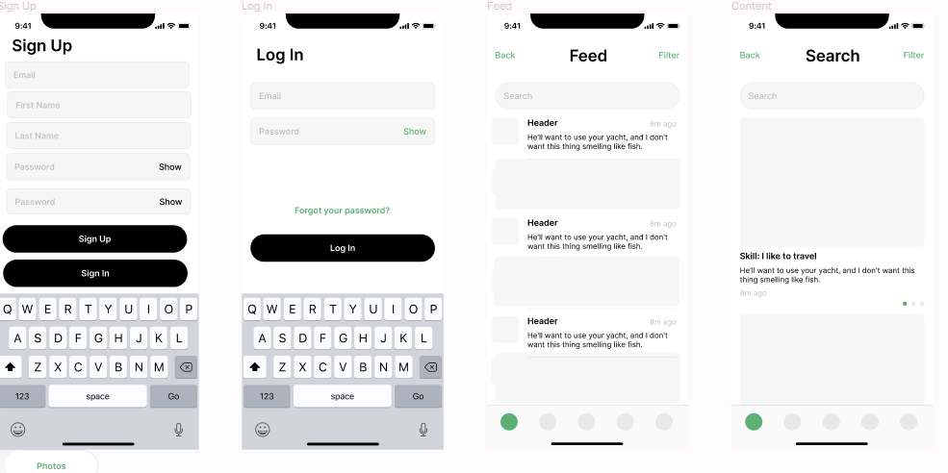
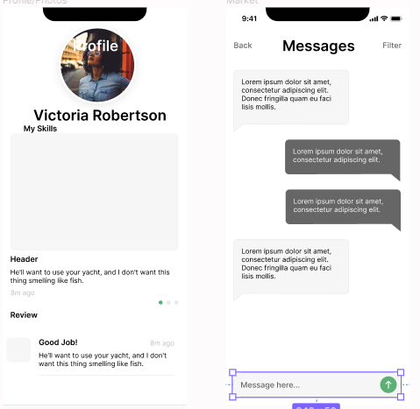
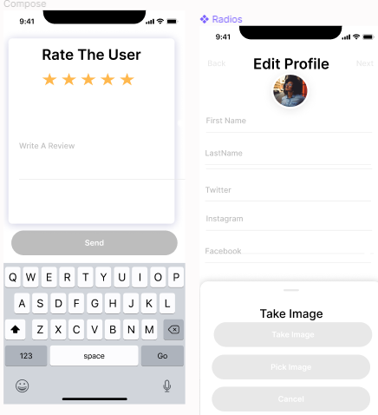
Prototypes
Mobile: Figma

Slide 12

Webapp < Prototype />
Link To Figma <Prototype />
This Photo by Unknown author is licensed under CC BY-ND.

Slide 13
Web App <Demonstration />
SkillTrade Web App
(Temp Mail Link)
This Photo by Unknown author is licensed under CC BY-ND.

Slide 14
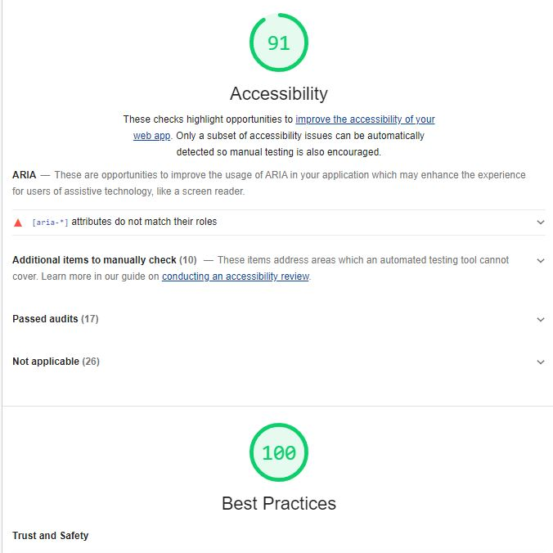
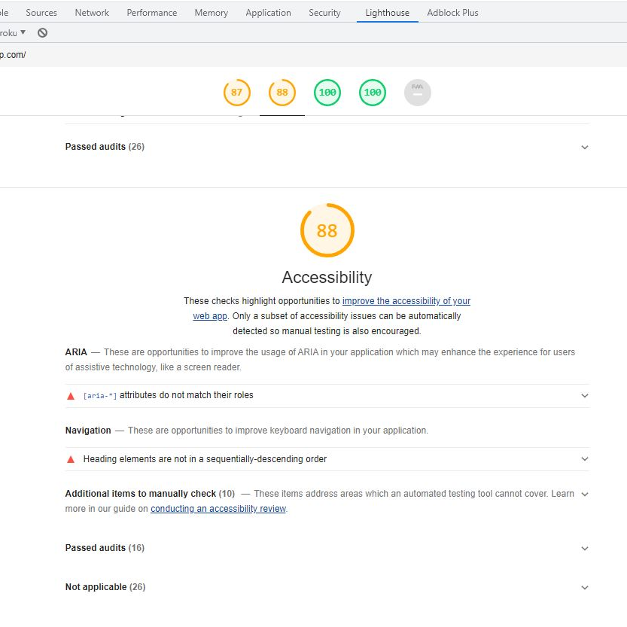
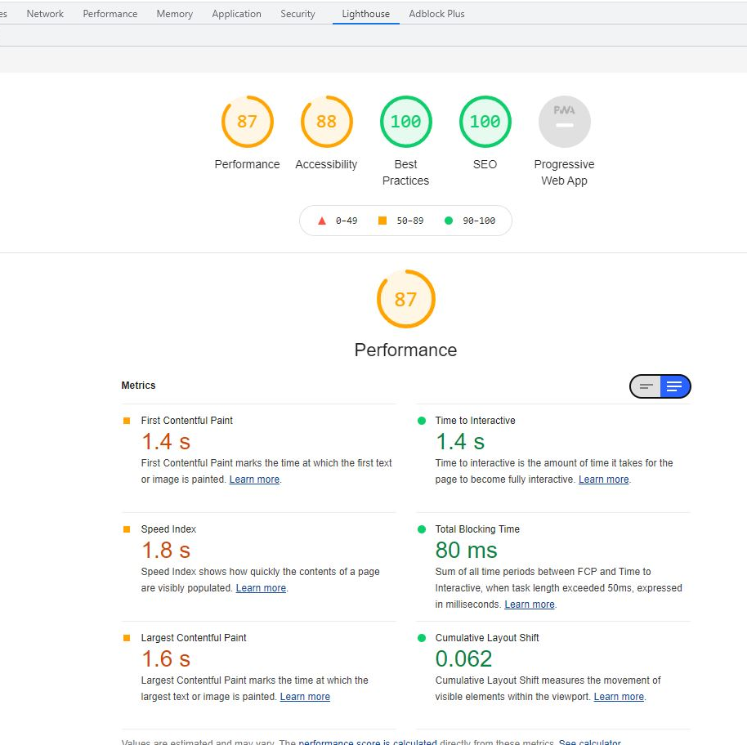
Accessibility
- aria-label
- aria-required

Slide 15
Mobile App Demonstration
40 seconds video for layout present
https://youtube.com/shorts/6xdiIJK4ELs?feature=share
Live mobile App operation for function present
This Photo by Unknown author is licensed under CC BY-ND.

Slide 16

Questions?

