Slide 1












Climate Data Challenge
16-17 March 2021
www.metoffice.gov.uk | © Crown Copyright 2021, Met Office

Slide 2



Sustainable Development
Dr Kirsty Lewis | Climate Science Advisor Foreign, Commonwealth and Development Office

Slide 3
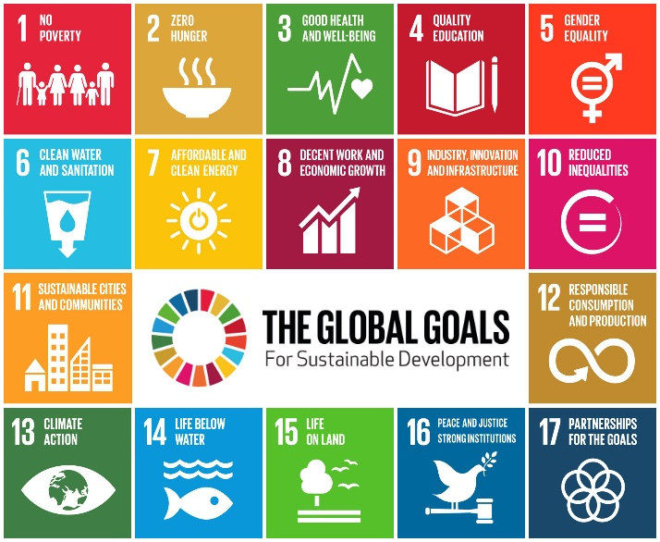
Background: Development in a changing climate
The Sustainable Development Goals (SDGs) are a collection of 17 interlinked goals designed to be a "blueprint to achieve a better and more sustainable future for all".
Climate change will hit the poorest and most vulnerable hardest and makes achieving these goals even more challenging. Adaptation to the climate change we are locked into is critical, even under the most optimistic mitigation scenarios, to meeting the SDGs and achieving a future that is better than the present.
Understanding that adaptation is required is one thing, it is a much harder task to know what needs to be done. Part of the reason for this is the complexity of human and human-environment systems and the need to account for diverse local situations. Informing adaptation action requires integrating knowledge at multiple scales that takes into account not only the climate but the socioeconomic, cultural, biophysical, and institutional contexts too.

Slide 4
Challenge: Development in a changing climate
This hackathon challenge is to develop a tool or tools for conceptualising the adaptation challenge to inform practical action towards managing climate-related risk to achieve sustainable development in a variable and changing climate.
Using an example Low Income Country (LIC), and potentially with a single SDG in mind, such as zero poverty. Develop a framework or tool for assessing and integrating the range of data and information sources that build a picture of climate risk in the context of development objectives for that country.
This requires consideration of the components of climate risk (hazard, exposure and vulnerability, where we can consider vulnerability to be comprised of sensitivity of systems to climate and capacity to cope with adverse events). Approaching from a broad systems perspective to highlight the impact that the changing climate might have in the context of overall risk, including sensitivity of outcomes to evidential uncertainty.

Slide 5

Useful information
Sustainable Development Goals: https://sdgs.un.org/goals
IPCC WG II Chapter 20 - Climate-Resilient Pathways: Adaptation, Mitigation, and Sustainable Development https://www.ipcc.ch/site/assets/uploads/2018/02/WGIIAR5-Chap20_FINAL.pdf

Slide 6
Contact information
In case of questions as you are working on your challenge:
Contact the expert for the ocean and coastal theme
Dr Kirsty Lewis | Kirsty.lewis@fcdo.gov.uk
Contact the Met Office for general queries about the Climate Data Challenge
cop26@metoffice.gov.uk

