Slide 1












Climate Data Challenge
16-17 March 2021
www.metoffice.gov.uk | © Crown Copyright 2021, Met Office

Slide 2




Nature Based Solutions
Nature Based Solutions for achieving multiple objectives from land
Dr Mike Rivington, Land Use Systems Modeller, The James Hutton Institute

Slide 3
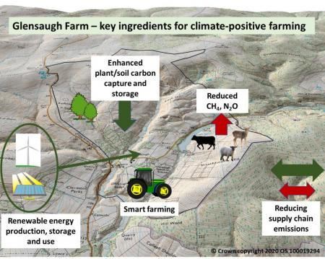
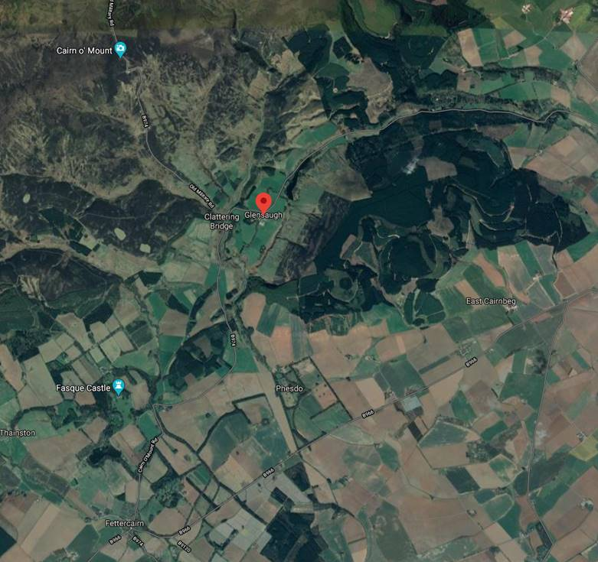
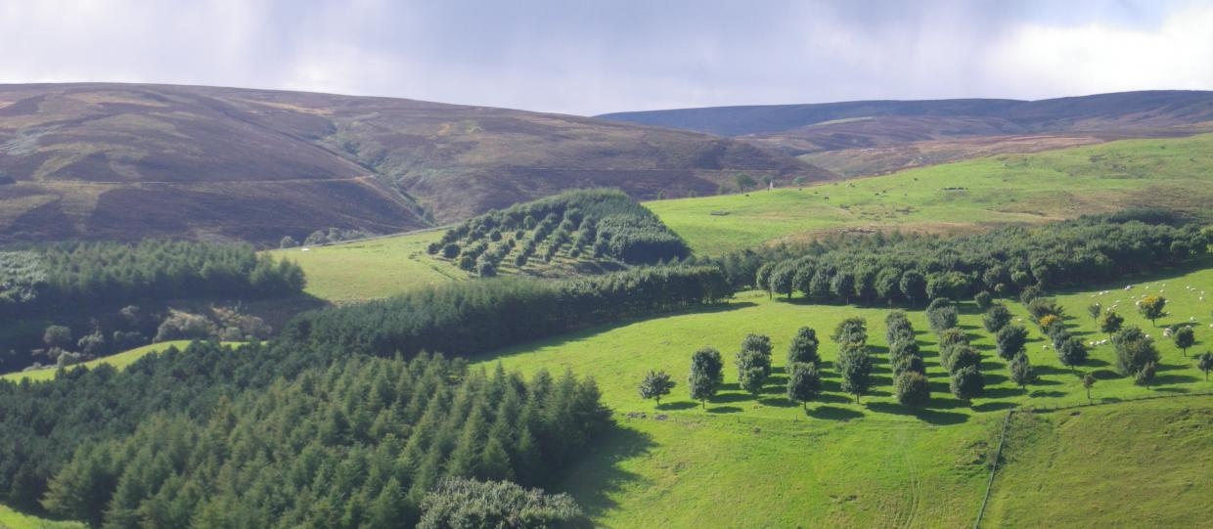
Challenge: Nature Based Solutions for achieving multiple objectives from land
Land provides us with many multiple benefits, including food, water, a place to live, recreation. These are often referred to as ecosystem services. Land is however vulnerable to climate change, over-exploitation and unsustainable practices. Land can be a source of greenhouse gases or a sink for carbon. How we manage land is therefore vital in the fight against climate change, as well as reversing biodiversity loss and ecosystem degradation.
Climate change is a known threat, but there is also an opportunity to use Nature Based Solutions to help adapt to impacts and achieve mitigation. This requires new approaches to land use and management.
This Challenge addresses the issue of how to use Nature Based Solutions to help achieve a sustainable mix of land uses to achieve multiple objectives, including:
Prosperous rural economies and communities.
Net zero emissions
Enhance biodiversity / ecosystem restoration
Sustainable food production
Water quality / quantity / flood risk management
Resilience to climate impacts and other shocks

Slide 4
Useful information
Glensaugh Climate-Positive Farming: https://glensaugh.hutton.ac.uk/
Spatial data sets: http://nar.hutton.ac.uk/dataset/spatial-datasets-for-glensaugh-research-farm
Natural Asset Register: http://nar.hutton.ac.uk/organization/natural-asset-register?page=1
Soils@Hutton: https://www.hutton.ac.uk/learning/soilshutton
Soils Information for Scottish Soils: http://sifss.hutton.ac.uk/SSKIB_Stats.php
Land Capability for Agriculture: https://www.hutton.ac.uk/learning/exploringscotland/land-capability-agriculture-scotland
Paper: The science, policy and practice of nature-based solutions: An interdisciplinary perspective
The James Hutton Institute: https://www.hutton.ac.uk/

Slide 5
Contact information
In case of questions as you are working on your challenge:
Contact the expert for the ocean and coastal theme
Mike Rivington | mike.rivington@hutton.ac.uk
Contact the Met Office for general queries about the Climate Data Challenge
cop26@metoffice.gov.uk

