Slide 1

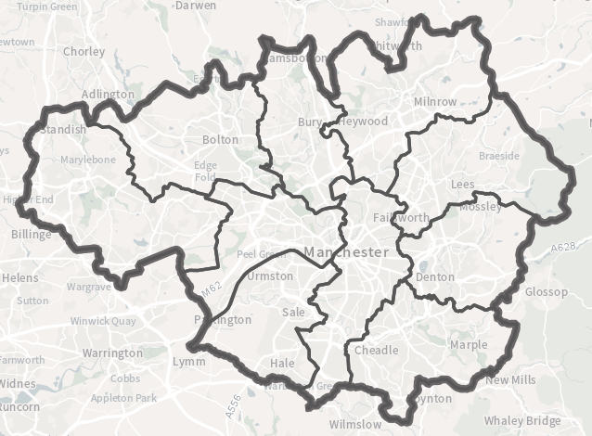
Met Office Climate Data Challenge Hackathon
Challenge Title:
Identify risks, propose Nature-based Solutions, and assess the suitability and feasibility of approaches within Greater Manchester
Primary Datasets:
IGNITION Nature-based Solutions Evidence Base
MappingGM Open Data Infrastructure Map
MappingGM Greater Manchester Spatial Framework Map
MappingGM Green City Region Map
MappingGM Bee Network Map
MappingGM People and Communities Map
Challenge Criteria:
Analyse the geospatial data and evidence base, identifying environmental, social and economic risks and defining ‘risk areas’ to focus on
Propose appropriate Nature-based Solutions to enhance the adaptive and mitigative capacity of the ‘risk areas’ identified
Develop a report that makes the case for the proposed Nature-based Solutions, assessing the broader delivery challenges encountered

