Slide 1
30 x 30 initiative
HOW CAN IT DELIVER FOR NATURE AND CLIMATE?
James Gardner
Daniela Schmidt
Hebin Lin
Guy Collins
Clive Walmsley
Duncan Stone
Micheil Page
https://30x30.github.io

Slide 2
30 x 30
Many countries are pledging to meet the 30 by 30 policy goal of protecting 30% of terrestrial and 30% of marine territory by 2030, including the UK.
The UK Prime Minister, in September 2020, has committed to protect 30% of the UK’s land by 2030, along with the Devolved Administrations.
The UK already is close to this target in both the terrestrial and marine having a diverse range of designations.
Designation does not necessarily mean protection.
Effective conservation management and adaptation require long-term management considering climate change impacts.
What should be the level of protection and management for both biodiversity and climate change mitigation and adaptation?

Slide 3
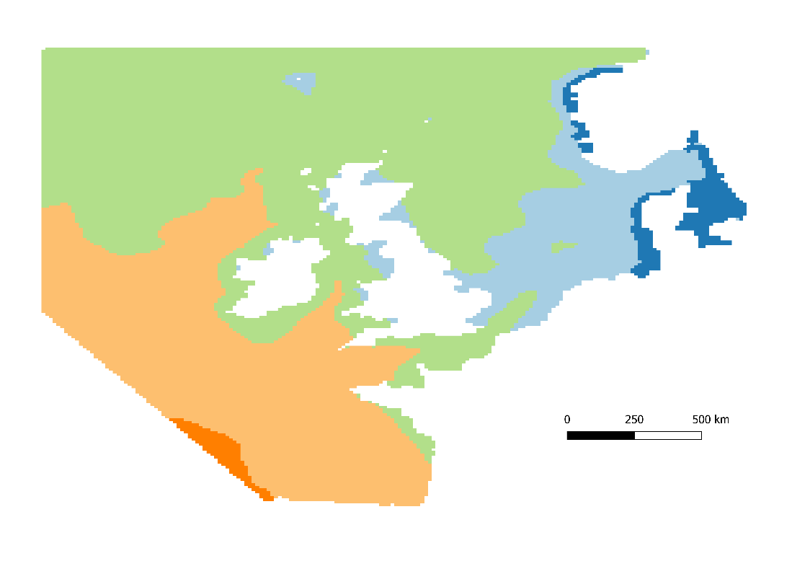
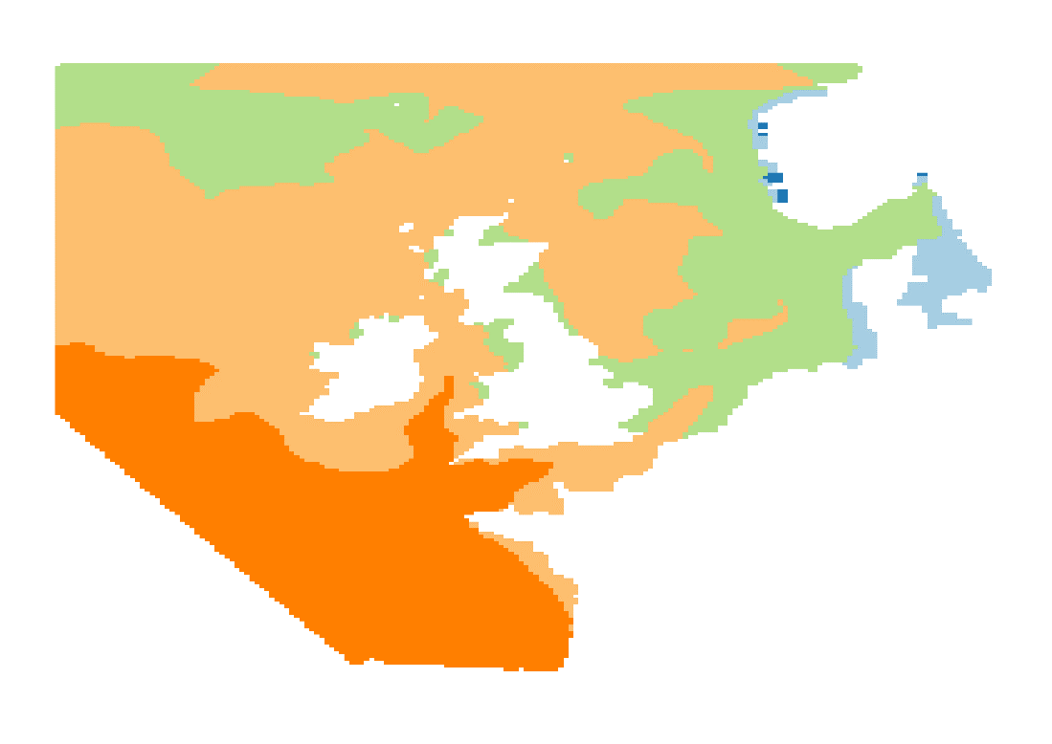
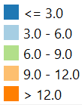
Winter Sea Surface Temperature
1960 to 1989
Winter Sea Surface Temperature
2069 to 2098
0
200
500 km
(Maps are based on data from UKCP09)

Slide 4
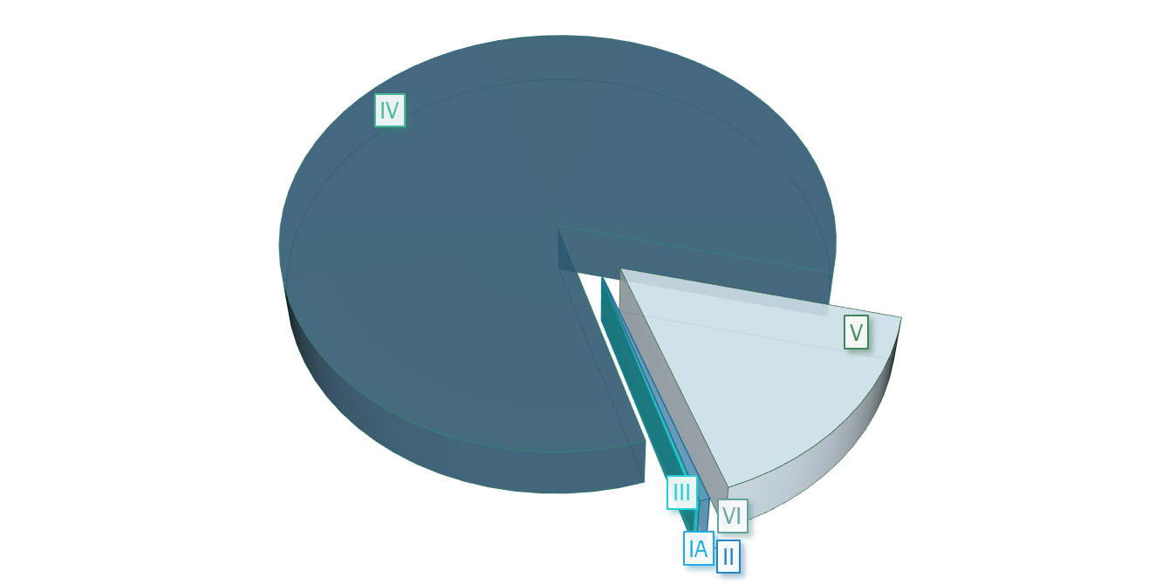
30 x 30: UK Protected AREAS by ExTent
IUCN Categories:
IA – Strict Nature Reserve
IB – Wilderness Area
II – ‘National Park’
III – Natural Monument or Feature
IV – Habitat / Species Management Area
V – Protected Landscape / Seascape
VI – Protected Area With Sustainable Use Of Natural Resources
(>80% of UK protection is in IV / V categories)
LAND
MARINE
Source: https://www.protectedplanet.net/country/GBR

Slide 5
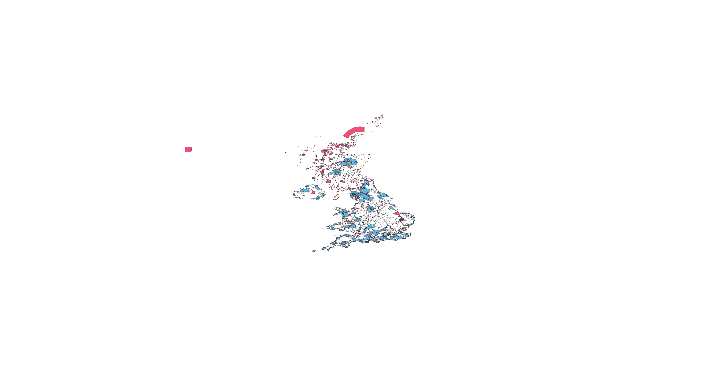
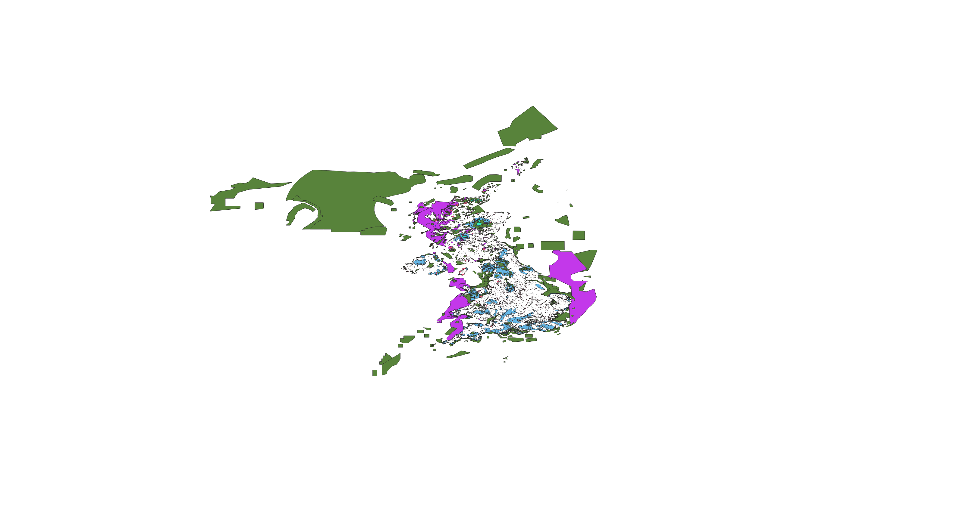
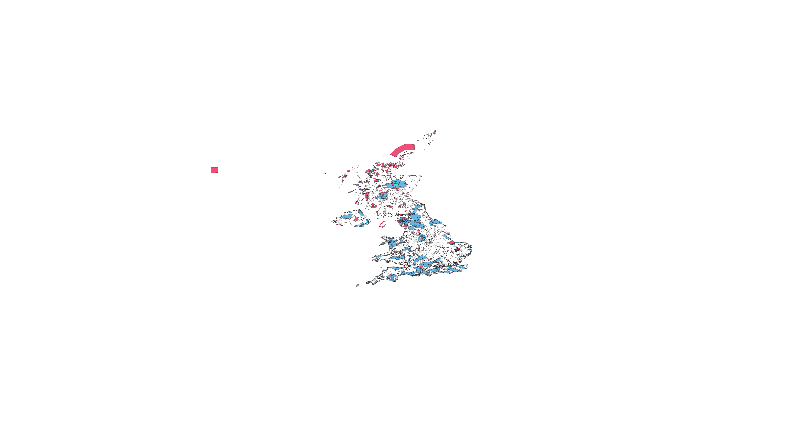



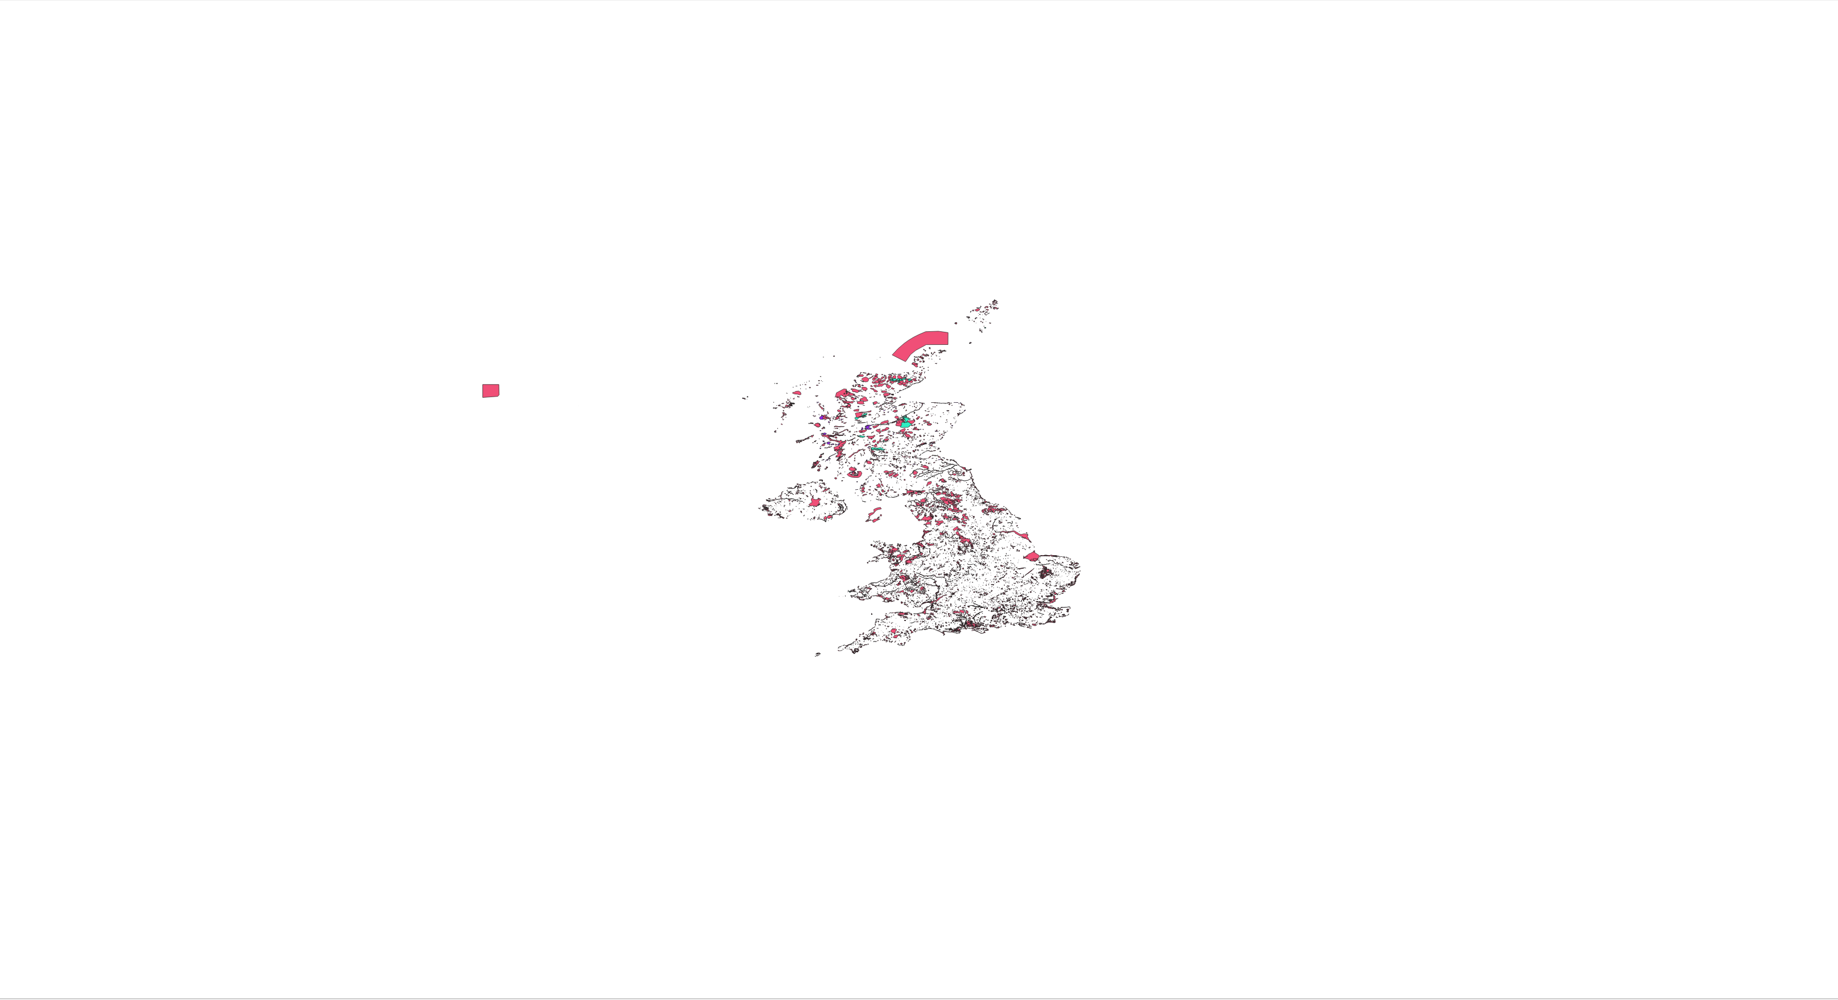

I, II
I, II, III, IV
I, II, III, IV, V
I, II, III, IV, V, VI
I, II, III, IV, V, VI and others
I, II, III, IV
I, II, III
I

Slide 6
30 x 30 INITIATIVE
Innovation – we took a holistic approach to consider the full range of marine and terrestrial protected areas across the UK.
How well protected are these areas? The International Union for the Conservation of Nature classification system with 6 levels of protection range from total protection to landscape and seascape designations BUT do not map directly to UK designations.
Impact – improves understanding that designating further land is not the end of the process, it needs to be an on-going process of active management with clear biodiversity and climate change goals, along with proactive local community engagement.
Alignment to COP26 – Nature based solutions are one of the 5 conference themes. The importance of nature for climate change action will mean that 30 x 30 will be an important international policy for the future.
It is important that this initiative is implemented to deliver nature based solutions that benefit humans and biodiversity rather than just climate mitigation that can potentially have negative side effects if badly implemented.
Delivery of 30 by 30 needs to have long-term perspective which takes into account species and ecosystem needs under future climate scenarios.
Right designation or protection in the right place!

