Slide 1
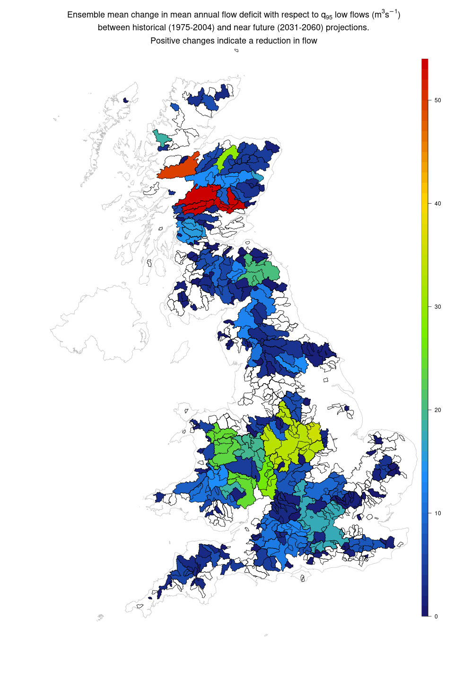







Nature Based Solutions, Challenge 2:
What is the best use for our land?
Q95
The river flow that is equalled or exceeded for 95% of the time.

Slide 2
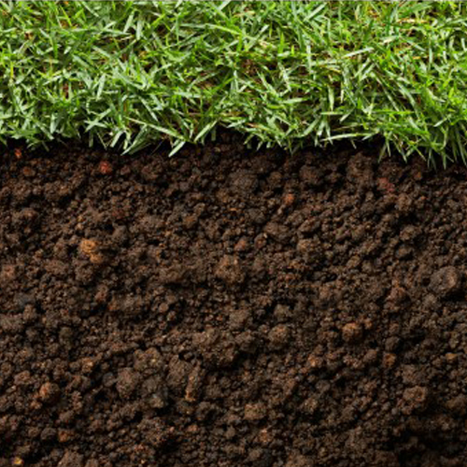


Nature Based Solutions, Challenge 2:
What is the best use for our land?
2.5%
Increase in organic matter content holds an extra
297,000 litres
of fresh water per hectare.
Improve water retention with better soil structure through
reduction in tillage and adopting
cover crops.
No till transition also reduces costs, reduces erosion and improves carbon sequestration.
Cover cropping also reduces evaporation, reduces erosion and improves carbon sequestration.

Slide 3
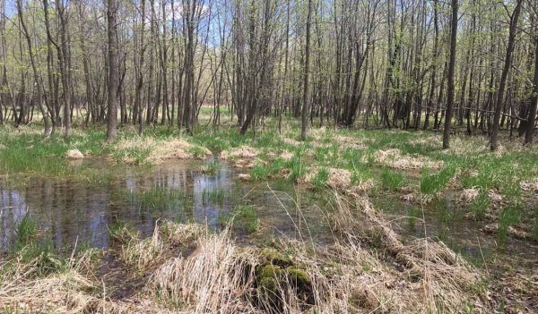

Nature Based Solutions, Challenge 2:
What is the best use for our land?
Wetland restoration
Through removing drainage and restoring wetland.
Agroforestry and silvopastoral systems combining trees, crops and livestock in complex rotations.
Reservoirs and lagoon rainwater capture to hold more water.

Slide 4
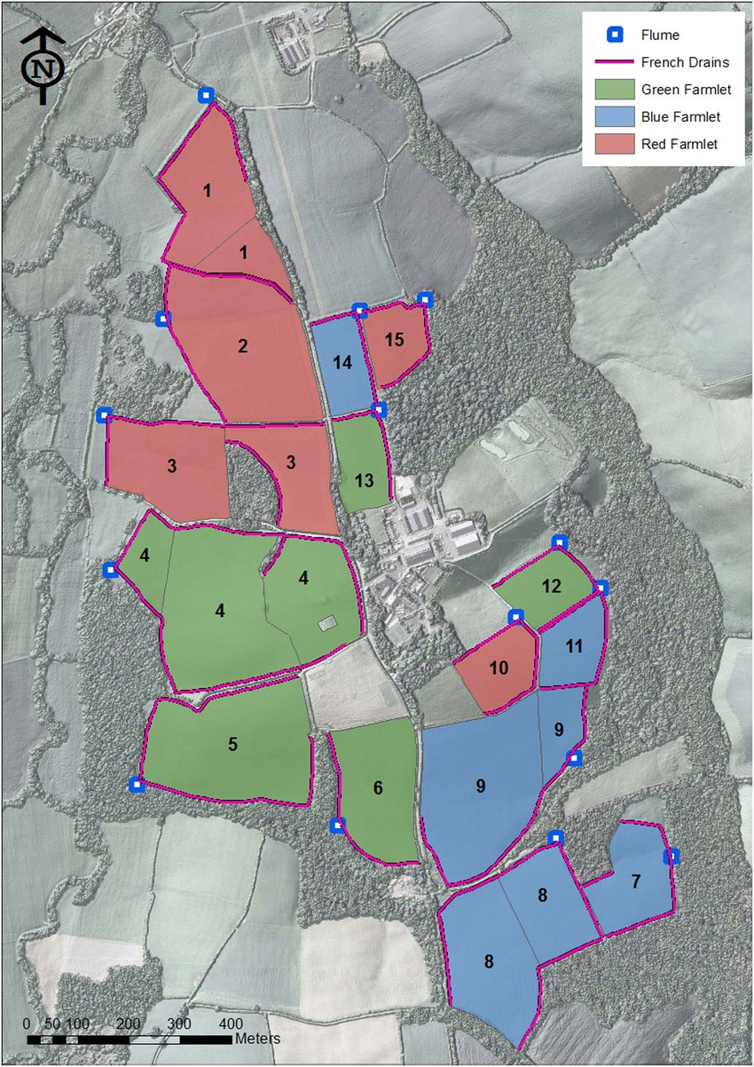

Nature Based Solutions, Challenge 2:
What is the best use for our land?
Using smart sensors to validate water retention and contamination in soil structure under different agricultural practices.
North Wyke Farm Platform
Rothamstead Research

Slide 5
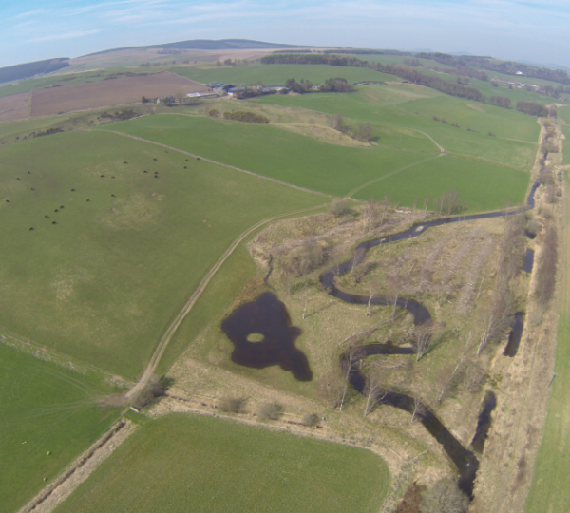

Nature Based Solutions, Challenge 2:
What is the best use for our land?
Eddlestone Water Project
Tweed Catchment
Glensaugh’s Farm Project
Grampian Hills
Re-meandering, wetland restoration and natural flow restriction interventions.
Agroforestry and peatland restoration.

Slide 6
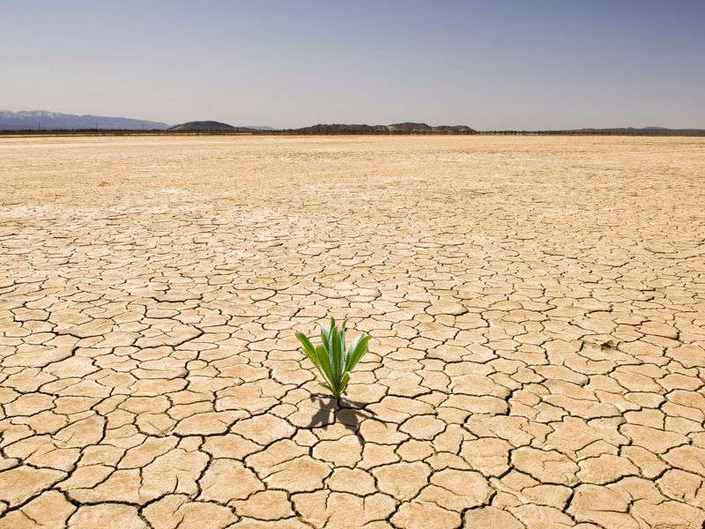

Nature Based Solutions, Challenge 2:
What is the best use for our land?
28%
Of all abstracted water comes from farm reservoirs, a significant increase since the droughts of the 1990’s.
£70-160 million.
Financial impact of 2011/2012 drought.
30%
River flow decrease during dry periods, given a 2°C increase in global temperature.
30b litres
Reduction in abstraction licences by the Environment Agency since 2008.

