Slide 1
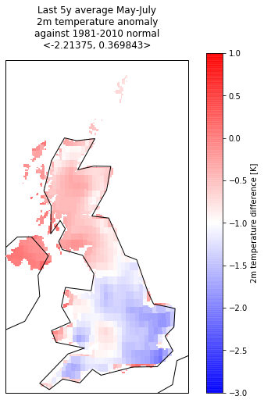
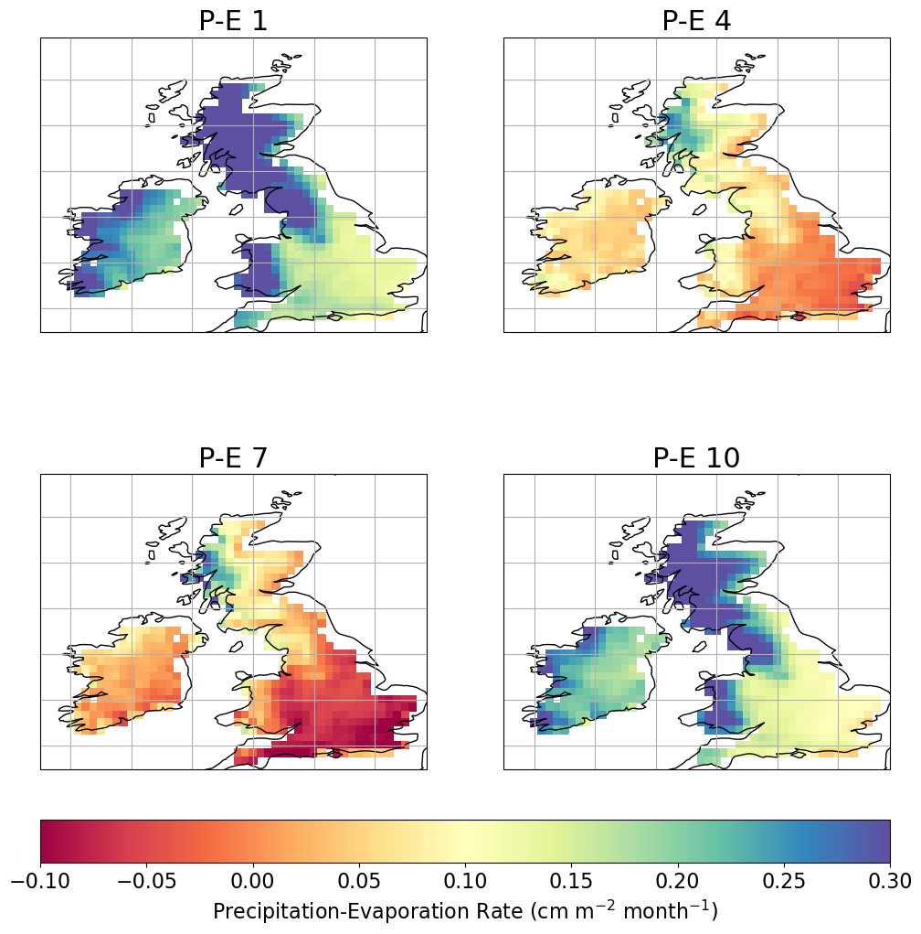
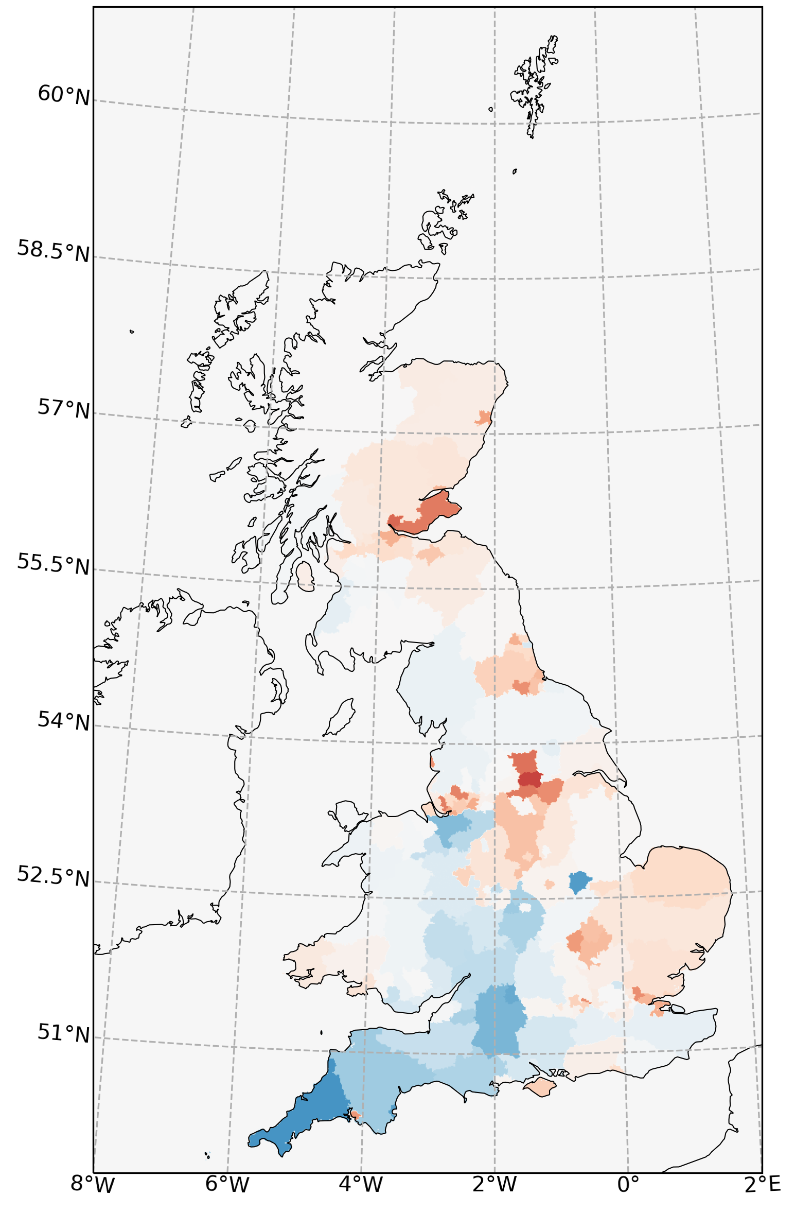
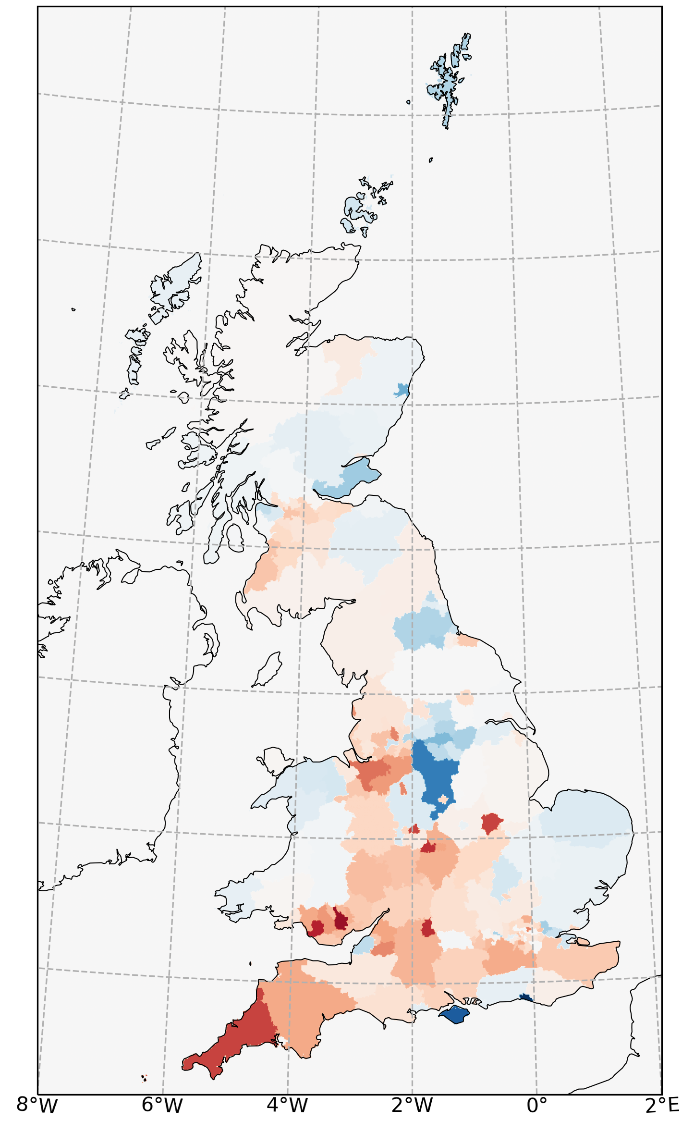
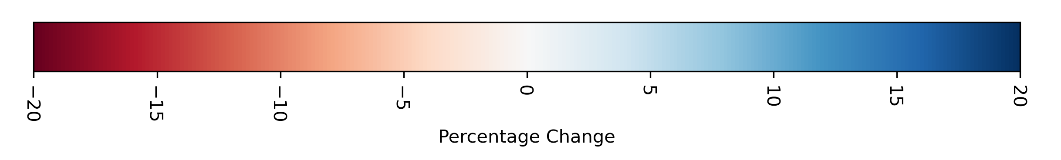
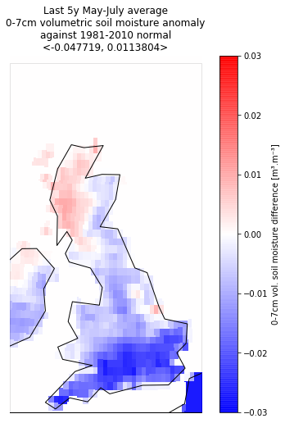
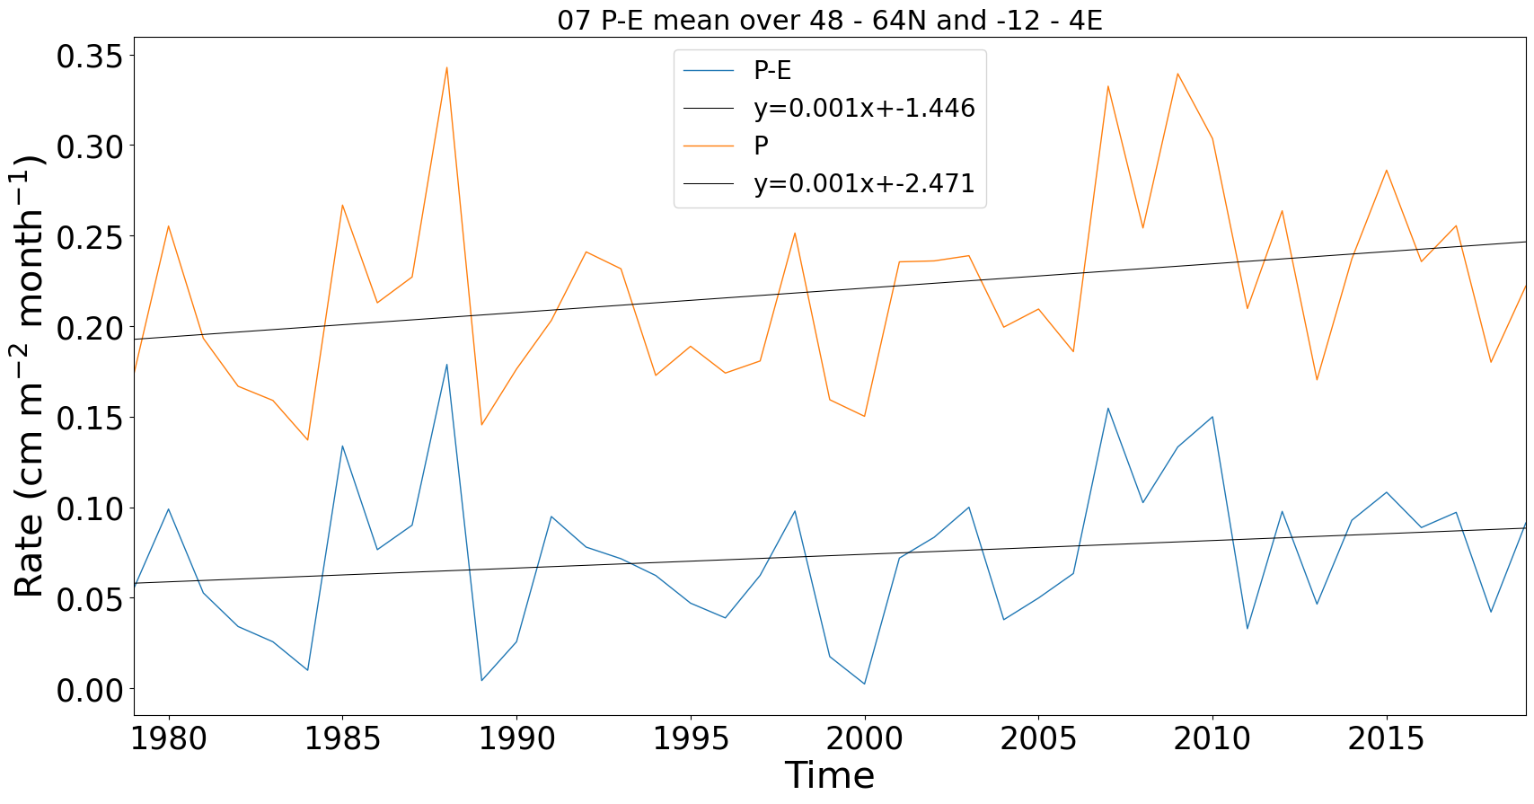
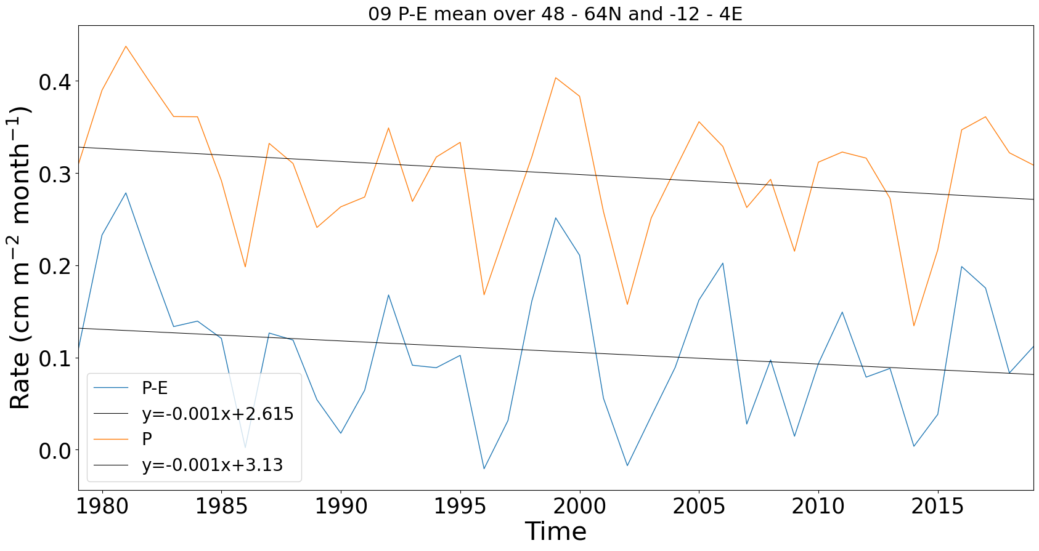
How has climate change affected agricultural choices?
Regional Land Use Changes: 1990 - 2015
Explaining these agricultural changes through climate drivers is inconclusive: - More detailed statistical analyses needed on a granular level - Assessing specific crop choices may provide stronger signal Data: CEH Land Cover; ECMWF ERA5 Reanalysis
Precipitation - Evaporation
Jan
Apr
2m
temperature
Jan
Jul
Oct
Arable Land Change
Grass Land Change
Jul
Soil
Moisture
Sep
Notes:
Started by looking at overall UK land changes and at a large scale there were obvious changes
Then tried to zoom in on certain regions BUT we didn’t find anything particularly conclusive at a county scale

