Slide 1
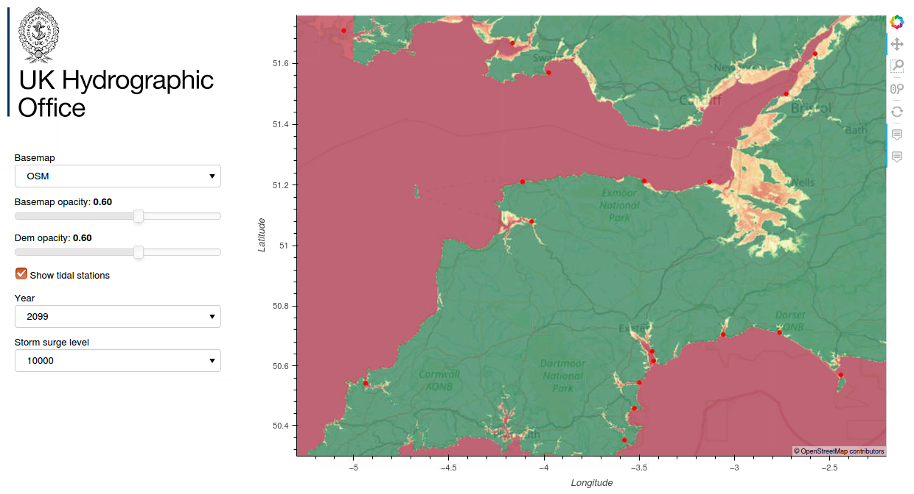
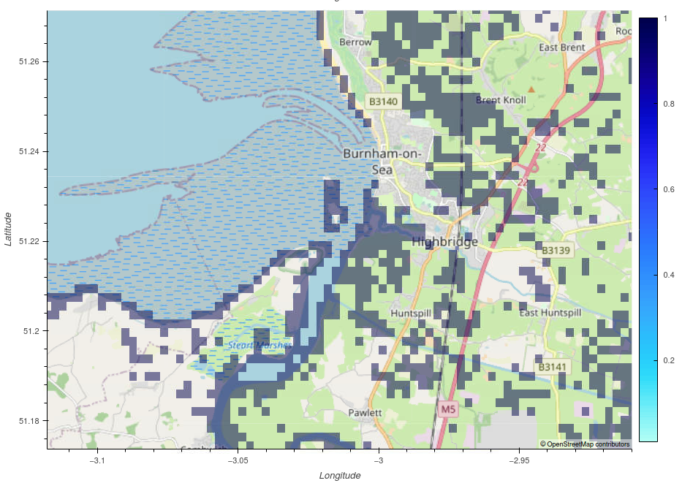
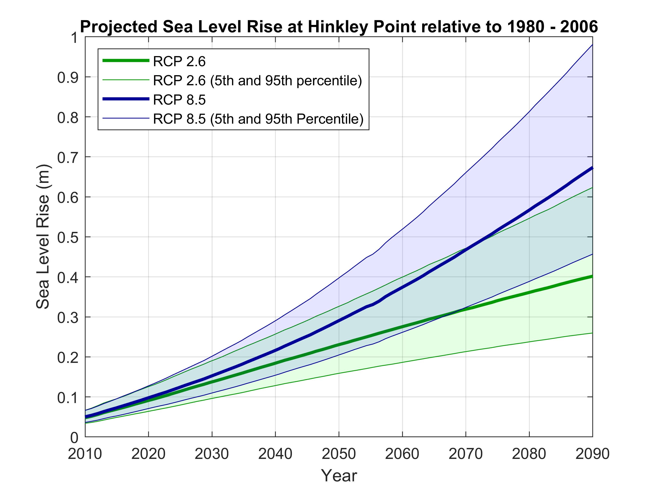
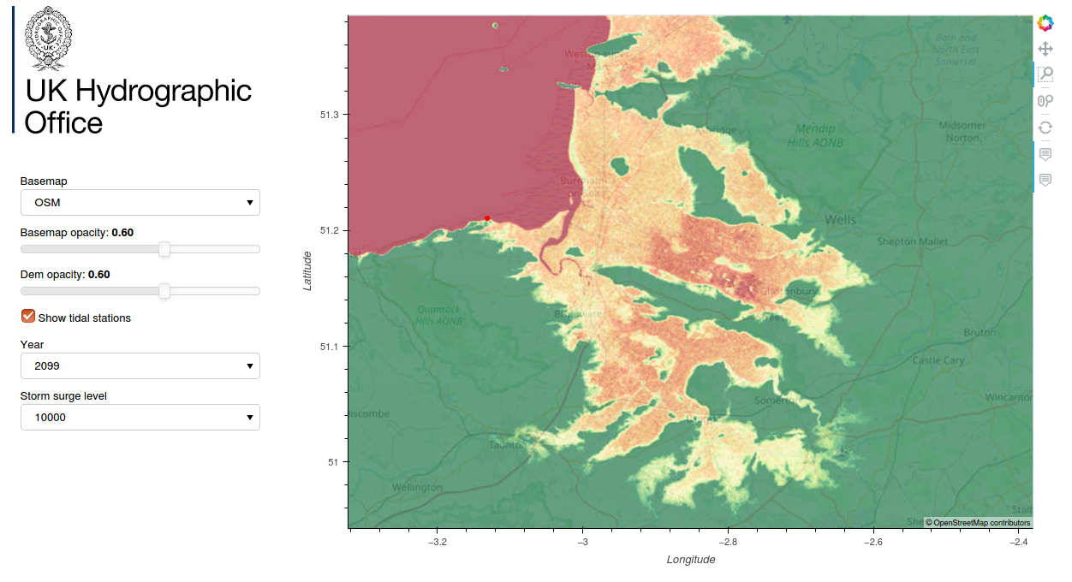
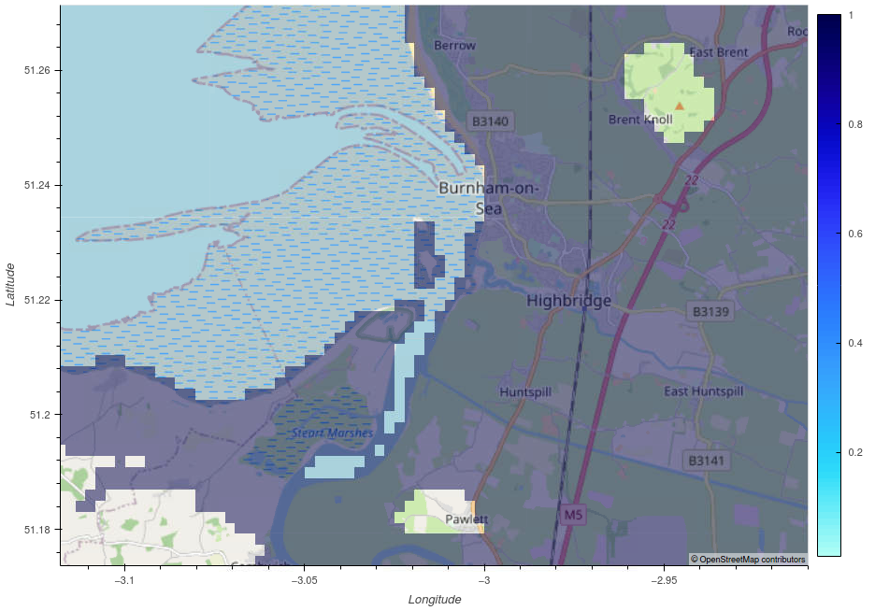
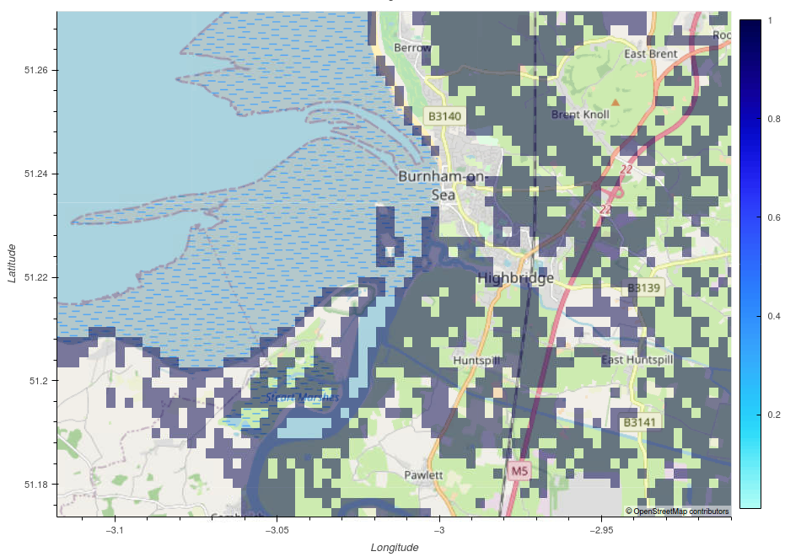
Interactive tool to identify communities vulnerable to inundation
Team UKHO
Providing an overview of at risk areas
Accurate predictions to assist local planning
Projected sea level in 2050
High tide
Variability in sea level rise projections
Year 2099
Storm surge 1 in 10,000
Red = at risk
Green = safe
High tide
1 in 100 year storm surge!
Projected sea level in 2099
High tide

