Slide 1












Climate Data Challenge
16-17 March 2021
www.metoffice.gov.uk | © Crown Copyright 2021, Met Office

Slide 2




Marine and Coastal
Sea level rise, extreme events
and coastal impacts challenge
Professor Kevin Horsburgh | National Oceanography Centre

Slide 3
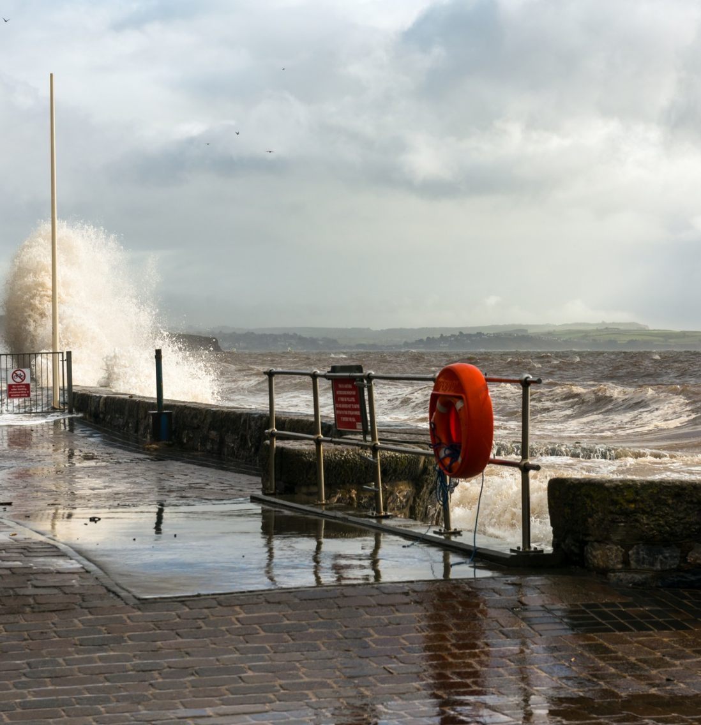
Challenge: Sea level rise, extreme events and coastal impacts
Coastal flood risk is increasing globally due to changing climate, population growth, and infrastructure development in low-lying coastal areas. Annual damages from coastal flooding in the UK alone are expected to more than double to £1.5 billion by the 2080’s, due to sea-level rise.
Protecting coastal communities is a long term problem that involves a better understanding of uncertainties surrounding sea level rise. Hard coastal defence infrastructure is becoming increasingly expensive and nature based solutions are gaining recognition as a key tool to provide protection from extreme events like storm surges.
Participants are encouraged to use the data sources indicated (or others) and perform novel analysis, and/or visualisation for a stakeholder group of their choice, for any of the following: sea level rise uncertainty; increased extreme sea levels; the role of nature based solutions for coastal protection

Slide 4
Useful information
UKCP18 Marine Projections: https://www.metoffice.gov.uk/research/approach/collaboration/ukcp/marine-projections
https://ukclimateprojections-ui.metoffice.gov.uk/ui/home
UK Tide Gauge data: https://www.ntslf.org/data
Global Sea Level Data from the Permanent Service for Mean Sea Level (PSMSL): https://www.psmsl.org/
Probabilistic sea level projections through the 21st century for RCP 4.5, RCP 8.5 and High-end (RCP 8.5 with increased ice-sheet contribution) from Jevrejeva et al. (2016):
http://www.climateeconometrics.org/data/
Extreme coastal flood levels from the Environment Agency:
https://www.gov.uk/government/publications/coastal-flood-boundary-conditions-for-uk-mainland-and-islands-design-sea-levels
MCM manual: https://www.mcm-online.co.uk/handbook/
Marine Environmental Data and Information Network: https://portal.medin.org.uk/portal/start.php

Slide 5
Useful information (continued)
National Coastal Erosion Risk Mapping (NCERM):
https://data.gov.uk/dataset/7564fcf7-2dd2-4878-bfb9-11c5cf971cf9/national-coastal-erosion-risk-mapping-ncerm-national-2018-2021
OpenStreetMap: https://www.openstreetmap.org/#map=5/54.910/-3.432
ONS population data:
https://www.ons.gov.uk/peoplepopulationandcommunity/populationandmigration/populationestimates/datasets/lowersuperoutputareamidyearpopulationestimates
ONS Open Geography portal: https://geoportal.statistics.gov.uk/
Land elevation data from Ordnance Survey:
https://osdatahub.os.uk/downloads/open/Terrain50
Coastal Channel Observatory survey data: https://www.channelcoast.org/data_management/online_data_catalogue/
Wales Coastal Monitoring Centre: http://www.welshcoastalmonitoringcentre.cymru/eng/

Slide 6
Contact information
In case of questions as you are working on your challenge:
Contact the expert for the ocean and coastal theme
Kevin Horsburgh | kevinh@noc.ac.uk
Contact the Met Office for general queries about the Climate Data Challenge
cop26@metoffice.gov.uk

