Slide 1
Group 3 Contact manager
By: Group 3

Slide 2
Team and Roles
Nathaniel McKain – Project Manager/Javascript
Ryan Heitz - Javascript
Phuoc Nguyen – PHP
Shawn Berkley – PHP
Zach Steinberg – PHP
Ryan Hildalgo - Database
Jared Jackson – HTML/CSS

Slide 3
Tools
goDaddy for both Database and Website
Cpanel for file management
MyPHP for Database management
goDaddy support

Slide 4
Our Project
Manages contacts for a user
Create a new user
Add contacts
Search contacts
Edit contacts
Remove contacts
Connects to a Database
User information
Contact information
Security
Hash password
Escape inputs

Slide 5
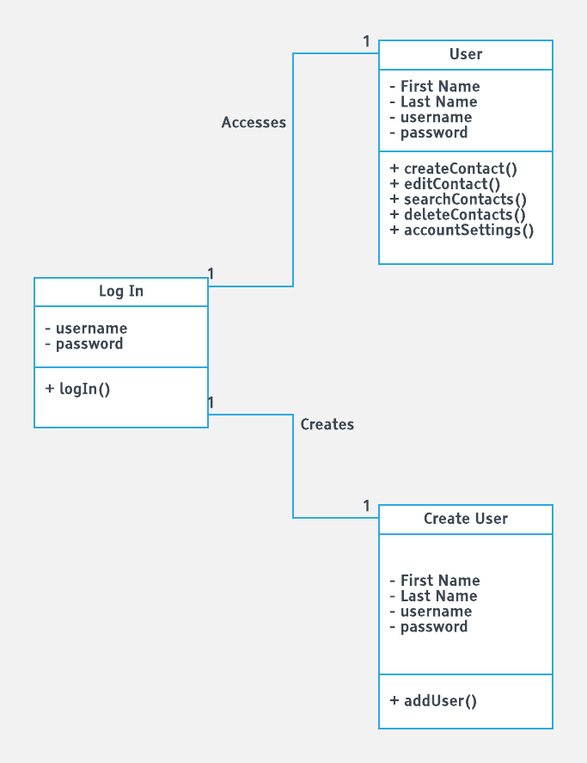
Class Diagram

Slide 6
The Good
Group got along really well
Made a functioning website
Learned useful information about building an application
Developed employable skills

Slide 7
The Not so Good
Overwrote each others files all the time
Sometimes online code editor did not save
For a day could not create a connection to the Database

Slide 8
What We Learned
How to make a Database
Create tables
Use a foreign key
How to write PHP
Connect to a Database
Select from and insert to a Database
How to write JavaScript
Creating a payload
How to hash a password
Coordination for version management
Combining different programming language in the Lamp stack

Slide 9
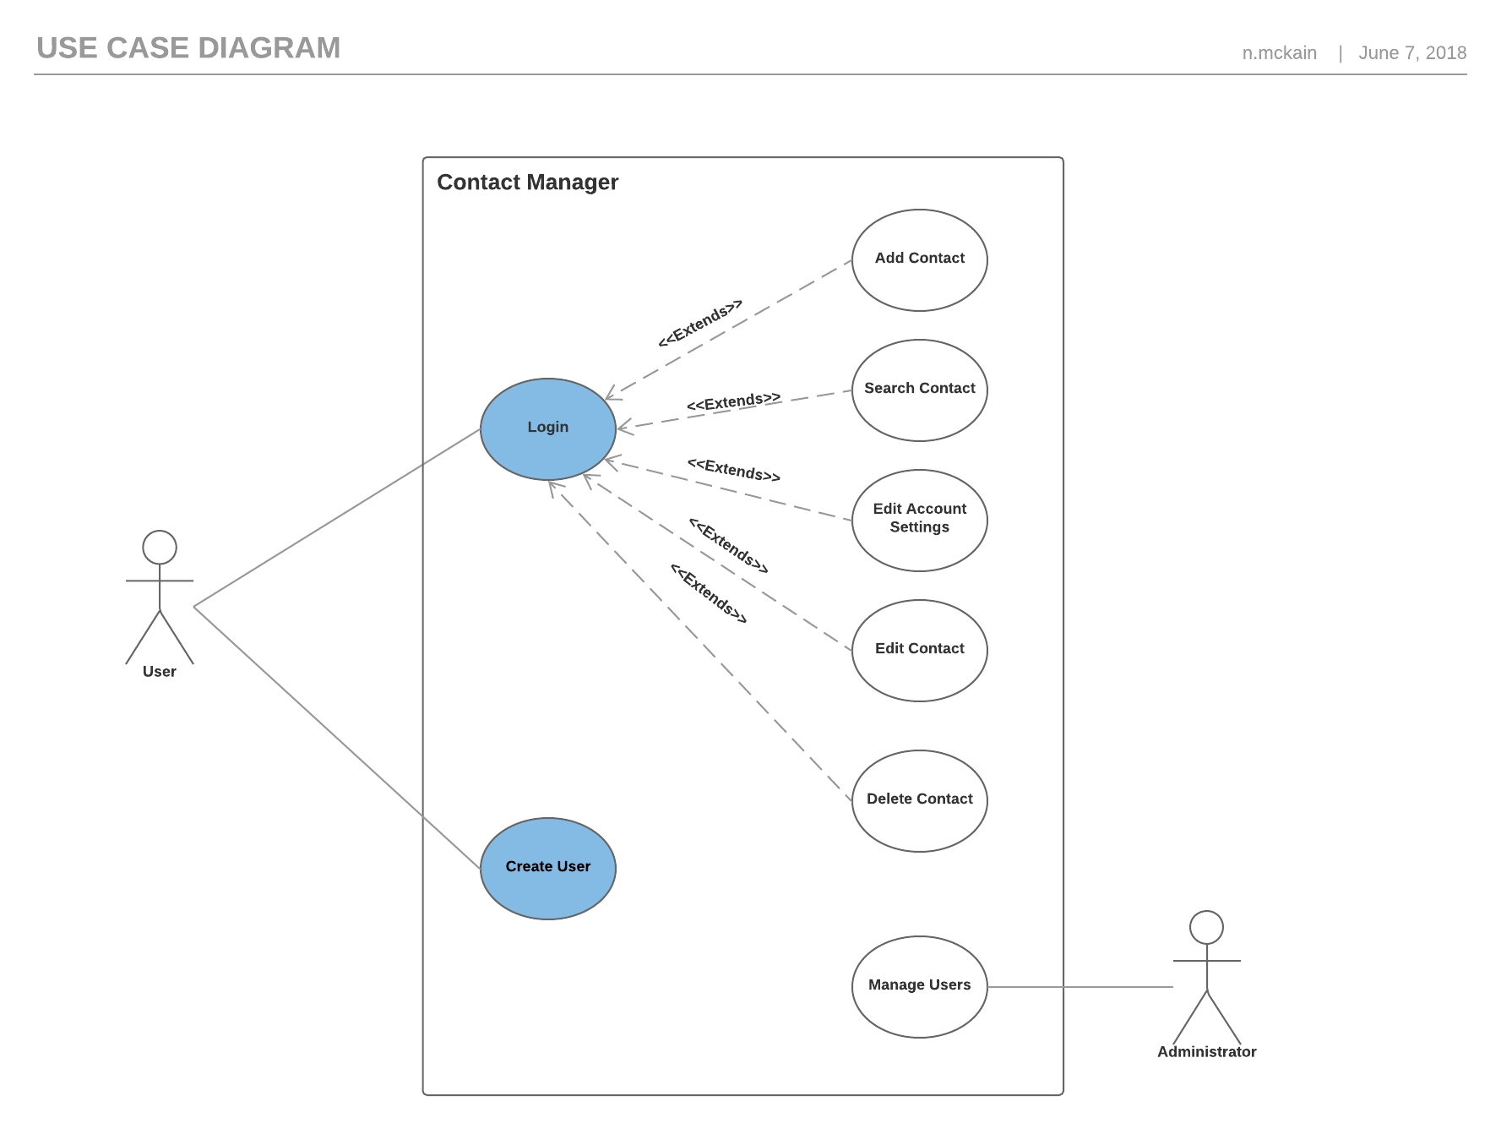
Use Case Diagram

Slide 10
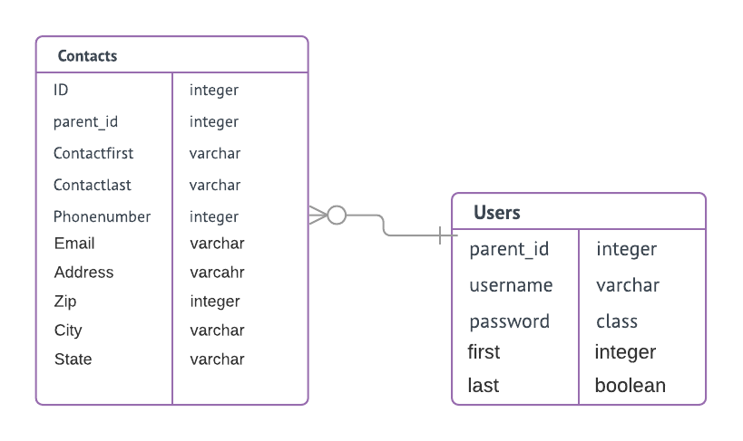
ER Diagram

