Slide 1
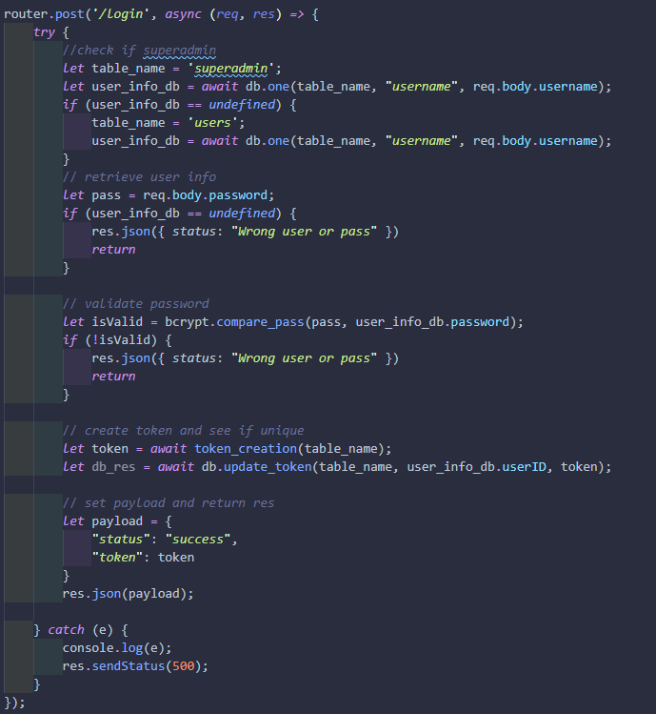
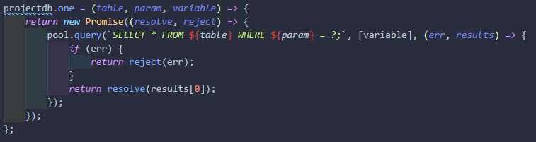
Other Requests:
Create user (POST)
Create event (POST)
Get user (GET)

