Slide 1
COP 4331 Group 16 Large Project

Slide 2
Group Members
Julian Espinoza: Project Manager
John Pacheco: Front-End
Orlando Rodriguez: Front-End
Marcelino Pozo: Back-End
James Moore: Back-End
Austin Stafford: Database

Slide 3

Our Project Idea
Our idea for the Large Project was to make a simple movie review site. At first, users will be able to see the list of movies, basic information on them, and their average rating calculated by the ratings given from other users. To add a review, users would need to signup for an account (or use an existing one). From there, a user can view the list of movies and add reviews for movies. Users can view all of their reviews and from there can edit and delete their reviews.

Slide 4
Development

Slide 5
















Technologies Used
Testing/Planning
Frameworks
Coding
Node Modules
Hosting

Slide 6
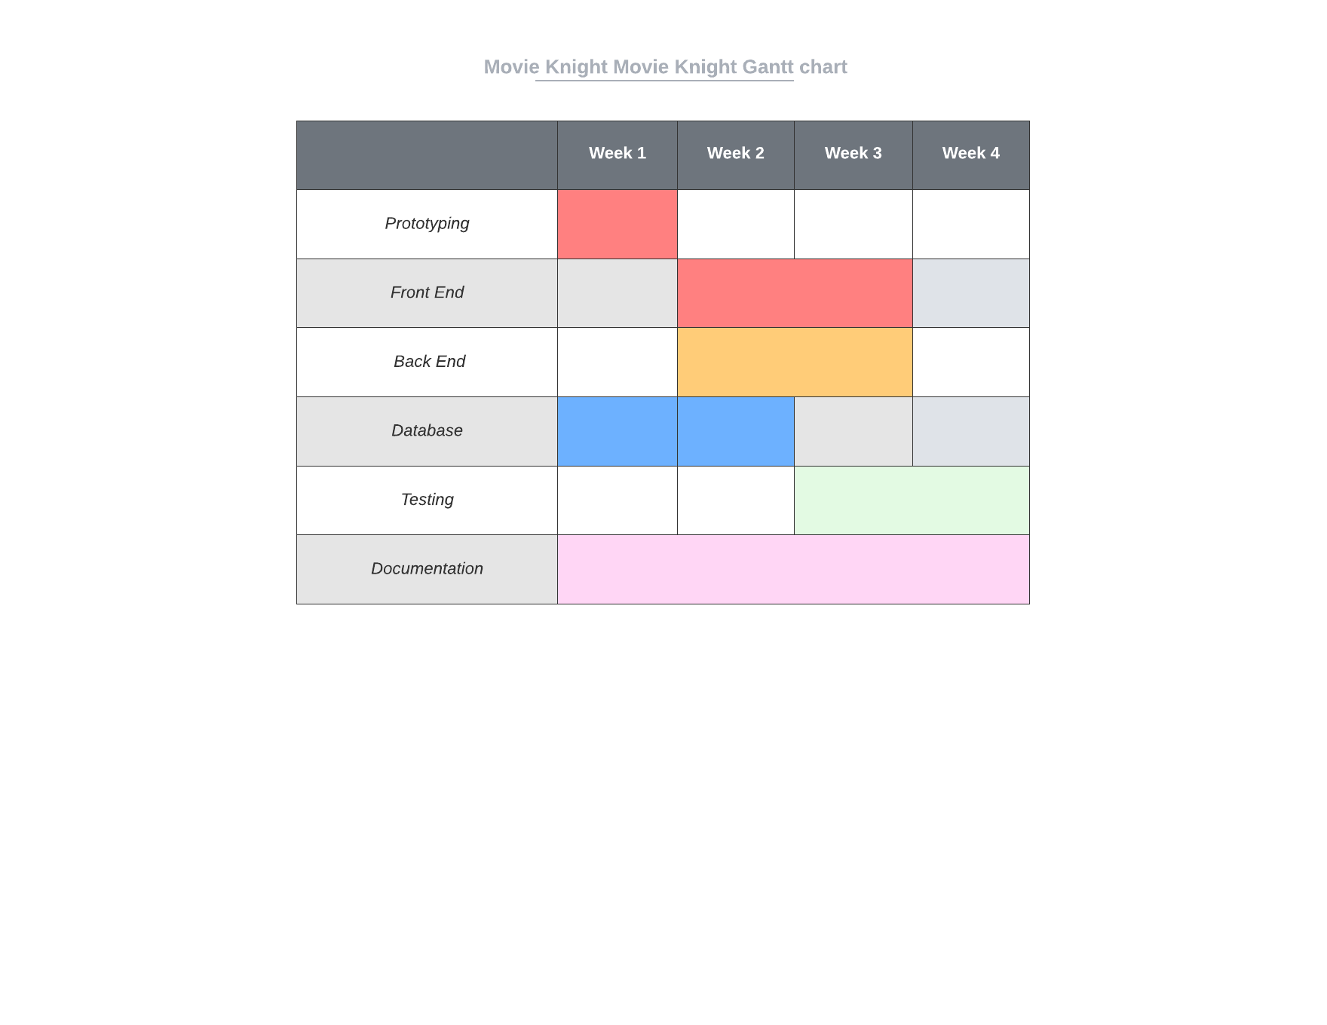
Gantt Chart

Slide 7
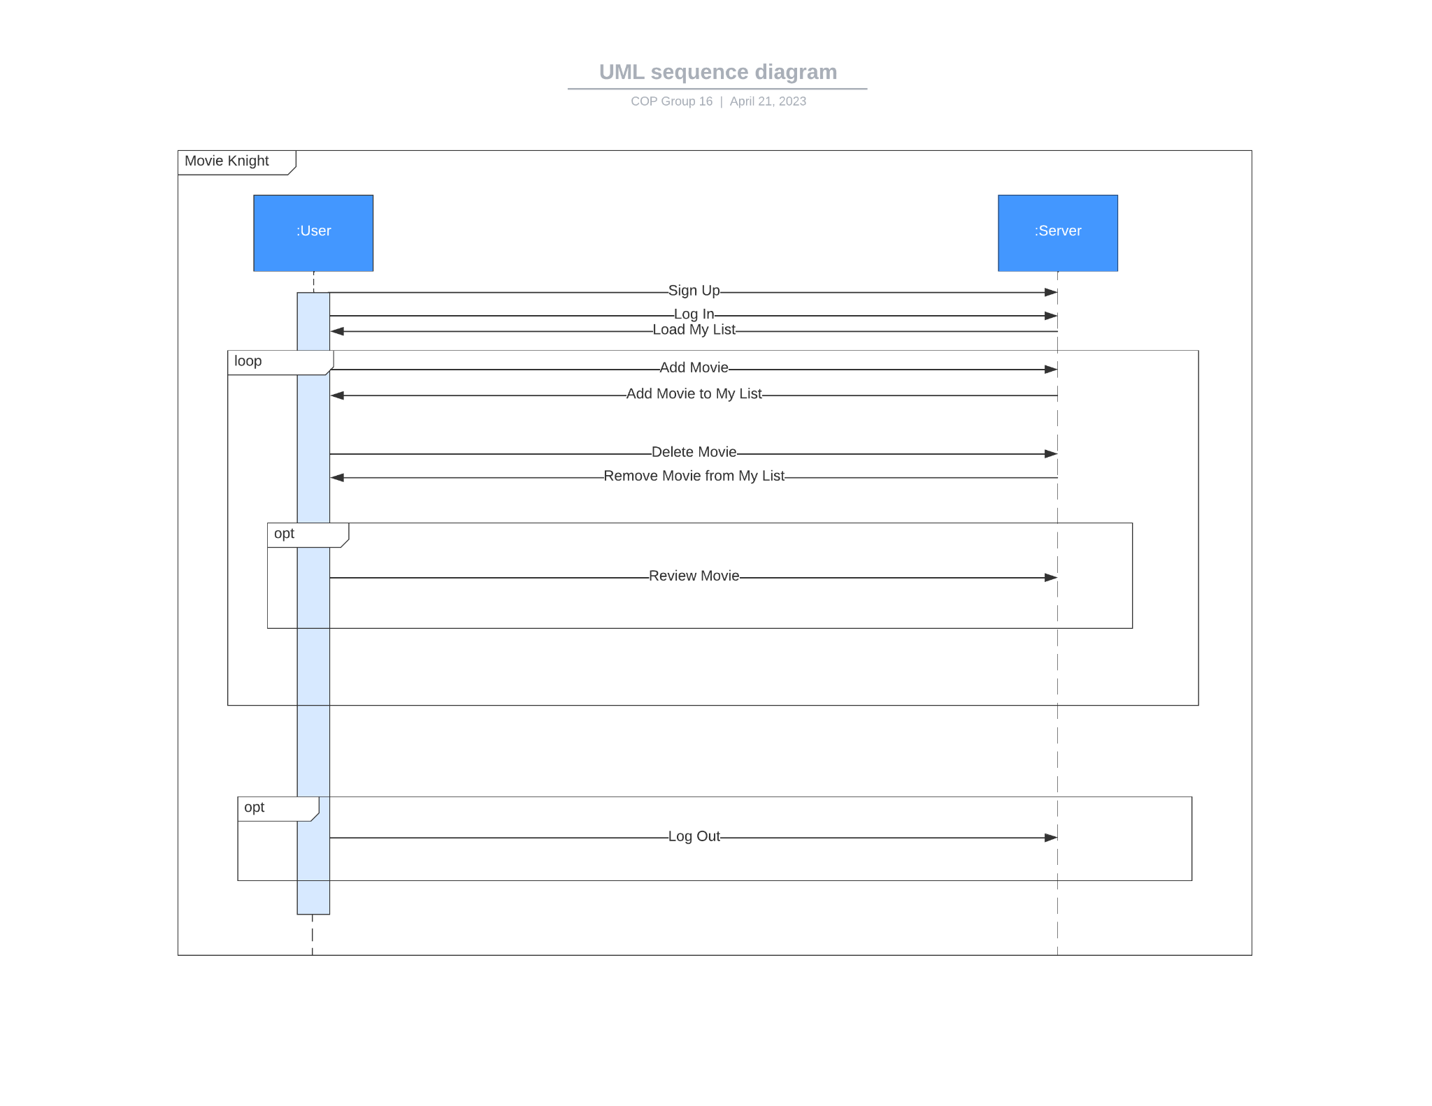
UML Diagram

Slide 8
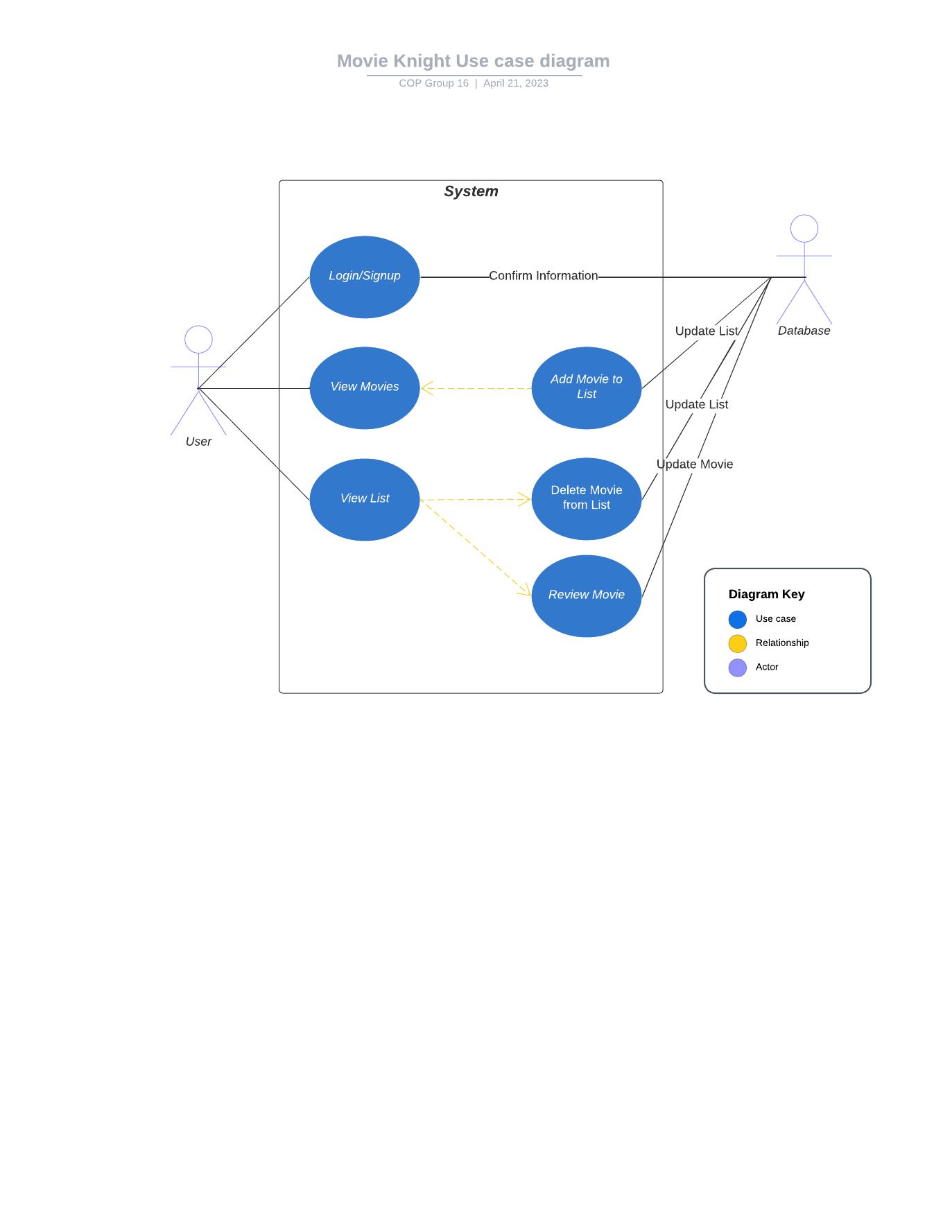
Use Case Diagram

Slide 9
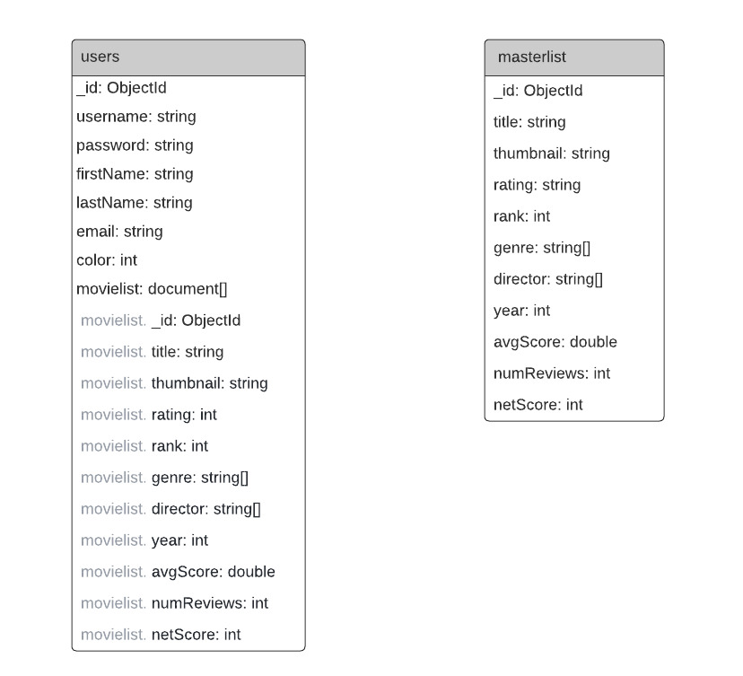
Entity Relationship Diagram

Slide 10
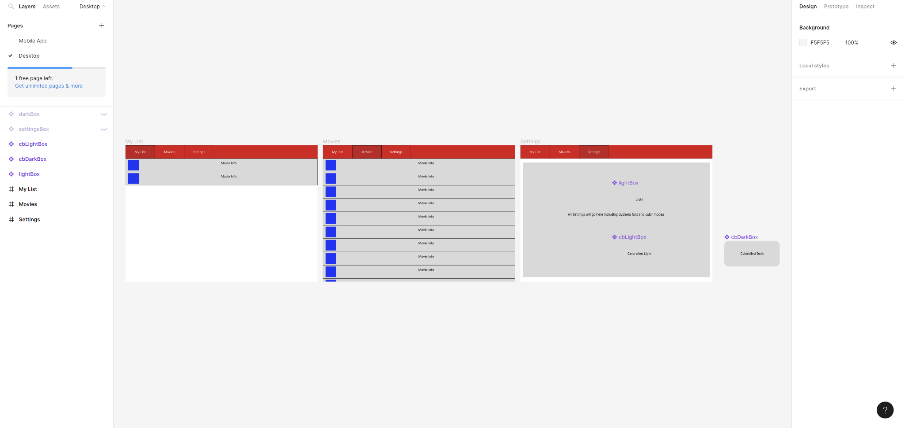
Early Prototype Design

Slide 11
Discoveries

Slide 12
Takeaways
The Good:
The Bad:
We were able to settle on an idea and design plan very quickly
We assisted each other a lot, especially when it came to learning the new technologies
We maintained good communication throughout, keeping each other posted on the state of things
Feature Creep, especially with such a short timeframe deadline, we had to drop a number of planned features in order to make the deadline
We struggled a lot with the steep learning curve when it came to the new MERN droplet, and how to use it, a lot of time was spent figuring things out

Slide 13
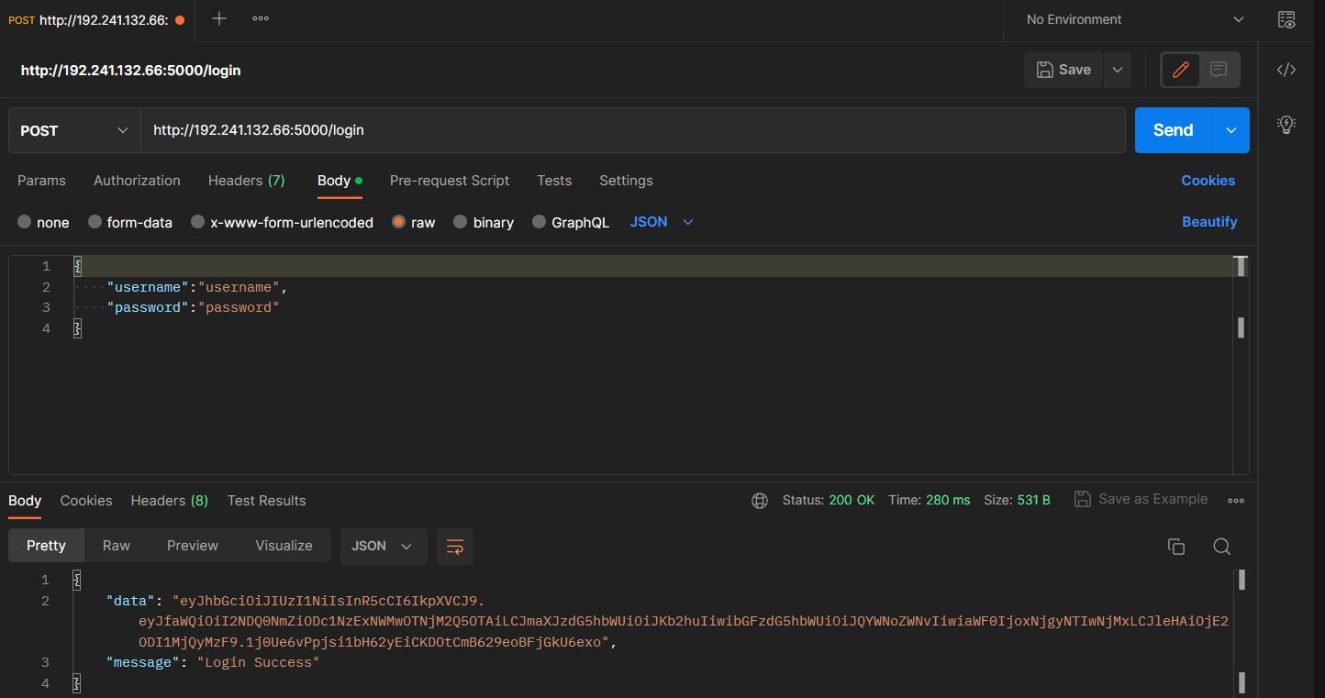
Login API Example

Slide 14
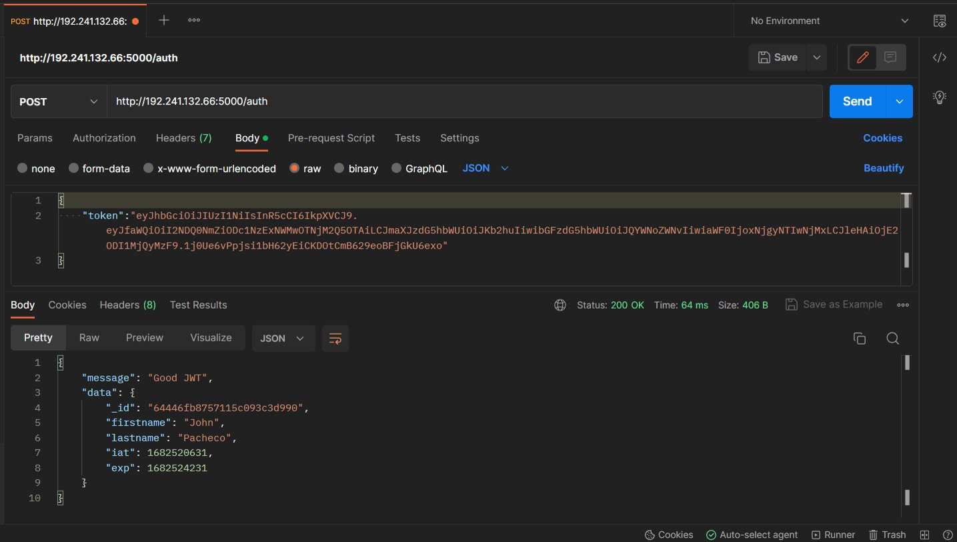
JWT Authenticate API Example

Slide 15
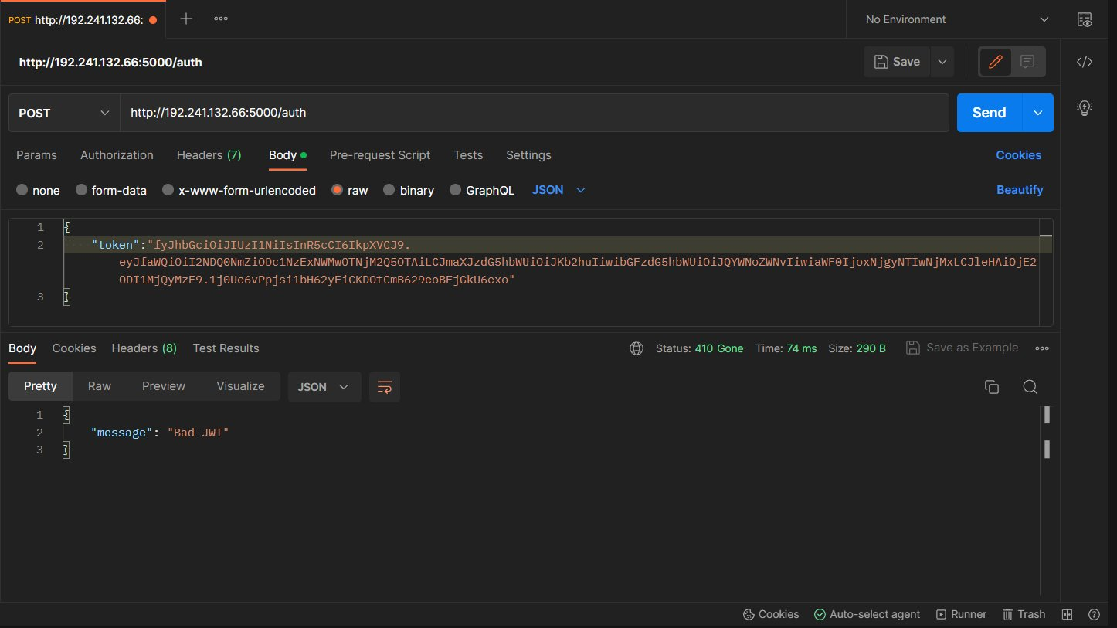
Bad JWT Authenticate API Example

Slide 16
App Demonstration
http://192.241.132.66

Slide 17
Questions?

