Slide 1
GPT-3

Slide 2
How GPT-3 is different from other models
The need for a large dataset of labeled examples for every new task limits the applicability of language models.
Humans do not require large supervised datasets to learn most language tasks

Slide 3
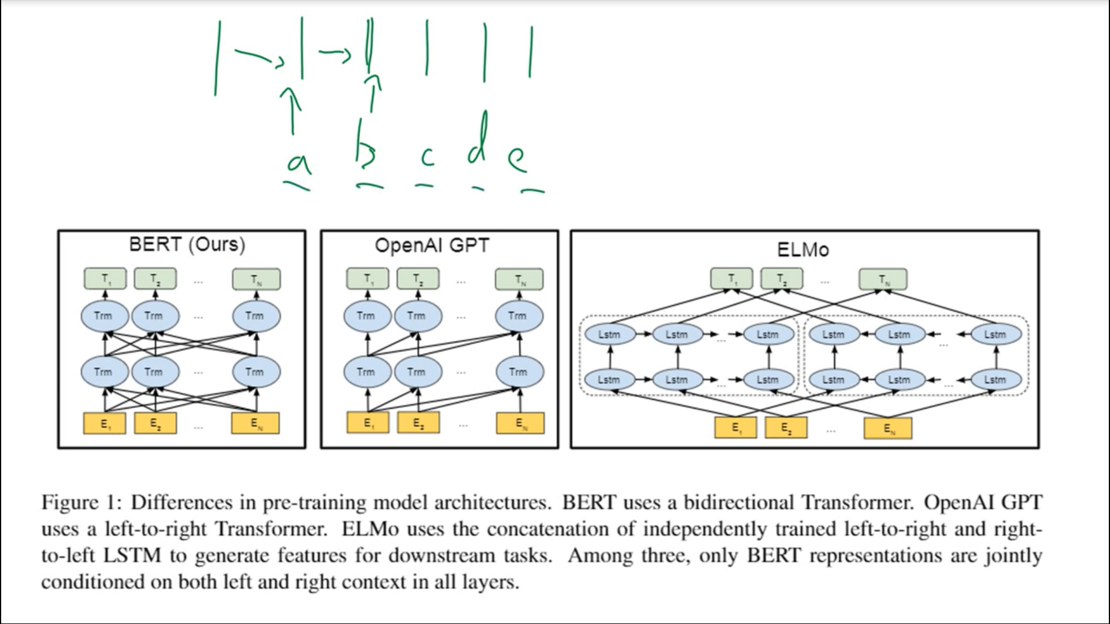

Slide 4
How no. of parameters in model affect the performance of model

Slide 5
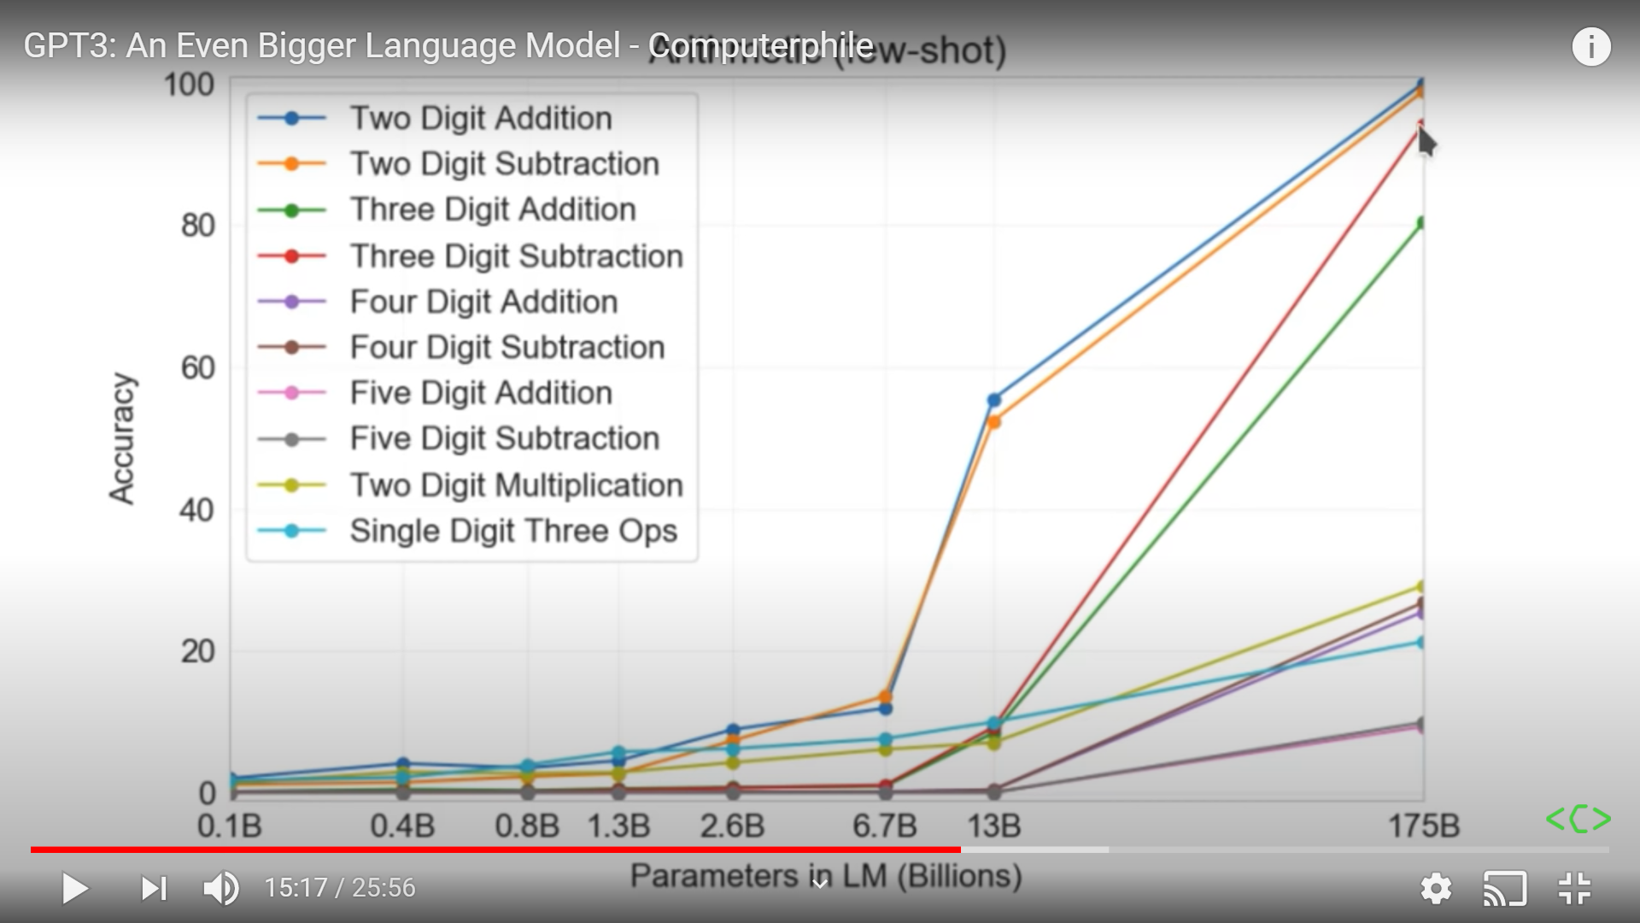
Let’s take a example

Slide 6
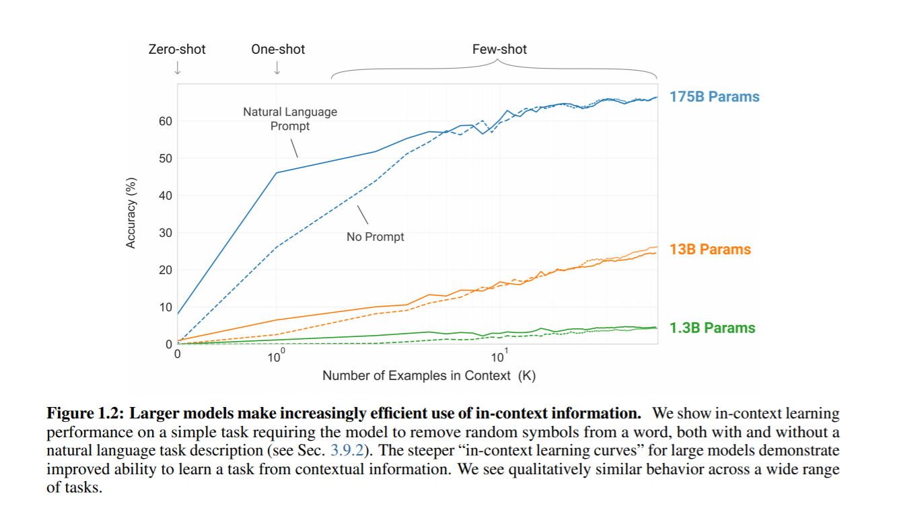

Slide 7
Approach
Zero shot learning
One shot learning
Few shot learning

Slide 8
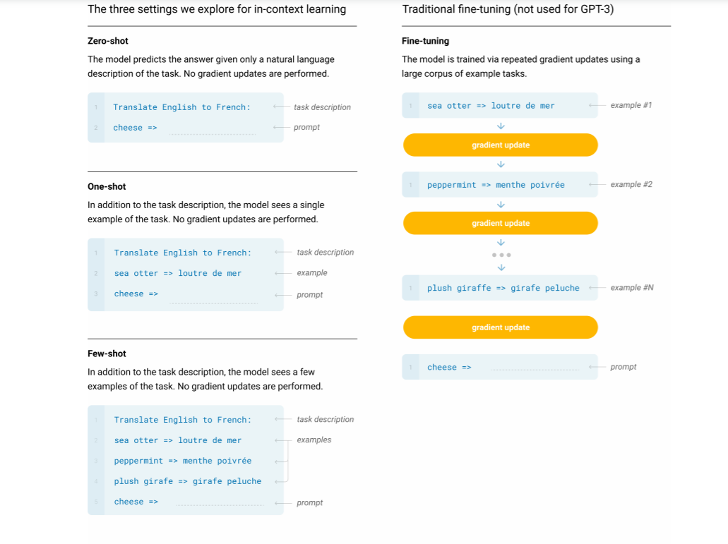

Slide 9
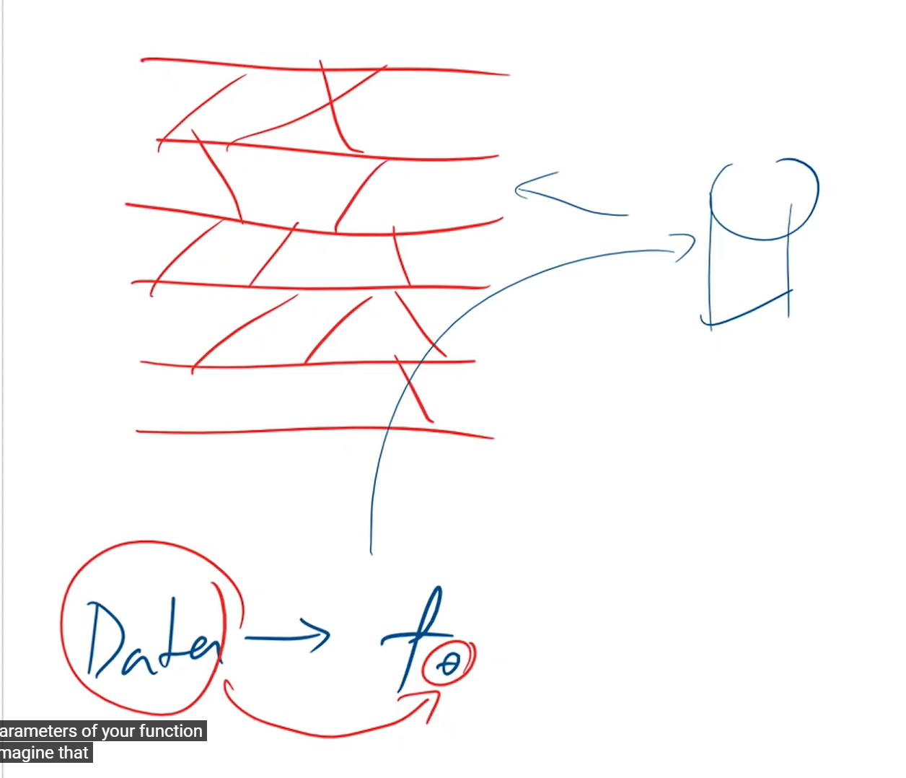
Interpretation of how GPT-3 work

Slide 10
Model and Architectures
GPT-3 uses the same model and architecture as GPT-2 and GPT i.e language model

Slide 11
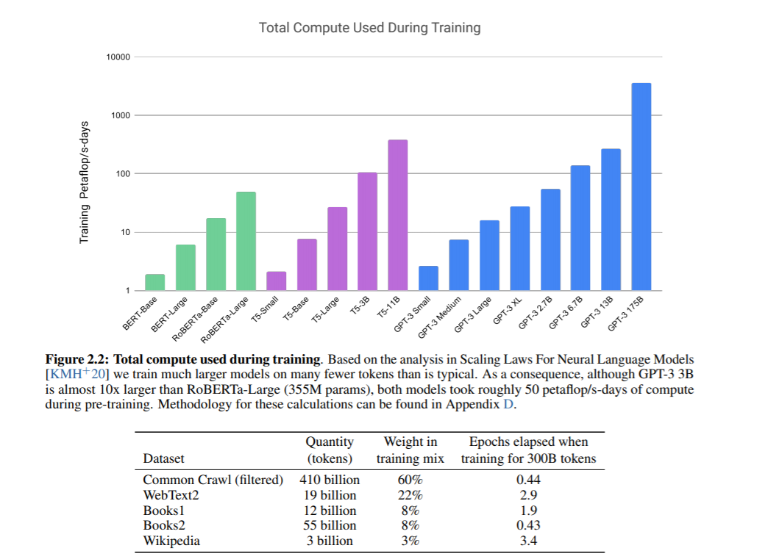
Training Dataset

Slide 12
Results

