Slide 1
A talk on Video Processing

Slide 2
What is an End to End approach
End to end approach basically means we don’t need to do some hard core feature engineering but it is carried out automatically by network with some guidelines.
We mostly here discuss about end to end video processing, hand featured video processing is already there but less existence of end to end networks like as Faster RCNN, Yolo etc. in case of image processing.

Slide 3
Why Videos processing is less familiar
Some of the possible arguments for less end to end video processing are:
It is Computationally expensive to deal with videos.
Videos consider temporal information which is related with the real time speed of your camera, and includes lagging effects also.
Most state of the art networks and architecture focus on image processing which makes end to end video processing less familiar

Slide 4
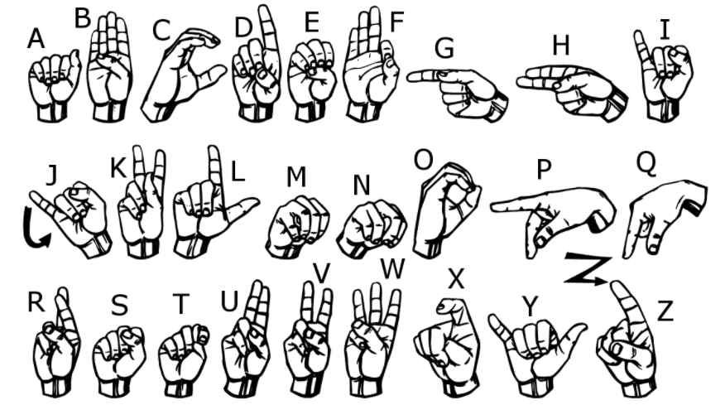
My motivation behind presenting on video processing
Image processing has achieved state of the art on various things but it is still unable to deal with few things
Sign language detection
Link – [https://www.handspeak.com/word/most-used/]

Slide 5
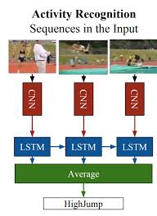
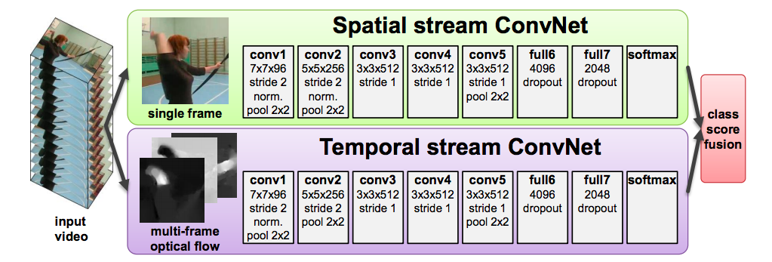
Earlier Works on Action Recognition
Extracting features from individual frame and passing it to predict action
Using separate Convnets for capturing spatial and temporal(time) info.

Slide 6
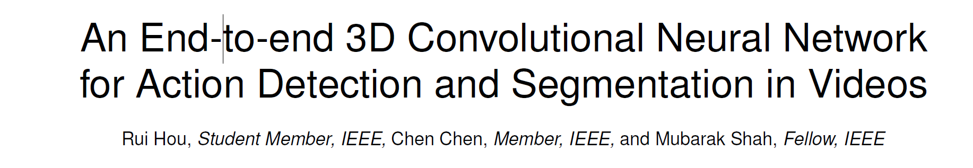
But these techniques don’t capture the temporal info well
This paper is divided into three parts:
Novelty and structural details
Implementation details
Results on benchmark datasets.
Paper link - https://arxiv.org/abs/1712.01111

Slide 7
Structural details
The authors of this paper proposes two different types of architectures T- CNN and ST- CNN based on the general detection approaches
General Detection Approaches :
Detection in general based on two approaches
1. Top- Down Approach - Uses exhaustive search for bounding box proposals
2. Bottom - Up Approach – Uses pixel wise segmentation and selective search for bounding box selection

Slide 8
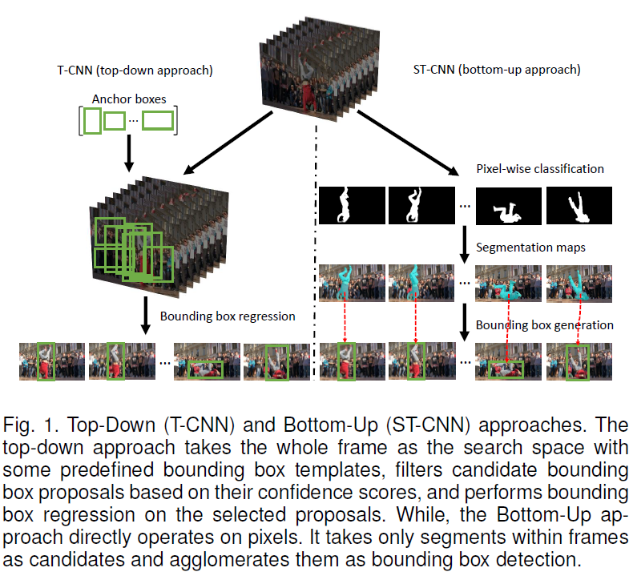

Slide 9
Rest from the paper

Slide 10
In last
Plans possible
We can implement new ideas where we implement these papers on actions task
A question in my mind if we are able to generalize RCNN they can we generalize Yolo also.
Anyone interested can join me in these works

