Slide 1
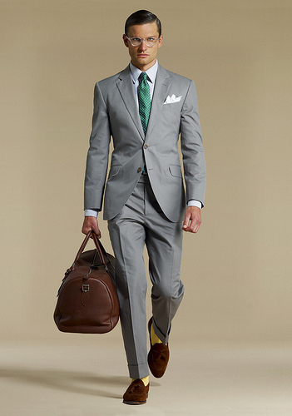
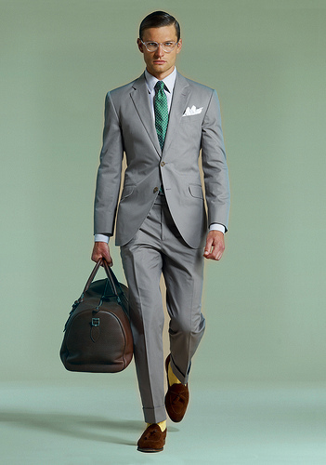

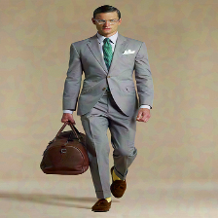
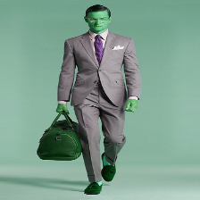


Original
ColorFool
BIM
TI-BIM
SemanticAdv
kimono
racket
suit
racket
DeepFool
SparseFool
trench coat
kimono
loafer

