Slide 1
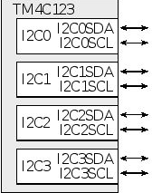
I2C
have zero to ten I²C modules
support master and slave modes, can generate interrupts on start and stop conditions
allow I²C networks with multiple masters. Microcontroller pins SDA and SCL can be connected directly to an I²C network

Slide 2
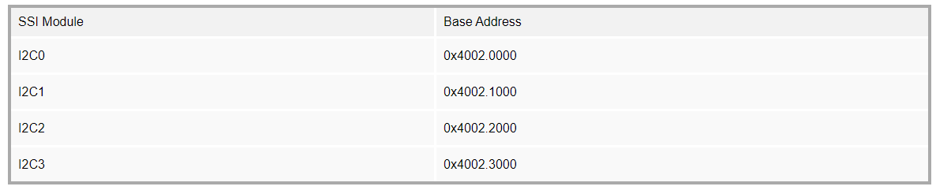
Base-Address

Slide 3
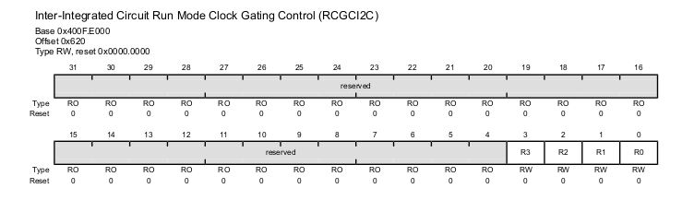
Enabling Clock

Slide 4
I2C Clock speed
The I2CMTPR (I2C Master Timer Period) register allows us to set the clock rate for the SCL. The SCL clock comes from the system clock and goes through clock divider circuit controlled by I2CMTPR register. The I2C standard defines four clock speeds for the SCL.
Standard mode of 100Kbps (bits per second),
Fast mode of 400Kbps,
Fast Plus mode of 1Mbps. and there is also a
High-Speed (HS) mode which can be as high as 3.3Mbps.
The lower 7 bits (D6-D0, TPR) of I2CMTPR register are used to set the I2C clock speed.

Slide 5
Calculation
We use the following formula to set the I2C clock speed:
SCL_PERIOD = 2×(1 + TPR)×(SCL_LP + SCL_HP)×CLK_PRD
In the above formula, SCL_PERIOD is the I2C clock period, CLK_PRD is the system clock period.
The SCL_LP is the SCL Low Period and is fixed at 6.
The SCL_HP is the SCL High Period and is fixed at 4.
Now, if we rearrange the above formula, we have:
SCL_PERIOD = 2×(1 + TPR)×(4 + 6)×CLK_PRD SCL_PERIOD = 2×(1 + TPR)×10×CLK_PRD SCL_PERIOD = (20×(1 + TPR))/System_Clock_Freq
Now, solving for TPR (the value we need for the I2CMTPR register) we have:
TPR = ( (System_Clock_Freq x SCL_PERIOD) / 20 ) - 1 TPR = (System_Clock_Freq) / (20 x I2C Clock) - 1
Example: Assume the system clock frequency is 16MHz. Find the values for the I2CMTPR register if we want I2C clock of (a) 100 Kbps, (b) 400 Kbps, and (c) 1 Mbps.
Solution: Using 16MHz for the CPU Frequency, we have: TPR = (System_Clock_Freq) / (20 x I2C Clock) - 1 , TPR = (16MHz) / (20 x I2C Clock) - 1 (a) TPR = (16MHz) / (20 x 100K) - 1 = 8 - 1 = 7 (b) TPR = (16MHz) / (20 x 400K) - 1 = 2 - 1 = 1

Slide 6
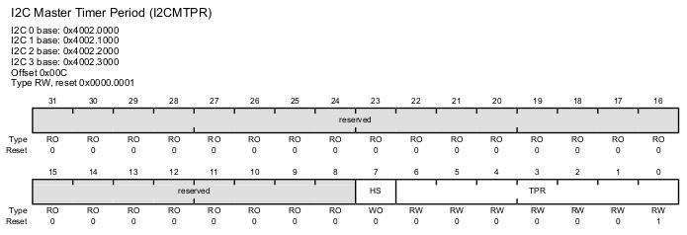
I2CMTPR

Slide 7
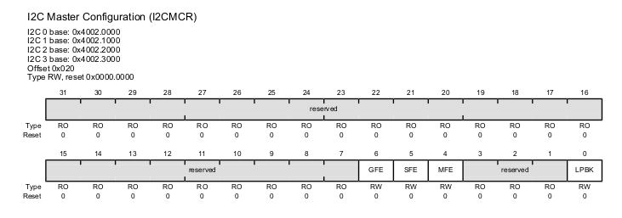
Master or Slave?

Slide 8
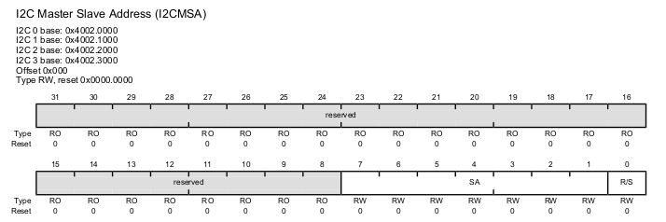
Slave Address
To transmit a byte of data to an I²C device, we must specify its I²C address. We use I2CMSA (I²C Master Slave Address) register to hold the address of the slave device.

Slide 9
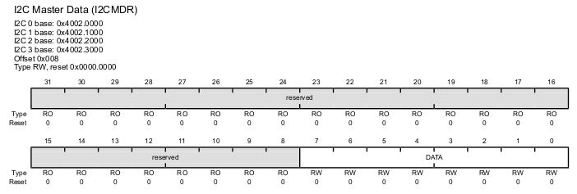
Data Register
In Master transmit mode, we place a byte of data in I2CMDR (I2C Master Data register) for transmission. Only the lower 8 bits of this register is used.

Slide 10
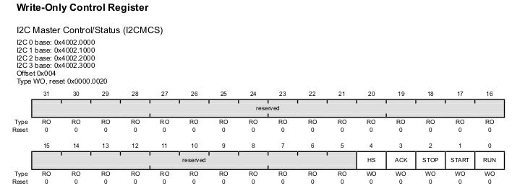
Control and Status Flag Register
Basically we have two registers with the same name. One we write to control the I2C module, the other one we read from to get the status of the I2C module.

Slide 11
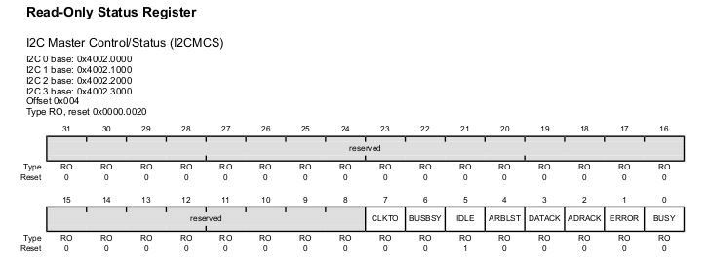
I2CMCS

Slide 12
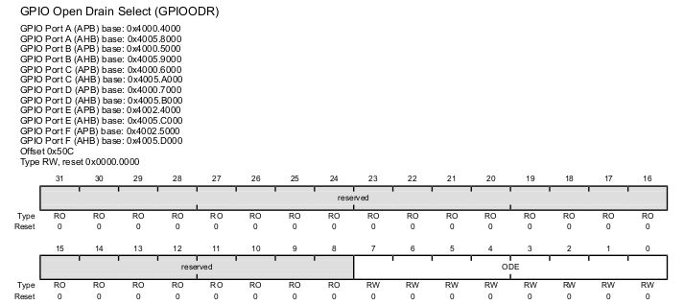
Enabling Open Drain

Slide 13
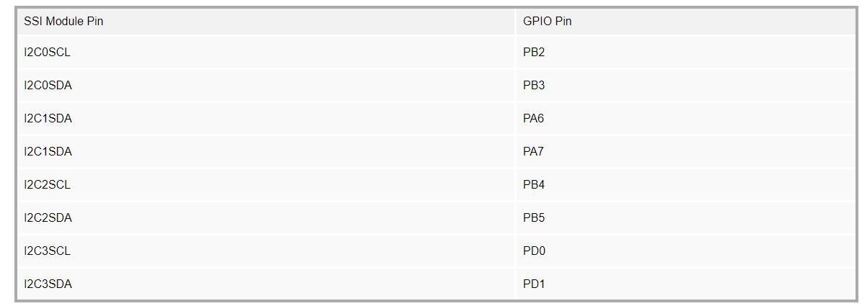
Configuring GPIO for I2C

Slide 14
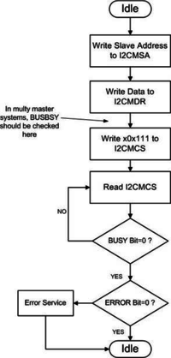
Flowchart
Enable the clock to I2C module using RCGCI2C (SYSCTL_RCGCI2C_R) register.
Initialize the I2C as Master using I2CMCR (I2Cn_MCR_R) register.
Set the I2C clock speed using I2CMTPR (I2Cn_MTPR_R) register.
Place the slave address with the R/W bit cleared for write in the I2CMSA (I2Cn_MSA_R) register.
Place the byte of data to be transmitted into the I2CMDR (I2Cn_MDR_R) register.
Initiate the data transmission by writing value 0x07 to the I2CMCS (I2Cn_MCS_R) register. With I2CMCS = 0x07, will make the STOP = 1, RUN = 1, and START = 1.
Read back I2CMCS (I2Cn_MCS_R) register to force the write out of the write buffer.
Keep reading the I2CMCS (I2Cn_MCS_R) register and check the BUSY flag. Wait until it goes low.
Now, read the I2CMCS (I2Cn_MCS_R) register again and check the ERROR flag to make sure there was no error

