Slide 1
TM4C123GH6PM
Powerful 32 bit-Arm core
80Mhz Operation
DMIPS

Slide 2
What is Processor, Core and Controller?? CORE-ALU,REGISTERS,PIPE PROCESSOR-CORE+DIFFERENT ADDITIONAL MODULES CONTROLLER=PROCCESOR+DIFFERENT

Slide 3
Features:
Thumb2 Technology 16/32bit mode
Battery backend hibernation module
Low power consumption
Six physical GPIO
Six 16/32 bit and six 32/64 bit General purpose timers
Internal oscillator, external main oscillator
256Kb flash,32Kb SRAM,2Kb EEPROM
JTAG,SWD-ETM interface

Slide 4
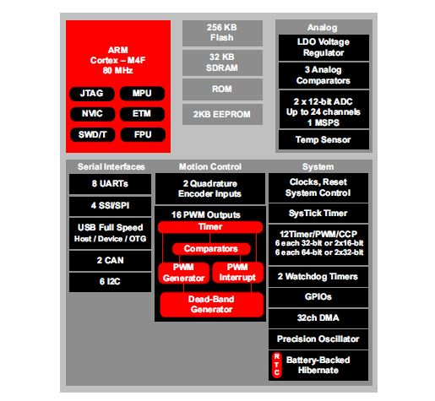
Architecture

Slide 5
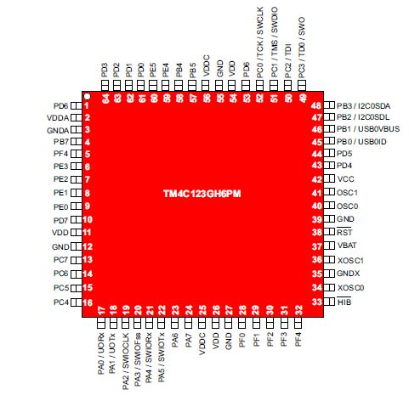
Pin Diagram

Slide 6
Practical 1
Aim: To blink and LED using Software generated Delay and delay generated by Systick timer
Software and Hardware requirement:
Code Composer Studio 9.1.0
Tiva tm4c123gh6pm Launchpad

Slide 7
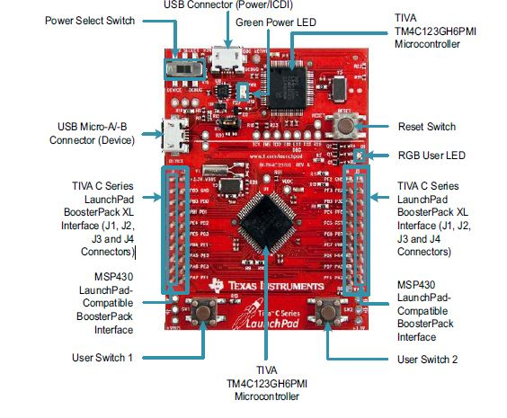
Launchpad

Slide 8
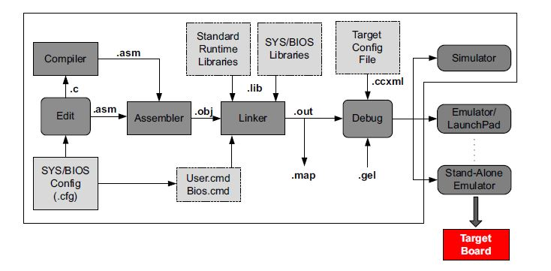
CCS Functional overview

Slide 9
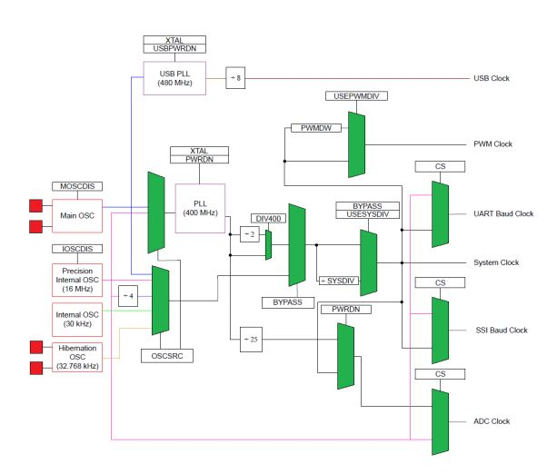
Clock system

Slide 10
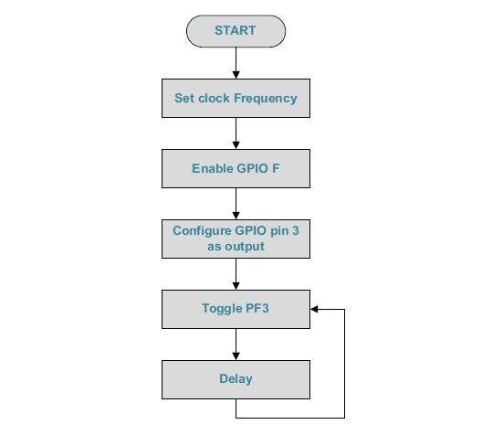
Flowchart

