Slide 1
FlashID South African Digital ID System
Tech Titans – Capstone 2026
Demo 3

Slide 2
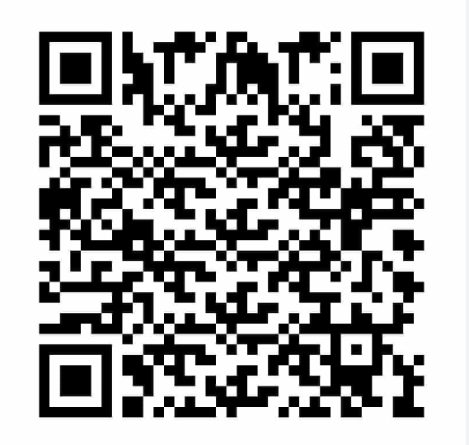

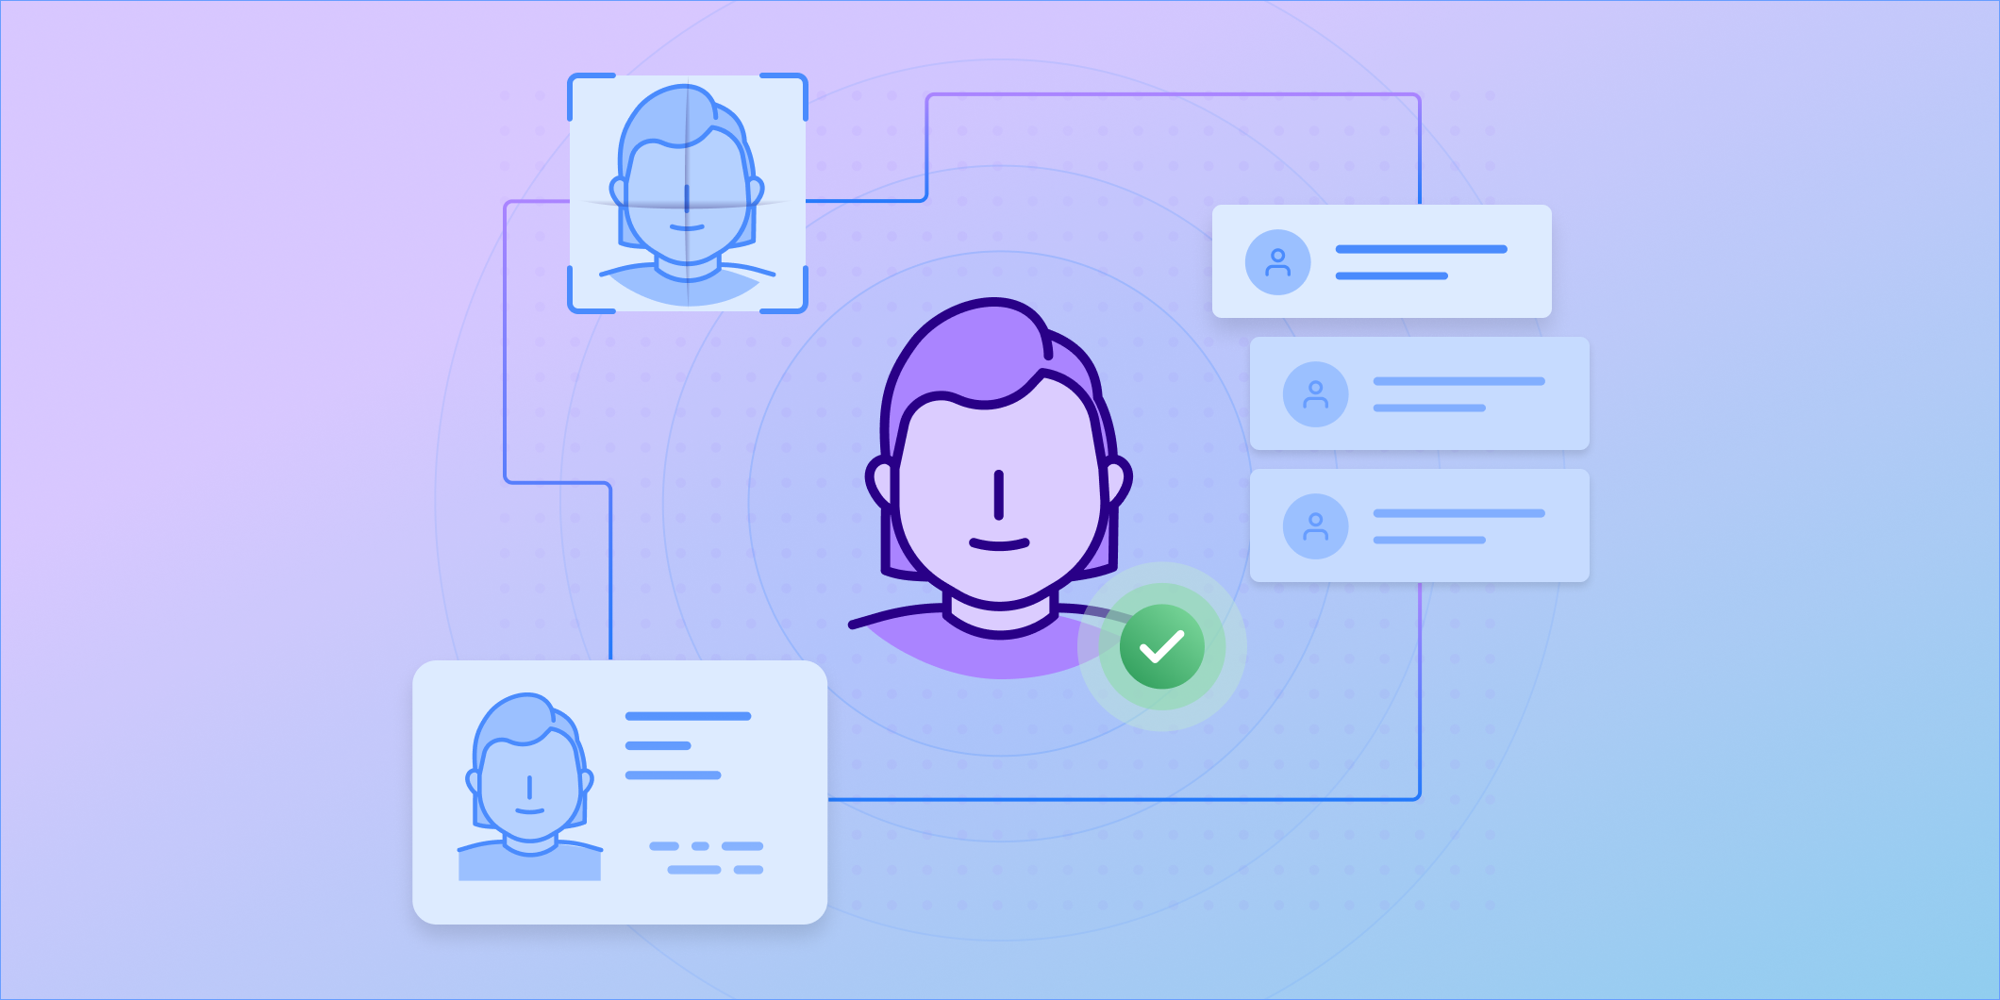
Project Overview
QR Code Generation
And Verification
Physical identity verification
Secure Credential Storage

Slide 3

Physical identity verification
Citizens are able to self-verify against the Government Registry using Azure Face liveness — no prior official onboarding needed.
All while ensuring that portraits and biometric data never leave the server.
The browser only gets a short lived Azure session token, and consent is required before any check runs.

Slide 4
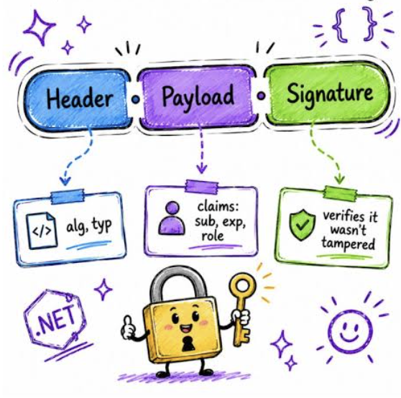
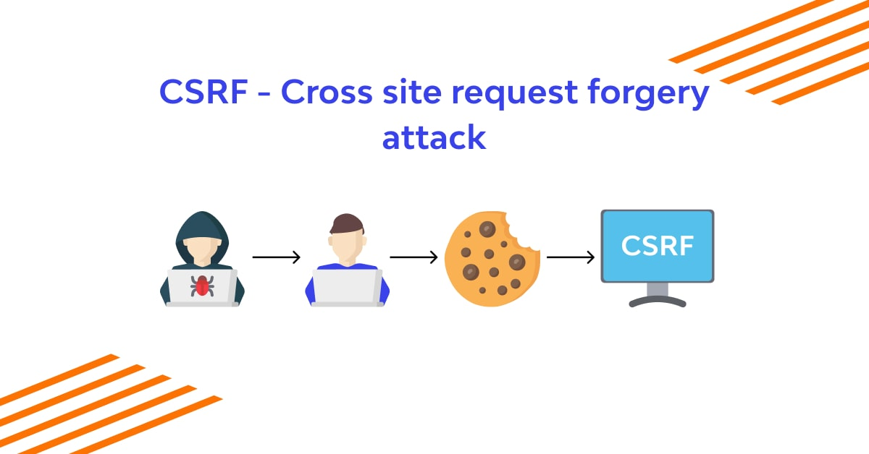
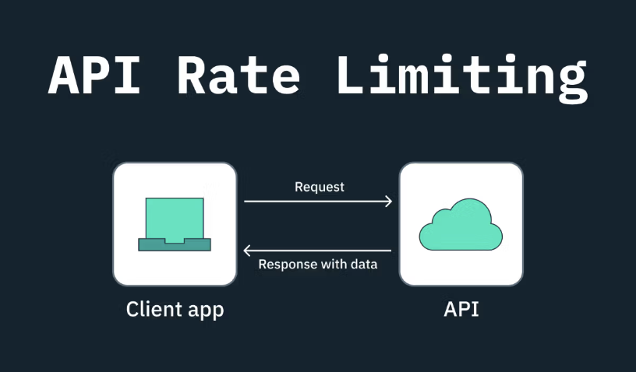
Security
CSFR
Rolling keys
Tampering the payload
Rate limiting

Slide 5
LIVE DEMO

Slide 6
QUESTIONS?

