Slide 1
ThinkTech
Goodness
Tshepiso
Hlavutelo
Xoliswa
Lelethu
DEMO 2
Flowchart planning and simulation tool
24 July 2015

Slide 2
Aspects discussed during Demo 1
JavaBlock
Instead of starting with the code from scratch, reuse the available JavaBlock source code
Given that creating a flowchart application isn’t something ‘new’, focus should be placed on the GUI
Client
The suggestions from the panel would then be discussed with the client

Slide 3
Working on project during recess
8 July - Met with the client to confirm the reuse of JavaBlock
Client requested the UML diagrams of JavaBlock to see if it’s ‘layout’ was feasible to work with
[Insert picture of Javablock uml diagram here]

Slide 4
Working on project during recess
Another meeting was scheduled and the client approved the use of the JavaBlock code
We are however, not to copy all the code but to reuse the concepts it affords
This is mostly because the client wants the code to really have an Object-Oriented base to it, JavaBlock is a bit messy
It is also important that the code that we have in the end be maintainable – JavaBlock code is not readily intuitive

Slide 5
Working on project during recess
Most of the work done at the beginning of the recess was based on the GUI
But the focus of the work has now shifted to the development of the flowchart components

Slide 6
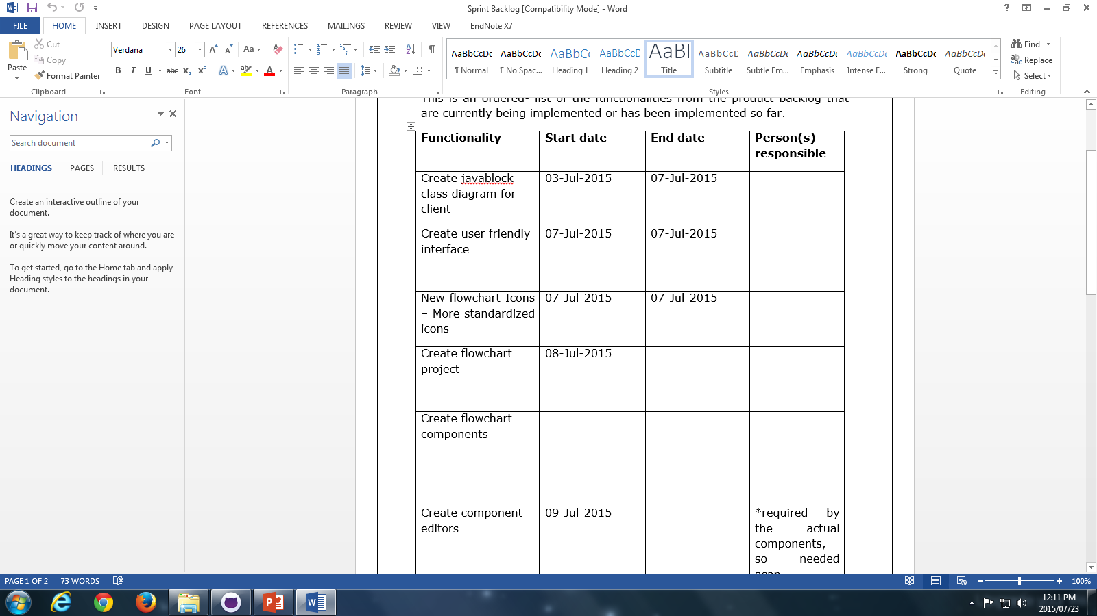
Working on project during recess
We utilized the SCRUM method by having meetings everyday and discussing where each member was at the moment and where they are heading
We also made use of producing Product and Sprint Backlogs
[Insert picture of screenshot of the backlogs here?]

Slide 7
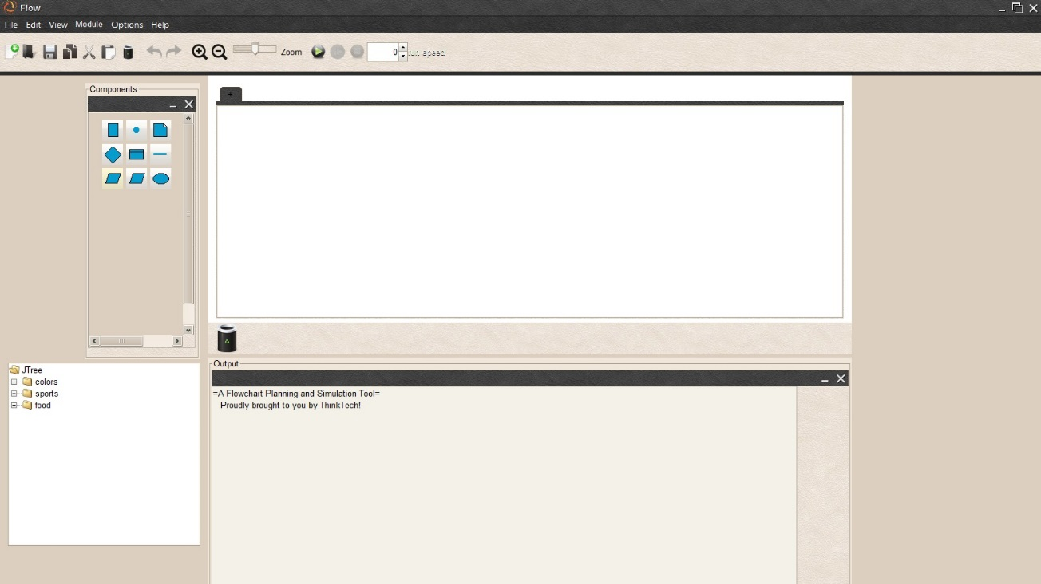
Working on project during recess
We met with the client a handful of times in the project to ensure that every implementation we completed was to his liking
This ensured that we would fully complete each task without worrying about whether or not the client will like it at a later stage
[Insert pictures of the GUI changes here]

Slide 8
Current focus
As of the last part of the recess, focus of the project has been on the development of the flowchart components

