Slide 1

ThinkTech
Goodness
Tshepiso
Hlavutelo
Xoliswa
Lelethu
DEMO 3
Flowchart planning and simulation tool
28 August 2015

Slide 2
Introduction
FLOW -Flowchart Simulation Tool
Introduction to the logic behind programming
Target Users- COS 151 Students, Novice programmers
Visualize how algorithms are likely to behave
Difference from other programming languages
1.User friendly interface
2.Basic programming structures available in all programming languages

Slide 3
Quality Requirements
Maintainability
  Making sure other are able to work well with the code in the future
 | Javablock | Flow
Number of classes | 80 | 50
Use of deprecated functions | YES | NO
Readability (variable names, comments, reuse of variable, classes in lower case, all code in English) | Not Quite | YES

Slide 4
Quality Requirements
Reliability
- What happen's when a user creates a flowchart with an infinite loop?
- What happens when an incorrect data type is entered for input?
- What happens when the stucture of the flowchart is incorrect?
- Error detection in Javablock is scarce and uninformative
- Flow code aims to rectify that

Slide 5
Quality Requirements
Usability
- Most critical requirement
- Whole point of the project
- Bridging the gap for users with no programming background to still be able to use the interface
- Javablock did not facilitate this
- We ensure usablity by using predefined blocks
such as For-Loops
- Creating an intuitive interface
- Ensuring user gets accurate and informative feedback

Slide 6
New features -
What makes Flow different?
Components for Looping Structures:
  For-Loop Block
  While Loop Block
Component for Module Block
Intuitive Interface
  Editors
    Decision Block
    Delcaration Block
  Infinite Loop Detection
  Better Feedback to user
Block Morphing

Slide 7
Use Cases Demonstration

Slide 8
Testing

Slide 9
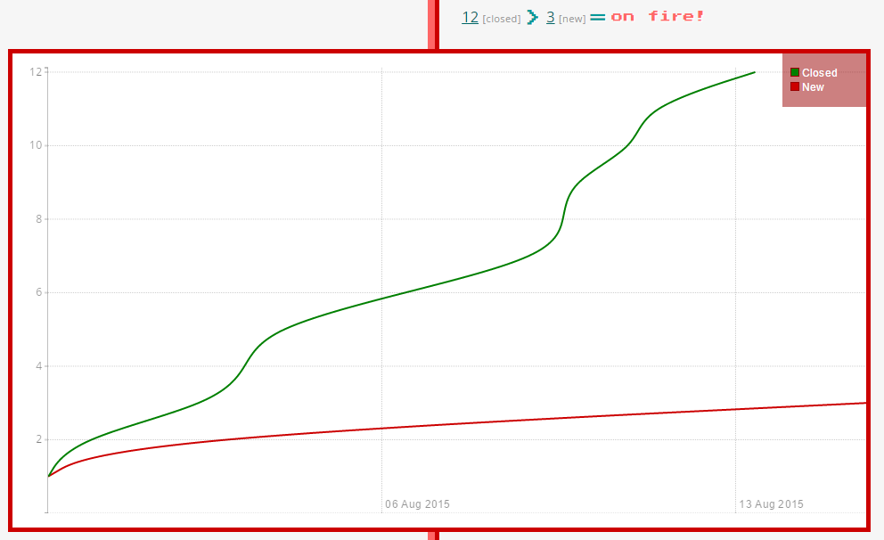
Burndown Chart

Slide 10
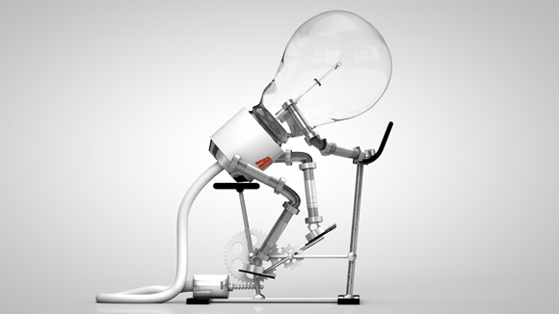
ThinkTech!

