Slide 1
Spanner Storage insights
COS 518: Advanced Computer Systems
Lecture 6
Michael Freedman

Slide 2
2PL & OCC = strict serialization
Provides semantics as if only one transaction was running on DB at time, in serial order
+ Real-time guarantees
2PL: Pessimistically get all the locks first
OCC: Optimistically create copies, but then recheck all read + written items before commit

Slide 3
Multi-version concurrency control
Generalize use of multiple versions of objects

Slide 4
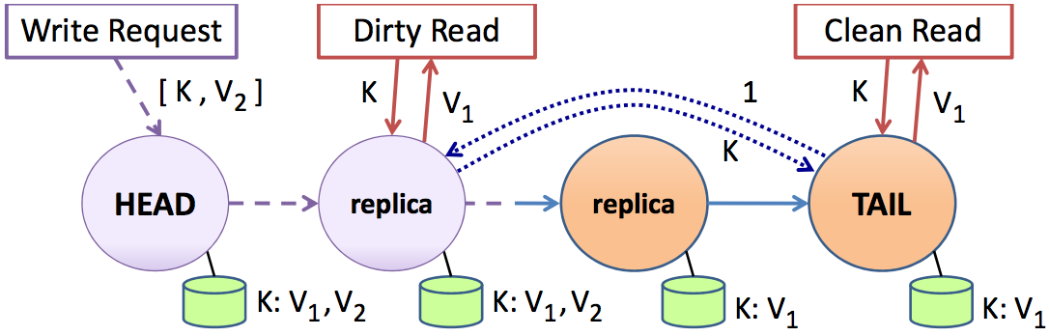
Multi-version concurrency control
Maintain multiple versions of objects, each with own timestamp. Allocate correct version to reads.
Prior example of MVCC:

Slide 5
Multi-version concurrency control
Maintain multiple versions of objects, each with own timestamp. Allocate correct version to reads.
Unlike 2PL/OCC, reads never rejected
Occasionally run garbage collection to clean up

Slide 6
MVCC Intuition
Split transaction into read set and write set
All reads execute as if one “snapshot”
All writes execute as if one later “snapshot”
Yields snapshot isolation < serializability

Slide 7
Serializability vs. Snapshot isolation
Intuition: Bag of marbles: ½ white, ½ black
Transactions:
T1: Change all white marbles to black marbles
T2: Change all black marbles to white marbles
Serializability (2PL, OCC)
T1 → T2 or T2 → T1
In either case, bag is either ALL white or ALL black
Snapshot isolation (MVCC)
T1 → T2 or T2 → T1 or T1 || T2
Bag is ALL white, ALL black, or ½ white ½ black

Slide 8
Timestamps in MVCC
Transactions are assigned timestamps, which may get assigned to objects those txns read/write
Every object version O_{V} has both read and write TS
ReadTS: Largest timestamp of txn that reads O_{V}
WriteTS: Timestamp of txn that wrote O_{V}

Slide 9
Executing transaction T in MVCC
Find version of object O to read:
# Determine the last version written before read snapshot time
Find O_{V} s.t. max { WriteTS(O_{V}) | WriteTS(O_{V}) <= TS(T) }
ReadTS(O_{V}) = max(TS(T), ReadTS(O_{V}))
Return O_{V} to T
Perform write of object O or abort if conflicting:
Find O_{V} s.t. max { WriteTS(O_{V}) | WriteTS(O_{V}) <= TS(T) }
# Abort if another T’ exists and has read O after T
If ReadTS(O_{V}) > TS(T)
Abort and roll-back T
Else
Create new version O_{W}
Set ReadTS(O_{W}) = WriteTS(O_{W}) = TS(T)

Slide 10
Digging deeper
Notation
W(1) = 3: Write creates version 1
with WriteTS = 3
R(1) = 3: Read of version 1
returns timestamp 3
txn
txn
txn
TS = 3
TS = 4
TS = 5
write(O)
by TS=3
O

Slide 11
Digging deeper
Notation
W(1) = 3: Write creates version 1
with WriteTS = 3
R(1) = 3: Read of version 1
returns timestamp 3
txn
txn
txn
TS = 3
TS = 4
TS = 5
W(1) = 3
R(1) = 3
write(O)
by TS=5
O

Slide 12
Digging deeper
Notation
W(1) = 3: Write creates version 1
with WriteTS = 3
R(1) = 3: Read of version 1
returns timestamp 3
txn
txn
txn
TS = 3
TS = 4
TS = 5
W(1) = 3
R(1) = 3
W(2) = 5
R(2) = 5
O
Find v such that max WriteTS(v) <= (TS = 4)
v = 1 has (WriteTS = 3) <= 4
If ReadTS(1) > 4, abort
3 > 4: false
Otherwise, write object
write(O)
by TS = 4
Notes:
Write O by txn T, find serializable write or abort:
Find OV s.t. max { WriteTS(OV) | WriteTS(OV) <= TS(T) }
If ReadTS(OV) > TS(T)
Abort and roll-back T
Else
Create new version OW
ReadTS(Ow) = WriteTS(Ow) = TS(T)

Slide 13
Digging deeper
Notation
W(1) = 3: Write creates version 1
with WriteTS = 3
R(1) = 3: Read of version 1
returns timestamp 3
txn
txn
txn
TS = 3
TS = 4
TS = 5
W(1) = 3
R(1) = 3
W(3) = 4
R(3) = 4
W(2) = 5
R(2) = 5
O
Find v such that max WriteTS(v) <= (TS = 4)
v = 1 has (WriteTS = 3) <= 4
If ReadTS(1) > 4, abort
3 > 4: false
Otherwise, write object

Slide 14
Digging deeper
Notation
W(1) = 3: Write creates version 1
with WriteTS = 3
R(1) = 3: Read of version 1
returns timestamp 3
txn
txn
txn
TS = 3
TS = 4
TS = 5
W(1) = 3
R(1) = 3
R(1) = 5
O
BEGIN Transaction
tmp = READ(O)
WRITE (O, tmp + 1)
END Transaction
Find v such that max WriteTS(v) <= (TS = 5)
v = 1 has (WriteTS = 3) <= 5
Set R(1) = max(5, R(1)) = 5
Notes:
Read O by txn T, find version to read (never rejected):
Find O_{V} s.t. max { WriteTS(O_{V}) | WriteTS(O_{V}) <= TS(T) }
ReadTS(O_{V}) = max(TS(T), ReadTS(O_{V}))
Return O_{V} to T

Slide 15
Digging deeper
Notation
W(1) = 3: Write creates version 1
with WriteTS = 3
R(1) = 3: Read of version 1
returns timestamp 3
txn
txn
txn
TS = 3
TS = 4
TS = 5
W(1) = 3
R(1) = 3
W(2) = 5
R(2) = 5
R(1) = 5
O
Find v such that max WriteTS(v) <= (TS = 5)
v = 1 has (WriteTS = 3) <= 5
If ReadTS(1) > 5, abort
5 > 5: false
Otherwise, write object
BEGIN Transaction
tmp = READ(O)
WRITE (O, tmp + 1)
END Transaction
Notes:
Read O by txn T, find version to read (never rejected):
Find O_{V} s.t. max { WriteTS(O_{V}) | WriteTS(O_{V}) <= TS(T) }
ReadTS(O_{V}) = max(TS(T), ReadTS(O_{V}))
Return O_{V} to T

Slide 16
Digging deeper
Notation
W(1) = 3: Write creates version 1
with WriteTS = 3
R(1) = 3: Read of version 1
returns timestamp 3
txn
txn
txn
TS = 3
TS = 4
TS = 5
W(1) = 3
R(1) = 3
W(2) = 5
R(2) = 5
R(1) = 5
O
Find v such that max WriteTS(v) <= (TS = 4)
v = 1 has (WriteTS = 3) <= 4
If ReadTS(1) > 4, abort
5 > 4: true
write(O)
by TS = 4
Notes:
Read O by txn T, find version to read (never rejected):
Find O_{V} s.t. max { WriteTS(O_{V}) | WriteTS(O_{V}) <= TS(T) }
ReadTS(O_{V}) = max(TS(T), ReadTS(O_{V}))
Return O_{V} to T

Slide 17
Digging deeper
Notation
W(1) = 3: Write creates version 1
with WriteTS = 3
R(1) = 3: Read of version 1
returns timestamp 3
txn
txn
txn
TS = 3
TS = 4
TS = 5
W(1) = 3
R(1) = 3
W(2) = 5
R(2) = 5
R(1) = 5
R(1) = 5
O
Find v such that max WriteTS(v) <= (TS = 4)
v = 1 has (WriteTS = 3) <= 4
Set R(1) = max(4, R(1)) = 5
BEGIN Transaction
tmp = READ(O)
WRITE (P, tmp + 1)
END Transaction
Then write on P succeeds as well
Notes:
Read O by txn T, find version to read (never rejected):
Find O_{V} s.t. max { WriteTS(O_{V}) | WriteTS(O_{V}) <= TS(T) }
ReadTS(O_{V}) = max(TS(T), ReadTS(O_{V}))
Return O_{V} to T

Slide 18
Distributed Transactions

Slide 19
Consider partitioned data over servers
R
L
U
O
L
R W
U
P
W
L
U
Q
Why not just use 2PL?
Grab locks over entire read and write set
Perform writes
Release locks (at commit time)
Notes:
When do you release locks before commit? Carefully – like when you are traversing a data structure but not actually using the data

Slide 20
Consider partitioned data over servers
R
L
U
O
L
R W
U
P
W
L
U
Q
How do you get serializability?
On single machine, single COMMIT op in the WAL
In distributed setting, assign global timestamp to txn (at sometime after lock acquisition and before commit)
Centralized txn manager
Distributed consensus on timestamp (not all ops)
Notes:
When do you release locks before commit? Carefully – like when you are traversing a data structure but not actually using the data

Slide 21
Strawman: Consensus per txn group?
R
L
U
O
L
R W
U
P
W
L
U
Q
R
S
Single Lamport clock, consensus per group?
Linearizability composes!
But doesn’t solve concurrent, non-overlapping txn problem
Notes:
When do you release locks before commit? Carefully – like when you are traversing a data structure but not actually using the data

Slide 22
Spanner: Google’s Globally-Distributed Database OSDI 2012

Slide 23
Google’s Setting
Dozens of zones (datacenters)
Per zone, 100-1000s of servers
Per server, 100-1000 partitions (tablets)
Every tablet replicated for fault-tolerance (e.g., 5x)

Slide 24
Scale-out vs. fault tolerance
O
O
O
P
P
P
Q
Q
Q
Every tablet replicated via Paxos (with leader election)
So every “operation” within transactions across tablets actually a replicated operation within Paxos RSM
Paxos groups can stretch across datacenters!
(COPS took same approach within datacenter)

Slide 25
Disruptive idea: Do clocks really need to be arbitrarily unsynchronized? Can you engineer some max divergence?

Slide 26
TrueTime
“Global wall-clock time” with bounded uncertainty
TT.now()
time
earliest
latest
2*ε
Consider event e_{now} which invoked tt = TT.new():
Guarantee: tt.earliest <= t_{abs}(e_{now}) <= tt.latest

Slide 27
Timestamps and TrueTime
Acquired locks
Release locks
T
Pick s > TT.now().latest
s
Wait until TT.now().earliest > s
Commit wait
average ε
average ε

Slide 28
Commit Wait and Replication
Start
consensus
Achieve
consensus
Notify
followers
Acquired locks
Release locks
T
Pick s
Commit wait done

Slide 29
Client-driven transactions
Client:
Issues reads to leader of each tablet group, which acquires read locks and returns most recent data
Locally performs writes
Chooses coordinator from set of leaders, initiates commit
Sends commit message to each leader, include identify of coordinator and buffered writes
Waits for commit from coordinator

Slide 30
Commit Wait and 2-Phase Commit
On commit msg from client, leaders acquire local write locks
If non-coordinator:
Choose prepare ts > previous local timestamps
Log prepare record through Paxos
Notify coordinator of prepare timestamp
If coordinator:
Wait until hear from other participants
Choose commit timestamp >= prepare ts, > local ts
Logs commit record through Paxos
Wait commit-wait period
Sends commit timestamp to replicas, other leaders, client
All apply at commit timestamp and release locks

Slide 31
Commit Wait and 2-Phase Commit
Start logging
Done logging
Acquired locks
Release locks
T_{C}
Committed
Notify participants s_{c}
Acquired locks
Release locks
T_{P1}
Acquired locks
Release locks
T_{P2}
Prepared
Send s_{p}
Compute s_{p} for each
Commit wait done
Compute overall s_{c}
Notes:
Leaders acquire local write locks
If non-coordinator:
Choose prepare ts > previous local timestamps
Log prepare record through Paxos
Notify coordinator of prepare timestamp
If coordinator:
Wait until hear from other participants
Choose commit timestamp >= prepare ts, > local ts
Logs commit record through Paxos
Wait commit-wait period
Sends commit timestamp to replicas, other leaders, client
All apply at commit timestamp and release locks

Slide 32
Example
Remove X from friend list
Risky post P
T_{C}
T₂
s_{p}= 6
s_{c}= 8
s = 15
Remove myself from X’s friend list
T_{P}
s_{p}= 8
s_{c}= 8
Time
<8
8
15
My friends
[X]
[]
My posts
[P]
X’s friends
[me]
[]

Slide 33
Read-only optimizations
Given global timestamp, can implement read-only transactions lock-free (snapshot isolation)
Step 1: Choose timestamp s_{read} = TT.now.latest()
Step 2: Snapshot read (at s_{read}) to each tablet
Can be served by any up-to-date replica

Slide 34
Disruptive idea: Do clocks really need to be arbitrarily unsynchronized? Can you engineer some max divergence?

Slide 35
TrueTime Architecture
GPS timemaster
GPS timemaster
GPS timemaster
GPS timemaster
Atomic-clock timemaster
GPS timemaster
Client
Datacenter 1
Datacenter 2
…
Datacenter n
Compute reference [earliest, latest] = now ± ε

Slide 36
TrueTime implementation
now = reference now + local-clock offset
ε = reference ε + worst-case local-clock drift
= 1ms + 200 μs/sec
ε
+6ms
time
0sec
30sec
60sec
90sec
What about faulty clocks?
Bad CPUs 6x more likely in 1 year of empirical data

Slide 37
Known unknowns > unknown unknowns Rethink algorithms to reason about uncertainty

Slide 38
The case for log storage: Hardware tech affecting software design

Slide 39
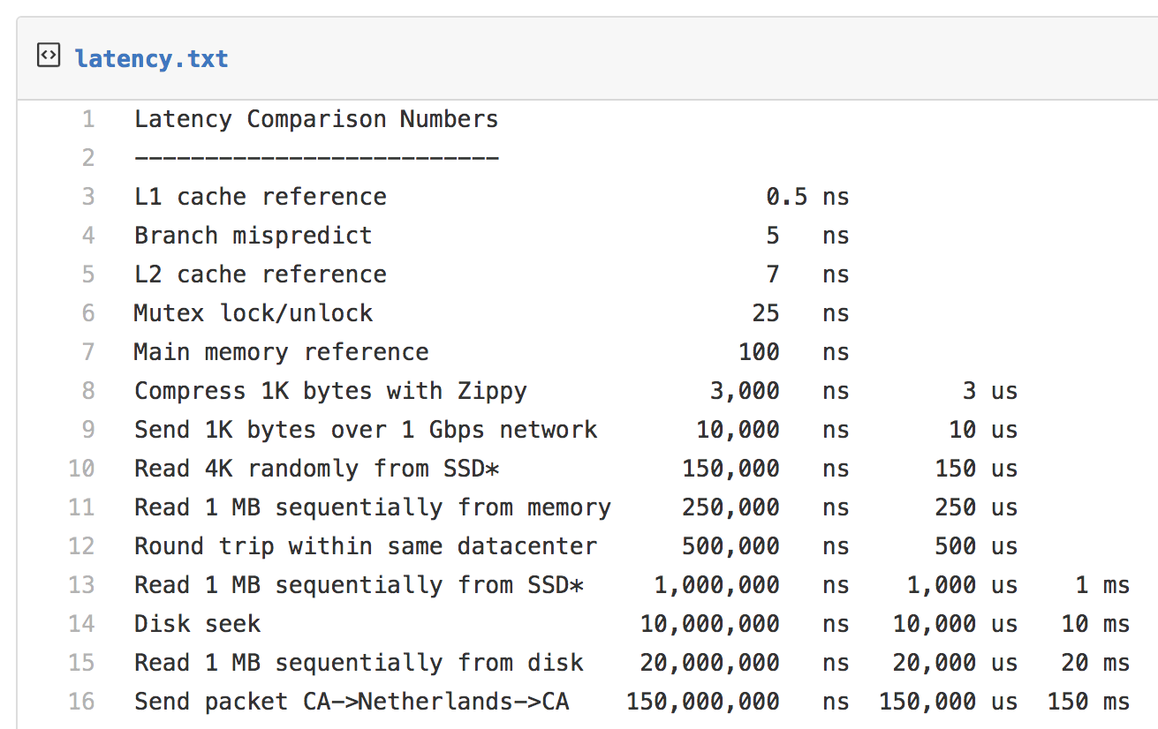
Latency Numbers Every Programmer Should Know
June 7, 2012
From https://gist.github.com/jboner/2841832
See also https://people.eecs.berkeley.edu/~rcs/research/interactive_latency.html

Slide 40

~2016
Seagate ($50)
1TB HDD 7200RPM
Model: STD1000DM003-1SB10C
Operation | HDD Performance
Sequential Read | 176 MB/s
Sequential Write | 190 MB/s
Random Read 4KiB | 0.495 MB/s 121 IOPS
Random Write 4KiB | 0.919 MB/s 224 IOPS
DQ Random Read 4KiB | 1.198 MB/s 292 IOPS
DQ Random Write 4KiB | 0.929 MB/s 227 IOPS
http://www.tomshardware.com/answers/id-3201572/good-normal-read-write-speed-hdd.html

Slide 41
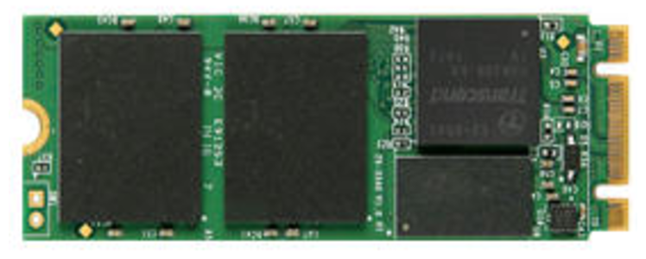
~2016
Seagate ($50)
1TB HDD 7200RPM
Model: STD1000DM003-1SB10C
Samsung ($330)
512 GB 960 Pro NVMe PCIe M.2
Model: MZ-V6P512BW
Operation | HDD Performance | SSD Performance
Sequential Read | 176 MB/s | 2268 MB/s
Sequential Write | 190 MB/s | 1696 MB/s
Random Read 4KiB | 0.495 MB/s 121 IOPS | 44.9 MB/s 10,962 IOPS
Random Write 4KiB | 0.919 MB/s 224 IOPS | 151 MB/s 36,865 IOPS
DQ Random Read 4KiB | 1.198 MB/s 292 IOPS | 348 MB/s 84961 IOPS
DQ Random Write 4KiB | 0.929 MB/s 227 IOPS | 399 MB/s 97,412 IOPS
http://www.tomshardware.com/answers/id-3201572/good-normal-read-write-speed-hdd.html
http://ssd.userbenchmark.com/SpeedTest/182182/Samsung-SSD-960-PRO-512GB

Slide 42
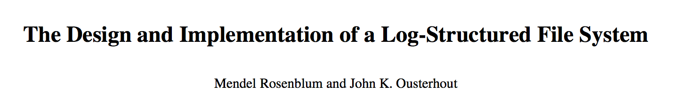
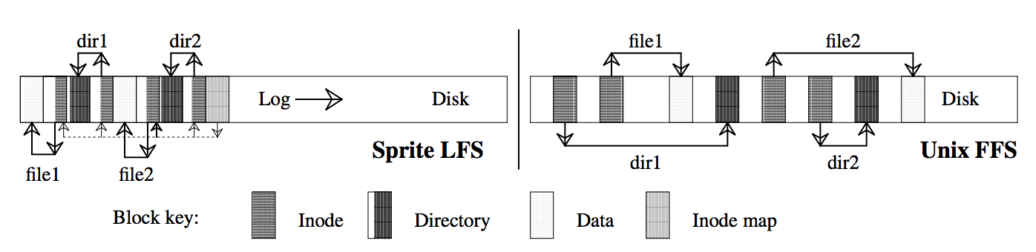
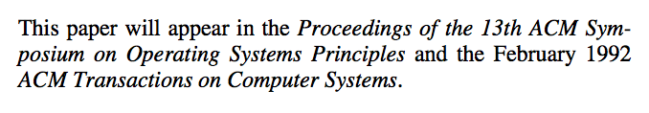
Idea: Traditionally disks laid out with spatial locality due to cost of seeks
Observation: main memory getting bigger → most reads from memory
Implication: Disk workloads now write-heavy → avoid seeks → write log
New problem: Many seeks to read, need to occasionally defragment
New tech solution: SSDs → seeks cheap, erase blocks change defrag

