Slide 1
Streaming
COS 518: Advanced Computer Systems
Lecture 11
Daniel Suo

Slide 2
What is streaming?
Fast data!
Fast processing!
Lots of data!

Slide 3
Streaming = unbounded data
(Batch = bounded data)

Slide 4
Other defns are somewhat misleading
We can use batch frameworks for stream processing (how?)
Batch frameworks can also handle scenarios historically covered by stream frameworks (e.g., low-latency, approximate)

Slide 5
Three major challenges
Consistency: historically, streaming systems were created to decrease latency and made many sacrifices (at-most-processing, anyone?)
Throughput vs. latency: typically a trade-off (why?)
Time: as we will soon see, streaming introduces some new challenges
We’ve covered consistency in a lot of detail, so let’s investigate time.

Slide 6
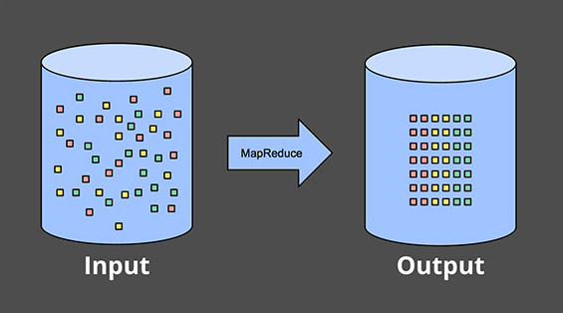
Our lives used to be easy…

Slide 7
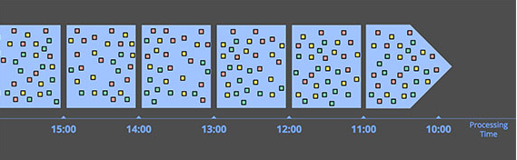
…but if you give a data scientist some data…
Once we move to unbounded data, we need new methods to process whether for sake of capacity (not enough machines) or availability (data doesn’t exist yet)
Easiest thing to do:

Slide 8
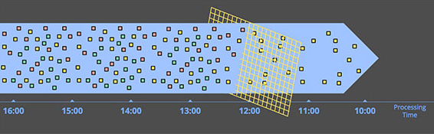
Windowing by processing time is great
Easy to implement and verify correctness
Great for applications like filtering or monitoring

Slide 9
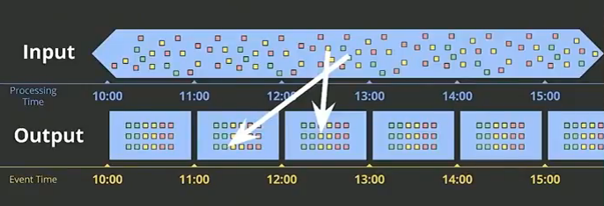
But what if we care about when events happen?
If we associate event times, then items could now come out-of-order! (why?)

Slide 10
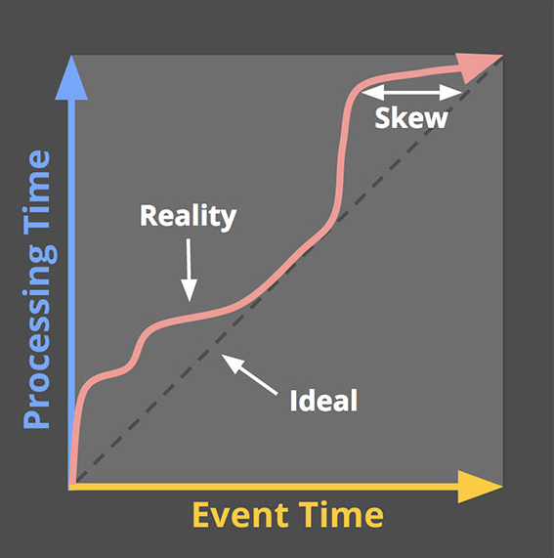
Time creates new wounds

Slide 11
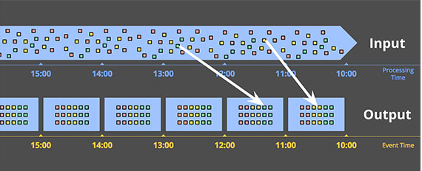
This would be nice

Slide 12
But not the case, so we need tools
Windows: how should we group together data?
Watermarks: how can we mark when the last piece of data in some window has arrived?
Triggers: how can we initiate an early result?
Accumulators: what do we do with the results (correct, modified, or retracted)?
All topics covered in next week’s readings!

