Slide 1
Batch Processing
COS 518: Distributed Systems
Lecture 10
Andrew Or, Mike Freedman

Slide 2
Basic architecture
in “big data” systems

Slide 3
Cluster Manager
Worker
Worker
Worker
Cluster

Slide 4
Cluster Manager
64GB RAM
32 cores
Worker
Worker
64GB RAM
32 cores
64GB RAM
32 cores
Worker
64GB RAM
32 cores
Cluster

Slide 5
Cluster Manager
Client
Submit WordCount.java
Worker
Worker
Worker
Cluster

Slide 6
Cluster Manager
Client
Launch driver
Launch executor
Worker
Worker
Launch executor
Worker
Cluster

Slide 7
Cluster Manager
Client
Worker
Worker
Word Count driver
Word Count executor
Worker
Word Count executor
Cluster

Slide 8
Cluster Manager
Client
Submit FindTopTweets.java
Client
Worker
Worker
Word Count driver
Word Count executor
Worker
Word Count executor
Cluster

Slide 9
Cluster Manager
Client
Launch executor
Client
Worker
Worker
Word Count driver
Word Count executor
Launch driver
Worker
Word Count executor
Cluster

Slide 10
Cluster Manager
Client
Client
Worker
Worker
Word Count driver
Word Count executor
Tweets executor
Worker
Word Count executor
Tweets driver
Cluster

Slide 11
Cluster Manager
Client
Client
Worker
Worker
Word Count driver
Word Count executor
Tweets executor
App3 executor
App3 executor
Client
Worker
Word Count executor
Tweets driver
App3 driver
Cluster

Slide 12
Basic architecture
Clients submit applications to the cluster manager
Cluster manager assigns cluster resources to applications
Each Worker launches containers for each application
Driver containers run main method of user program
Executor containers run actual computation
Examples of cluster manager: YARN, Mesos
Examples of computing frameworks: Hadoop MapReduce, Spark

Slide 13
Two levels of scheduling
Cluster-level: Cluster manager assigns resources to applications
Application-level: Driver assigns tasks to run on executors
A task is a unit of execution that operates on one partition
Some advantages:
Applications need not be concerned with resource fairness
Cluster manager need not be concerned with individual tasks
Easy to implement priorities and preemption

Slide 14
Case Study: MapReduce
(Data-parallel programming at scale)

Slide 15
Application: Word count
Hello my love. I love you, my dear. Goodbye.
hello: 1, my: 2, love: 2, i: 1, dear: 1, goodbye: 1

Slide 16
Application: Word count
Locally: tokenize and put words in a hash map
How do you parallelize this?
Split document by half
Build two hash maps, one for each half
Merge the two hash maps (by key)

Slide 17

How do you do this in a distributed environment?

Slide 18
When in the Course of human events, it becomes necessary for one people to dissolve the political bands which have connected them with another, and to assume, among the Powers of the earth, the separate and equal station to which the Laws of Nature and of Nature's God entitle them, a decent respect to the opinions of mankind requires that they should declare the causes which impel them to the separation.
Input document

Slide 19
When in the Course of human events, it becomes necessary for one people to
dissolve the political bands which have connected them with another, and to assume,
among the Powers of the earth, the separate and equal station to which the Laws of
Nature and of Nature's God entitle them, a decent respect to the opinions of mankind
requires that they should declare the causes which impel them to the separation.
Partition

Slide 20
requires that they should declare the causes which impel them to the separation.
When in the Course of human events, it becomes necessary for one people to
Nature and of Nature's God entitle them, a decent respect to the opinions of mankind
dissolve the political bands which have connected them with another, and to assume,
among the Powers of the earth, the separate and equal station to which the Laws of

Slide 21
requires: 1, that: 1, they: 1, should: 1, declare: 1, the: 1, causes: 1, which: 1 ...
when: 1, in: 1,
the: 1, course: 1,
of: 1, human: 1,
events: 1, it: 1
nature: 2, and: 1, of: 2, god: 1, entitle: 1, them: 1, decent: 1, respect: 1, mankind: 1, opinion: 1 ...
dissolve: 1, the: 2, political: 1, bands: 1, which: 1, have: 1, connected: 1, them: 1 ...
among: 1, the: 2, powers: 1, of: 2, earth: 1, separate: 1, equal: 1, and: 1 ...
Compute word counts locally

Slide 22
requires: 1, that: 1, they: 1, should: 1, declare: 1, the: 1, causes: 1, which: 1 ...
when: 1, in: 1,
the: 1, course: 1,
of: 1, human: 1,
events: 1, it: 1
nature: 2, and: 1, of: 2, god: 1, entitle: 1, them: 1, decent: 1, respect: 1, mankind: 1, opinion: 1 ...
Now what…
How to merge results?
dissolve: 1, the: 2, political: 1, bands: 1, which: 1, have: 1, connected: 1, them: 1 ...
among: 1, the: 2, powers: 1, of: 2, earth: 1, separate: 1, equal: 1, and: 1 ...
Compute word counts locally

Slide 23
Merging results computed locally
Several options
Don’t merge
— requires additional computation for correct results
Send everything to one node
— what if data is too big? Too slow…
Partition key space among nodes in cluster (e.g. [a-e], [f-j], [k-p] ...)
Assign a key space to each node
Partition local results by the key spaces
Fetch and merge results that correspond to the node’s key space

Slide 24
requires: 1, that: 1, they: 1, should: 1, declare: 1, the: 1, causes: 1, which: 1 ...
when: 1, in: 1,
the: 1, course: 1,
of: 1, human: 1,
events: 1, it: 1
nature: 2, and: 1, of: 2, god: 1, entitle: 1, them: 1, decent: 1, respect: 1, mankind: 1, opinion: 1 ...
dissolve: 1, the: 2, political: 1, bands: 1, which: 1, have: 1, connected: 1, them: 1 ...
among: 1, the: 2, powers: 1, of: 2, earth: 1, separate: 1, equal: 1, and: 1 ...

Slide 25
[a-e]
[f-j]
[k-p]
[q-s]
[t-z]
causes: 1, declare: 1,
requires: 1, should: 1,
that: 1, they: 1, the: 1,
which: 1
when: 1, the: 1,
in: 1, it: 1, human: 1,
course: 1, events: 1,
of: 1
nature: 2, of: 2,
mankind: 1, opinion: 1,
entitle: 1, and: 1,
decent: 1, god: 1,
them: 1, respect: 1,
bands: 1, dissolve: 1,
connected: 1, have: 1,
political: 1, the: 1,
them: 1, which: 1
among: 1, and: 1,
equal: 1, earth: 1,
separate: 1, the: 2,
powers: 1, of: 2
Split local results by key space

Slide 26
[q-s]
[t-z]
[f-j]
[a-e]
[k-p]
All-to-all shuffle

Slide 27
[a-e]
[f-j]
[k-p]
[q-s]
[t-z]
when: 1, the: 1, that: 1, they: 1, the: 1, which: 1, them: 1, the: 2, the: 1, them: 1, which: 1
requires: 1, should: 1, respect: 1, separate: 1
god: 1, have: 1, in: 1, it: 1, human: 1,
bands: 1, dissolve: 1,
connected: 1, course: 1,
events: 1, among: 1, and: 1,
equal: 1, earth: 1, entitle: 1,
and: 1, decent: 1, causes: 1,
declare: 1
powers: 1, of: 2,
nature: 2, of: 2,
mankind: 1, of: 1,
opinion: 1, political: 1
Note the duplicates...

Slide 28
[a-e]
[f-j]
[k-p]
[q-s]
[t-z]
requires: 1, should: 1, respect: 1, separate: 1
when: 1, the: 4, that: 1, they: 1, which: 2, them: 2
god: 1, have: 1, in: 1, it: 1, human: 1,
bands: 1, dissolve: 1,
connected: 1, course: 1,
events: 1, among: 1, and: 2,
equal: 1, earth: 1,
entitle: 1, decent: 1,
causes: 1, declare: 1
powers: 1, of: 5,
nature: 2, mankind: 1,
opinion: 1, political: 1
Merge results received from other nodes

Slide 29
MapReduce
Partition dataset into many chunks
Map stage: Each node processes one or more chunks locally
Reduce stage: Each node fetches and merges partial results from all other nodes

Slide 30
MapReduce Interface
map(key, value) -> list(<k’, v’>)
Apply function to (key, value) pair
Outputs set of intermediate pairs
reduce(key, list<value>) -> <k’, v’>
Applies aggregation function to values
Outputs result

Slide 31
MapReduce: Word count
map(key, value):
// key = document name
// value = document contents
for each word w in value:
emit (w, 1)
reduce(key, values):
// key = the word
// values = number of occurrences of that word
count = sum(values)
emit (key, count)

Slide 32
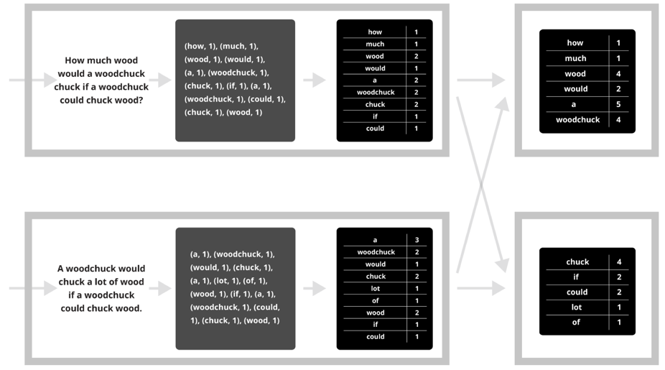
MapReduce: Word count
map
combine
partition
reduce

Slide 33
Synchronization Barrier

Slide 34




MapReduce
2011
2004
2007
2012
2015
Dryad

Slide 35
Brainstorm: Top K
Top K is the problem of finding the largest K values from a set of numbers
How would you express this as a distributed application?
In particular, what would the map and reduce phases look like?
Hint: use a heap…

Slide 36
Brainstorm: Top K
Assuming that a set of K integers fit in memory…
Key idea...
Map phase: everyone maintains a heap of K elements
Reduce phase: merge the heaps until you’re left with one

Slide 37
Brainstorm: Top K
Problem: What are the keys and values here?
No notion of key here, just assign the same key to all the values (e.g. key = 1)
Map task 1: [10, 5, 3, 700, 18, 4] → (1, heap(700, 18, 10))
Map task 2: [16, 4, 523, 100, 88] → (1, heap(523, 100, 88))
Map task 3: [3, 3, 3, 3, 300, 3] → (1, heap(300, 3, 3))
Map task 4: [8, 15, 20015, 89] → (1, heap(20015, 89, 15))
Then all the heaps will go to a single reducer responsible for the key 1
This works, but clearly not scalable…

Slide 38
Brainstorm: Top K
Idea: Use X different keys to balance load (e.g. X = 2 here)
Map task 1: [10, 5, 3, 700, 18, 4] → (1, heap(700, 18, 10))
Map task 2: [16, 4, 523, 100, 88] → (1, heap(523, 100, 88))
Map task 3: [3, 3, 3, 3, 300, 3] → (2, heap(300, 3, 3))
Map task 4: [8, 15, 20015, 89] → (2, heap(20015, 89, 15))
Then all the heaps will (hopefully) go to X different reducers
Rinse and repeat (what’s the runtime complexity?)

Slide 39

Case Study:
(Data-parallel programming at scale)

Slide 40

What is ?
General distributed data execution engine
Key optimizations
General computation graphs (pipelining, lazy execution)
In-memory data sharing (caching)
Fine-grained fault tolerance
#1 most active big data project

Slide 41









What is ?
Spark Streaming real-time
MLlib
machine learning
GraphX
graph processing
Spark SQL structured data
Spark Core
…

Slide 42
Spark computational model
Most computation can be expressed in terms of two phases
Map phase defines how each machine processes its individual partition
Reduce phase defines how to merge map outputs from previous phase
Spark expresses computation as a DAG of maps and reduces

Slide 43
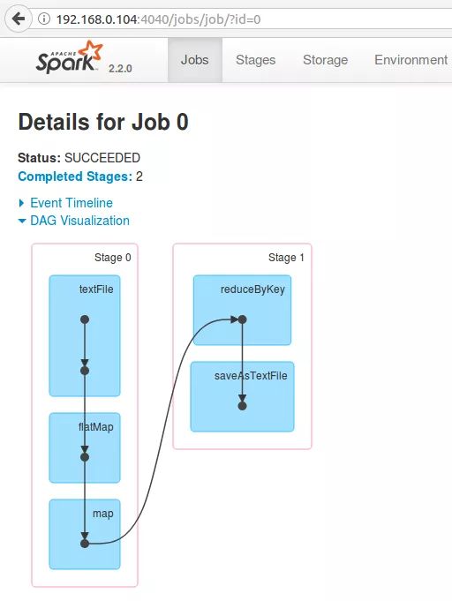
Reduce phase
Map phase
Synchronization barrier

Slide 44
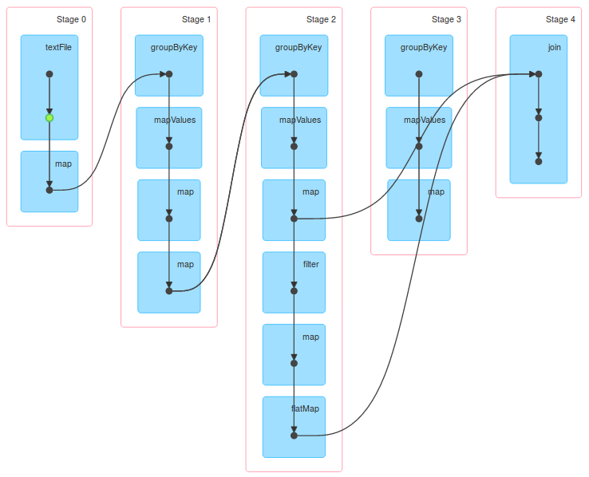
More complicated DAG

Slide 45
Spark: Word count
Transformations express how to process a dataset
Actions express how to turn a transformed dataset into results
sc.textFile("declaration-of-independence.txt")
.flatMap { line => line.split(" ") }
.map { word => (word, 1) }
.reduceByKey { case (counts1, counts2) => counts1 + counts2 }
.collect()

Slide 46
Pipelining + Lazy execution
Transformations can be pipelined until we hit
A synchronization barrier (e.g. reduce), or
An action
Example:
data.map { ... }.filter { ... }.flatMap { ... }.groupByKey().count()
These three operations can all be run in the same task
This allows lazy execution; we don’t need to eagerly execute map

Slide 47
In-memory caching
Store intermediate results in memory to bypass disk access
Important for iterative workloads (e.g. machine learning!)
Example:
val cached = data.map { ... }.filter { ... }.cache()
(1 to 100).foreach { i =>
cached.reduceByKey { ... }.saveAsTextFile(...)
}

Slide 48
Reusing map outputs
Reusing map outputs allows Spark to avoid redoing map stages
Along with caching, this makes iterative workloads much faster
Example:
val transformed = data.map { ... }.reduceByKey { ... }
transformed.collect()
transformed.collect() // does not run map phase again

Slide 49
Logistic Regression Performance
127 s / iteration
first iteration 174 s
further iterations 6 s
[Borrowed from Matei Zaharia’s talk, “Spark: Fast, Interactive, Language-Integrated Cluster Computing”]
Notes:
This is for a 29 GB dataset on 20 EC2 m1.xlarge machines (4 cores each)

Slide 50
Monday
Stream processing

Slide 51
Application: Word Count
SELECT count(word) FROM data
GROUP BY word
cat data.txt
| tr -s '[[:punct:][:space:]]' '\n'
| sort | uniq -c

Slide 52
Using partial aggregation
Compute word counts from individual files
Then merge intermediate output
Compute word count on merged outputs

Slide 53
Using partial aggregation
In parallel, send to worker:
Compute word counts from individual files
Collect result, wait until all finished
Then merge intermediate output
Compute word count on merged intermediates

Slide 54
MapReduce: Programming Interface
map(key, value) -> list(<k’, v’>)
Apply function to (key, value) pair and produces set of intermediate pairs
reduce(key, list<value>) -> <k’, v’>
Applies aggregation function to values
Outputs result

Slide 55
MapReduce: Programming Interface
map(key, value):
for each word w in value:
EmitIntermediate(w, "1");
reduce(key, list(values):
int result = 0;
for each v in values:
result += ParseInt(v);
Emit(AsString(result));

Slide 56
MapReduce: Optimizations
combine(list<key, value>) -> list<k,v>
Perform partial aggregation on mapper node:
<the, 1>, <the, 1>, <the, 1> → <the, 3>
reduce() should be commutative and associative
partition(key, int) -> int
Need to aggregate intermediate vals with same key
Given n partitions, map key to partition 0 ≤ i < n
Typically via hash(key) mod n

Slide 57
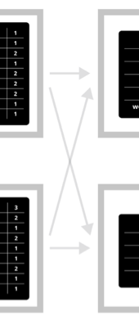
Fault Tolerance in MapReduce
Map worker writes intermediate output to local disk, separated by partitioning. Once completed, tells master node.
Reduce worker told of location of map task outputs, pulls their partition’s data from each mapper, execute function across data
Note:
“All-to-all” shuffle b/w mappers and reducers
Written to disk (“materialized”) b/w each stage

Slide 58
Fault Tolerance in MapReduce
Master node monitors state of system
If master failures, job aborts and client notified
Map worker failure
Both in-progress/completed tasks marked as idle
Reduce workers notified when map task is re-executed on another map worker
Reducer worker failure
In-progress tasks are reset to idle (and re-executed)
Completed tasks had been written to global file system

Slide 59
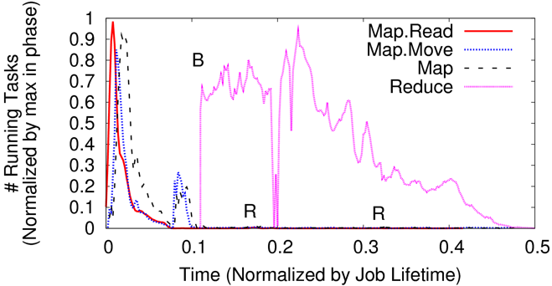
Straggler Mitigation in MapReduce
Tail latency means some workers finish late
For slow map tasks, execute in parallel on second map worker as “backup”, race to complete task

