Slide 1
Erasure Codes for Systems
COS 518: Advanced Computer Systems
Lecture 14
Michael Freedman
Slides originally by Wyatt Lloyd

Slide 2
Things Fail, Let’s Not Lose Data
Replication
Store multiple copies of the data
Simple and very commonly used!
But, requires a lot of extra storage
Erasure coding
Store extra information we can use to recover the data
Fault tolerance with less storage overhead

Slide 3
Erasure Codes vs Error Correcting Codes
Error correcting code (ECC):
Protects against errors is data, i.e., silent corruptions
Bit flips can happen in memory -> use ECC memory
Bits can flip in network transmissions -> use ECCs
Erasure code:
Data is erased, i.e., we know it’s not there
Cheaper/easier than ECC
Special case of ECC
What we’ll discuss today and use in practice
Protect against errors with checksums

Slide 4
Erasure Codes, a simple example w/ XOR
A
B
A⊕B

Slide 5
Erasure Codes, a simple example w/ XOR
A
B
A⊕B

Slide 6
Erasure Codes, a simple example w/ XOR
A
B
A⊕B
A
=
B
⊕
A⊕B

Slide 7
Reed-Solomon Codes (1960)
N data blocks
K coding blocks
M = N+K total blocks
Recover any block from any N other blocks!
Tolerates up to K simultaneous failures
Works for any N and K (within reason)

Slide 8
Reed-Solomon Code Notation
N data blocks
K coding blocks
M = N+K total blocks
RS(N,K)
(10,4): 10 data blocks, 4 coding blocks
f4 uses this, FB HDFS for data warehouse does too
Will also see (M, N) notation sometimes
(14,10): 14 total blocks, 10 data blocks, (4 coding blocks)

Slide 9
Reed-Solomon Codes, How They Work
Galois field arithmetic is the secret sauce
Details aren’t important for us ☺
See “J. S. Plank. A tutorial on Reed-Solomon coding for fault-tolerance in RAID-like systems. Software—Practice & Experience 27(9):995–1012, September 1997.”

Slide 10
Reed-Solomon (4,2) Example
A
B
C
D
1
2

Slide 11
Reed-Solomon (4,2) Example
A
B
C
D
1
2

Slide 12
Reed-Solomon (4,2) Example
A
B
C
D
1
2
A
=
B
C
+
D
+
1
+

Slide 13
Reed-Solomon (4,2) Example
A
B
C
D
1
2
A
=
B
C
+
D
+
1
+
=
=
=
A
=
C
D
+
1
+
2
+

Slide 14
Erasure Codes Save Storage
Tolerating 2 failures
3x replication = ___ storage overhead

Slide 15
Erasure Codes Save Storage
Tolerating 2 failures
3x replication = 3x storage overhead
RS(4,2) = ___ storage overhead

Slide 16
Erasure Codes Save Storage
Tolerating 2 failures
3x replication = 3x storage overhead
RS(4,2) = (4+2)/4 = 1.5x storage overhead

Slide 17
Erasure Codes Save Storage
Tolerating 2 failures
3x replication = 3x storage overhead
RS(4,2) = (4+2)/4 = 1.5x storage overhead
Tolerating 4 failures
5x replication = 5x storage overhead
RS(10,4) = ___ storage overhead

Slide 18
Erasure Codes Save Storage
Tolerating 2 failures
3x replication = 3x storage overhead
RS(4,2) = (4+2)/4 = 1.5x storage overhead
Tolerating 4 failures
5x replication = 5x storage overhead
RS(10,4) = (10+4)/10 = 1.4x storage overhead
RS(100,4) = ___ storage overhead

Slide 19
Erasure Codes Save Storage
Tolerating 2 failures
3x replication = 3x storage overhead
RS(4,2) = (4+2)/4 = 1.5x storage overhead
Tolerating 4 failures
5x replication = 5x storage overhead
RS(10,4) = (10+4)/10 = 1.4x storage overhead
RS(100,4) = (100+4)/100 = 1.04x storage overhead

Slide 20
What’s the Catch?

Slide 21
Catch 1: Encoding Overhead
Replication:
Just copy the data
Erasure coding:
Compute codes over N data blocks for each of the K coding blocks

Slide 22
Catch 2: Decoding Overhead
Replication
Just read the data
Erasure Coding

Slide 23
Catch 2: Decoding Overhead
Replication
Just read the data
Erasure Coding
Normal case is no failures -> just read the data!
If there are failures
Read N blocks from disks and over the network
Compute code over N blocks to reconstruct the failed block

Slide 24
Catch 3: Updating Overhead
Replication:
Update the data in each copy
Erasure coding
Update the data in the data block
And all of the coding blocks

Slide 25
Catch 3’: Deleting Overhead
Replication:
Delete the data in each copy
Erasure coding
Delete the data in the data block
Update all of the coding blocks

Slide 26
Catch 4: Update Consistency
Replication:
Erasure coding

Slide 27
Catch 4: Update Consistency
Replication:
Consensus protocol (Paxos!)
Erasure coding
Need to consistently update all coding blocks with a data block
Need to consistently apply updates in a total order across all blocks
Need to ensure reads, including decoding, are consistent

Slide 28
Catch 5: Fewer Copies for Reading
Replication
Read from any of the copies
Erasure coding
Read from the data block
Or reconstruct the data on fly if there is a failure

Slide 29
Catch 6: Larger Min System Size
Replication
Need K+1 disjoint places to store data
e.g., 3 disks for 3x replication
Erasure coding
Need M=N+K disjoint places to store data
e.g., 14 disks for RS(10,4) replication

Slide 30
What’s the Catch?
Encoding overhead
Decoding overhead
Updating overhead
Deleting overhead
Update consistency
Fewer copies for serving reads
Larger minimum system size

Slide 31
Different codes make different tradeoffs
Encoding, decoding, and updating overheads
Storage overheads
Best are “Maximum Distance Separable” or “MDS” codes where K extra blocks allows you to tolerate any K failures
Configuration options
Some allow any (N,K), some restrict choices of N and K
See “Erasure Codes for Storage Systems, A Brief Primer. James S. Plank. Usenix ;login: Dec 2013” for a good jumping off point
Also a good, accessible resource generally

Slide 32
Erasure Coding Big Picture
Huge Positive
Fault tolerance with less storage overhead!
Many drawbacks
Encoding overhead
Decoding overhead
Updating overhead
Deleting overhead
Update consistency
Fewer copies for serving reads
Larger minimum system size

Slide 33
Let’s Improve Our New Hammer!

Slide 34
Erasure Coding Big Picture
Huge Positive
Fault tolerance with less storage overhead!
Many drawbacks
Encoding overhead
Decoding overhead
Updating overhead
Deleting overhead
Update consistency
Fewer copies for serving reads
Larger minimum system size
Immutable data

Slide 35
Erasure Coding Big Picture
Huge Positive
Fault tolerance with less storage overhead!
Many drawbacks
Encoding overhead
Decoding overhead
Updating overhead
Deleting overhead
Update consistency
Fewer copies for serving reads
Larger minimum system size
Immutable data

Slide 36
Erasure Coding Big Picture
Huge Positive
Fault tolerance with less storage overhead!
Many drawbacks
Encoding overhead
Decoding overhead
Updating overhead
Deleting overhead
Update consistency
Fewer copies for serving reads
Larger minimum system size
Immutable data
Storing lots of data
(when storage overhead actually matters this is true)

Slide 37
Erasure Coding Big Picture
Huge Positive
Fault tolerance with less storage overhead!
Many drawbacks
Encoding overhead
Decoding overhead
Updating overhead
Deleting overhead
Update consistency
Fewer copies for serving reads
Larger minimum system size
Immutable data
Storing lots of data
(when storage overhead actually matters this is true)

Slide 38
Erasure Coding Big Picture
Huge Positive
Fault tolerance with less storage overhead!
Many drawbacks
Encoding overhead
Decoding overhead
Updating overhead
Deleting overhead
Update consistency
Fewer copies for serving reads
Larger minimum system size
Data is stored for a long time after being written
Immutable data
Storing lots of data
(when storage overhead actually matters this is true)

Slide 39
Erasure Coding Big Picture
Huge Positive
Fault tolerance with less storage overhead!
Many drawbacks
Encoding overhead
Decoding overhead
Updating overhead
Deleting overhead
Update consistency
Fewer copies for serving reads
Larger minimum system size
Low read rate
Data is stored for a long time after being written
Immutable data
Storing lots of data
(when storage overhead actually matters this is true)

Slide 40
Erasure Coding Big Picture
Huge Positive
Fault tolerance with less storage overhead!
Many drawbacks
Encoding overhead
Decoding overhead
Updating overhead
Deleting overhead
Update consistency
Fewer copies for serving reads
Larger minimum system size
Low read rate
Data is stored for a long time after being written
Immutable data
Storing lots of data
(when storage overhead actually matters this is true)

Slide 41
f4: Facebook’s Warm BLOB Storage System [OSDI ‘14]
Subramanian Muralidhar*, Wyatt Lloyd*ᵠ, Sabyasachi Roy*, Cory Hill*, Ernest Lin*, Weiwen Liu*, Satadru Pan*, Shiva Shankar*, Viswanath Sivakumar*, Linpeng Tang*⁺, Sanjeev Kumar*
*Facebook Inc., ᵠUniversity of Southern California, ⁺Princeton University
1

Slide 42
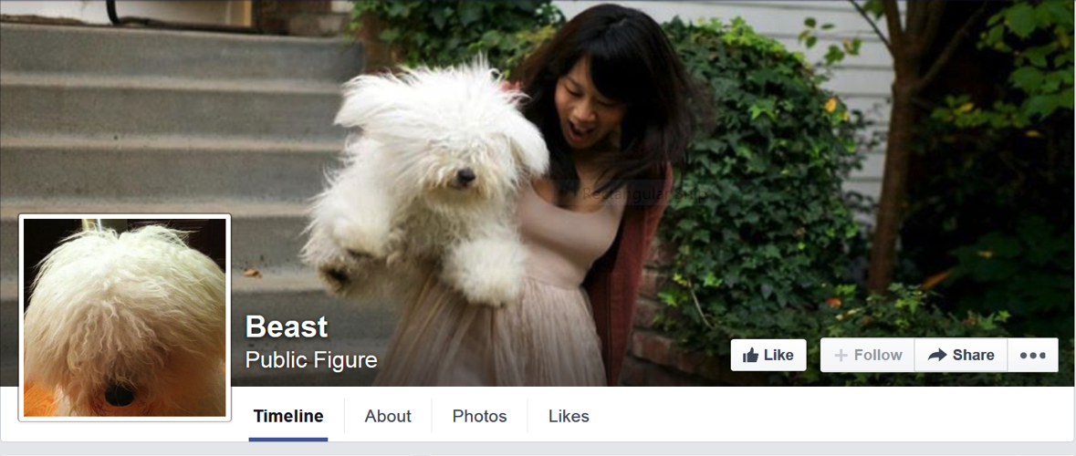
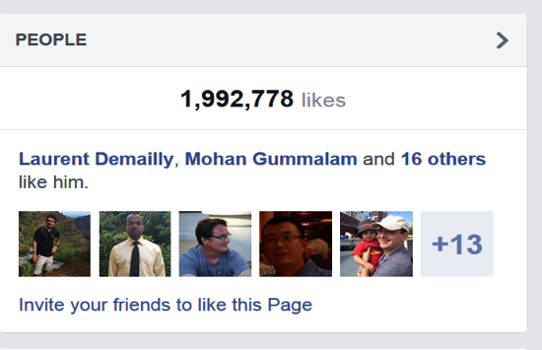
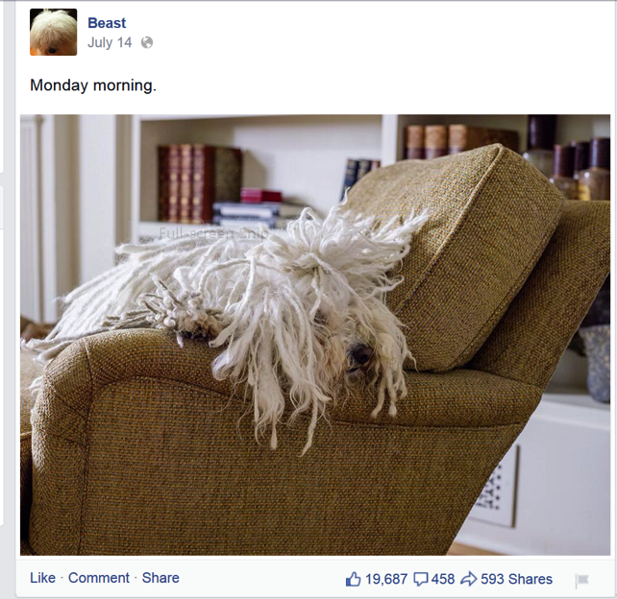

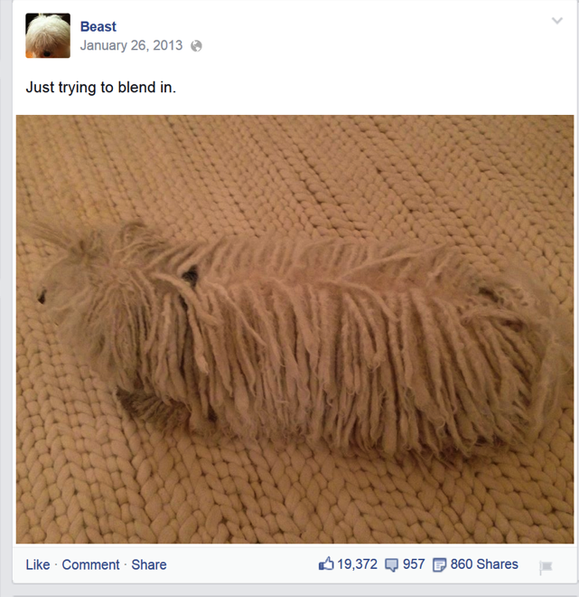
BLOBs@FB
Cover Photo
Profile Photo
Immutable
&
Unstructured
Feed Photo
Diverse
A LOT of them!!
Feed Video

Slide 43

590X
510X
HOT DATA
WARM DATA
Data cools off rapidly
98X
68X
30X
16X
14X
7X
6X
2X
1X
1X
< 1 Days
1 Day
1 Week
1 Month
3 Months
1 Year

Slide 44
Handling failures
3 Host failures
9 Disk failures
3 DC failures
3 Rack failures
DATACENTER
DATACENTER
DATACENTER
RACKS
RACKS
RACKS
HOST
HOST
HOST
1.2
Replication:
* 3 = 3.6

Slide 45
Handling load
HOST
HOST
HOST
HOST
HOST
HOST
HOST
6
Reduce space usage
AND
Not compromise reliability

Slide 46
Background: Data serving
User Requests
CDN protects storage
Router abstracts storage
Web tier adds business logic
Writes
Reads
CDN
Web Servers
Router
BLOB
Storage

Slide 47
Background: Haystack [OSDI’10]
Header
BID1: Off
Volume is a series of BLOBs
In-memory index
BLOB1
BID2: Off
Footer
Header
BIDN: Off
BLOB1
In-Memory Index
Footer
Header
BLOB1
Footer
Volume

Slide 48
Introducing f4: Haystack on cells
Rack
Rack
Rack
Data+Index
Cell
Compute

Slide 49
Data splitting
10G Volume
Reed Solomon Encoding
4G parity
Stripe1
Stripe2
BLOB4
BLOB1
BLOB4
BLOB6
BLOB8
BLOB10
BLOB5
RS
BLOB2
BLOB5
=>
BLOB2
BLOB11
BLOB7
BLOB9
BLOB3
BLOB4
RS
=>
BLOB2

Slide 50
Data placement
10G Volume
4G parity
Stripe1
Stripe2
RS
RS
Cell with 7 Racks
Reed Solomon (10, 4) is used in practice (1.4X)
Tolerates 4 racks (→ 4 disk/host ) failures

Slide 51
Reads
Router
Storage Nodes
Index
Read
Index
User
Request
Data
Read
Compute
Cell
2-phase: Index read returns exact physical location of BLOB

Slide 52
Reads under cell-local failures
Router
Storage Nodes
Index
Read
Index
User
Request
Data
Read
Compute (Decoders)
Decode
Read
Cell
Cell-Local failures (disks/hosts/racks) handled locally

Slide 53
Reads under datacenter failures (2.8X)
User
Request
Compute (Decoders)
Proxying
Cell in Datacenter1
Compute (Decoders)
Mirror Cell in Datacenter2
2 * 1.4X = 2.8X

Slide 54
Cross datacenter XOR
(1.5 * 1.4 = 2.1X)
67%
Index
Cell in
Datacenter1
33%
Index
Cell in
Datacenter2
Index
Cell in
Datacenter3
Cross –DC
index copy

Slide 55
Reads with datacenter failures (2.1X)
Router
Index
Data
Read
User
Request
Router
XOR
Index
Index
Read
Data
Read
Index
Index
Router

Slide 56
 | Haystack 3-way replication | f4 2.8 RS(10,4) | f4 2.1 RS(10,4)
Replication | 3.6X | 2.8X | 2.1X
Irrecoverable Disk Failures | 9 | 10 | 10
Irrecoverable Host Failures | 3 | 10 | 10
Irrecoverable Rack failures | 3 | 10 | 10
Irrecoverable Datacenter failures | 3 | 2 | 2
Load split | 3X | 2X | 1X

Slide 57
Evaluation
What and how much data is “warm”?
Can f4 satisfy throughput and latency requirements?
How much space does f4 save
f4 failure resilience

Slide 58
Methodology
CDN data: 1 day, 0.5% sampling
BLOB store data: 2 week, 0.1%
Random distribution of BLOBs assumed
The worst case rates reported

Slide 59
Hot and warm divide
HOT DATA
WARM DATA
< 3 months → Haystack
> 3 months → f4
80 Reads/Sec

Slide 60
It is warm, not cold
Haystack (50%)
F4 (50%)
HOT DATA
WARM DATA

Slide 61
f4 Performance: Most loaded disk in cluster
Peak load on disk: 35 Reads/Sec
Reads/Sec

Slide 62
f4 Performance: Latency
P80 = 30ms
P99 = 80ms

Slide 63
Summary
Facebook’s BLOB storage is big and growing
BLOBs cool down with age
~100X drop in read requests in 60 days
Haystack’s 3.6X replication over provisioning for old, warm data.
f4 encodes data to lower replication to 2.1X

