Slide 1
Distributed Systems
COS 418: Distributed Systems
Lecture 1
Mike Freedman

Slide 2
Case Study: MapReduce
(Data-parallel programming at scale)

Slide 3
Application: Word Count
SELECT count(word) FROM data
GROUP BY word
cat data.txt
| tr -s '[[:punct:][:space:]]' '\n'
| sort | uniq -c

Slide 4
Using partial aggregation
Compute word counts from individual files
Then merge intermediate output
Compute word count on merged outputs

Slide 5
Using partial aggregation
In parallel, send to worker:
Compute word counts from individual files
Collect result, wait until all finished
Then merge intermediate output
Compute word count on merged intermediates

Slide 6
MapReduce: Programming Interface
map(key, value) -> list(<k’, v’>)
Apply function to (key, value) pair and produces set of intermediate pairs
reduce(key, list<value>) -> <k’, v’>
Applies aggregation function to values
Outputs result

Slide 7
MapReduce: Programming Interface
map(key, value):
for each word w in value:
EmitIntermediate(w, "1");
reduce(key, list(values):
int result = 0;
for each v in values:
result += ParseInt(v);
Emit(AsString(result));

Slide 8
MapReduce: Optimizations
combine(list<key, value>) -> list<k,v>
Perform partial aggregation on mapper node:
<the, 1>, <the, 1>, <the, 1> → <the, 3>
reduce() should be commutative and associative
partition(key, int) -> int
Need to aggregate intermediate vals with same key
Given n partitions, map key to partition 0 ≤ i < n
Typically via hash(key) mod n

Slide 9
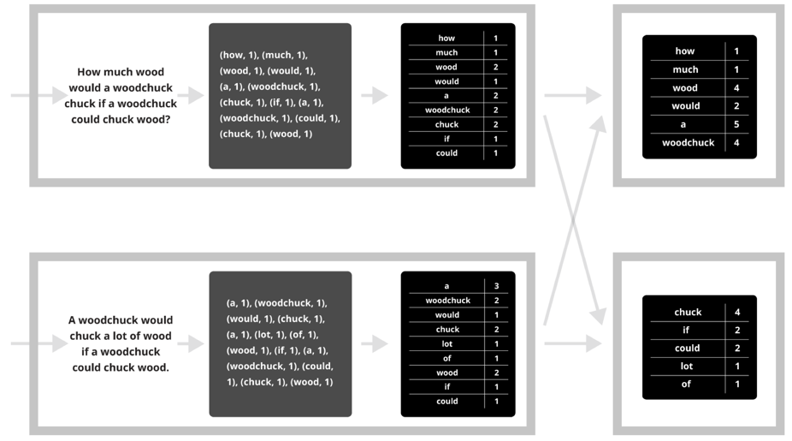
Putting it together…
map
combine
partition
reduce

Slide 10
Synchronization Barrier

Slide 11
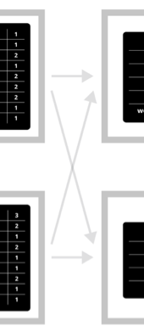
Fault Tolerance in MapReduce
Map worker writes intermediate output to local disk, separated by partitioning. Once completed, tells master node.
Reduce worker told of location of map task outputs, pulls their partition’s data from each mapper, execute function across data
Note:
“All-to-all” shuffle b/w mappers and reducers
Written to disk (“materialized”) b/w each stage

Slide 12
Fault Tolerance in MapReduce
Master node monitors state of system
If master failures, job aborts and client notified
Map worker failure
Both in-progress/completed tasks marked as idle
Reduce workers notified when map task is re-executed on another map worker
Reducer worker failure
In-progress tasks are reset to idle (and re-executed)
Completed tasks had been written to global file system

Slide 13
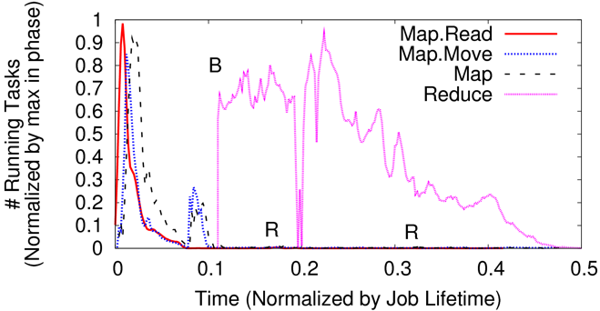
Straggler Mitigation in MapReduce
Tail latency means some workers finish late
For slow map tasks, execute in parallel on second map worker as “backup”, race to complete task

