Slide 1
Graph Processing
COS 518: Advanced Computer Systems
Lecture 12
Mike Freedman
[Content adapted from K. Jamieson and J. Gonzalez]

Slide 2
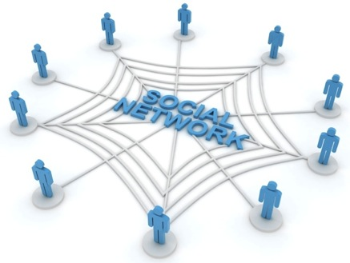
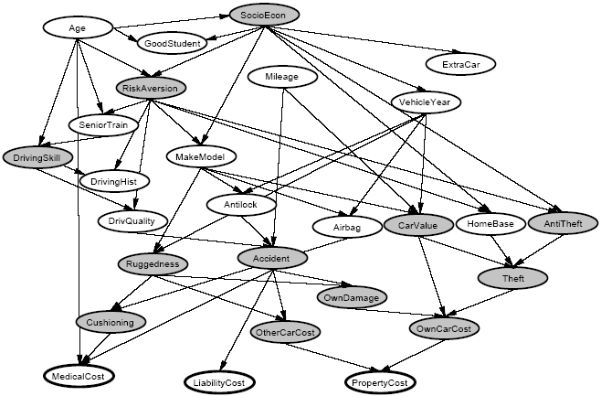
Graphs are Everywhere
Social Network
Collaborative Filtering
Users
Netflix
Movies
Probabilistic Analysis
Text Analysis
Docs
Wiki
Words
Notes:
This idea has lots of applications. Might be inferring interests about people in a social network,
>>> Collaborative filtering: trying to predict movie ratings of each user given a handful of movie ratings from all users. BIPARTITE GRAPH where you have users on one side and movies on the other --> sparse matrix (RED).
>>> Textual analysis: e.g. detecting user sentiment regarding product reviews on a website like Amazon.
>>> relate random variables.

Slide 3
Concrete Examples
Label Propagation
Page Rank
Notes:
So for a concrete example, let’s look at label propagation in a social network graph.

Slide 4




Label Propagation Algorithm
Social Arithmetic:
Recurrence Algorithm:
iterate until convergence
Parallelism:
Compute all Likes[i] in parallel
Sue Ann
50% What I list on my profile
40% Sue Ann Likes
10% Carlos Like
80% Cameras
20% Biking
40%
+
I Like:
60% Cameras, 40% Biking
Profile
50%
50% Cameras
50% Biking
Me
Carlos
10%
30% Cameras
70% Biking
Notes:
So suppose we want to inferences about for example someone’s hobbies, we might want to do "social arithmetic" on a social networking graph...
>>> Then once we have these interests on the graph we can compute the probability someone likes a hobby as the weighted probabilities that their friends likes that hobby. Some measure of closeness would be the weight. This is JUST ONE STEP that gets applied to the ENTIRE GRAPH – so iterate this applied to ALL NODES.
>>> FURTHERMORE we want to perform this computation on all nodes in the graph IN PARALLEL to speed it up!

Slide 5
PageRank Algorithm
PageRank of u is dependent on PR of all pages linking to u, divided by the number of links from each of these pages
Recurrence Algorithm:
PR[u] = 𝛴_{v∈Bu} PR[v] / L[v]
iterate until convergence
Parallelism:
Compute all PR[u] in parallel
Notes:
. the PageRank value for a page u is dependent on the PageRank values for each page v contained in the set B_{u} (the set containing all pages linking to page u), divided by the number L(v) of links from page v.

Slide 6




Properties of Graph Parallel Algorithms
Dependency
Graph
Factored
Computation
Iterative
Computation
What I Like
What My Friends Like
Notes:
Taking a step back – the big picture here is that this is one example of many GRAPH PARALLEL algorithms that have the following properties:
(L) Significant information in the DEPENDENCIES between different pieces of data, can represent those deps naturally using a graph.
(C) As a result computation FACTORS into different LOCAL neighborhoods, depends DIRECTLY only on those neighborhoods.
(R) b/c graph has many CHAINS of connections, need to ITERATE local computation, PROPAGATING information.

Slide 7
Map-Reduce for Data-Parallel ML
Excellent for large data-parallel tasks!
Data-Parallel Graph-Parallel
MapReduce
MapReduce?
Feature
Extraction
Algorithm
Tuning
Label Propagation
Lasso
Belief
Propagation
Kernel
Methods
Basic Data Processing
Tensor
Factorization
PageRank
Deep Belief
Networks
Neural
Networks
Notes:
So that's what these Graph-Parallel algorithms are all about.
So at this point you should be wondering, why not use MapReduce for Graph Parallel Algorithms?

Slide 8
Problem: Data Dependencies
MapReduce doesn’t efficiently express data dependencies
User must code substantial data transformations
Costly data replication
Independent Data Rows
Notes:
Number of reasons. First, MR doesn't have any way of directly representing a DEPENDENCY GRAPH.
To use MR, on these problems, user has to code up substantial TRANSFORMATIONS to data to make each piece of data independent from the others, this often involves REPLICATING data, which is costly in terms of storage.

Slide 9
Iterative Algorithms
MR doesn’t efficiently express iterative algorithms:
Iterations
Data
Data
Data
Data
CPU 1
CPU 1
CPU 1
Data
Data
Data
Data
Data
Data
Data
Data
Slow
Processor
CPU 2
CPU 2
CPU 2
Data
Data
Data
Data
Data
Data
Data
Data
CPU 3
CPU 3
CPU 3
Data
Data
Data
Data
Data
Data
Data
Data
Barrier
Barrier
Barrier
Notes:
Many ML algorithms (like the social network example before) ITERATIVELY REFINE their variables during operation.
>>> >>> >>> MR doesn’t provide a mechanism to directly encode ITERATIVE computation, so it's forced to wait for all the data in the PRECEDING ITERATION before computing the next.
>>> SEGUE: If one processor is slow (common case) then whole system runs slowly.

Slide 10
MapAbuse: Iterative MapReduce
Only a subset of data needs computation:
Iterations
Data
Data
Data
Data
CPU 1
CPU 1
CPU 1
Data
Data
Data
Data
Data
Data
Data
Data
CPU 2
CPU 2
CPU 2
Data
Data
Data
Data
Data
Data
Data
Data
CPU 3
CPU 3
CPU 3
Data
Data
Data
Data
Data
Data
Data
Data
Barrier
Barrier
Barrier
Notes:
Often just a SUBSET of the data needs to be computed on, that subset will change on each iteration of the algorithm. So this setup using MapReduce is doing a lot of UNNECESSARY PROCESSING.

Slide 11
MapAbuse: Iterative MapReduce
System is not optimized for iteration:
Iterations
Data
Data
Data
Data
CPU 1
CPU 1
CPU 1
Data
Data
Data
Data
Data
Data
Data
Data
CPU 2
CPU 2
CPU 2
Startup Penalty
Disk Penalty
Startup Penalty
Disk Penalty
Startup Penalty
Data
Data
Disk Penalty
Data
Data
Data
Data
Data
Data
CPU 3
CPU 3
CPU 3
Data
Data
Data
Data
Data
Data
Data
Data
Notes:
Finally there is a STARTUP PENALTY associated with the storage and network delays of reading and writing to disk. So the system isn’t optimized for iteration from a performance standpoint.

Slide 12
ML Tasks Beyond Data-Parallelism
Data-Parallel Graph-Parallel
Map Reduce
Feature
Extraction
Cross
Validation
Graphical Models
Gibbs Sampling
Belief Propagation
Variational Opt.
Semi-Supervised Learning
Label Propagation
CoEM
Computing Sufficient
Statistics
Collaborative
Filtering
Tensor Factorization
Graph Analysis
PageRank
Triangle Counting
Notes:
There’s a large universe of applications that fit nicely into graph-parallel algorithms, and GraphLab is designed to target these applications.

Slide 13
This week’s lectures
Graph processing
Why relationships, sampling, and iterations often use in graph processing not well fit by MapReduce
How to take a graph-centric processing perspective
Machine learning
These are solving one type of ML algorithm
What other systems are needed, particularly given heavy focus on iterative algorithms

Slide 14
Today’s readings
Streaming is about unbounded data sets, not particular execution engines
Streaming is in fact a strict superset of batch, Lambda Architecture destined for retirement
Needs of good streaming systems: correctness and tools for reasoning about time.
Differences between event time and processing time, and the challenges they impose

Slide 15
Today’s readings
What about major data processing approaches for bounded & unbounded data?
Challenges/needs for unbounded include:
time-agnostic, approximation, windowing by processing time, windowing by event time
Key mechanisms (in Cloud DataFlow)
Watermarks: ideal vs. heuristic
Triggers
Discarding, accumulating, accumulating + retracting

