Slide 1
Anonymous Communication
COS 518: Advanced Computer Systems
Lecture 19
Michael Freedman
Slides based heavily on Christo Wilson’s CS4700/5700 at Northeastern

Slide 2
Definition
Hiding identities of parties involved in communications from each other, or from third-parties
“Who you are” from the communicating party
“Who you are talking to” from everyone else

Slide 3














Quantifying Anonymity
How can we calculate how anonymous we are?
Suspects (Anonymity Set)
Who sent this message?
Larger anonymity set = stronger anonymity

Slide 4
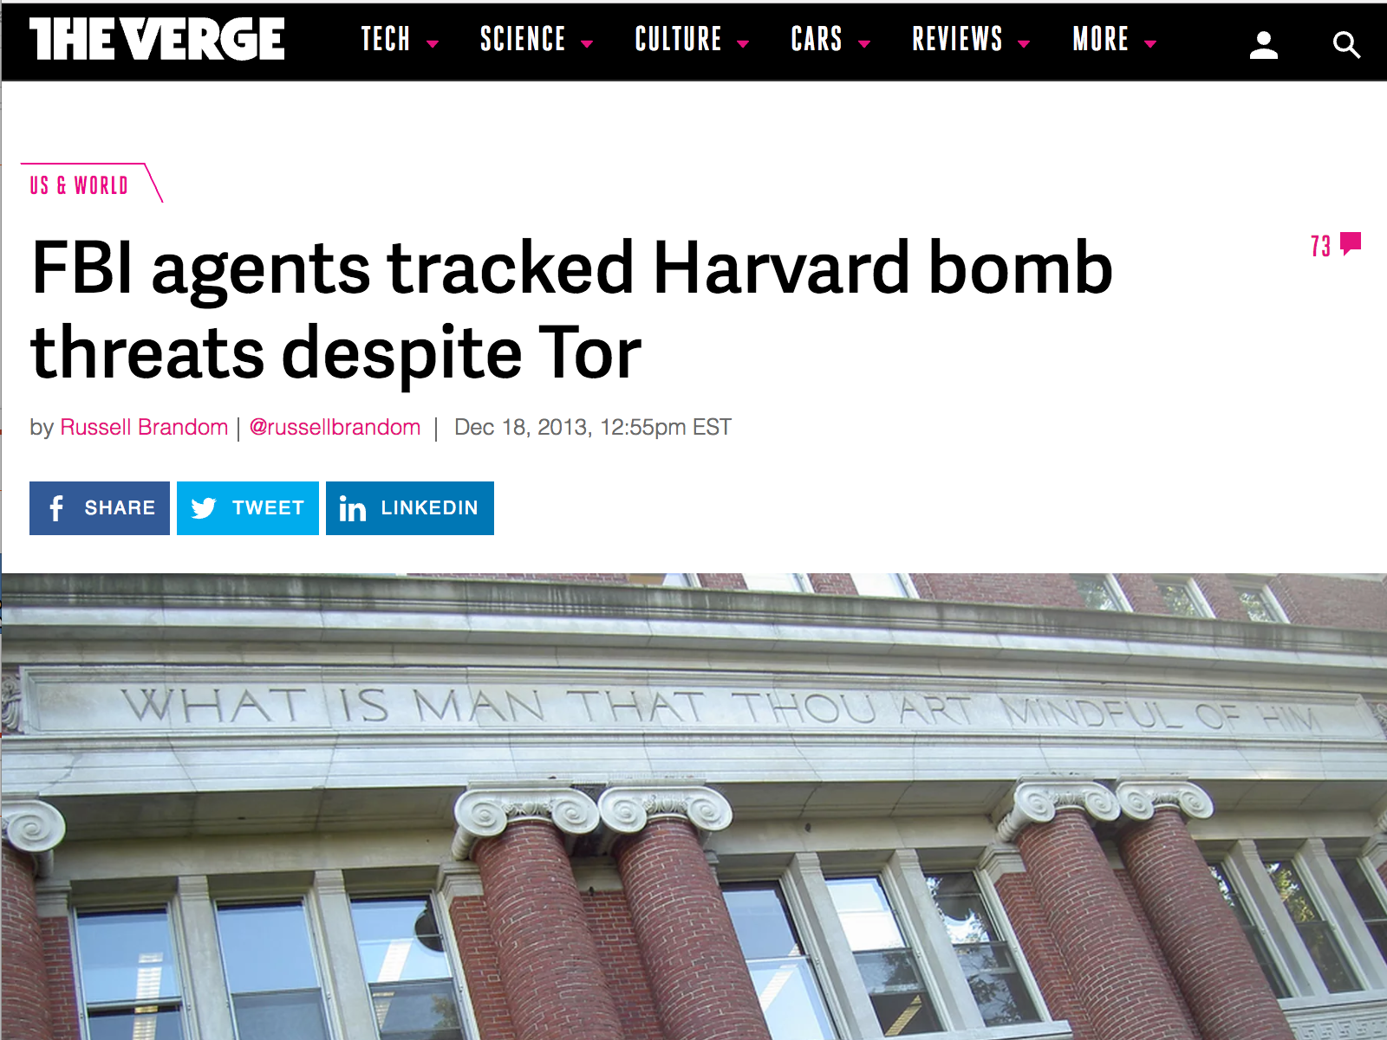

Slide 5
Anonymity Systems

Slide 6


Crypto (SSL)
Data Traffic
Content is unobservable
Due to encryption
Source and destination are trivially linkable
No anonymity!

Slide 7








Anonymizing Proxies
HTTPS Proxy
No anonymity!
Source is known
Destination anonymity
Destination known
Source anonymity

Slide 8

Anonymizing VPNs
VPN Gateway
No anonymity!
Source is known
Destination anonymity
Destination known
Source anonymity

Slide 9
Crowds

Slide 10
Crowds
Key idea
Users’ traffic blends into a crowd of users
Eavesdroppers and end-hosts don’t know which user originated what traffic
High-level implementation
Every user runs a proxy on their system
When a message is received, select x [0, 1]
If x > p_{f}: forward the message to a random proxy
Else: deliver the message to the actual receiver

Slide 11

Crowds Example
Links between users use public key crypto
Users may appear on the path multiple times
Final Destination

Slide 12
Anonymity in Crowds
No source anonymity
Target receives m (>= 0) msgs, sends m+1 msgs
Thus, target is sending something
Destination anonymity is maintained
If the source isn’t sending directly to the receiver

Slide 13
Anonymity in Crowds
Source and destination are anonymous
Source and destination are proxies
Destination is hidden by encryption

Slide 14
Anonymity in Crowds
Destination known
Source is anonymous
O(n) possible sources, where n is the number of proxies

Slide 15
Anonymity in Crowds
Destination is known
Evil proxy able to decrypt the message
Source is somewhat anonymous
Suppose f evil in system and if p_{f} > 0.5 and n > 3(f + 1), source cannot be inferred with prob > 0.5

Slide 16
Summary of Crowds
The good:
Crowds has excellent scalability
Each user helps forward messages and handle load
More users = better anonymity for everyone
Strong source anonymity guarantees
The bad:
Very weak destination anonymity
Evil proxies can always see the destination
Weak unlinkability guarantees

Slide 17
MIXes

Slide 18
Mix Networks
A different approach to anonymity than Crowds
Originally designed for anonymous email
David Chaum, 1981
Concept has since been generalized for TCP traffic
Hugely influential ideas
Onion routing
Traffic mixing
Dummy traffic (a.k.a. cover traffic)

Slide 19




Onion Routing
Encrypted Tunnels
Mix
[K_{P} , K_{P} , K_{P}]
<K_{P}, K_{S}>
<K_{P}, K_{S}>
<K_{P}, K_{S}>
<K_{P}, K_{S}>
<K_{P}, K_{S}>
<K_{P}, K_{S}>
<K_{P}, K_{S}>
<K_{P}, K_{S}>
E(K_{P} , E(K_{P} , E(K_{P} , M))) = C
Non-encrypted data
Mixes form a cascade of anonymous proxies
All traffic is protected with layers of encryption

Slide 20
Another View of Encrypted Paths
<K_{P}, K_{S}>
<K_{P}, K_{S}>
<K_{P}, K_{S}>

Slide 21
Return Traffic
In a mix network, how can the destination respond to the sender?
During path establishment, the sender places keys at each mix along the path
Data is re-encrypted as it travels the reverse path
<K_{P1} , K_{S1}>
K_{P1}
K_{P2}
K_{P3}
<K_{P2} , K_{S2}>
<K_{P3} , K_{S3}>

Slide 22



Traffic Mixing
Mix collects msgs for t seconds
Messages are randomly shuffled and sent in a different order
Hinders timing attacks
Messages may be artificially delayed
Temporal correlation is warped
Problems:
Requires lots of traffic
Adds latency to network flows
Arrival Order
Send Order
1
1
4
2
2
3
3
4

Slide 23
Applied to cryptographic voting
Server collects votes
Computes random shuffle of votes
Outputs votes in randomized order
Includes “proof” that correctly shuffled
Arrival Order
Send Order
1
1
4
2
2
3
3
4

Slide 24
Chain multiple MIXes for security
Synchronously collects and shuffles messages (votes)
Secure as long as at least 1 honest
Arrival Order
Send Order
1
1
4
2
2
3
Random
shuffle
Random
shuffle
Random
shuffle
3
4

Slide 25
Dummy / Cover Traffic
Simple idea:
Send useless traffic to help obfuscate real traffic

Slide 26
In practice Hard to be anonymous Information leaked at many layers

Slide 27
Using Content to Deanonymize
HTTPS Proxy
Login to email account
Information sent in cookies
Accessing Facebook pages
No anonymity!

Slide 28
It’s Hard to be Anonymous!
Network location (IP address) can be linked directly to you
ISPs store communications records (legally required for several years)
Law enforcement can subpoena these records
Application is being tracked
Cookies, Flash cookies, E-Tags, HTML5 Storage, browser fingerprinting
Centralized services like Skype, Google voice
Activities can be used to identify you
Unique websites and apps that you use, types of clicked links
Types of links that you click

Slide 29
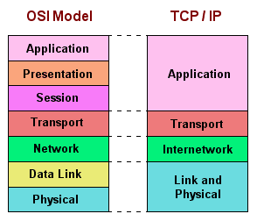
You Have to Protect at All Layers!
Challenges:
Maintain performance
Provide functionality!

Slide 30
Wednesday’s reading
Tor: 2nd generation onion routing (2004)
Freenet: Anonymous file-sharing (2000)

