Slide 1
Replication and Consistency
COS 518: Advanced Computer Systems
Lecture 3
Michael Freedman

Slide 2

Correct consistency model?
A
B
Let’s say A and B send an op.
All readers see A → B ?
All readers see B → A ?
Some see A → B and others B → A ?
Notes:
Processes may be running on different machines

Slide 3


Time and distributed systems
With multiple events, what happens first?
A shoots B
B shoots A
A dies
B dies

Slide 4
Just use time stamps?
p
Time server,S
Clients ask time server for time and adjust local clock, based on response
How to correct for the network latency?
RTT = Time_received – Time_sent
Time_local_new = Time_server + (RTT / 2)
Error = Time_local_new – Time_local _old

Slide 5
Is this sufficient?
Server latency due to load?
If can measure: Time_local_new = Time_server + (RTT / 2 + lag)
But what about asymmetric latency?
RTT / 2 not sufficient!
What do we need to measure RTT?
Requires no clock drift!
What about “almost” concurrent events?
Clocks have micro/milli-second precision
Notes:
Certainly not!

Slide 6
Order by logical events, not by wall clock time

Slide 7
Correct consistency model?
A
B
Let’s say A and B send an op.
All readers see A → B ?
All readers see B → A ?
Some see A → B and others B → A ?
Notes:
Processes may be running on different machines

Slide 8
“Lazy replication”
OK
A
A
Acknowledge writes immediately
Lazily replicate elsewhere (push or pull)
Eventual consistency: Bayou, Dynamo, …
Notes:
Processes may be running on different machines

Slide 9
“Eager replication”
OK
A
OK
OK
A
On a write, immediately replicate elsewhere
Wait until write committed to sufficient # of nodes before acknowledging
Notes:
Processes may be running on different machines

Slide 10
Consistency models
Strong
consistency
Causal
Consistency
Sequential
Consistency
Eventual
consistency

Slide 11
Strong consistency
Provide behavior of a single copy of object:
Read should return the most recent write
Subsequent reads should return same value, until next write
Telephone intuition:
Alice updates Facebook post
Alice calls Bob on phone: “Check my Facebook post!”
Bob read’s Alice’s wall, sees her post

Slide 12

Strong Consistency?
write(A,1)
success
1
read(A)
Phone call: Ensures happens-before relationship, even through “out-of-band” communication

Slide 13
Strong Consistency?
write(A,1)
success
1
read(A)
One cool trick: Delay responding to writes/ops until properly committed

Slide 14
Strong Consistency? This is buggy!
write(A,1)
success
eager
replication
1
committed
read(A)
Isn’t sufficient to return value of third node: It doesn’t know precisely when op is “globally” committed
Instead: Need to actually order read operation

Slide 15
Strong Consistency!
write(A,1)
success
1
read(A)
Order all operations via (1) leader, (2) consensus

Slide 16
Strong consistency = linearizability
Linearizability (Herlihy and Wang 1991)
All servers execute all ops in some identical sequential order
Global ordering preserves each client’s own local ordering
Global ordering preserves real-time guarantee
All ops receive global time-stamp using a sync’d clock
If ts_{op1}(x) < ts_{op2}(y), OP1(x) precedes OP2(y) in sequence
Once write completes, all later reads (by wall-clock start time) should return value of that write or value of later write.
Once read returns particular value, all later reads should return that value or value of later write.
Notes:
If ts(a) < ts (b), are either linearizable? Does ts(a) have to be before ts(b)? If concurrent, both just need to agree (tie break via some other thing (processor ID)?)

Slide 17
Intuition: Real-time ordering
write(A,1)
success
1
committed
read(A)
Once write completes, all later reads (by wall-clock start time) should return value of that write or value of later write.
Once read returns particular value, all later reads should return that value or value of later write.

Slide 18
Weaker: Sequential consistency
Sequential = Linearizability – real-time ordering
All servers execute all ops in some identical sequential order
Global ordering preserves each client’s own local ordering
With concurrent ops, “reordering” of ops (w.r.t. real-time ordering) acceptable, but all servers must see same order
e.g., linearizability cares about time sequential consistency cares about program order
Notes:
If ts(a) < ts (b), are either linearizable? Does ts(a) have to be before ts(b)? If concurrent, both just need to agree (tie break via some other thing (processor ID)?)

Slide 19
Sequential Consistency
write(A,1)
success
0
read(A)
In example, system orders read(A) before write(A,1)

Slide 20

Valid Sequential Consistency?
x
✓
Why? Because P3 and P4 don’t agree on order of ops. Doesn’t matter when events took place on diff machine, as long as proc’s AGREE on order.
What if P1 did both W(x)a and W(x)b?
Neither valid, as (a) doesn’t preserve local ordering

Slide 21
Even Weaker: Causal consistency
Potentially causally related operations?
R(x) then W(x)
R(x) then W(y), x ≠ y
Necessary condition: Potentially causally-related writes must be seen by all processes in the same order
Concurrent writes may be seen in a different order on different machines

Slide 22

Causal consistency
Allowed with causal consistency, but not with sequential
W(x)b and W(x)c are concurrent
So all processes don’t see them in the same order
P3 and P4 read the values ‘a’ and ‘b’ in order as potentially causally related. No ‘causality’ for ‘c’.

Slide 23
Causal consistency
Why not sequentially consistent?
P3 and P4 see W(x)b and W(x)c in different order.
But fine for causal consistency
Writes W(x)b and W(x)c are not causally dependent
Write after write has no dependencies

Slide 24
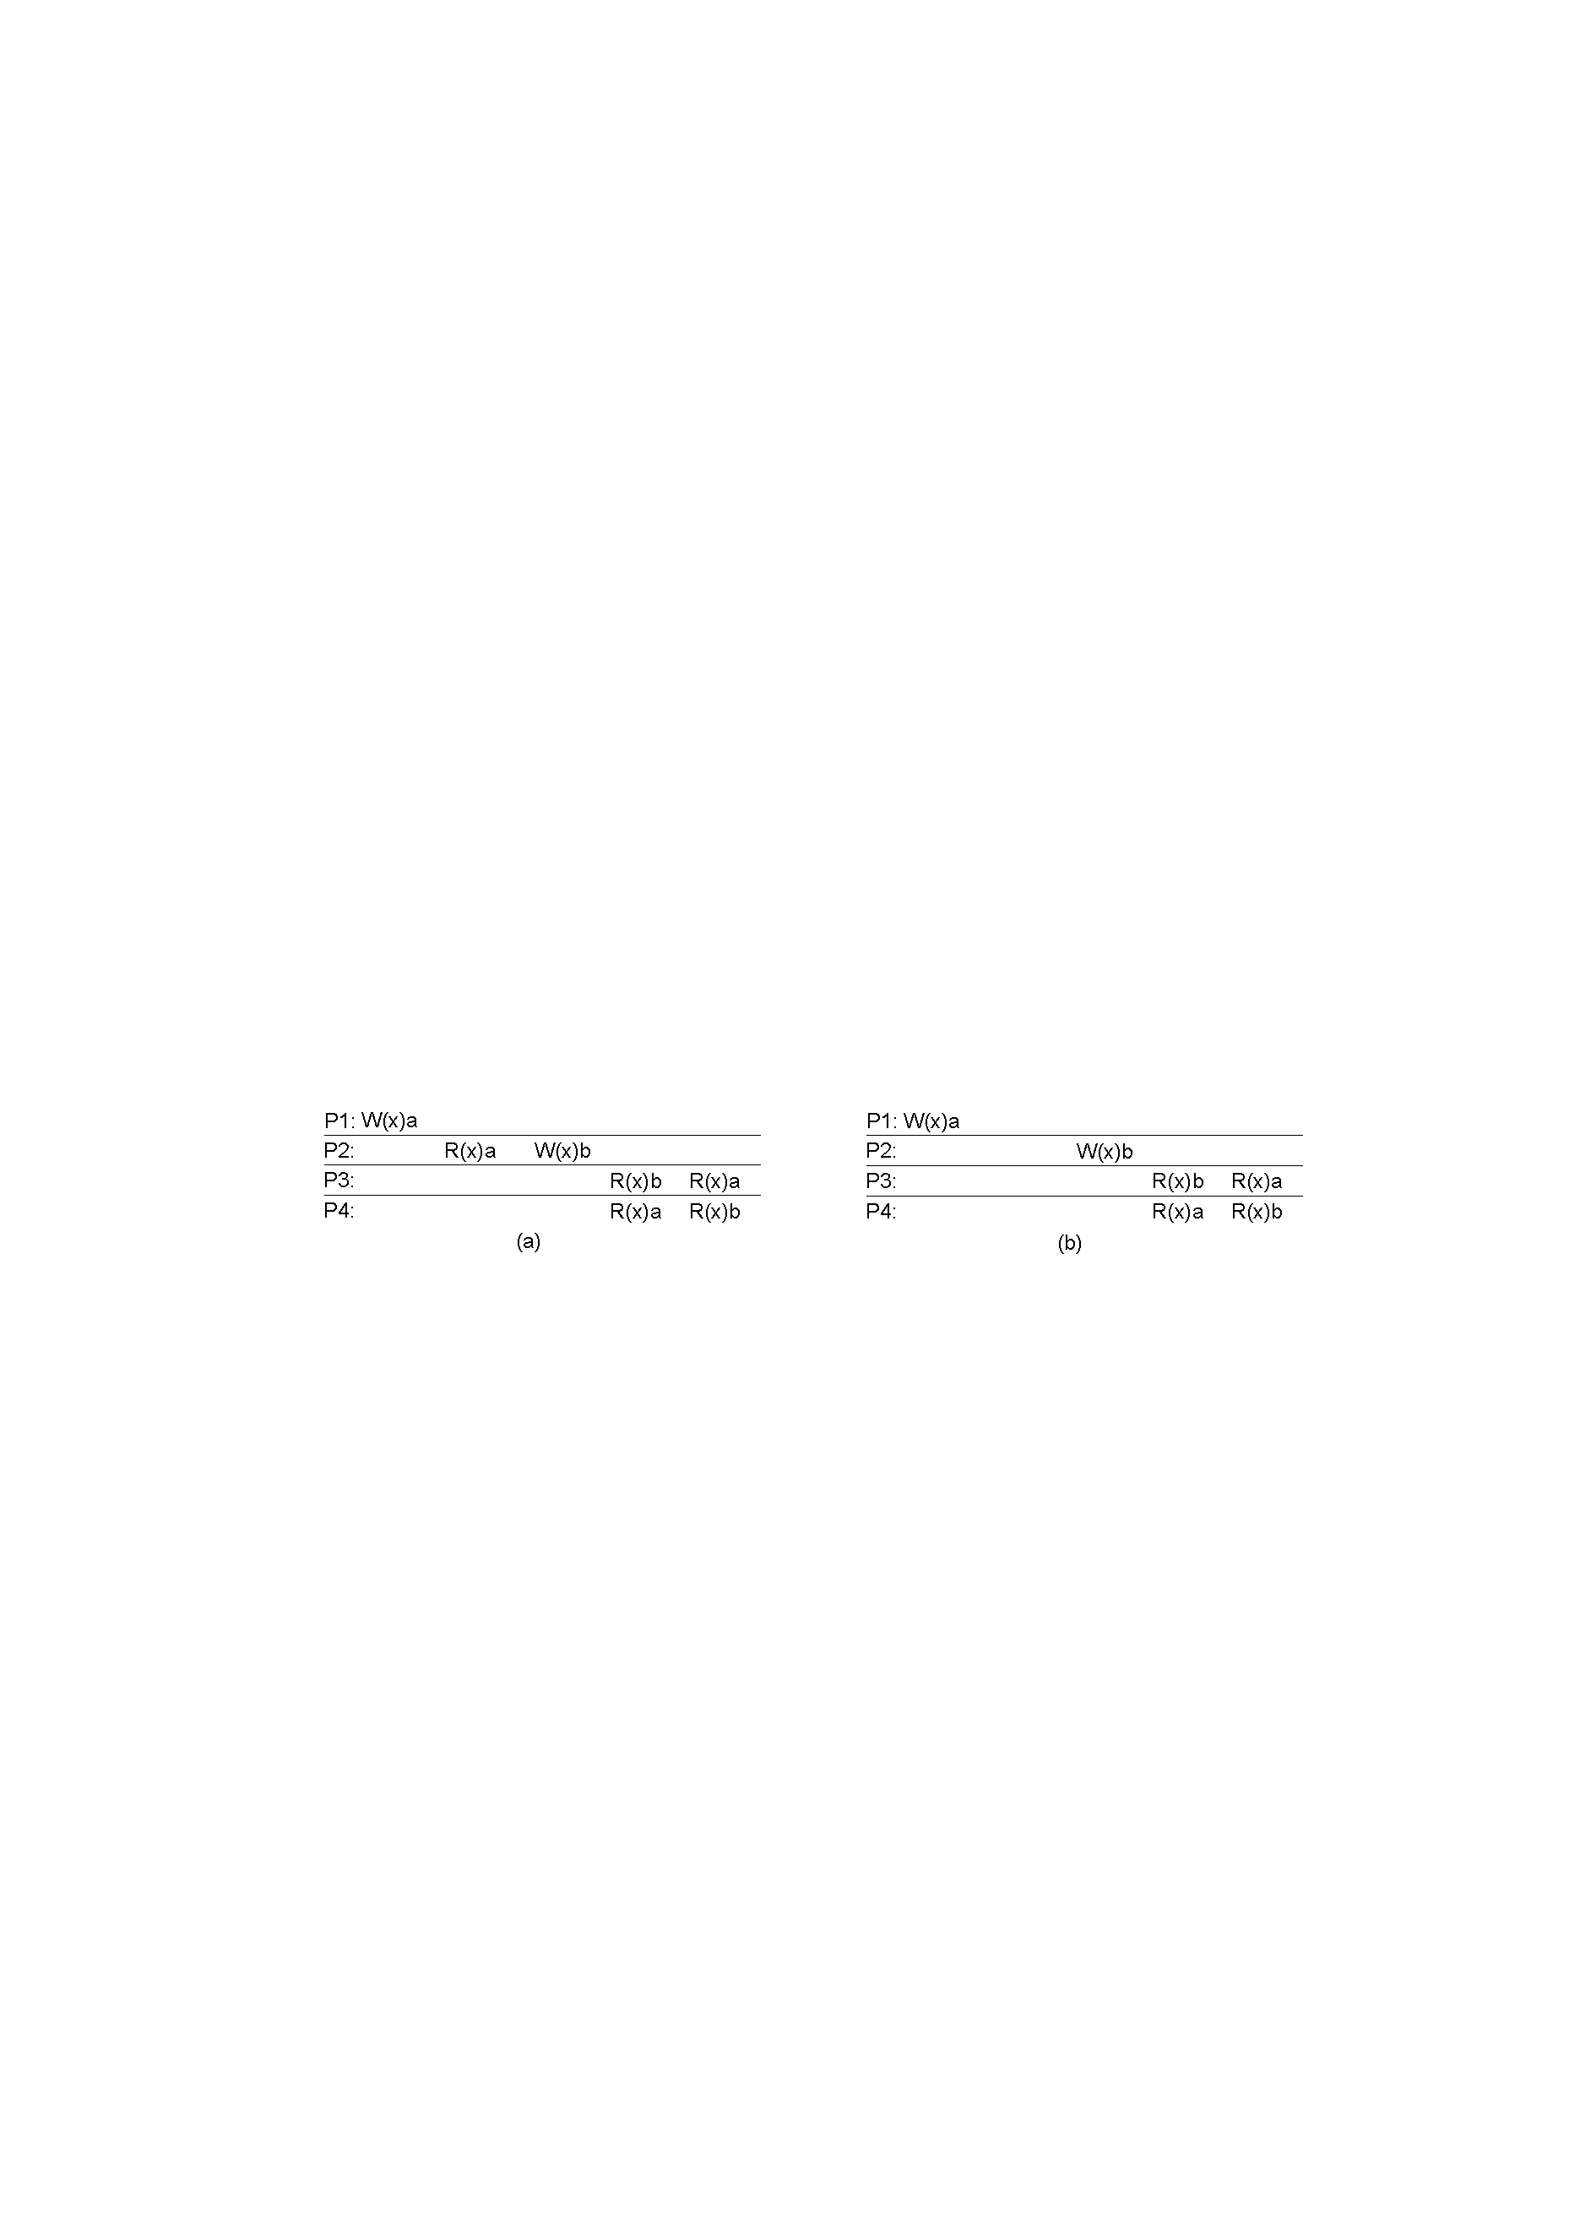
Causal consistency
x
✓
A: Violation: W(x)b potentially dependent on W(x)a
B: Correct. P2 doesn’t read value of a before W

Slide 25
Causal consistency
Requires keeping track of which processes have seen which writes
Needs a dependency graph of which op is dependent on which other ops
…or use vector timestamps!
See COS 418: https://www.cs.princeton.edu/courses/archive/fall16/cos418/docs/L4-time.pptx

Slide 26
Implementing strong consistency

Slide 27
Recall “eager replication”
OK
A
OK
OK
A
On a write, immediately replicate elsewhere
Wait until write committed to sufficient # of nodes before acknowledging
What does this mean?

Slide 28


Two phase commit protocol
C → P: “request write X”
P → A, B: “prepare to write X”
A, B → P: “prepared” or “error”
P → C: “result write X” or “failed”
P → A, B: “commit write X”
Client C
Primary P
Backup
A
B

Slide 29
State machine replication
Any server is essentially a state machine
Operations transition between states
Need an op to be executed on all replicas, or none at all
i.e., we need distributed all-or-nothing atomicity
If op is deterministic, replicas will end in same state

Slide 30
Two phase commit protocol
C → P: “request <op>”
P → A, B: “prepare <op>”
A, B → P: “prepared” or “error”
P → C: “result exec<op>” or “failed”
P → A, B: “commit <op>”
Client C
Primary P
What if primary fails?
Backup fails?
Backup
A
B

Slide 31
Two phase commit protocol
C → P: “request <op>”
P → A, B: “prepare <op>”
A, B → P: “prepared” or “error”
P → C: “result exec<op>” or “failed”
P → A, B: “commit <op>”
Client C
Primary P
“Okay” (i.e., op is stable) if written to > ½ backups
Backup
A
B

Slide 32
Two phase commit protocol
Client C
> ½
nodes
> ½
nodes
Primary P
Commit sets always overlap ≥ 1 node
Any >½ nodes guaranteed to see committed op
Backup
A
B

Slide 33
Wednesday class
Papers: Strong consistency
Lecture: Consensus, view change protocols

