Slide 1
DB storage architectures: Rows, Columns, LSM trees
COS 518: Advanced Computer Systems
Lecture 7
Michael Freedman

Slide 2
Basic row-based storage
8 | 32 | 4 | 2 | 4 | = 50
Id BIGINT | Name CHAR(32) | Age INT | Gender SMALLINT | Birthday DATE

Slide 3
Basic row-based storage
8 | 32 | 4 | 2 | 4 | = 50
0
Id BIGINT | Name CHAR(32) | Age INT | Gender SMALLINT | Birthday DATE
50
Id BIGINT | Name CHAR(32) | Age INT | Gender SMALLINT | Birthday DATE
100
Id BIGINT | Name CHAR(32) | Age INT | Gender SMALLINT | Birthday DATE
150
Id BIGINT | Name CHAR(32) | Age INT | Gender SMALLINT | Birthday DATE

Slide 4
Basic row-based storage
8 | 32 | 4 | 2 | 4 | = 50
0
Id BIGINT | Name CHAR(32) | Age INT | Gender SMALLINT | Birthday DATE
50
Id BIGINT | Name CHAR(32) | Age INT | Gender SMALLINT | Birthday DATE
100
Id BIGINT | Name CHAR(32) | Age INT | Gender SMALLINT | Birthday DATE
150
Id BIGINT | Name CHAR(32) | Age INT | Gender SMALLINT | Birthday DATE
READ 32 bytes at positions (0 + 8), (50 + 8), (100 + 8), (150 + 8)

Slide 5
Row-based storage: variable lengths
8 | 0 - 255 | 4 | 2 | 4 | = 18 - 273
Id BIGINT | URL VARCHAR(255) | Size INT | Code SMALLINT | Fetched DATE
How do you walk through all the URLs?
No longer at fixed offsets

Slide 6
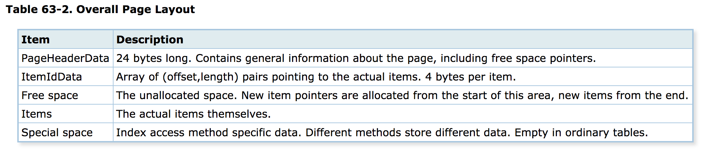
Row-based storage: variable lengths
https://www.postgresql.org/docs/9.5/static/storage-page-layout.html
ItemIdData: [(0, 18), (18, 273), (291, 59)]
0
Id BIGINT | URL VARCHAR(255) | Size INT | Code SMALLINT | Fetched DATE
18
Id BIGINT | URL VARCHAR(255) | Size INT | Code SMALLINT | Fetched DATE
291
Id BIGINT | URL VARCHAR(255) | Size INT | Code SMALLINT | Fetched DATE

Slide 7
Row-based disk layout
Data stored in fixed-sized pages on disk
E.g., typically 8K in PostgreSQL
Page includes metadata and actual data items
Items = indexes, data rows
Id BIGINT | Name CHAR(32) | Age INT | Gender SMALLINT | Birthday DATE
Id BIGINT | Name CHAR(32) | Age INT | Gender SMALLINT | Birthday DATE
Id BIGINT | Name CHAR(32) | Age INT | Gender SMALLINT | Birthday DATE

Slide 8
Row-based disk layout
Data stored in fixed-sized pages on disk
E.g., typically 8K in PostgreSQL
Page includes metadata and actual data items
Items = indexes, data rows
Id BIGINT | Name CHAR(32) | Age INT | Gender SMALLINT | Birthday DATE
Id BIGINT | Name CHAR(32) | Age INT | Gender SMALLINT | Birthday DATE
Id BIGINT | Name CHAR(32) | Age INT | Gender SMALLINT | Birthday DATE
READ 32 bytes at positions (0 + 8), (50 + 8), (100 + 8), (150 + 8)

Slide 9
Types of database workloads
OLTP = OnLine Transaction Processing
Write-heavy
Transactions
OLAP = OnLine Analytical Processing
Read-heavy
Analytical scans or “rollups” along column
“SELECT AVG(latency) FROM system WHERE time > now() – interval(“1h”)

Slide 10
Comparison of disk layouts
Row-oriented layout
Id BIGINT | Name CHAR(32) | Age INT | Gender SMALLINT | Birthday DATE
Id BIGINT | Name CHAR(32) | Age INT | Gender SMALLINT | Birthday DATE
Id BIGINT | Name CHAR(32) | Age INT | Gender SMALLINT | Birthday DATE
Column-oriented layout
Id BIGINT | Id BIGINT | Id BIGINT | Id BIGINT | Id BIGINT | Id BIGINT
Name CHAR(32) | Name CHAR(32) | Name CHAR(32) | Name CHAR(32) | Name CHAR(32) | Name CHAR(32)
Age INT | Age INT | Age INT | Age INT | Age INT | Age INT
Particularly good for compression, especially for long runs of identical numbers or small deltas

Slide 11
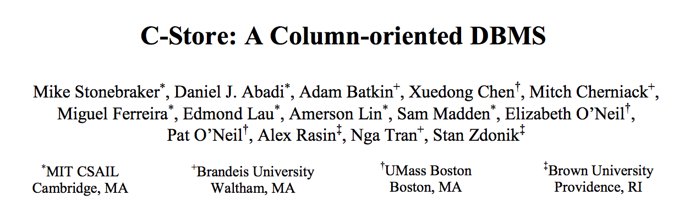
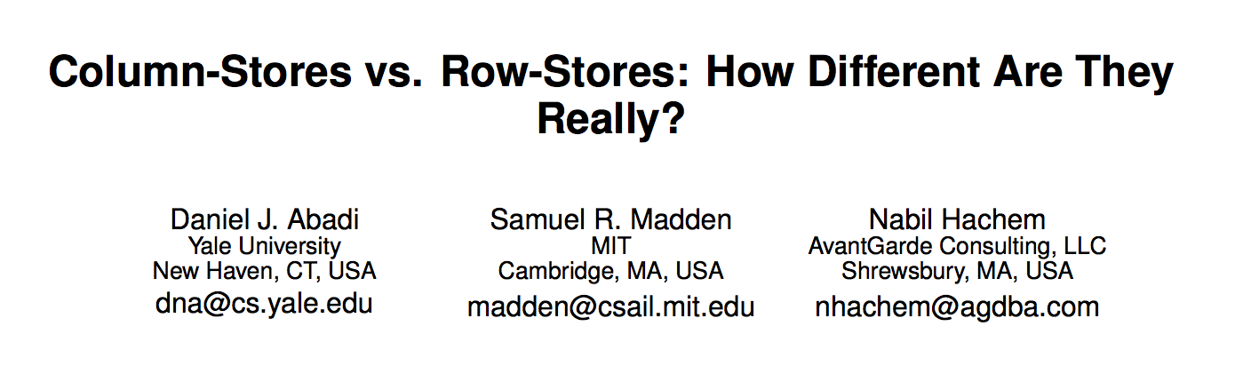
Good discussion of benefits of columns...
http://db.csail.mit.edu/projects/cstore/vldb.pdf
http://db.csail.mit.edu/projects/cstore/abadi-sigmod08.pdf

Slide 12
LSM Trees: Discussion
SSTable: set of arbitrary, sorted key-value pairs
LSM Trees: Write to memory, then flush to disk

Slide 13
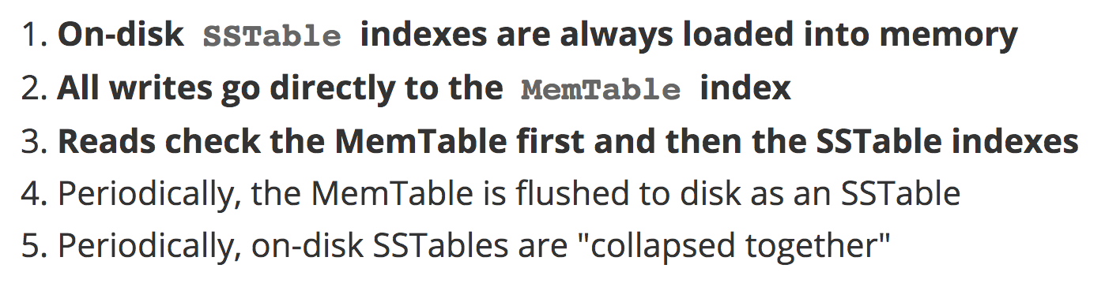
LSM Trees: Discussion
LSM Trees: Write to memory, then flush to disk

