Slide 1
Interim Project Presentation Re-implementation and Re-evaluation of Chain Replication
COS 518: Advanced Computer Systems
Joe Eichenhofer
& Allison Chang
April 17, 2019

Slide 2
Problem Statement / Motivation
Network-connected object storage is valuable for large-scale business applications
Consistency guarantees are important for the programming model.
Maintaining high throughput, strong consistency, and availability despite failures is a challenging trade-off.

Slide 3
Key Idea
Provides strongly consistent, serializable order of operations
Avoiding consensus protocols by reducing source of truth
Replication for fault tolerance
Read latencies do not suffer from server failures
Notes:
The key ideas of chain replication is that it provides a strongly consistent, serializable order of operations by essentially stating that the head node is the node which will enforce all ordering. Additionally, all updates are propagated through the head node downwards, so all the intermediary nodes + tail nodes will see this order of operations
High throughput and availability along with strong consistency
Faster because you don’t need to wait for consensus from all backups as in a conventional primary backup system that a certain quorum of nodes have actually written the item/key,value since you only query the tail
Replication through the intermediary nodes + tail nodes
Read latencies will only suffer if the tail node crashes, other server failures will not impact performance

Slide 4
Key Challenges
Tracking chain & node state
Inserting new nodes and removing nodes
Responding to failed nodes
Efficient RPC and interface

Slide 5
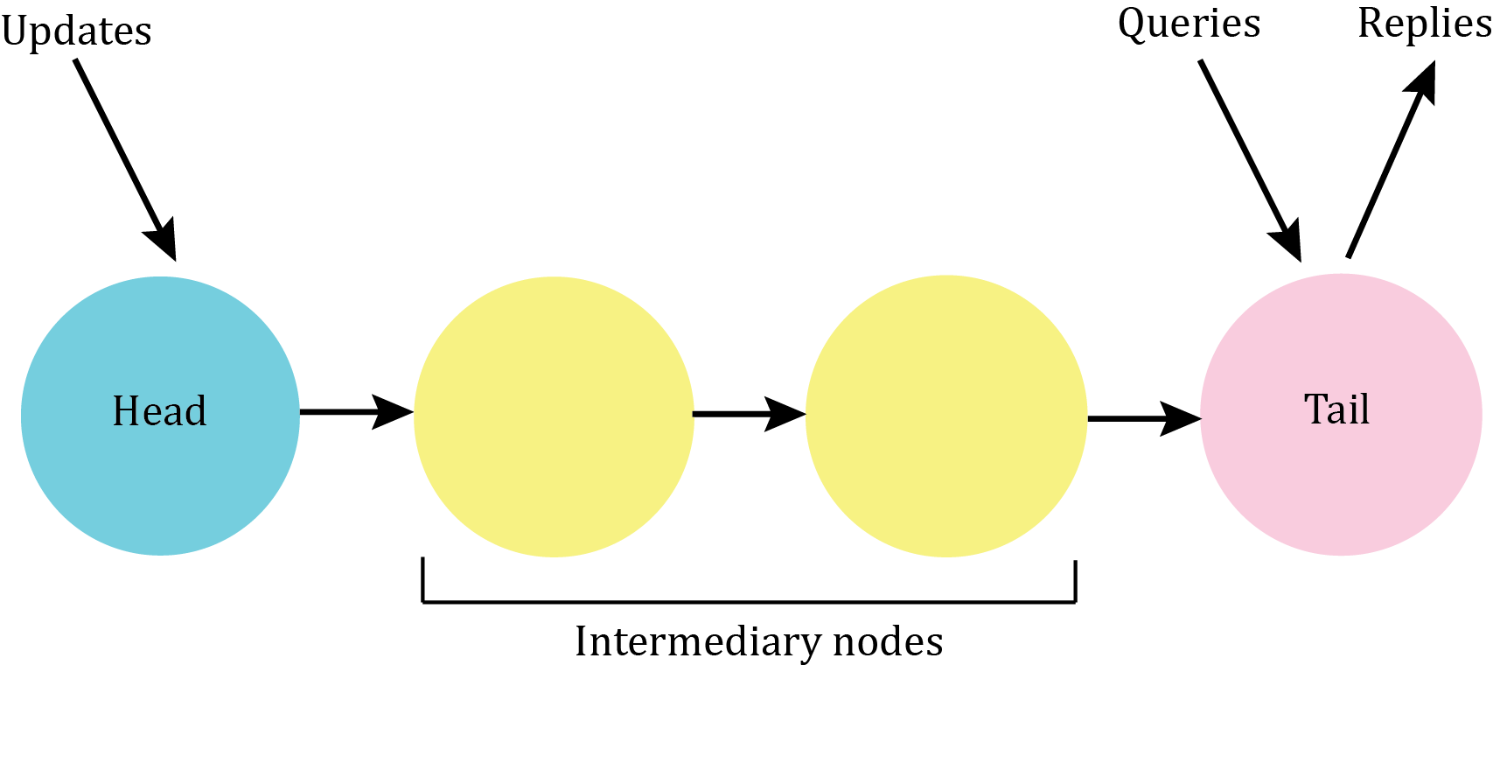
System Architecture
Notes:
This is the basic system architecture with each server connected with a reliable FIFO link ordering the servers in the chain, so this is a four-server chain
As you can see, all updates go to the head node, which are then propagated down the chain to intermediary nodes. The tail node is the only one that accepts queries and replies back to external clients, in the case of failures, there is a master service that is not depicted here that is responsible for server failure and re-establishing the chain order when a node has failed

Slide 6
Technical Details

Slide 7
Key Idea: Server/Client Communication
We decided to use gRPC which is a public library for protocol buffers by Google
Public Interface (client to server)
getObject()
putObject()
Private Interface (server to server)
propagateObject()
setSuccessor()

Slide 8
Key Idea: Chain & Node State
Internal boolean variables for determining head or tail state per server
The head and tail nodes will be established in the initial configuration of the chain
All other nodes will be informed of the head and tail of the chain they belong to via the master service
Notes:
One of the challenges we have is track the state of a chain, as well as a node. So what does that mean? It means establishing a way for servers themselves to determine what they are, as well as for the system as a whole to determine the ordering of the head and tail nodes
To do so, we have established bo

Slide 9
Implementation Status
Initial set up of a chain node client and servers
getObject()
putObject()
propagateObject()
setSuccessor()

Slide 10
Planned Evaluation
Utilization on individual nodes during read-heavy and write-heavy workloads
Tail failure during read-heavy workloads
Head failure during write-heavy workloads
Recovery times?
Physical servers
Considering EmuLab or AWS

Slide 11
Project Timeline
Complete Master service implementation to handle server failures as well as successor/predecessor tracking
Testing + Evaluation
Initial per-node performance monitoring
Specialized failure/recovery per-node evaluation

