Slide 1
Evaluation of tradeoffs when building in memory distributed cache
Prakash Murali and Narek Galstyan
Notes:
Introduce us
Say what we are building
~30 sec

Slide 2
Problem
Rajesh Nishtala, Hans Fugal, et al. “Scaling Memcache at Facebook”(NSDI13)
Berk Atikoglu, et al."Workload Analysis of a Large-Scale Key-Value Store"(SIGMETRICS'12)
Yuehai Xu, Eitan Frachtenberg, Song Jiang, Mike Paleczny. “Characterizing Facebook's Memcached Workload” . In IEEE Internet Computing, 18 (2): 41-49, March 2014.
Notes:
Talk about memcached paper
Mention its shortcomings as a research paper:
Lack of evaluation, not many (If any) diagrams
Design choises were almost never motivated
Looked like they just took a snapshot of their system and vaguely described it
Mention the other two papers
Had more measuremment
No more design discussion so no questions about design
It often was not clear what they are plotting
They mostly explain which direction of the graph is better and give the result
What they do give is distributions that best fitthe load memcached is under
~1.5min

Slide 3
We want to:
Design a cache layer architecturally similar to Facebook Memcache based on the info we can find on different papers
Get a baseline performance using the measurement paper results
Explore the the design space of possible tradeoffs in cache design choices
Notes:
~1min

Slide 4
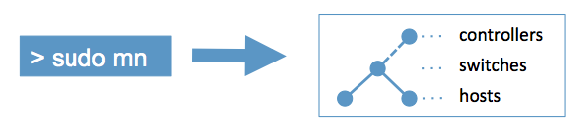
Mininet
Simulate arbitrary network topologies
Control network latency and bandwidth in link granularity
Simulate packet loss and arbitrary failures
Notes:
Give an intro to mininet & network simulation
~ 1min

Slide 5
Why use simulation?
When working with FB Memcached, we only have access to workload distributions and not actual data so a real system would not add much value
Hypotheses can be tested faster in a simulation
Code we write can be ported to truly distributed system without any changes
Smw in Stanford wrote a paper about this

Slide 6
Implementation
Start with a simple mininet topology (done)
Implement Memcache (MVP done)
Run the distributed cache inside the network simulation
Explore the design space(see next slide) and quantify the tradeoffs
Run a particular configuration in a distributed setting

Slide 7
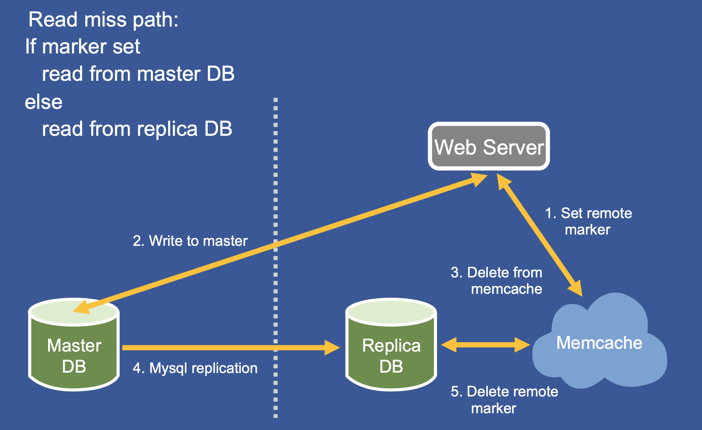
Exploring the design space
Compare naïve LRU(what FB uses) and other cache eviction policies (these can be network aware )
Notes:
Explain why evicting certain items may be more costly than others

Slide 8
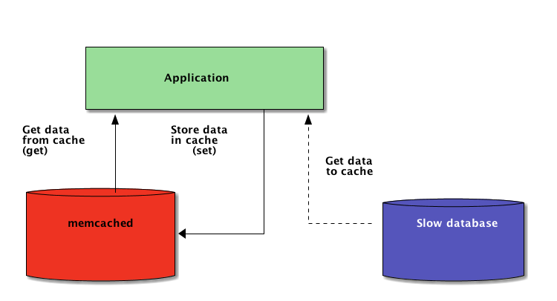
Exploring the design space
Cost: 15ms
Cost:2ms

Slide 9
Exploring the design space
Explore tradeoffs among different ways of failure handling
Consistent hashing mechanism
Small set of temporary nodes to keep redundant keys
Notes:
Failure handling can be done either using the failover mechanism in consistent hashing or by employing a small set of temporary nodes to keep keys. In consistent hashing, keys have to be remapped during a failure. For a cache, we can afford to lose some of the entries and avoid the remapping overhead. Here, we will explore whether it is beneficial to map a single temporary node to a single hash node or multiplex.

Slide 10
Bibliography
Rajesh Nishtala, Hans Fugal, et al. “Scaling Memcache at Facebook”(NSDI13)
Berk Atikoglu, et al."Workload Analysis of a Large-Scale Key-Value Store"(SIGMETRICS'12)
Yuehai Xu, Eitan Frachtenberg, Song Jiang, Mike Paleczny. “Characterizing Facebook's Memcached Workload” . In IEEE Internet Computing, 18 (2): 41-49, March 2014.
https://ccronline.sigcomm.org/wp-content/uploads/2017/05/acmdl17-97.pdf
Lisa Yan, Nick McKeown. “Learning Networking by Reproducing Research Results”

