Slide 1
Hot or Not
COS 518: Advanced Computer Systems
Jennifer Lam, Jeffrey Helt

Slide 2

Problem Statement / Motivation
The standard approach to load balancing and scaling in large, distributed databases is sharding
Ideal:
App Server 1
App Server 2
Shard 1
Shard 2
Shard 3
Shard 4
Keys:
A
B
C
D
Database

Slide 3
Problem Statement / Motivation
In reality, we see significant skew, such as Facebook’s linchpin objects.
Reality:
App Server 1
App Server 2
Shard 1
Shard 2
Shard 3
Shard 4
Keys:
A
B
C
D
Database

Slide 4
Key Idea
Observation: Transaction processing algorithms do the most work when transaction messages to different shards arrive in different orders.
2 Phase
Commit:
App Server 1
App Server 2
Shard 1
Shard 2
A
B
Database

Slide 5
Key Idea
Idea: Can we remove/reduce the possibility of message reorderings by placing the most popular keys all on the same shard?

Slide 6

Key Idea
Contention: intuitively defined as competition over resources.
Observation: competition over access to hot keys increases contention.

Slide 7
Key Idea
Idea: given the presence of a hot shard, can we come up with a new transaction algorithm to reduce contention?

Slide 8
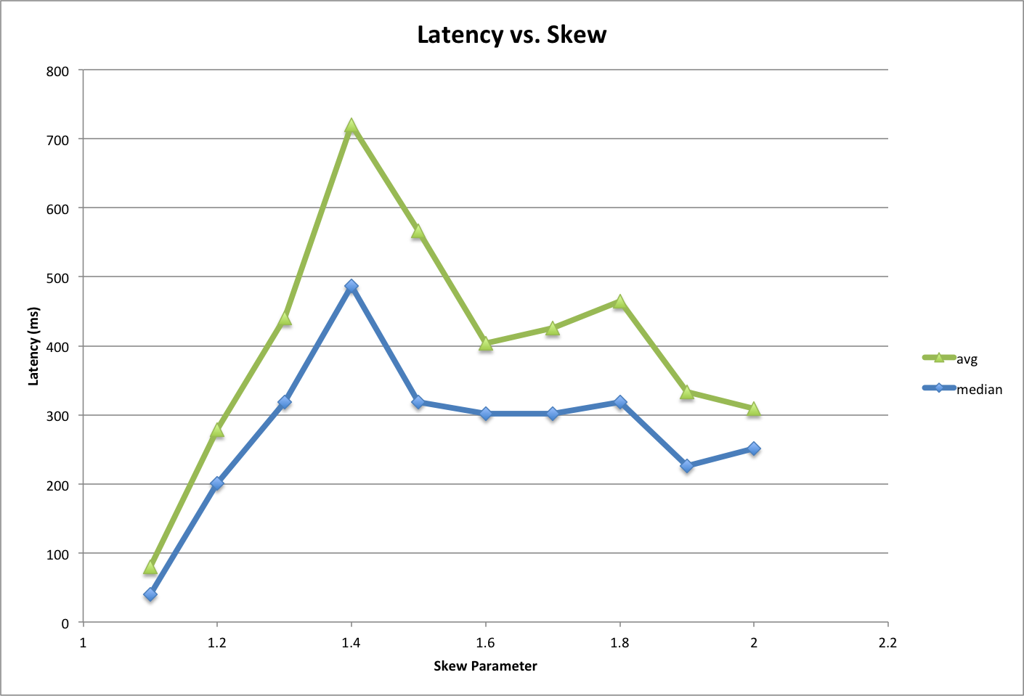
Evaluation

Slide 9
Key Challenge
Allow system to remain performant despite having most popular keys on a single machine.

Slide 10
Plan for Final Month
Continue teasing out the effect of contention and shard access mis-ordering.

Slide 11
Plan for Final Month
Continue teasing out the effect of contention and shard access mis-ordering.
Data locality: group all hot keys on a single node on their own separate database.
Measure effects on latency / throughput.

Slide 12
Plan for Final Month
Continue teasing out the effect of contention and shard access mis-ordering.
Data locality: group all hot keys on a single node on their own separate database.
Measure effects on latency / throughput.
Implement an algorithm that reduces contention by taking into account the data locality of the separate db.
Measure effects on latency / throughput.

Slide 13
Technical Details

Slide 14
System Architecture
App Server 1
App Server 2
Hot-shard-aware Transaction Algorithms
Hot Shard
Warm Shard 1
Warm Shard 2
Warm Shard 3
Keys:
H1
H2
A
B
C
Database

Slide 15
Implementation Status
Running a 16-node CockroachDB cluster on CloudLab (emulab).
Modified KV benchmark to be transactional (as opposed to be simple reads/writes).
Instrumenting for contention. Hypothesize that it increases with skew to some degree.

Slide 16
Novel Algorithm
Idea: given the existence of a hot shard, reduce contention on hot keys.
Reduce number of accesses to hot shard.
Reduce time spent locked on hot shard.
Algorithm covers read-only / write-only one-shot transactions for now.

Slide 17


Novel Algorithm
Write-only txns: modified 2PC.
Warm shard
Lock warm shards.
Lock hot shard.
Write to hot shard.
Unlock hot shard.
Write to warm shards.
Unlock warm shards.
Commit.
Hot shard
Warm shard
Warm shard

Slide 18
Novel Algorithm
Read-only txns: modified MVCC.
Warm shard
Read from hot shard, retrieve epoch number.
Consistency check: transaction completion from past hot shard accesses.*
Read all warm shards.
Never lock.
Hot shard
Warm shard
*Fairly nuanced for the time limits of this presentation
Warm shard

Slide 19
Thank You!

