Slide 1
Student Presentation Interim Project Report
COS 518: Advanced Computer Systems
Josh Zhang, Jace Lu
April 17, 2019

Slide 2
Problem Statement / Motivation
Fundamental Problem:
How to efficiently locate the node that stores a data item in peer-to-peer distributed application
Motivation:
In a distributed kv store, fast look up node
Many distributed systems can use Chord
Build a distributed key-value storage system based on a fast lookup service Chord

Slide 3
Key Idea & Key Challenges
Chord Lookup Service:
Simple Interface: LookUp(key) -> IP Address
SHA1 Consistent Hashing - load balance
Cost of a lookup is log(n) - scalability
Self-manage node joins/leaves - availability
Finger Table: fast lookup(logn)
ith entry of finger table: n + 2^i
Challenges:
Concurrent Joins and Leaves
Testing the correctness of Chord is hard

Slide 4
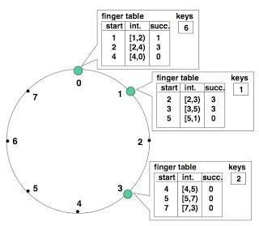
System Architecture
Key-value storage service
RPC to chord node for lookup

Slide 5
Implementation Status
Chord lookup service:
Basic lookup logic is finished (assume correct finger table)
Node arrival and departure algorithm 30% finished
Key-value storage:
Basic client interface (Put, Get)
Working on RPC to chord node for lookup

Slide 6
Evaluation
Run each chord server in a process locally
Run each chord server in an AWS EC2 instance
Test lookup latency with different network size
Test path length with different network size
Test number of keys per node
Test failed lookup rate at a failed nodes rate

Slide 7
Plan for Final Month
Finish chord lookup services, node arrival/departure (concurrent join/leave)
Continue to create key-value storage service on top of chord
Build test cases for Chord service evaluation

Slide 8


