Slide 1
Key Partitioner for LSM Based KV Stores
Yue Tan
Ashwini Raina

Slide 2
Problem Statement
Many popular KV stores use LSM (LevelDB, RocksDB)
LSMs over flash suffer from high write amplification
Past research has focused on optimizing a standalone LSM implementation
Wisc-Key (Fast’16), PebblesDB (SOSP’17), Triad (ATC’17)
Sometimes adding design complexity
But LSM based KV stores aren’t deployed standalone
Hundreds or Thousands of instances
With a load balancer/key partitioner
With a memcachier like system as origin cache
Take a bird’s eye view at LSM based KV store deployment

Slide 3
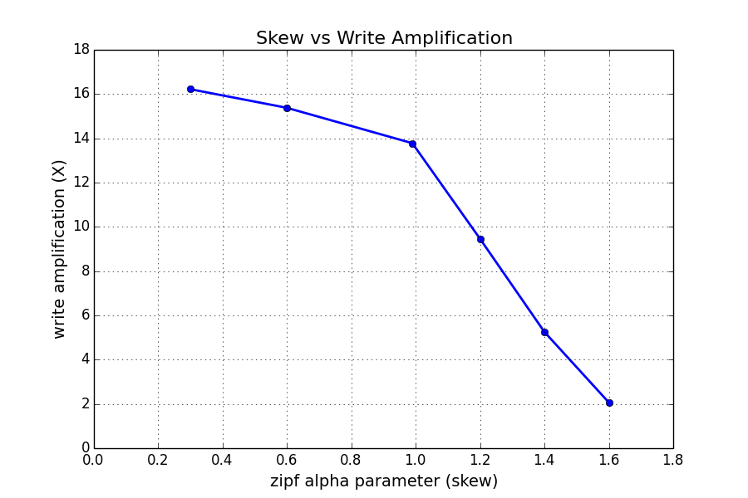
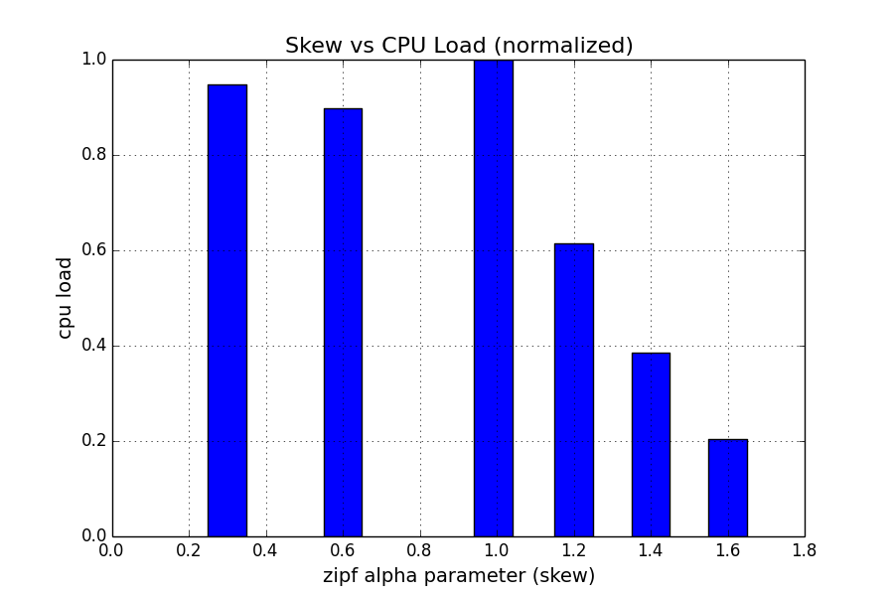
Key Idea
Write patterns have skew
Skew vs write amplification curve has a knee
How can we exploit this behavior?
Idea: Partition the key space (based on key popularity) such that:
A shard either has high skew OR
A shard has less skew.
Assumption: Key popularity is known apriori
Facebook social signals
Possibly relax this assumption later
High skew shard !=> High CPU load

Slide 4
Key Challenges
Partition all keys into many highly skewed shards and a few nearly uniform shards
Keep all servers load balanced

Slide 5
System Architecture
Clients
Keyspace, Popularity
Coordinator
Partitioner
LSM Instance (RocksDB)
LSM Instance
(RocksDB)
LSM Instance
(RocksDB)
LSM Instance
(RocksDB)

Slide 6
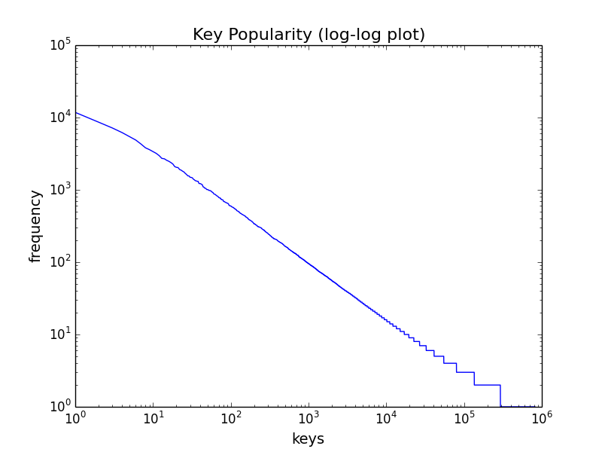
Technical Details
Our proposed partitioning algorithm is to pick k₁ most popular keys and combine them with m₁ least popular keys to form the 1st shard and do the same with the rest keys until all keys are partitioned.
...
...

Slide 7
Implementation Status
Initial focus has been to:
Analyze KV store workload traces
Evaluate different write popularity distributions on standalone RocksDB
Partitioner implementation not started yet

Slide 8
Evaluation
Testbed
3 servers running 5 RocksDB instances each
Client, Partitioner and Coordinator running on a separate server
Experiment
Client issues millions of key writes into the system
Baseline
Range partitioning
Consistent hashing
Evaluation Metrics
System-wide write amplification
Write Throughput
Write Latency

Slide 9
Plan - Final Month
Finalize the design of partitioner
Implement the partitioner, client and coordinator.
Setup the testbed and the experiment
Collect logs, generate plots.

